Slide 1
Fine Tuning SPAM classification with LoRA (Deep Dive)
- Ashwani Kumar, Alex Ntafos, Nikhil Hegde, Paul Mason

Slide 2
Overview
Goal
Fine tune a pre-trained transformer model using LoRA(Low Rank Adaptation) for spam detection on email/text data.
Why ?
It is a well-defined binary classification task.
Useful real-world application with clear evaluation metrics (accuracy, precision, recall) .
What we are exploring? How LoRA compares to full fine-tuning in terms of :
Performance
Training efficiency
Memory footprint

Slide 3
Existing Parameter efficient finetuning approaches
Hard prompt tuning
Prompt modifications
Training set
Training set
Soft prompt tuning
Prefix tuning
Update all layers
Pretrained transformer
Keep frozen
Pretrained transformer
Adapter methods
update
FineTuning A2
FineTuning A1

Slide 4
Problem statement
Apply LoRA to evaluate the accuracy of classification model on SMS Spam Collection dataset (SMS Spam Collection - UCI Machine Learning Repository)
Compare LoRA with traditional fine-tuning methods.
Investigate optimal rank (r) for LoRA

Slide 5
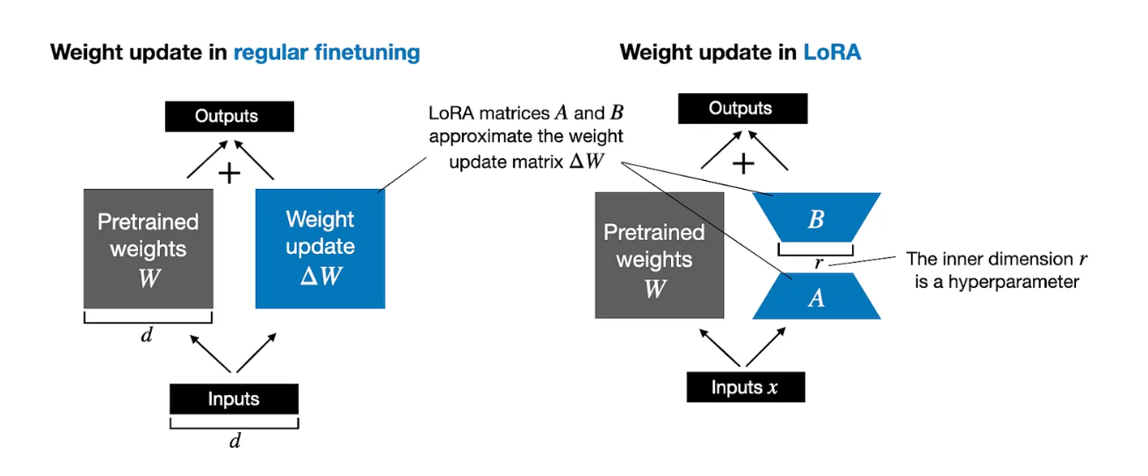

LoRA: LOW-RANK ADAPTATION OF LARGE LAN GUAGE MODELS
LoRA is a parameter –efficient fine-tuning technique
Adds a small trainable update matrices A and B (A = r *k’ B=d*r)
Source: Parameter-Efficient LLM Finetuning With Low-Rank Adaptation (LoRA)

Slide 6
Model initialization
Architecture Design
Download dataset
Fine-tune with LoRA
Load pretrained weights
Preprocess dataset
Evaluate fine tuned model
Stages in parameter efficient fine-tuning of a spam classification model using LoRA
Inject LoRA adaptures for for fine-tuning
Create data loaders
Test model on new data
Evaluation metrices
Data preparation
Model setup
Model fine tuning

Slide 7
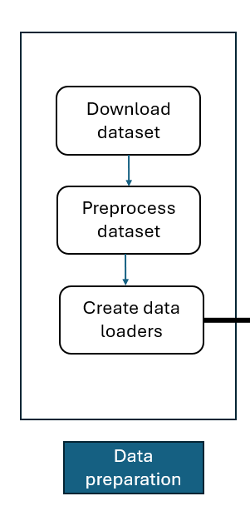
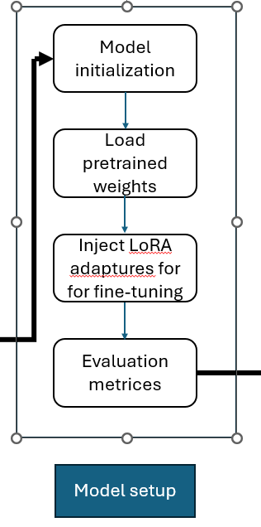
Code template
download_and_load_gpt2
load_weights_into_gpt
generate_text_simple
text_to_token_ids
token_ids_to_text
calc_accuracy_loader
Functions:
download_data
create_balanced_dataset
randomly_split_dataset
makespamDataset
DataLoader

Slide 8
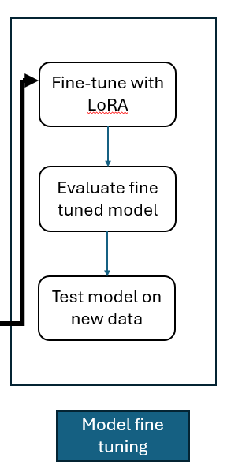
class LoRALayer
calc_accuracy_loader

