Slide 1

Sentimental Analysis on Mental Health
Project Group no: G297
Project Supervisor: Prof. MD. Aijaz
Presented By:
Name: Abhinay Kumar, Ashvanee Kumar, Lokesh Dwivedi, Kuldeep Dixit
Roll no: 2401560002, 2401560022, 2401560026, 2401560033
Course: MCA 2nd - A
Session: 2024-26

Slide 2

Project Overview
Objective
Text Preprocessing
Models
Classify text into mental health categories
Cleaning and lemmatization
Logistic Regression, Random Forest, RNN
Transformer
Deployment
Handled with SMOTE
Ready pipeline

Slide 3



Dataset Summary
Source
Preprocessing
Combined Data.csv
Contraction expansion
Entries
Stopword removal
Lemmatization
51,068 total
Labels
Normal (16,039)
Depression (15,085)
Suicidal (10,638)
Anxiety (3,617)

Slide 4
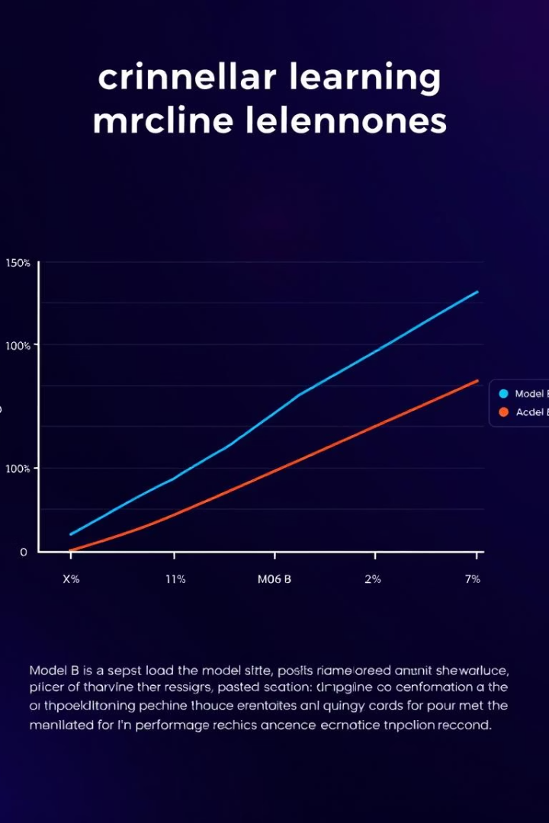

Model Performance Comparison
Logistic Regression
Random Forest + SMOTE
77 % accuracy, best for imbalanced data
69.2% accuracy
RNN (LSTM)
In progress

Slide 5
Deployment Architecture
User submits text via web interface
Preprocessing: clean text
Feature extraction: TF-IDF vectorizer
Prediction: Logistic Regression model
Return result and confidence score
Tools: Google Colab, Jupyter notebook, streamlit

Slide 6
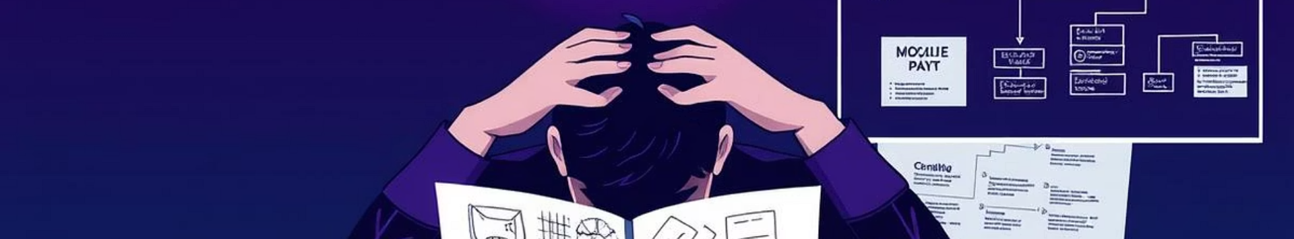


Challenges & Solutions
Text Variability
Scalability
Class Imbalance
Text preprocessing
TF-IDF + Logistic Regression
SMOTE oversampling

Slide 7

Future Work
Improve RNN/LSTM with Word2Vec embeddings
Real-time API for apps
Explainability via SHAP values

Slide 8

Demo
Input
Example Prediction
Today my result is declared
"I can't sleep, my mind is racing" → Anxiety (82% confidence)

Slide 9


Transformer
For Optimize model accuracy
For More hyper perameter tune
For Maintenance

Slide 10

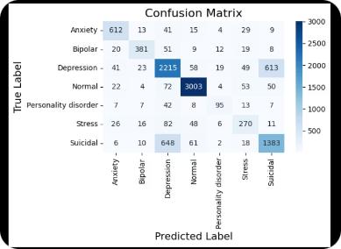



Additional Notes
Visuals
Code Snippets
Metrics
Confusion matrices and ROC curves
Highlight SMOTE application
Emphasize early suicidal text detection

Slide 11
_{THANK YOU}

