Slide 1

Ramrao Adik Institute of Technology
Department of Computer Engineering
M.Tech MINI Project Presentation
On
“Cross-Site Scripting (XSS) Attacks”
By
Masoom Shaikh
24CO1009
Guided by
Dr. Puja Padiya

Slide 2
Cross-Site Scripting (XSS) Attacks
Cross-site scripting (XSS) attacks involve injecting malicious scripts into trusted websites or applications, which are then executed in the context of a user's browser.
XSS refers to a vulnerability where attackers can execute arbitrary scripts in a user's session, leading to data theft, session hijacking, or other malicious activities.

Slide 3
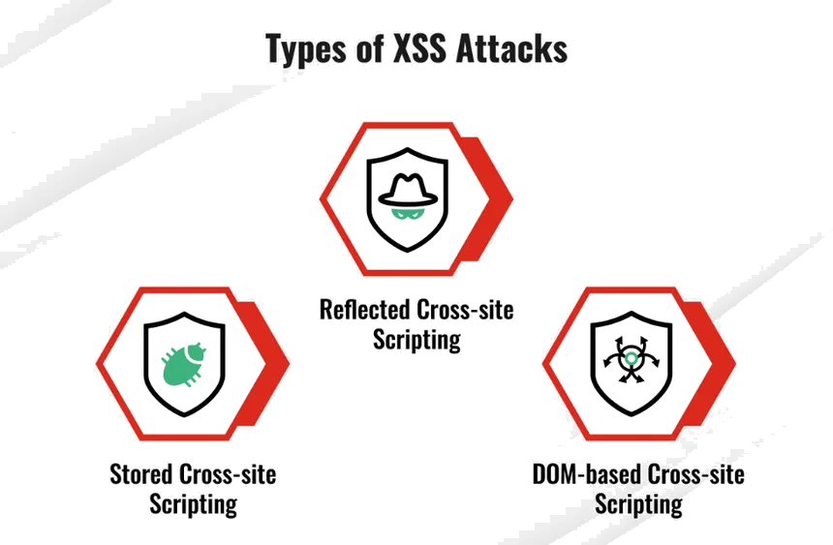
Types of Cross-Site Scripting (XSS)

Slide 4
Stages of Cross-Site Scripting (XSS)
Target Identification - Identifying vulnerable input fields or web pages that fail to properly validate or sanitize user input.
Data Collection - Gathering information on how the application handles user inputs, looking for patterns where malicious scripts can be injected.
Payload injection - Crafting and injecting a malicious script (usually JavaScript) into a vulnerable input field or URL parameter.
Malicious Script Execution – The Injected Script is executed when the victim interact with the compromised page, usually through reflection of storage.
Impact Execution – The attacker’s script performs malicious actions, such as stealing sensitive data, hijacking sessions, or redirecting users to malicious sites.

Slide 5
Stage 1: Target Identification
What is Target Identification?
Identifying vulnerable web pages or input fields in a web application that fail to properly validate or sanitize user inputs, making them susceptible to XSS attacks. This phase involves reconnaissance to locate areas where malicious scripts can be injected.
Tools and Techniques
Inspecting web applications for invalidated input fields, using browser developer tools to analyze responses, reviewing source code for improper data handling, and testing for common vulnerabilities in forms, search bars, or URL parameters.

Slide 6
Stage 2: Data Collection
Gathering Sensitive Information –
The objective of XSS attacks is often to gather sensitive information from the victim, such as authentication tokens, session cookies, or personal data, to facilitate further malicious actions.
Common Methods –
Session Hijacking, credential harvesting, Key-logging, and Exfiltrating Stored Data .
Compromising User Accounts
Once an attacker has access to sensitive data via XSS, they may target user accounts for the purpose of gaining unauthorized access to systems, services, or sensitive data.
Leveraging Open-Source Intelligence
Publicly available information can be used to craft more effective XSS attacks by gaining insights into the target’s vulnerabilities and behavior patterns.

Slide 7
Tools and Techniques for Data Collection
Browser Developer Tools
Allows attackers to manipulate web page content, inject malicious scripts, and monitor network traffic directly from the browser.
Burp Suite
A popular tool for web application security testing, commonly used to intercept, manipulate, and analyze HTTP requests and responses.
OWASP ZAP (ZED Attack Proxy)
Another open-source tool for security testing and penetration testing of web applications.

Slide 8
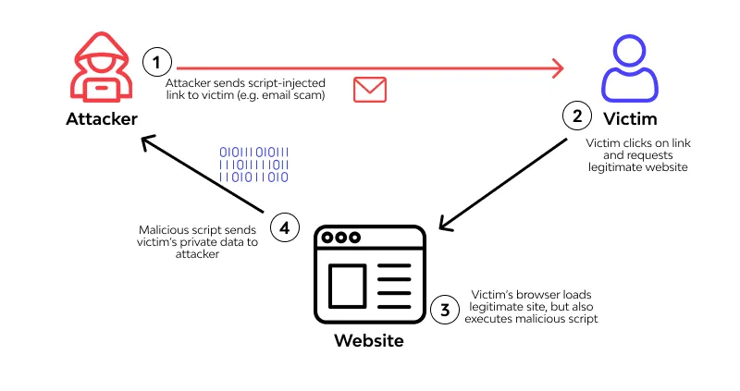
Performing the Cyber Attack

Slide 9
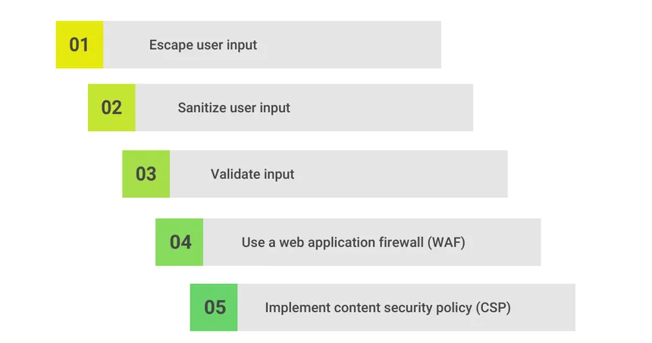
Prevention & Mitigation

Slide 10
Thank You

