Slide 1


CodeX
Plagiarism Detection Tool by Team-102

Slide 2
System Functionality
CodeX
Initial Use Cases count : 9
Implemented Use cases count : 14
System Actors
  Admin
    Professor Approval
    Usage Statistics
  Professor
    Create course and homework
    Check Plagiarism and detailed report
  Student
    Enroll new courses
    Upload python assignments(folders and file)

Slide 3
Additional Significant System Functionalities
CodeX
Implementation of four sophisticated plagiarism detection strategies :
  Identifier and function renaming
  Structure match
  Context match
  Weighted polynomial
Application of machine learning techniques for scaling the overall score generated by stated strategies.
Snippet Generation
Simple and Intuitive User Interface

Slide 4
Continuous Integration
CodeX
Integration of GitHub, Jenkins, Jira and Slack.
Project repository master branch protection.
Usage of smart commits.
Continuous system quality check and maintenance via Jenkin+SonaQube pipeline.
Code review by peers before merging to master.
Automation of Slack messages and Email for each build status.

Slide 5
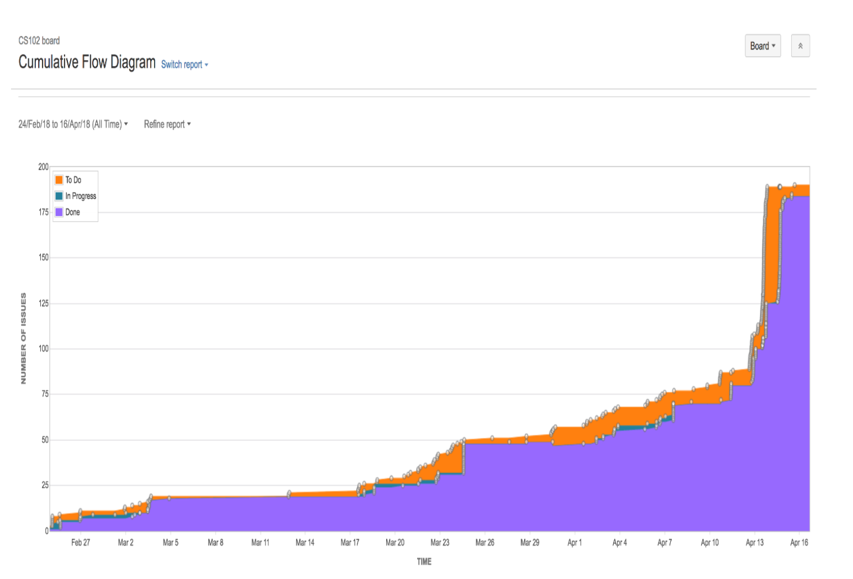
Backlog Statistics
CodeX

Slide 6
Quality Job
CodeX
Test Driven Approach.
Maintaining JIRA tickets and corresponding branches for each issue.
Usage of Smart commits.
Automating Jenkins pipeline to send message/emails to peers via slack.
Enforcing peer review for pull request before merging to master.
Code quality analysis through Sonar Lint and SonarQube.

Slide 7
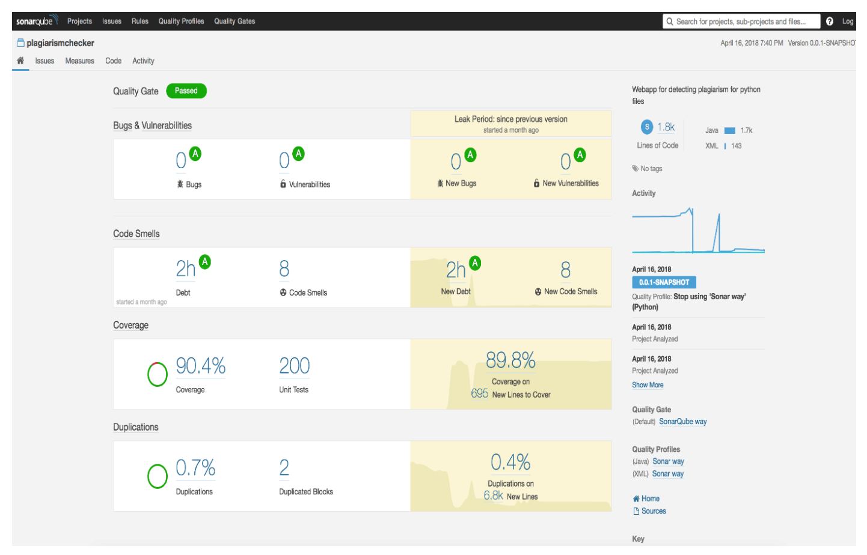
Quality Statistics
CodeX

Slide 8
Team Work
CodeX
Team co-ordination – well-structured and divided responsibility
Flexibility – Team was able accommodate unexpected issues during development and deployment.
Ownership -Reliable and responsible for individual tasks
Timely Communication – weekly SCRUM meets to discuss status of the development and blockings if any
Achieving goals of project working together.

Slide 9
Agile Process
CodeX
Adopted agile methodology
Development phase expanded over 3 sprints.
New featured development discussed and assigned for each sprint
Prioritized issues
Thorough code review before merging into master.
Focused on integration and deployment towards the end of each sprint.
Embedded Design patterns to follow best coding practices.

Slide 10
Shortcomings
Missed submitting first peer review on teammates – Set up calendar reminder for above for all other sprint reviews.
Jenkins docker issues - Unresponsive Jenkins docker due to low system memory on AWS t2.micro server instance. Migrated from t2.micro to t2.small AWS instance.
Automating process
For every pull request the application builds on Jenkins, runs all test cases and checks for code quality on SonarQube before merging the branch into master.

Slide 11
Technology transfer
Fork or clone this project using git clone https://github.ccs.neu.edu/cs5500/team-102.git
Open the Project in any IDE of your choice
Run mvn clean install.
Run /plagiarismchecker/src/main/java/com/northeastern/msd/team102/plagiarismchecker/PlagiarismcheckerApplication.java
To run on localhost: http://localhost:8080/#/login
AWS link: http://codex.us-east-1.elasticbeanstalk.com/

Slide 12
Future Scope
Plagiarism check for multiple languages.
New plagiarism check strategies can be embedded easily.
Email/Download plagiarism report for each student.

Slide 13
Thank you!

