Slide 1
The Dream Team Creator
Anurag Yadav : anurag19150@iiitd.ac.in
Yash Aggarwal : yash19219@iiitd.ac.in
Ajay Kumar : ajay19293@iiitd.ac.in
Agamdeep Bains : agamdeep19009@iiitd.ac.in

Slide 2
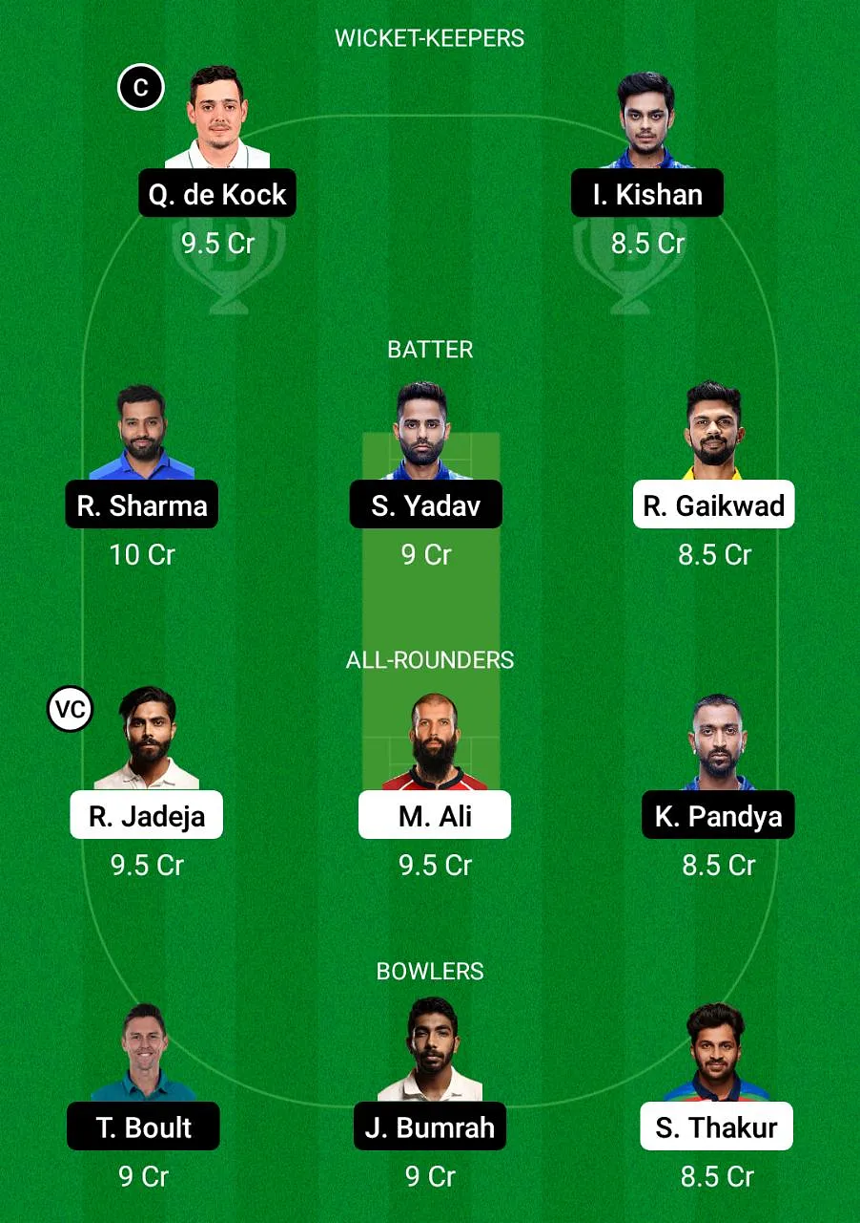
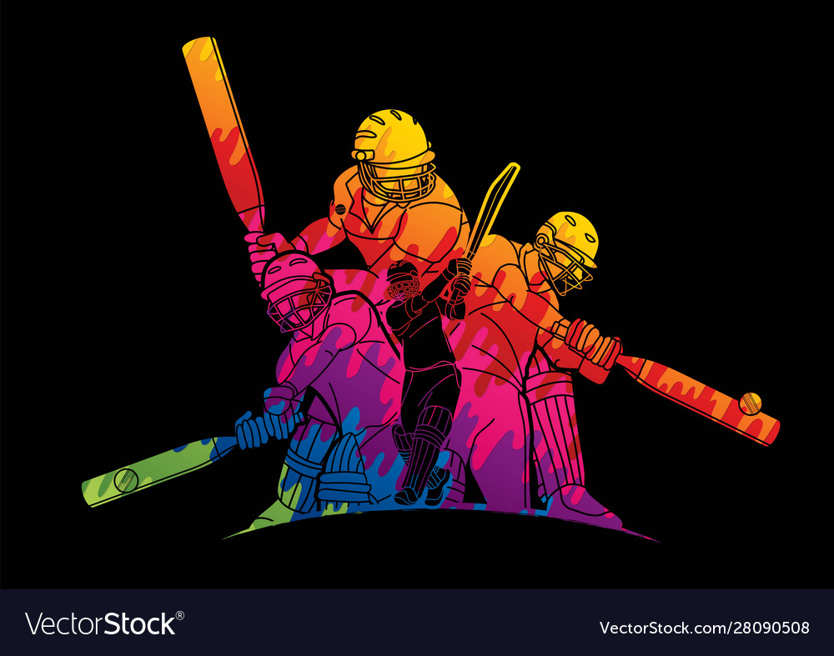
Introduction

Slide 3
Literature review
1) Player’s Performance Prediction in ODI Cricket Using Machine Learning Algorithms
Author: Aminul Islam Anik, Sakif Yeaser
Abstract : This paper proposes a model to predict a cricket player’s performance in upcoming match by implementing machine learning algorithms
Algorithms and Techniques Used : Recursive Feature Elimination, Univariate Selection, linear regression, support vector machine
→ Feature Selection Algorithms are used for extracting the attributes that are more related to the output feature
→ Machine learning algorithms are used to predict the runs scored by a batsman and runs conceded by a bowler in the upcoming match
Published in: 2018 4th International Conference on Electrical Engineering and Information & Communication Technology(iCEEiCT)
Reference: https://ieeexplore.ieee.org/document/8628118/citations#citations

Slide 4
2)Machine learning-based Selection of Optimal sports Team based on the Players Performance
Author : Monali Shetty, Sankalp Rane
Abstract : This paper provides a model that can select the best playing 11 in the Indian Cricket team. There are various factors on which a player's performance depends, like pitch type, the opposition team, the ground, etc.
Algorithms and Techniques Used : Logistic Regression, Support Vector , Random Forest
→ Random forest algorithm used for predicting performance.
→ This model gives you a 360-degree view of the player's skill set, be it, batting, bowling, and fielding.
→ The player performance classified into several classes, and a random forest classifier used to predict the player's performance.
Published in: 2020 5th International Conference on Communication and Electronics Systems (ICCES)
Reference : https://ieeexplore.ieee.org/document/9137891

Slide 5
3)INCREASED PREDICTION ACCURACY IN THE GAME OF CRICKET USING MACHINE LEARNING
Author : Kalpdrum Passi and Niravkumar Pandey
Abstract : This paper attempts to predict the performance of players as how many runs will each batsman score and how many wickets will each bowler take for both the teams.
Algorithms and Techniques Used : naïve bayes, decision trees, random forest and multiclass support vector machines
→ defined a new measure called Combined Bowling Rate to measure the performance of bowlers. The combined bowling
rate is a combination of three traditional bowling measures: bowling average, strike rate and economy.
→ .Random Forest turned out to be the most accurate classifier with an accuracy of 90.74% for predicting runs scored by a batsman and 92.25% for predicting wickets taken by a bowler.
→ Results of SVM were surprising as it achieved an accuracy of just 51.45% for predicting runs and 68.78% for predicting wickets. .
Published in: International Journal of Data Mining & Knowledge Management Process (IJDKP) Vol.8, No.2, March 2018
Reference : https://arxiv.org/pdf/1804.04226.pdf

Slide 6
Dataset description
We have used two different data set
Ball by Ball
Match by Match
Features of match by match dataset
id , city , date , player_of_match , venue , neutral_venue , team1 , team2 , toss_winner , toss_decision , winner , result , result_margin , eliminator method , umpire 1 , umpire 2
Features of ball by ball dataset
id, inning, over, ball, batsman, non_striker, bowler, batsman_runs, extra_runs, total_runs, non_boundary, is_wicket, dismissal_kind, player_dismissed, fielder, extras_type, batting_team, bowling_team

Slide 7
Some detail about the data
Ball by Ball data set doesn’t provide as such valuable information so we have to processing and extract the important information like all information about the players
Strike rate , economy and there are various factors which are important and we had to calculate them using the formula as these data were not present directly
From Match by Match data we easily extracted the data about the venus like which team wins more matches on which venue and so on
We also extracted the data about the man of match

Slide 8
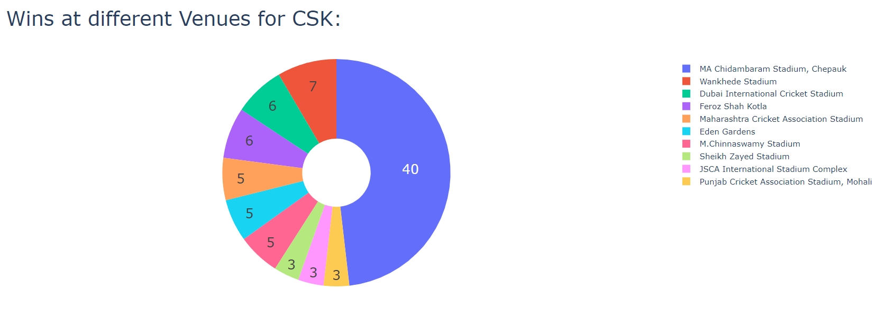
Some Visualization
runs scored by some players total matches played

Slide 9
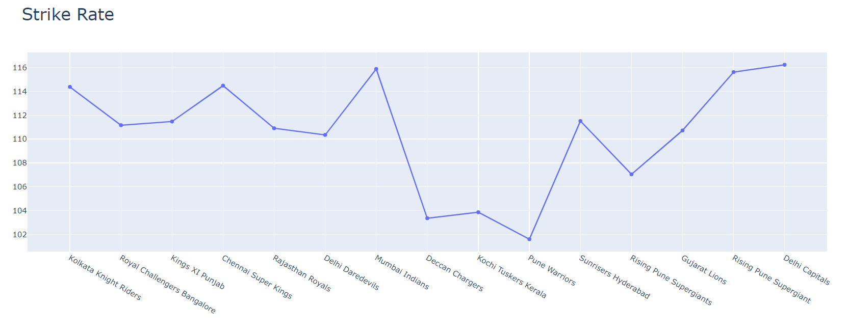
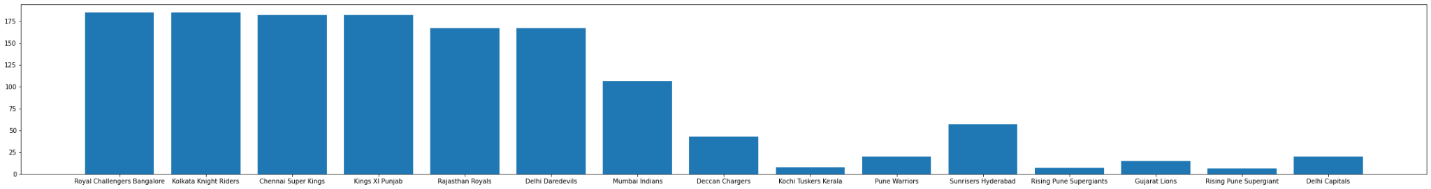
Strike rate of different ipl teams from 2008

Slide 10
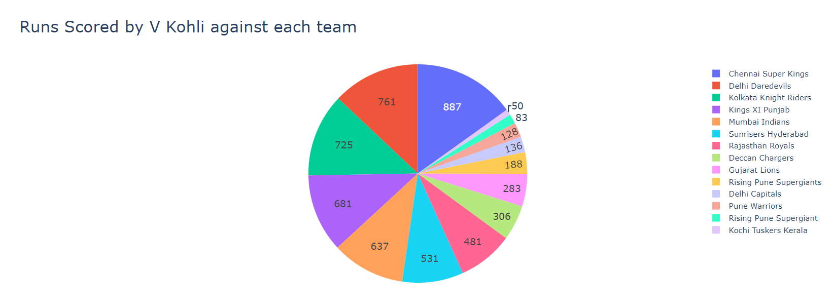
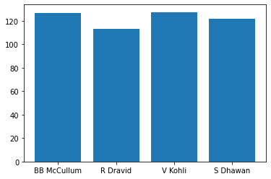

Slide 11
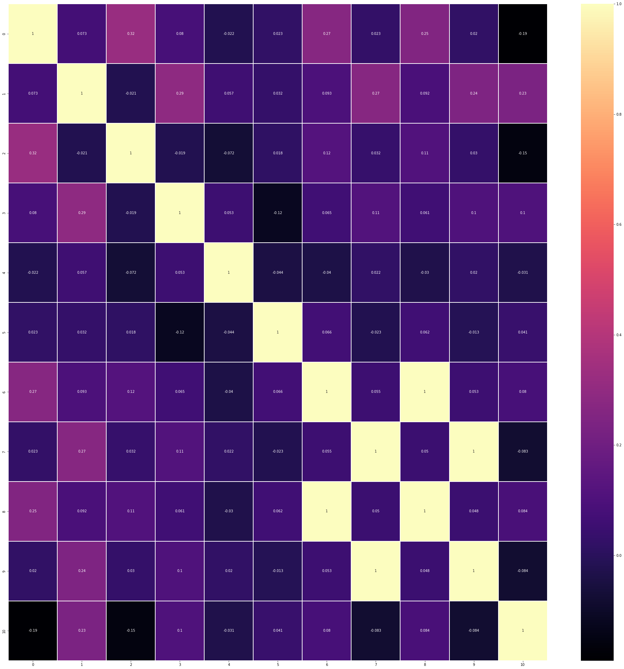
Correlation HeatMap

Slide 12
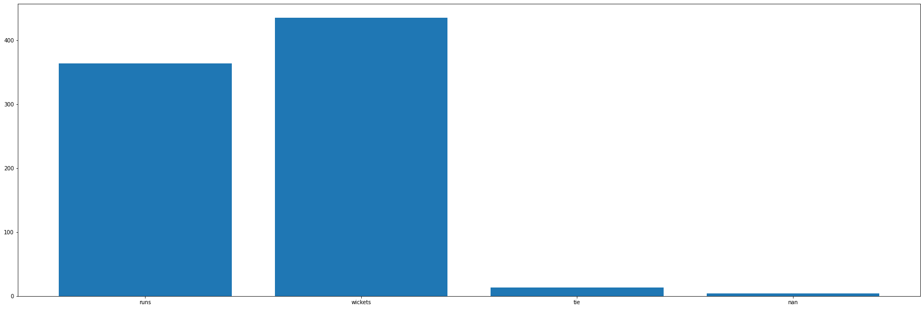
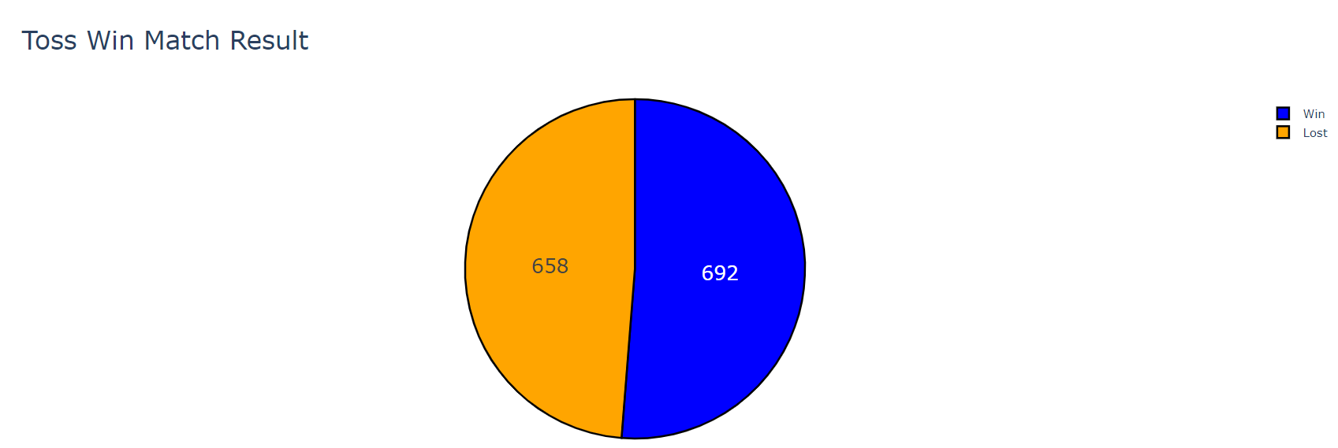
IMPACT OF TOSS ON THE MATCH

Slide 13
Methodology
Naive Bayesian model :
Parameters are:
Match Venue (stadium name)
Bat/Field (what a team does in the first inning)
We do not plan to use this model as a baseline model
We had planned to use model as just a yardstick to evaluate our final model but later decided to use it to build on the current model

Slide 14
Methodology
Logistic Regression (batch gradient descent):
It uses 11 parameters of each player:
Average Runs per Match, Balls Faced, Catches, Economy, Runs Given, Strike Rate, Players Stumped, Total Boundaries, Total Runs, Wickets, Wickets Per Over
We averages these values across a team and find the difference of these averaged values between both the teams
The model is then trained on the resulting difference

Slide 15
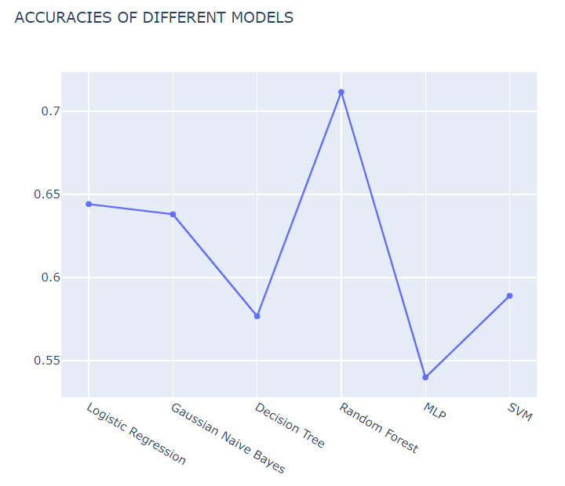
Model Details

Slide 16
Model Details
Logistic Regression: 0.6441717791411042
Gaussian Naive Bayes: 0.6380368098159509
Decision Tree: 0.5766871165644172
Random Forest: 0.7116564417177914 (Final model used)
MLP: 0.5398773006134969
SVM: 0.588957055214724

Slide 17
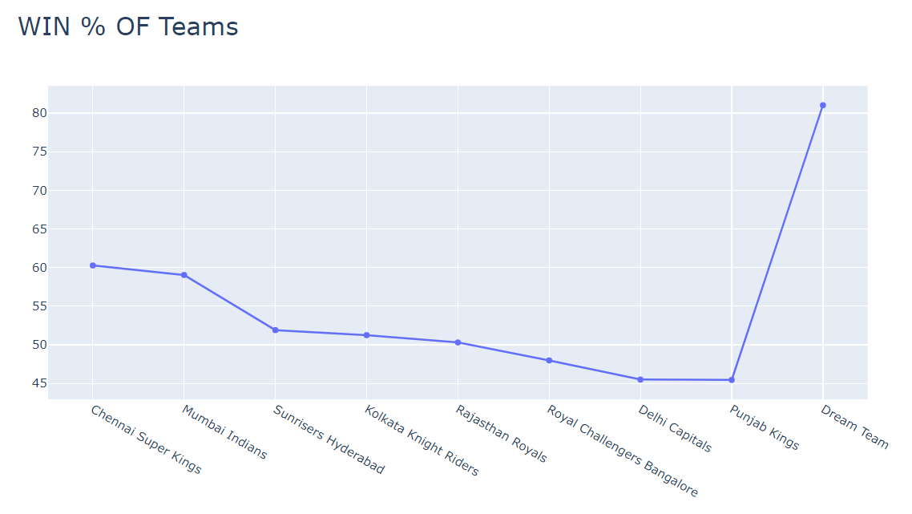

Slide 18
TIMELINE
The project progress has been completed on schedule
Week 1 – Study and Research about Sport/Tournament of Interest
Week 2 – Data Collection/Mining/Scraping from Trusted Sources
Week 3 – Selecting and Extracting Relevant Features from Dataset
Week 4 – Preprocessing Data and Reducing Noise
Week 5 – Determine Optimal Model to use and Start Training
Week 6 – Analysis of the Resultant Model
Week 7 – Evaluation and Normalization
Week 8 – Parameter and Hyperparameter Tuning
Week 9 – Fine-tuning the Entire Project
Week 10 – Preparing Documentation, Report and Presentation

Slide 19
WORK DONE
Work done by every member of the team
1) Anurag Yadav: Dataset Preprocessing- Data Extraction, Features extraction, Data collecting, Data analysis, Noise Reduction,Report writing, helped in the logistic regression model
2) Yash Aggarwal: Data Collection, Feature extraction, Report Writing, Data Preprocessing, helped in Naive Bayesian model and metric Collection
3) Agamdeep Bains: Data collection, Feature extraction, Coding Logistic Regression model and Naive Bayesian model, Metric Collection, Report Writing
4) Ajay Kumar: Naive Bayesian model, Report Writing,data collection

