Slide 1
ArogyaRaksha
School of AI health care hackathon
M.Ajay Kumar
K.Sandhya Laxmi
M.Sukharam
M.Kiran Kumar

Slide 2
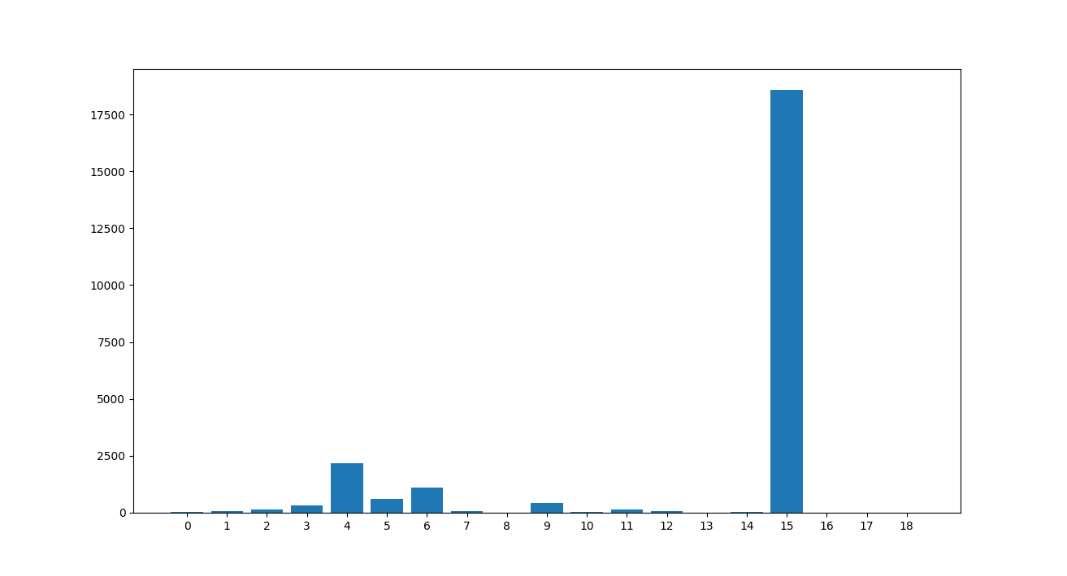
ISIC Dataset

Slide 3
Domain Understanding

Slide 4
Main Categories
Melanocytic nevi
Melanoma
Benign keratosis-like lesions
Basal cell carcinoma
Actinic keratoses
Vascular lesions
Dermatofibroma

Slide 5
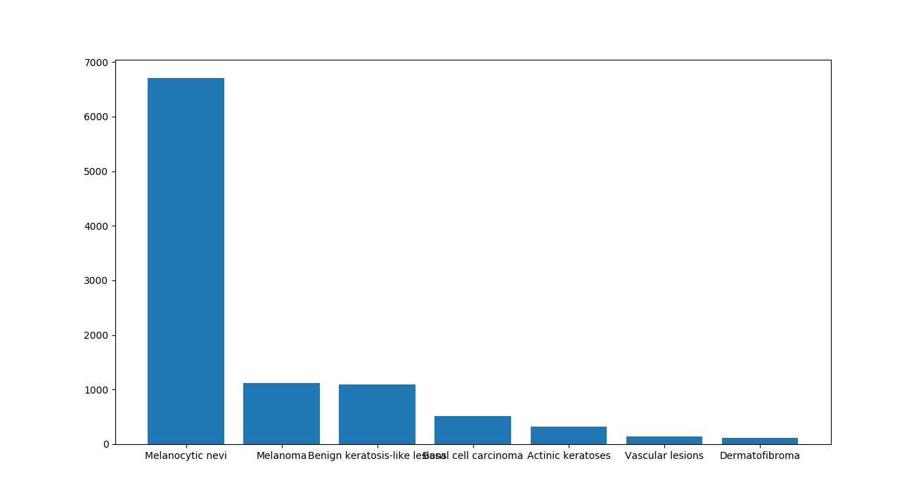
HAM10000 Dataset

Slide 6
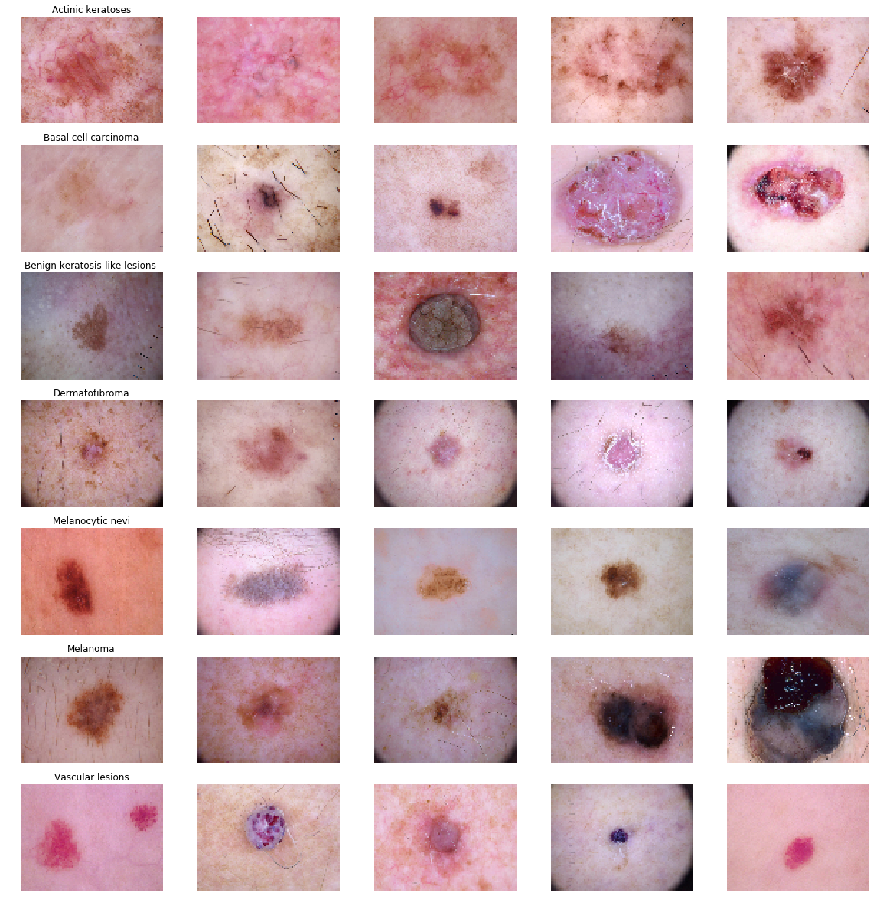

Slide 7
Insights of dataset
Gender: Type of tool used while collection data:
Male 5406 Histo 5340
Female 4552 Follow_up 3704
Unknown 57 Consensus 902
Confocal 69

Slide 8
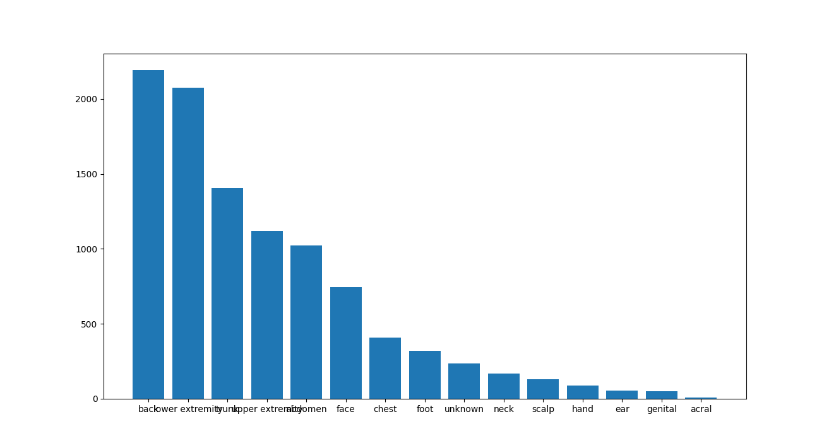
Localization

Slide 9
Train Val Test Split
Testing Data : Data completely unseened used for final model testing.
Training Data : Data used for training only.
Val data: Used for validate the model at each epoch.

Slide 10
Train Val Test Split
Train 35% of Nevus(Melanocytic nevi) data 65% testing.
Remaining all classes 80% data to train 20% for testing.
Training Data again split into 80% for training 20% val.

Slide 11
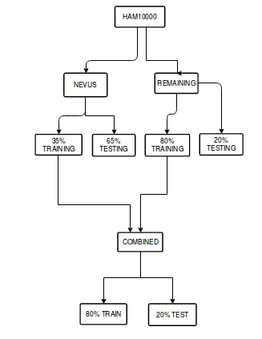
Train Val Test Split

Slide 12
Model Details
Used Keras
Written own model from scratch
16 Layers used (Conv2d, MaxPool2D, Dropout).
Used Adam optimizer
Learning Rate =0.00001
Basic random augmentation applied

Slide 13
Model Details
Epochs : 50
Loss function : Categorical Cross Entropy
Used ReduceLROnPlateau for patience 5

Slide 14
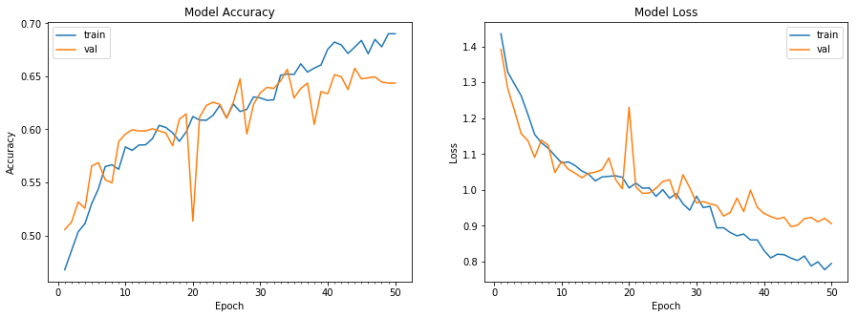
Train - val plot

Slide 15
Accuracy
Validation: accuracy = 0.657658
Test: accuracy = 0.788772

Slide 16
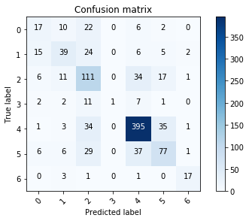
Confusion matrix
on val data

Slide 17
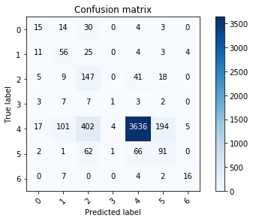
Confusion matrix
on Test data(Unseen)

Slide 18
Ideas to Improve the Accuracy
We are now used only image features for classification.
We can use the features like gender, age, localization..etc. to improve the accuracy.
We only tested with Categorical Cross Entropy loss function we can try with different losses like perceptual loss, weighted kappa loss etc.

Slide 19


Slide 20

Keep Learning…..

