Slide 1

Pizza Sales Performance
A data-driven deep dive into orders, revenue, and growth opportunities.

Slide 2
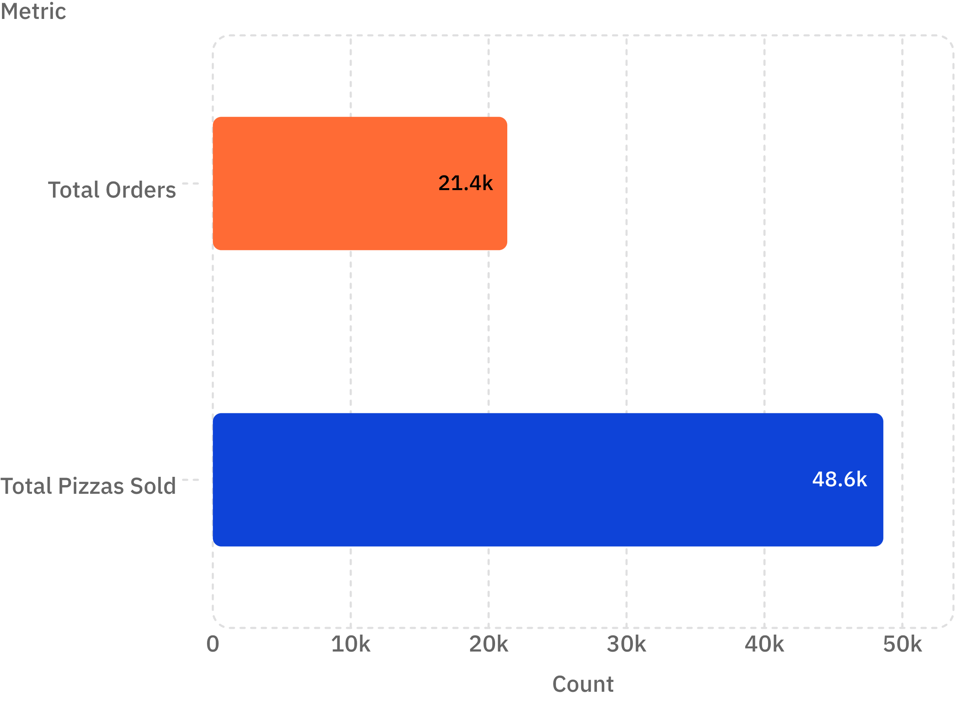
The Numbers That Matter
Operational Scale at a Glance
Massive order volume demonstrates strong market demand and a well-oiled operation capable of handling high throughput.
21,350
48,620
2.28
Unique orders executed
Pizzas sold total
Items per order — strong group dining

Slide 3
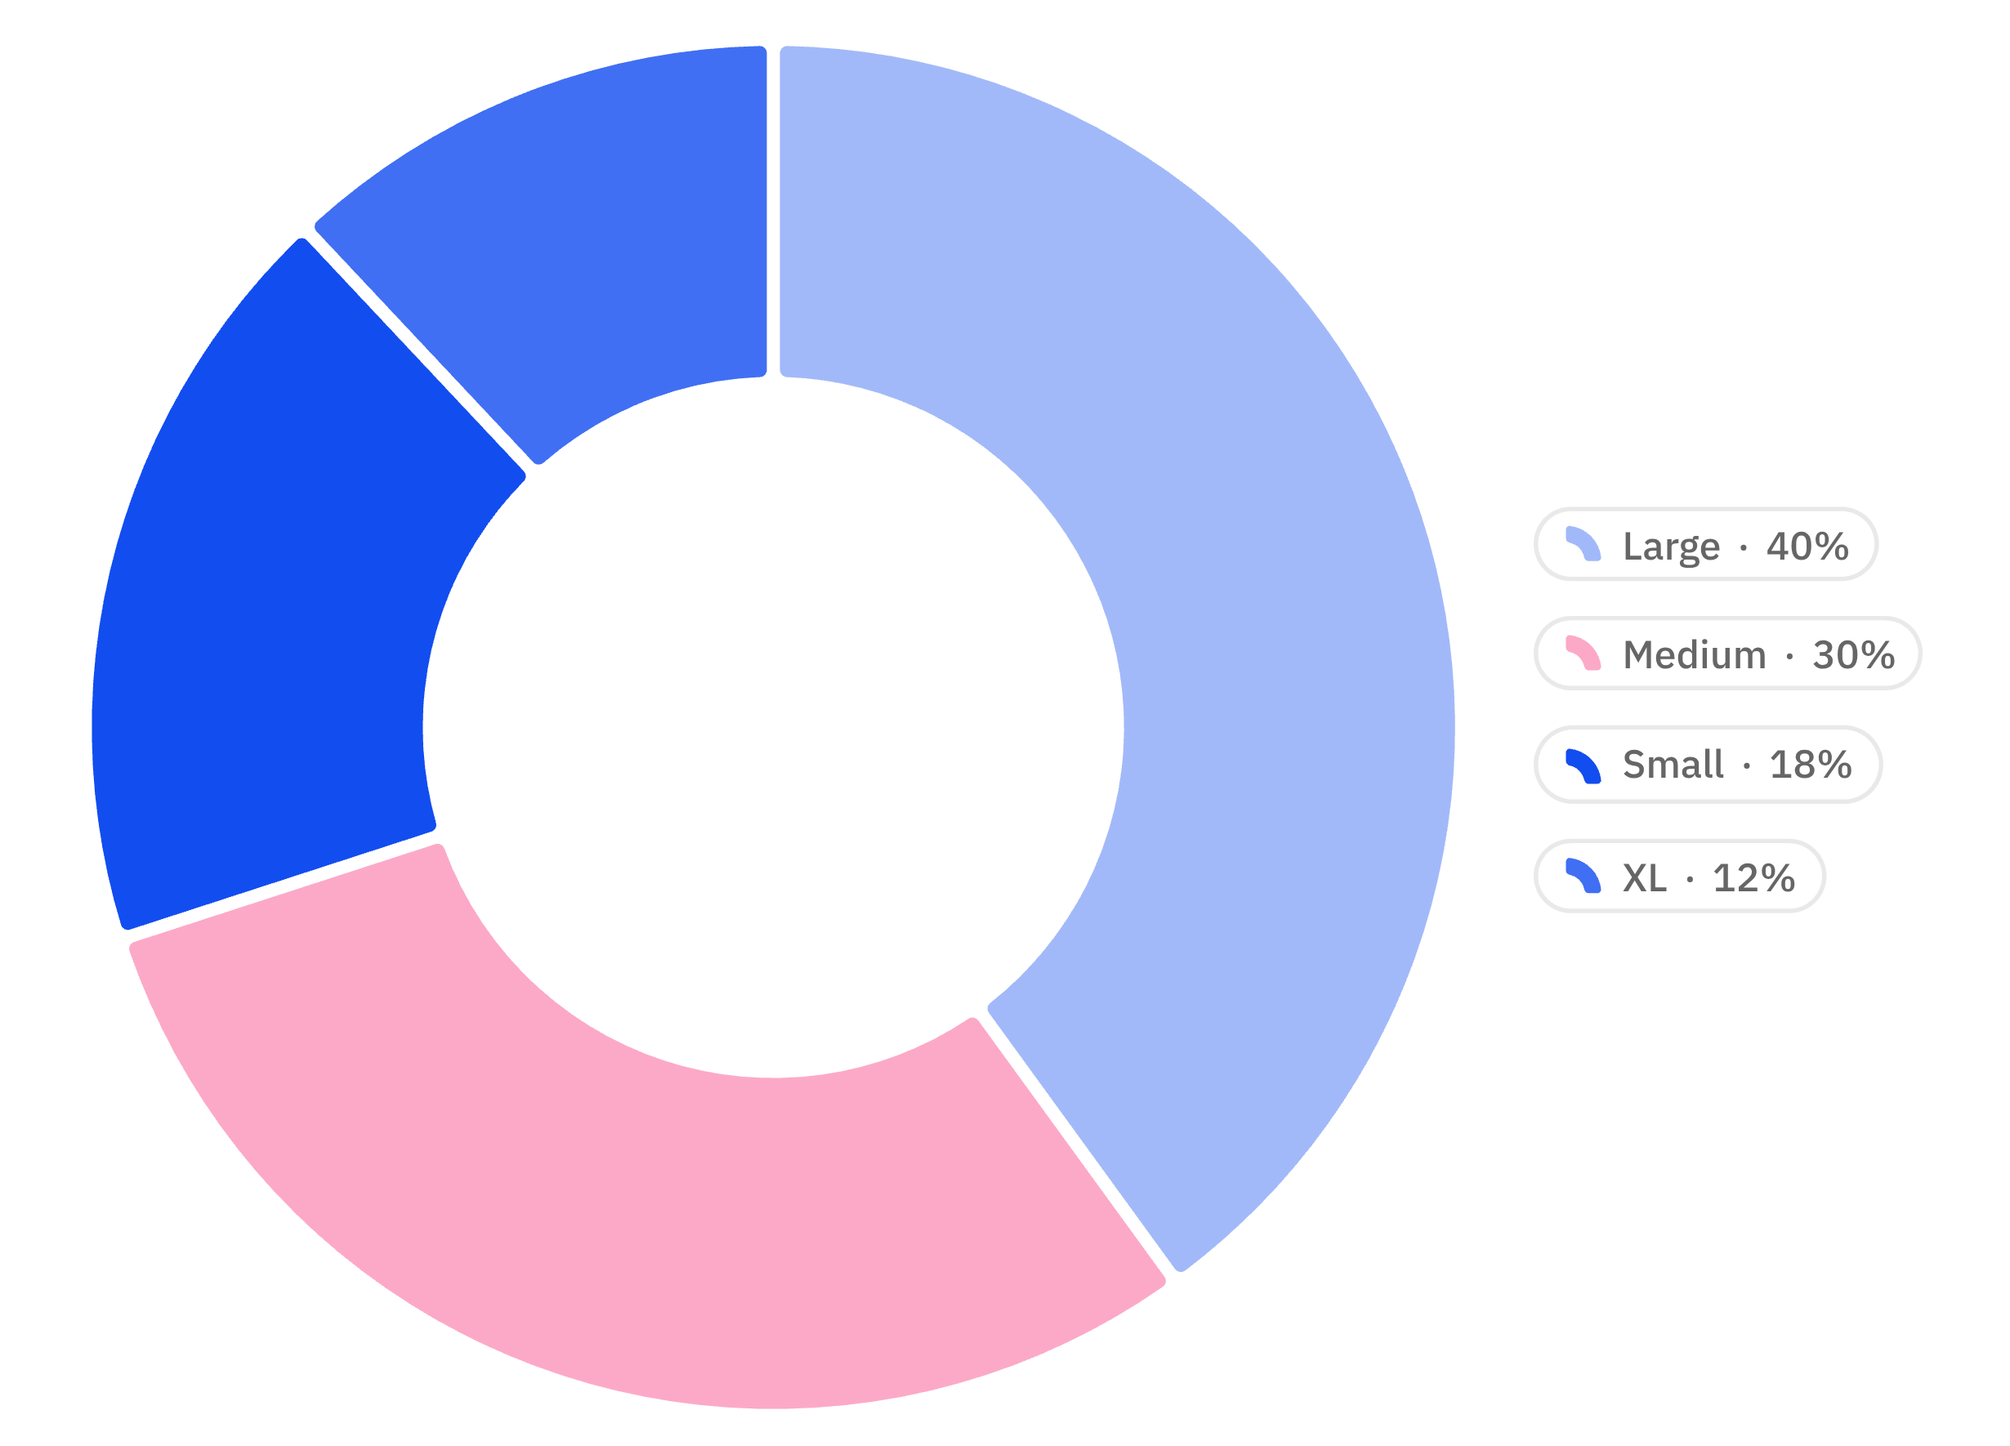

Size Dominance: Large & Medium Rule
Revenue Powerhouses
Large (L) & Medium (M) sizes capture a commanding 70% of total revenue, driven by premium per-unit pricing and high order frequency.
Large: 40% revenue share — the dominant format
Medium: 30% — ideal for groups and families
Small: 18% — individual and niche demand
XL: 12% — specialty group sharing occasions
Prioritize L & M inventory to protect the 70% revenue core.

Slide 4

Top Pizza Performers
1
2
Thai Chicken
Barbecue Chicken
Highest cumulative sales revenue across all categories — the undisputed #1 performer on the menu.
Strong second performer with broad appeal across size variants and customer cohorts.
3
Classic Deluxe
Consistent baseline demand year-round — a reliable anchor of the menu lineup.

Slide 5
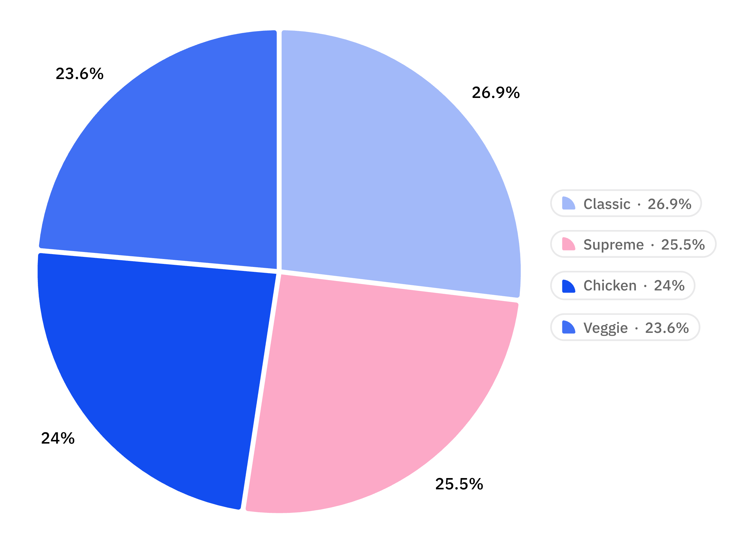
Category Revenue Breakdown
Balanced Portfolio
All four categories perform with remarkable parity — a sign of diverse, healthy customer preferences and a well-crafted menu.
Classic: 26.9% — consistent baseline, high order frequency
Supreme: 25.5% — premium toppings, higher ticket value
Chicken: 24.0% — strong in medium & large sizes
Veggie: 23.6% — stable across all customer cohorts

Slide 6
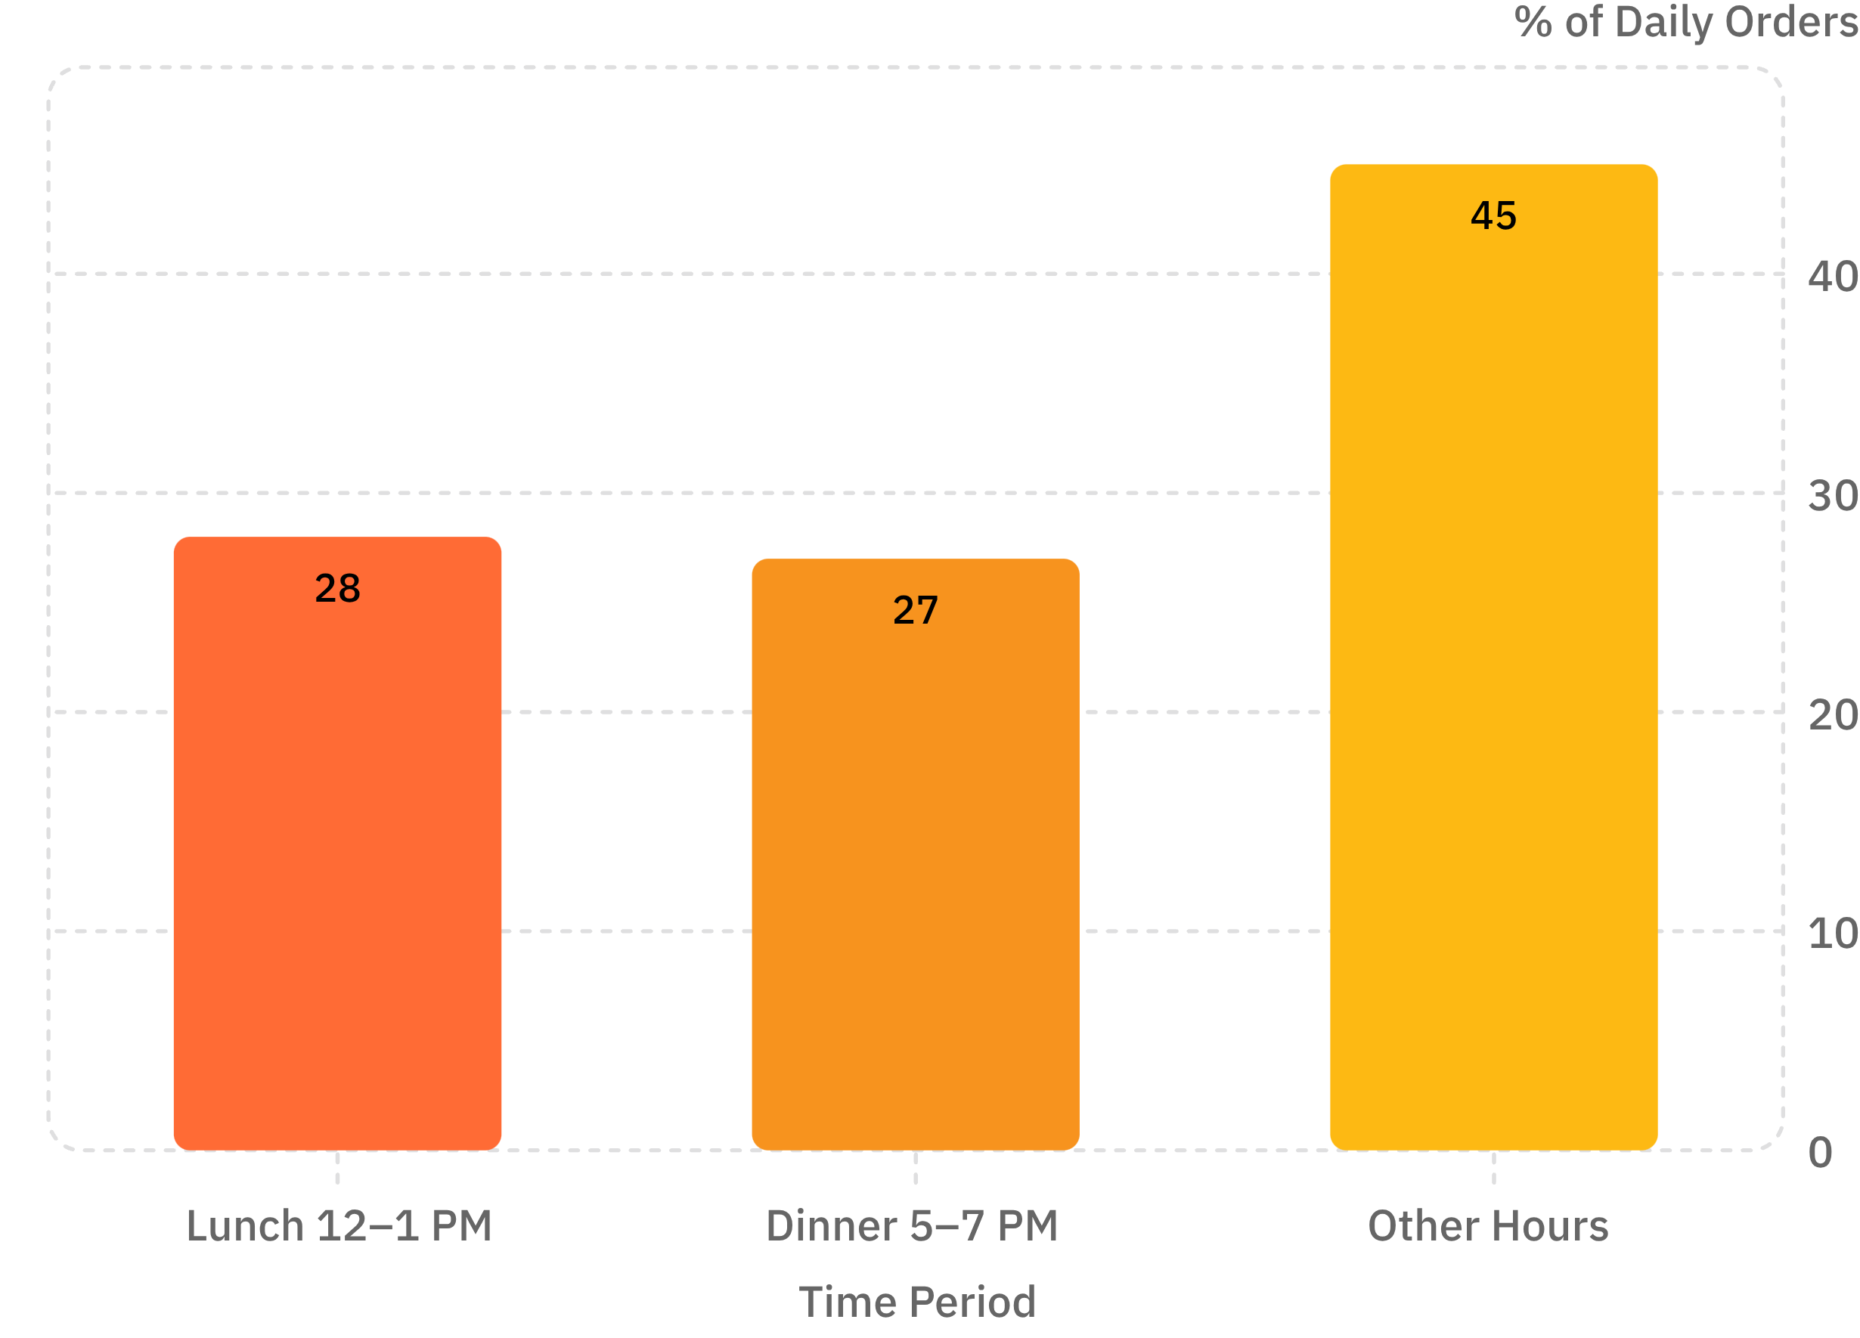
Peak Hours & Days
When Orders Surge
Lunch and Dinner windows together account for 55%+ of daily transactions — making staffing and ingredient readiness during these windows mission-critical.
Friday & Saturday evenings — massive order spikes, peak of the week
July & May — highest seasonal ordering volumes
Thursdays & Fridays — sharp mid-week to weekend ramp-up

Slide 7
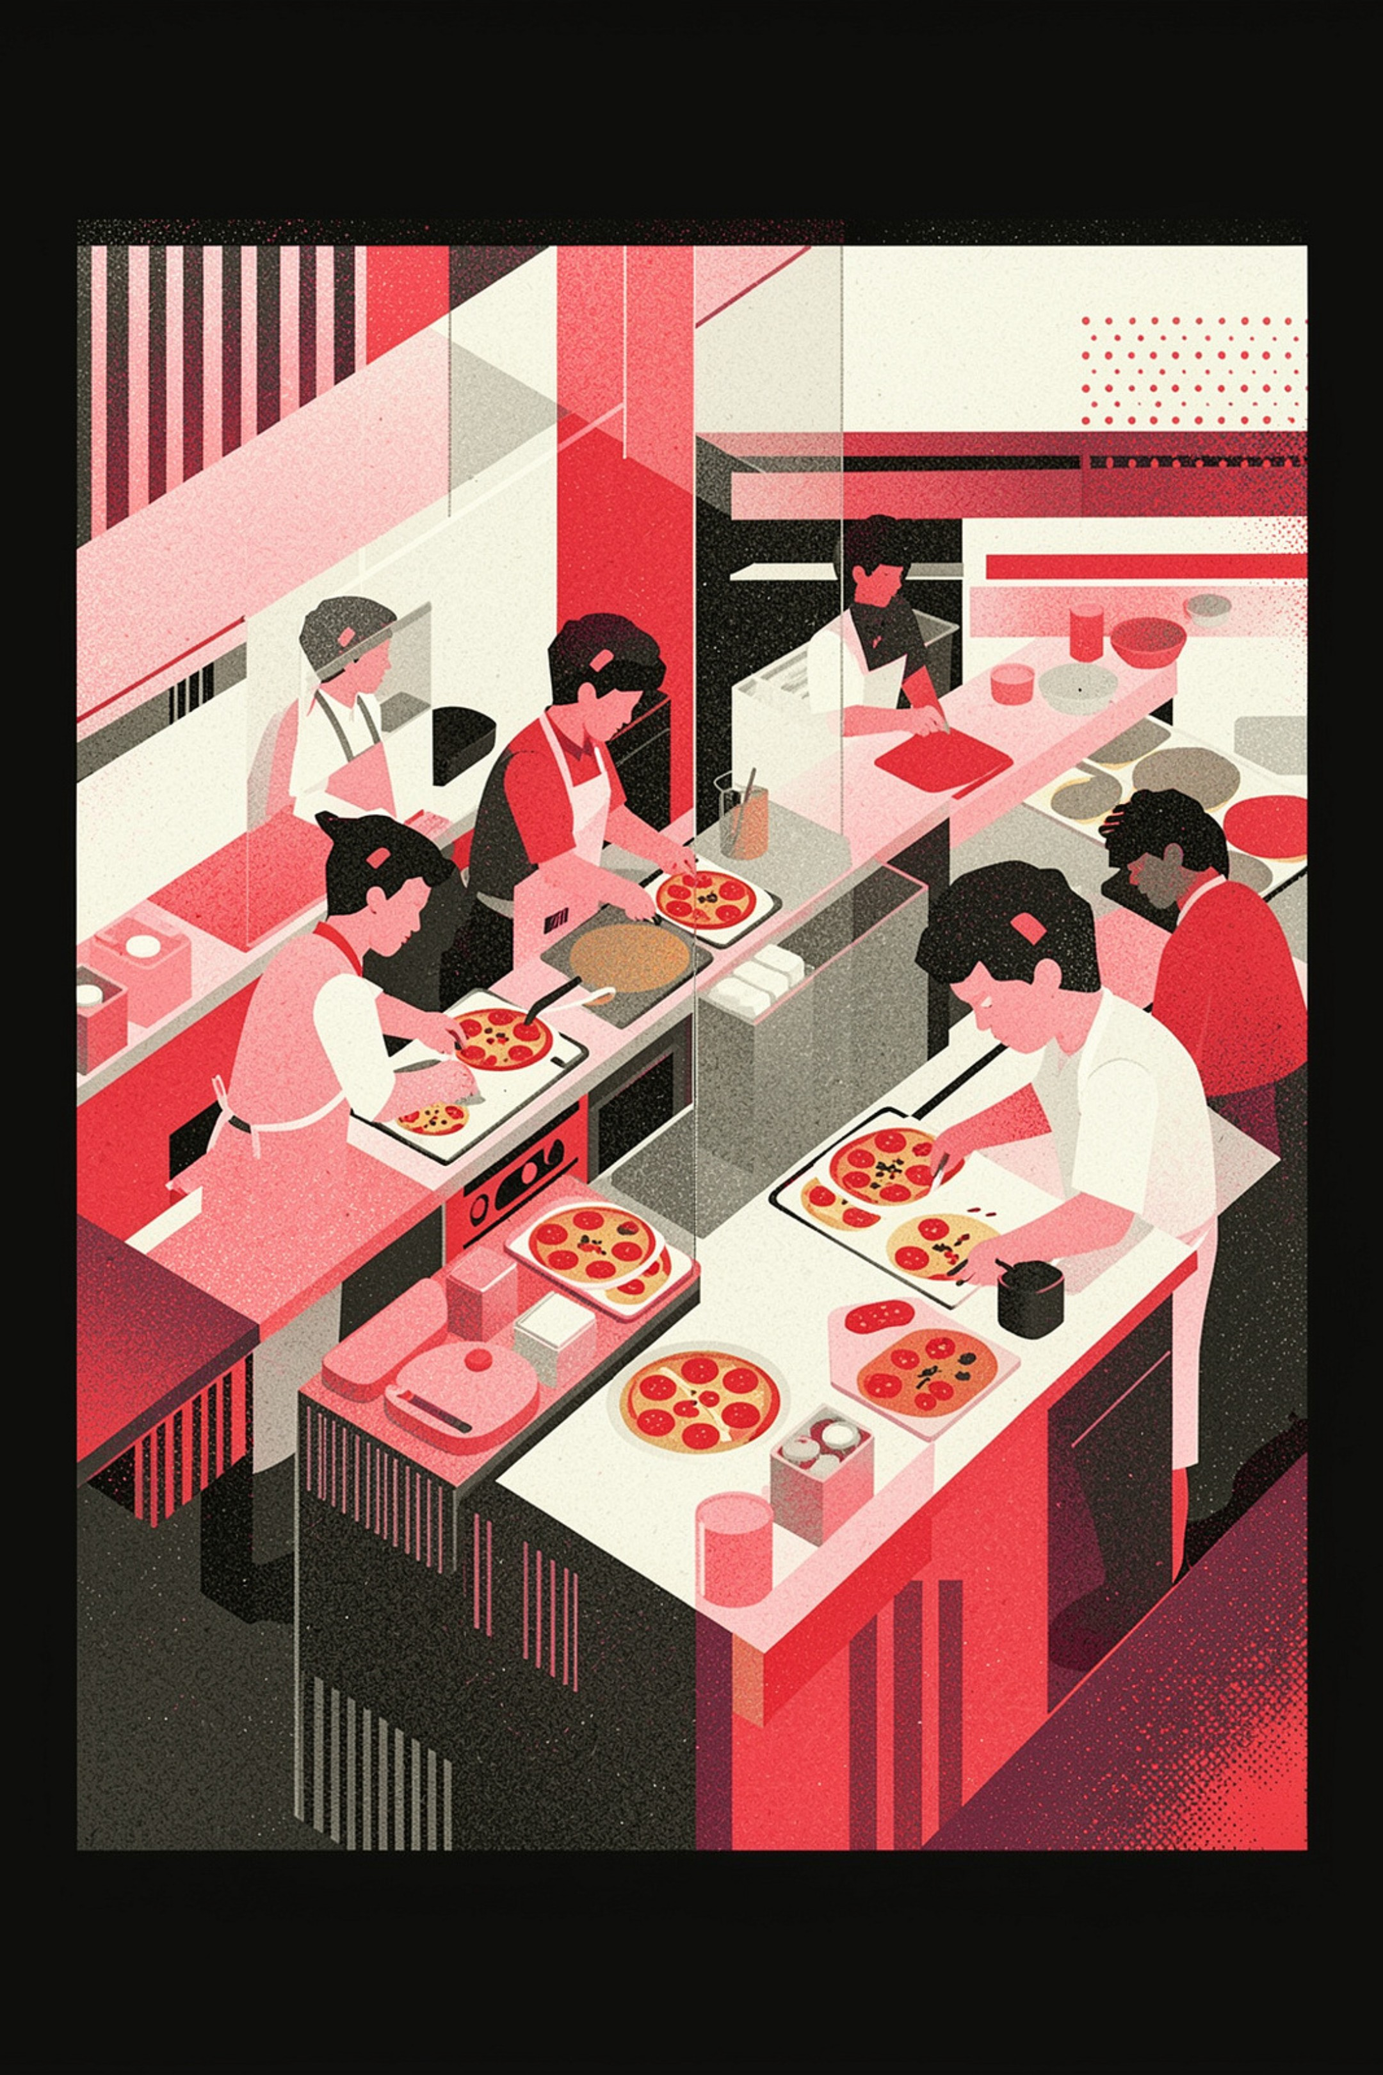
Strategic Recommendations
Inventory Forecasting
Weekend Marketing
Dynamically adjust cheese, dough, and proteins for peak days — Thursday through Saturday — to avoid shortfalls during the highest-revenue windows.
Launch targeted promotions during Friday and Saturday dinner rushes to capture incremental spend at the highest-traffic moments of the week.
Menu Engineering
Feature top-grossing Chicken and Supreme pizzas prominently on digital menus and physical boards to guide customers toward high-margin choices.

Slide 8
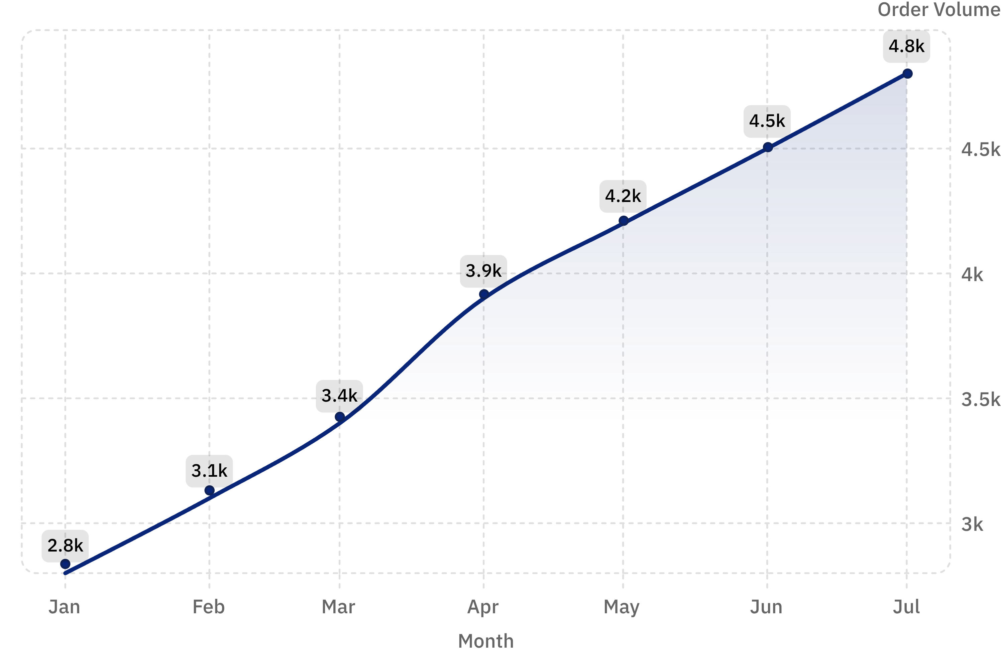
Customer Satisfaction & Order Trends
Our steady increase in order volume, particularly during the summer months, strongly correlates with high customer satisfaction. Positive experiences drive repeat business and organic growth, reinforcing our market position.
Consistent growth from January to July indicates strong customer loyalty.
Peak summer months (May-July) highlight potential for seasonal campaigns and retention strategies.

Slide 9
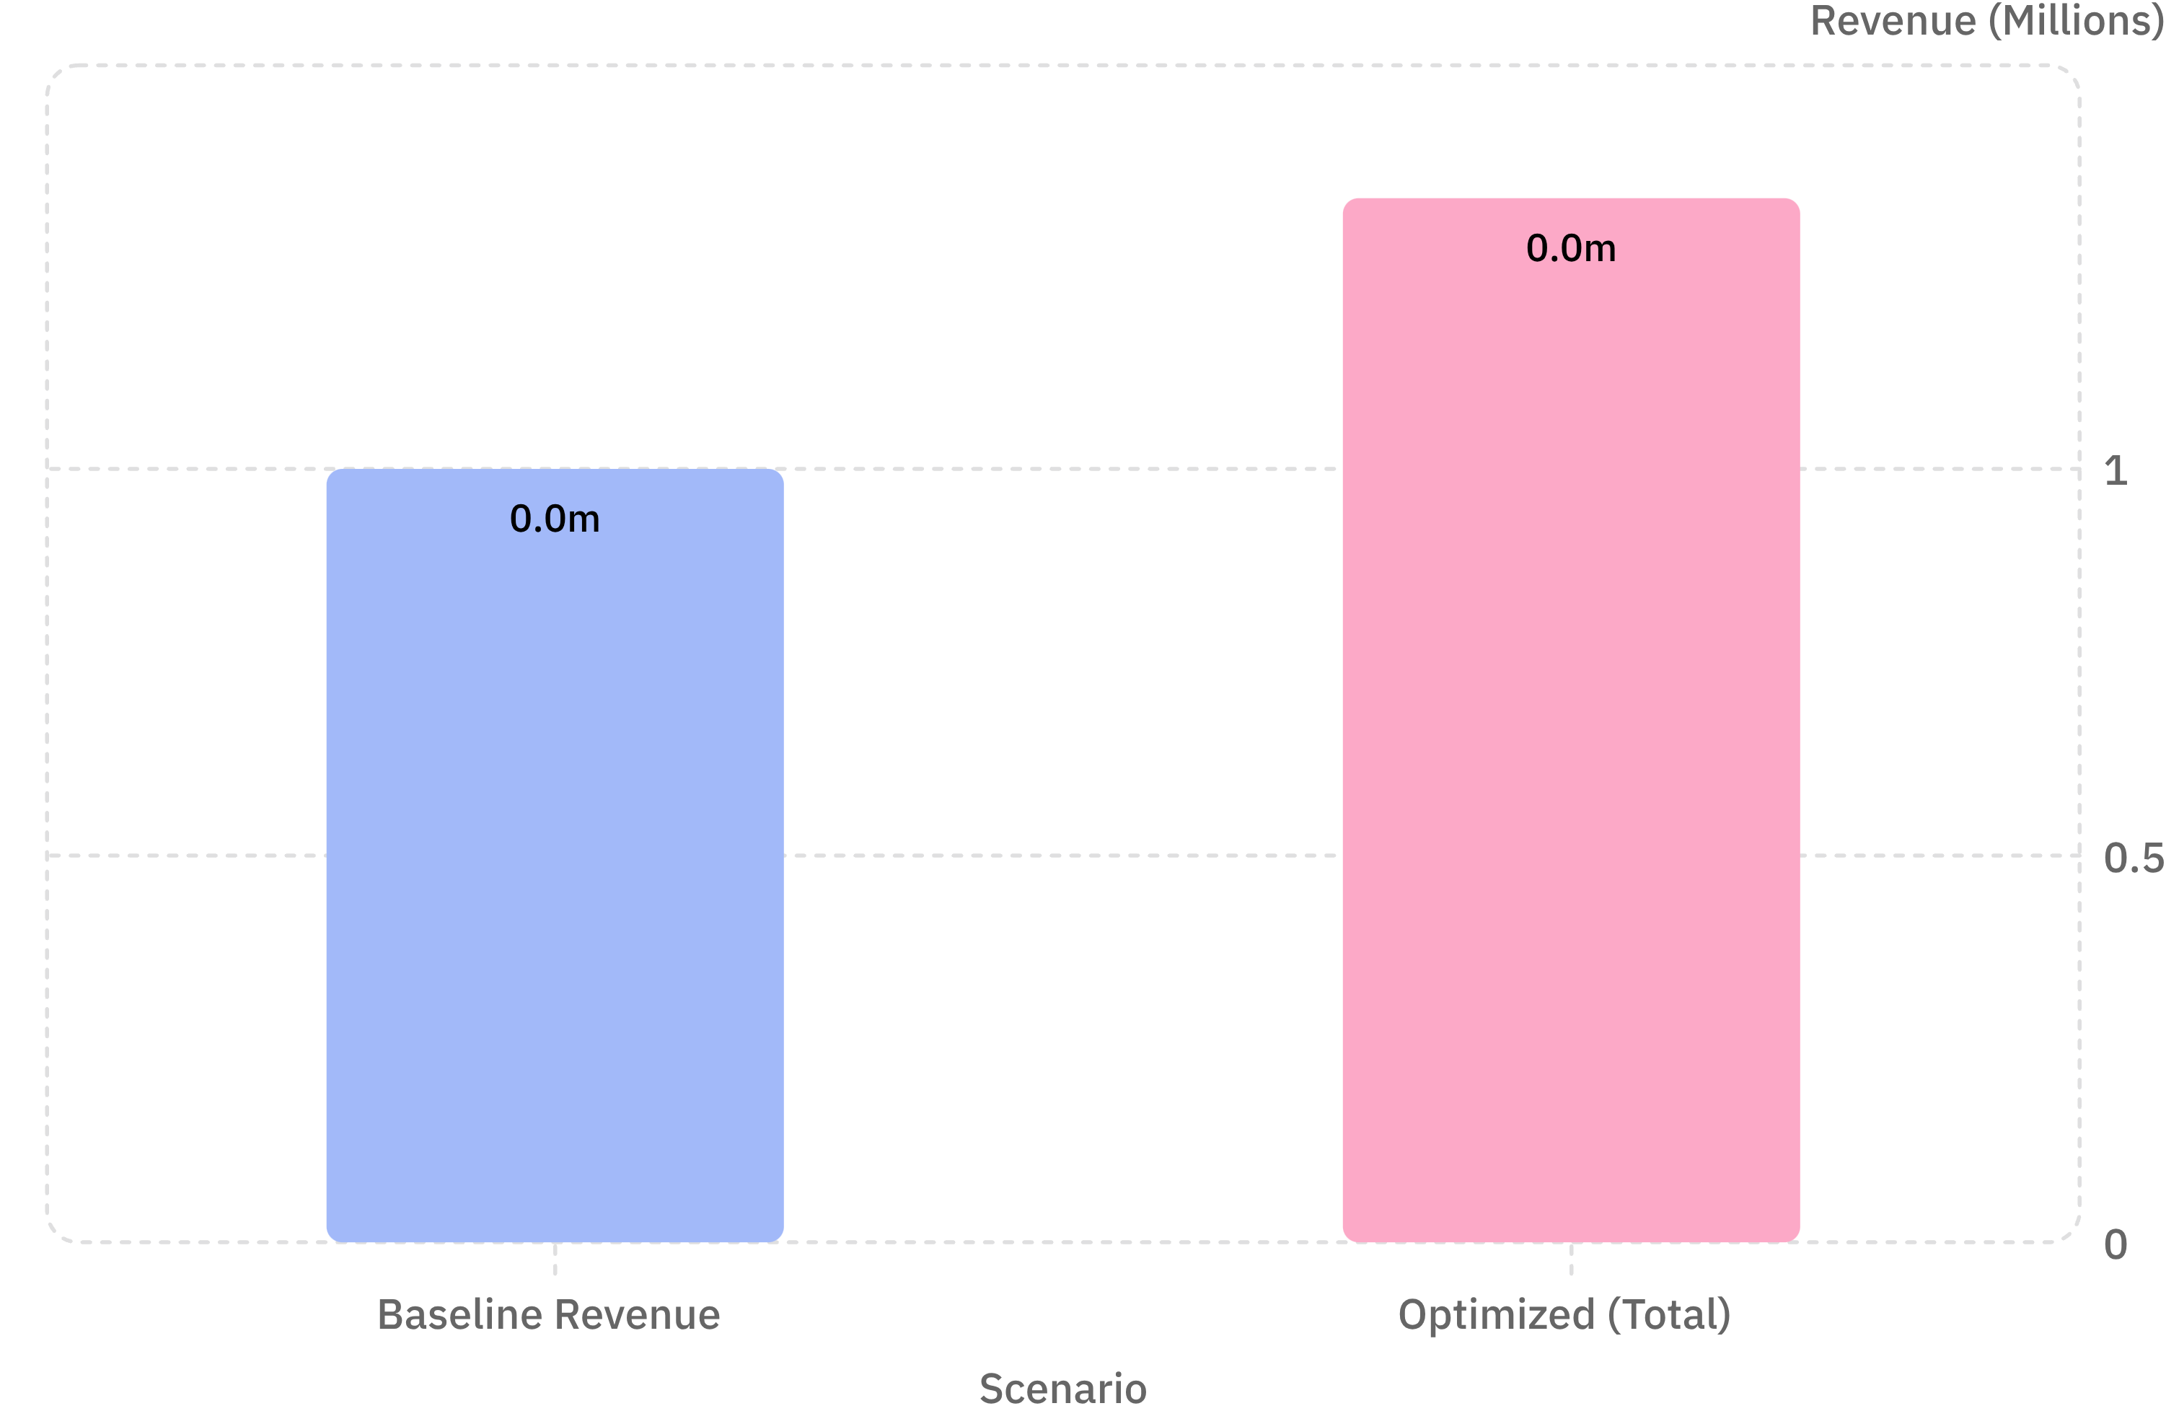

Unlocking Revenue Growth Potential
Strategic Uplift Targets
By implementing key optimization strategies, we project a substantial increase in annual revenue, building on our current performance.
Inventory Forecasting: ~8% uplift by reducing waste and ensuring stock for peak demand.
Weekend Marketing: ~12% uplift through targeted promotions during high-traffic times.
Menu Engineering: ~15% uplift by promoting high-margin items and optimizing menu placement.
A combined 35% growth potential could elevate annual revenue from $1M to $1.35M.

Slide 10
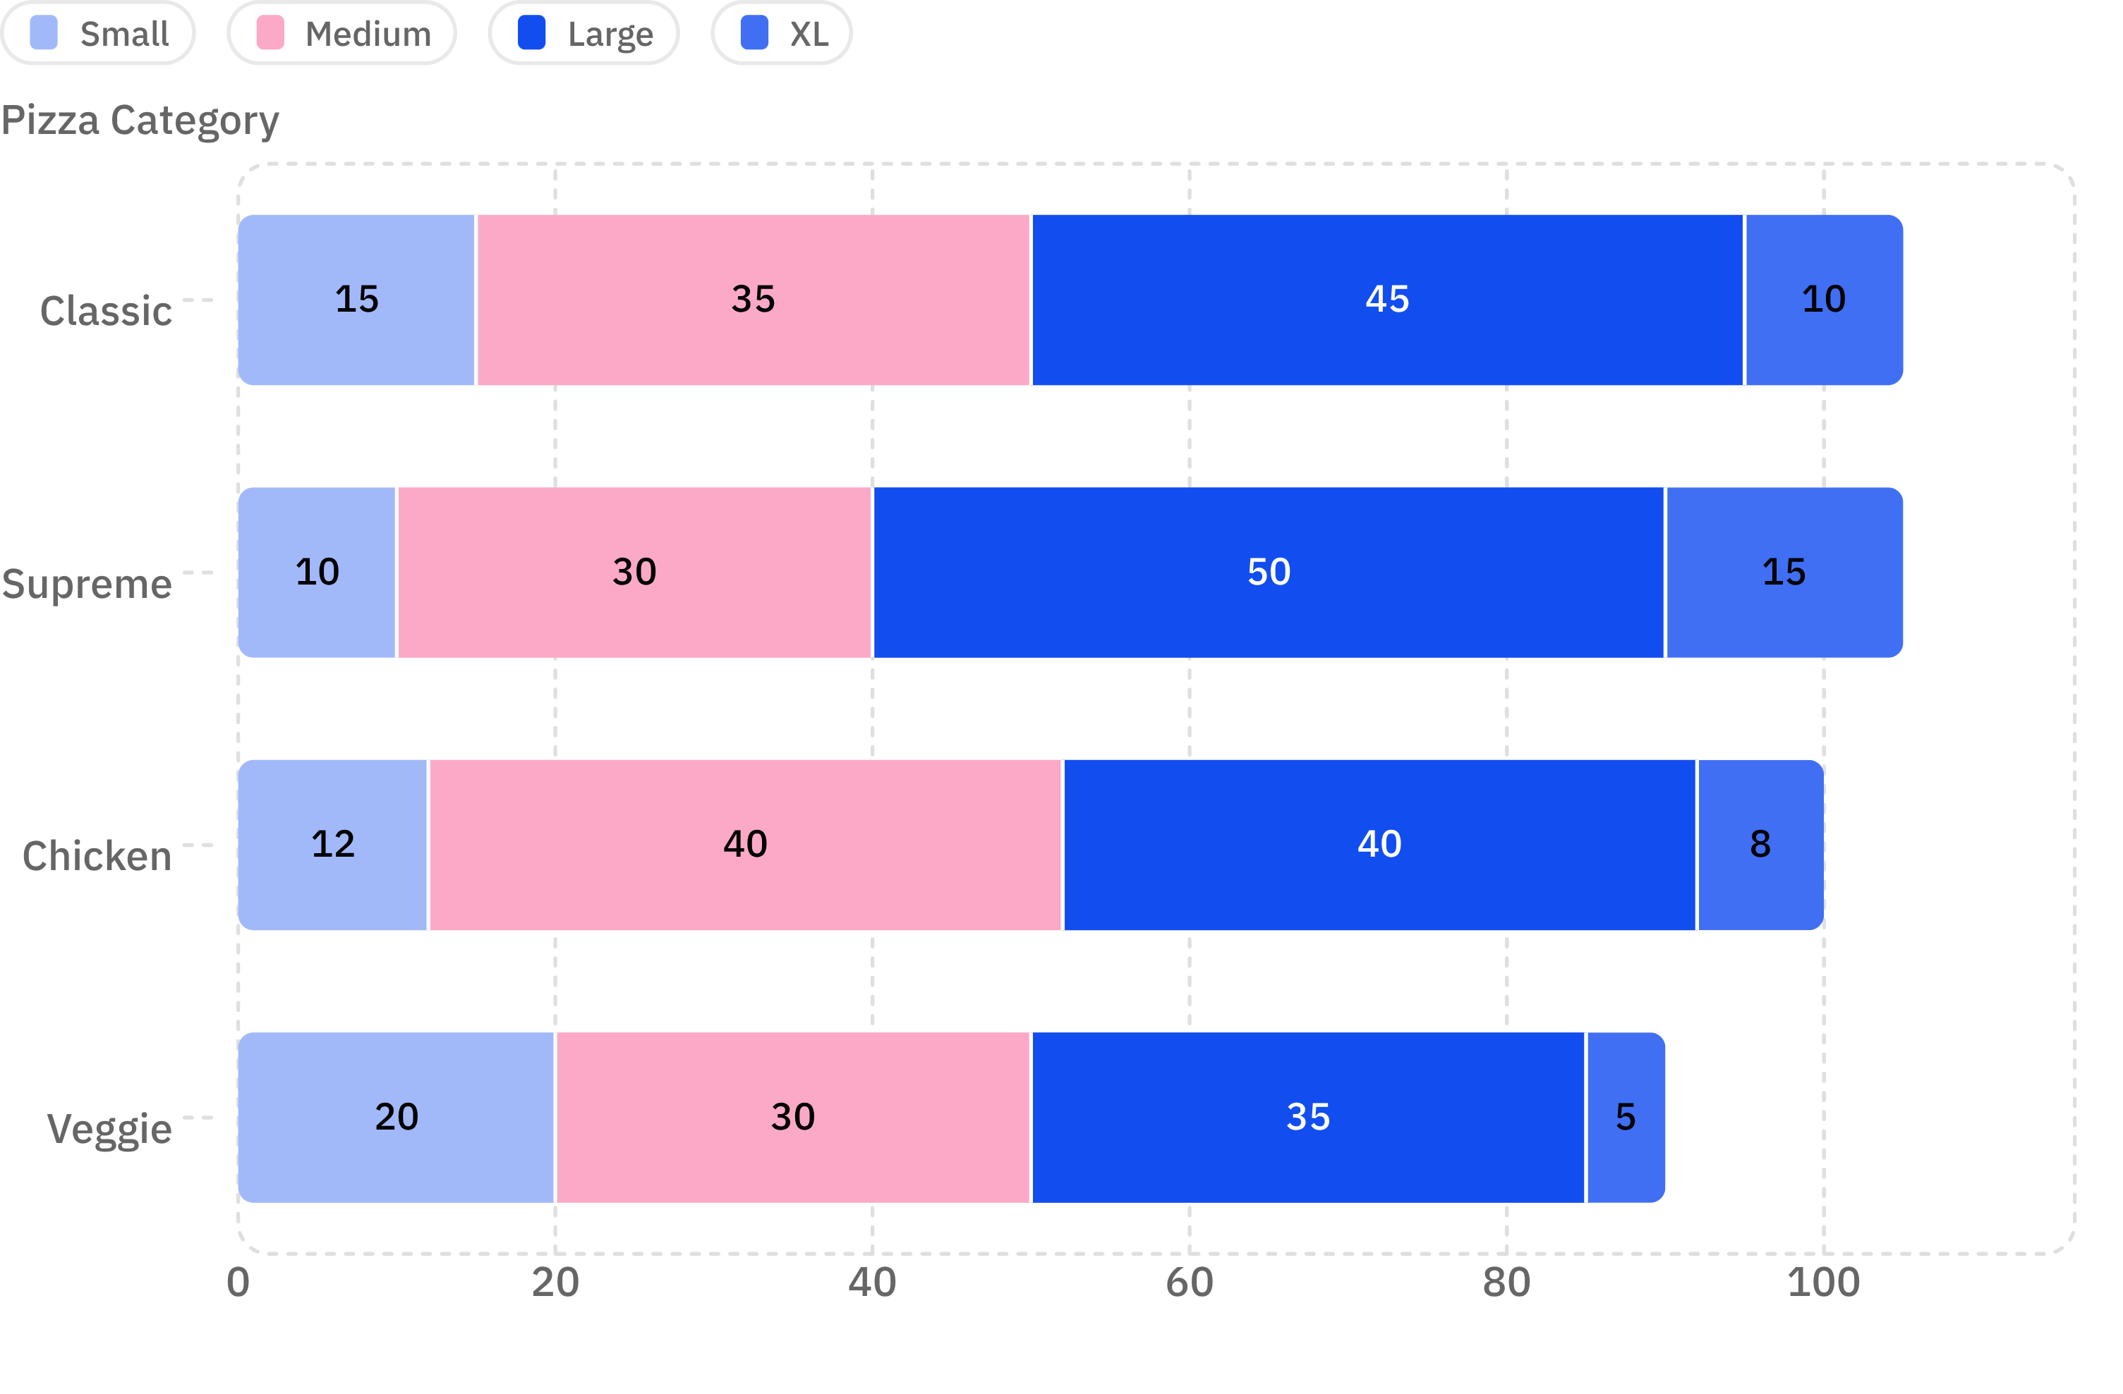

Customer Preferences by Size & Category
Understanding the nuanced demand for each pizza category across different sizes is key to optimizing production and marketing.
Key Takeaways
Large & Medium sizes dominate across all categories, reinforcing their importance.
Supreme category performs exceptionally well in Large & XL sizes, indicating a preference for premium options for group orders.
Veggie pizzas show a stronger presence in Small sizes, catering to individual preferences or lunch orders.
Chicken pizzas are highly popular in Medium sizes, suggesting they are a go-to for family meals.
Focus marketing efforts on promoting Supreme pizzas in larger sizes and exploring potential for combo deals around Chicken Medium pizzas.

Slide 11

Key Insight: Data-Driven Growth
From Data to Profit
Granular SQL analytics transform raw transaction logs into strategic intelligence. By optimizing inventory, targeting peak hours, and featuring top performers, you maximize both profitability and customer satisfaction.
Optimize Inventory
Target Peak Hours
Feature Top Performers
Stock the right ingredients at the right time.
Staff and market when it matters most.
Let your bestsellers drive the bottom line.

