Slide 1
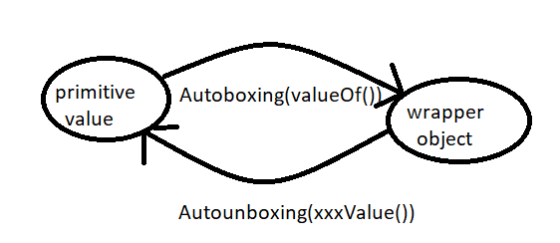
Autoboxing and Autounboxing
Autoboxing
Automatic conversion of primitive to wrapper object by compiler is called Autoboxing
Integer I = 10;(compiler converts int to Integer automatically by autoboxing )
After compilation the above line will become
Integer I = Integer.valueOf(10);
Ie. Internally autoboxing concept is implemented by using valueOf() methods
AutoUnboxing
Automatic conversion of wrapper object to primitive by compiler is called autounboxing .
Integer I = new Integer(10);
Int i = I; [ compiler converts Integer to int automatically by Autounboxing
After compilation the above line will become
int I = I.intValue(); i.e. Internally autounboxing concept is implemented by using xxxValue() methods .

Slide 2
Example:
public class Test{
static Integer I = 10; // == Autoboxing
public static void main(String[] args){
int i = I; // autounboxing
m1(i);
}
public static void m1(Integer K){ // Autoboxing
int m = K; // autounboxing
System.out.println(m);
}
} // 10
Just because of autoboxing and autounboxing we can use primitives and wrapper objects interchangeably from 1.5 version onwards
Example 2
public class Test{ static Integer I=0; public static void main(String[] args){ int m = I; System.out.println(m); } } // 0 | public class Test{ static Integer I ; // I == Null public static void main(String[] args){ int m = I; // = int m = I.intValue();// I === Null System.out.println(m); } } // RE: NullPointerException

Slide 3
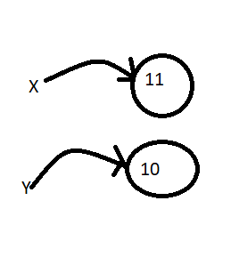
Note:
On null reference if we are trying to perform autounboxing then we will get RuntimeException saying NullPointerException
Example 3:
public class Test{
public static void main(String[] args){
Integer x = 10;
Integer y = x;
x++;
System.out.println(x); // 11
System.out.println(y); // 10
System.out.println(x==y); // false
}
}
Note :
All wrapper class objects are immutable i.e . Once we create wrapper class object we can’t perform any changes in that object . If we are trying to perform any changes with those changes a new object will be created .

