Slide 1
Enum(Enumeration):
If we want to represent a group of named constants then we should go for Enum .
Example
enum Month{
JAN,FEB,MAR,APR …….. DEC; // Semi colon is optional
}
enum Beer{
KF,KO,RC,FO;
}
It is group of named constants .
The main Objective of enum is to define our own datatypes (enumerated datatypes );
Enum concept introduced in 1.5 version when compared with old languages enum . Java enum is more powerful
Internal Implementation of Enum :
Every enum is internally implemented by using class concept . Every enum constant is always public static final .
Every enum constant represents an object of the type enum

Slide 2
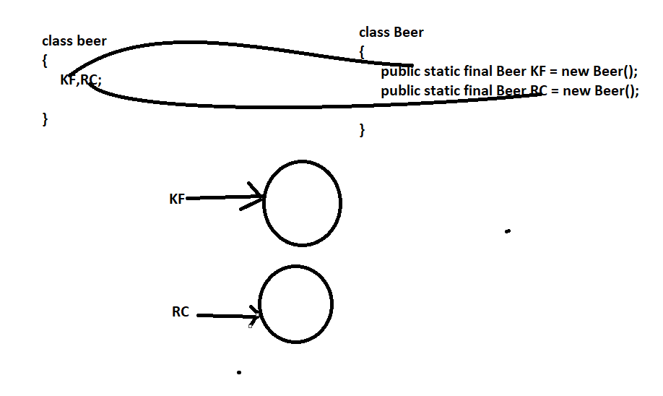

Slide 3
Enum Declaration and Usage :
Enum Beer
{
KF,KO,RC,FO;
}
class Test{
psv main(String[] args){
Beer b = Beer.RC;
sopln(b); // RC
}
}
Every enum constant is always public static Final and Hence we can access enum constant by using enum name
Note
Inside enum toString method is internally implemented to return name of the constant
We can declare enum either within a class or outside of the class But not inside a method
If we are trying to declare inside a method then we will get compiletime error saying enum types must not be local

Slide 4
enum x
{
}
Class y{
}
Class x
{
enum y{
}
}
All above are valid
=============
Class x
{
Psv m1(){
enum y{} // Not valid
}
}
CE : enum types must not be local

Slide 5
If we declare enum outside the class then applicable modifiers are
public,default ,strictfp
2. If we declare enum inside the class then applicable modifiers are :
public ,default,strictfp,private, protected and static.
Enum vs Switch:
Until 1.4 version the allowed arguments type for the switch statements are Byte, short,char,int But from 1.5 v onwards
Corresponding wrapper classes and enum types are allowed . From 1.7 version onwards String is also allowed
Hence from 1.5 version onwards we can pass enum types as arguments to switch statement .

Slide 6
package practuce1;
enum Beer{
KF,KO,RC,FO
}
public class TestDemo1 {
public static void main(String[] args) {
Beer b = Beer.RC;
switch(b) {
case KF : System.out.println("It is the childrens brand ");
break;
case KO: System.out.println("It is too Light ");
break;
case RC: System.out.println("It is Not that much kick ");
break;
case FO: System.out.println("Buy one Get 1 free ");
}
}
}
// Output : It is Not that much kick

Slide 7
If we pass enum type as argument to switch statement then every case level should be valid enum constant otherwise we will get compile time error .
Switch(b){
Case kF:
Case KO:
Case RC:
Case FO:
Case KALYANI:
} // unqualified enumeration constant name required
Enum vs Inheritance :
Every enum is always direct child class of java.lang .Enum and hence our enum can’t extend anyother enum because java won’t provide support for multiple Inheritance .
Evry enum is always final implicitly and hence for our enum we can’t create child enum .
Because of above reasons we can conclude Inheritance concept not applicable for enum explicitly and hence we can’t use extends keyword for enum .

Slide 8
enum x
{
}
enum y extends x{} //not valid
enum y extends java.lang.Enum{} // not Valid
class x{}
Enum y extends x{} // not valid
===========================================
Enum x{}
class y extends x{}
CE 1: can not inherit from final x .
CE2: enum types are not extensible .
Any Way enum can implement any number of interfaces .
Interface x{}
enum y implements x{}

Slide 9
Java.lang.Enum
Every enum in java is the direct child class of java.lang.Enum and Hence this class acts as base class for all java Enum
It is an abstract class and it is the direct child class of Object
It implements serializable and comparable interface
Values() :
Every enum implicitly contains values method to list out all values present inside enum
package practuce1;
enum Beer{
KF,KO,RC,FO
}
public class TestDemo1 {
public static void main(String[] args) {
Beer[] b = Beer.values();
for(Beer b1: b)
System.out.println(b1); }
}
Note
Values method not present in java.lang.enum and Object classes Enum keyword implicity provides this method .

Slide 10
Ordinal() Method:
Inside enum order of constants is important and we can represent this order by using ordinal value we can find ordinal value of ordinal constant by using odinal method == public final int ordinal();
Ordinal value is zero based like array index .
package practuce1;
enum Beer{
KF,KO,RC,FO
}
public class TestDemo1 {
public static void main(String[] args) {
Beer[] b = Beer.values();
for(Beer b1: b)
System.out.println(b1+"===="+b1.ordinal());
}
}
Output d
KF====0
KO====1
RC====2
FO====3

Slide 11
Speciality of java enum .
In old languages enum we can take only constants . But in java enum in addition to constants we can take methods costrutors and normal variable etc.. Hence java enum is more powerful then old languages enum .
Even inside Java enum we can declare main method and we can run enum class directly from command prompt
enum fish
{
STAR,GUPPY,GOLD
public static void main(String[] args){
sopln(“Enum Main Method ”)
}
}
Javac fish.java
Java fish
// output
Enum main Method
Note :
In addition to constant if we are taking any extra member like a method then list of constant should be in the first line and should ends with semi colon .
2. An empty enum is java valid syntax
enum fish{} = = = // this is valid

Slide 12
enum fish{
STAR , GUPPY; // semi colon is mandatory
public void m(){}
}
enum Fish{
STAR,GUPPY
public void m(){}
}
// This is not allowed
enum Fish{
public void m1(){
}
STAR,GUPPY; // THIS IS NOT VALID
}
========================================================================================
Inside enum if we are taking any extra member like a method compulsory the first line should contain list constants atleast semi colon ;
enum {
public void m(){} // this is not valid
}
enum fish{
;
public void m(){} // this is valid
}

Slide 13
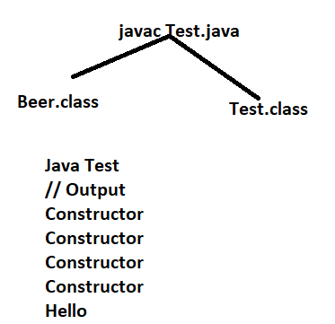
Enum vs Constructor
An enum can contain constructor enum constructor will be executed separately for every enum constant at the time of enum class loading automatically .
Example :
enum Beer{
kF,KO,RC,FO;
Beer()
{
sopl(“constructor”);
} }
class Test {
p s v main(String[] args)
{
Beer b = Beer.RC; == line 1
sopln(“HELLO !”);
}
}

Slide 14
If we comment line then output is Hello .
We can’t create enum objects directly and hence we can’t invoke enum constructor directly
Beer b = new Beer() // CE enum types may not be instantiated .
NOTE:
KF = public static final Beer KF = new Beer();
KF(70) == public static final Beer KF = new Beer(70);

Slide 15
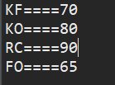
Example Of Enum :
package practuce1;
enum Beer{
KF(70),KO(80),RC(90),FO;
int price;
Beer(int price){
this.price = price;
}
Beer(){
this.price = 65;
}
public int getPrice() {
return price;
}
}
public class TestDemo1 {
public static void main(String[] args) {
Beer[] b = Beer.values();
for(Beer b1: b)
System.out.println(b1+"===="+b1.getPrice());
}
}

Slide 16
Inside enum we can declare methods but should be concrete methods only and we can’t declare abstract methods .
Case 1
Every enum constants represents an object of the type enum hence whatever methods we can apply on normal java Objects , can be applicable on enum constants also .
Beer.KF.equals(Beer.RC);
Beer.KF.hashCode()>Beer.RC.hashCode();
Beer.KF<Beer.RC ; // not valid
Beer.KF.Ordinal()<Beer.RC.Ordinal();
Case 2
If we want to use any class or interface directly from outside package then the required import is normal import .
If we want to access static members without class name then the required import is static import.
Import static java.lang.Math.sqrt;
Import java.util.AL;
Class Test
{
p s v main(String[] args){
AL l = new AL();
sopln(sqrt(4));
}
}

Slide 17
package pack1 public enum Fish{ STAR,GUPPY; } | package pack2 public class Test1 { psv main(String[] args){ Fish f = Fish.GUPPY; sopln(f) } } The required import is : Import pack1.Fish; or Import pack1.*; | package pack3 public class Test1 { psv main(String[] args){ sopln(STAR) } } The required import is : Import static pack1.Fish.STAR; or Import static pack1.Fish.*; | package pack4 public class Test1 { psv main(String[] args){ Fish f = Fish.GUPPY; sopln(GUPPY) } } The required import are : Import pack1.Fish; or Import pack1.*; Import static pack1.Fish.GUPPY Import static pack1.Fish.*;

Slide 18

Case 3
package practuce1; enum Color{ BLUE,RED,GREEN; public void info() { System.out.println("Universal color"); } } public class TestDemo1 { public static void main(String[] args) { Color[] c = Color.values(); for(Color c1: c) c1.info(); } } | package practuce1; enum Color{ BLUE,RED{ public void info() { System.out.println("Dangerous color"); // Specific //implementaion } },GREEN; public void info() { System.out.println("Universal color"); } } public class TestDemo1 { public static void main(String[] args) { Color[] c = Color.values(); for(Color c1: c) c1.info(); } } Universal color Dangerous color Universal color

Slide 19
enum vs Enum vs Enumeration
enum
enum is a keyword in java which can be used to define a group of named constants
Enum :
Enum is a class in java present in java.lang package every enum in java should be direct child class of Enum class . Hence this class acts as base class for all java enums
Enumeration
Enummeration is an interface present in java.util package we can use enumeratcion object to get object one by one from the collection .

