Slide 1
Garbage Collection :-
In old languages like c++ programmer is responsible to create new objects and to destroy useless objects . Usually Programmer taking very much care while creating objects and neglecting destruction of useless Objects . Because of this negligence at certain point for creation of new objects sufficient memory may not be available (because total memory filled with useless objects only ).And total application will be down with memory problems . Hence Out of memory Error is very common problem in old languages like c++.
But In java programmer is responsible only for creation of objects and programmer is not responsible to destroy useless objects .SUN people provided one assistant to destroy useless objects this assistant is always running in the background(demon thread) and destroy useless objects jus because of this assistant the chance of failing java programme with memory problem is very very low . This assistant is nothing but Garbage collector . Hence the main objective of garbage collector is to destroy useless objects (i.e. garbage collection)

Slide 2
The ways to make an object eligible for gc :
Even though programmer is not responsible to destroy useless objects . It is highly recommended to make an object eligible for gc if it is not required .
An object is said to be eligible for gc if and only if it doesn’t contain any reference variable .
The following are various ways to make an object eligible for GC:
I. Case 1 Nullify the reference variable : if an object no longer required then assign null to all its reference variables. Then that object automatically eligible for garbage collection . This approach is nothing but nullifying the reference variable .
Example :
Student s1 = new Student();
Student s2 = new Student(); No objects are eligible for GC .
S1 = null
here Both the objects are eligible for GC // Nullifying the references
S2 = null

Slide 3
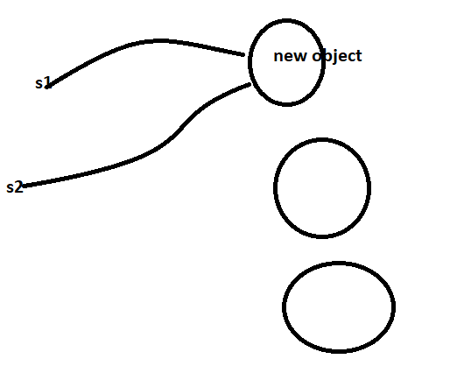
2 . Reassigning the reference variable :
If an object no longer required then reassign its reference variable to some other object then old object by default eligible for garbage collection.
Student s1 = new Student()
Student s2 = new Student() Here no objects are eligible for gc
S1 = new Student(); // here one object is eligible for GC
S2 = s1 ; // here both the objects are eligible for gc ;

Slide 4
3. Objects created inside a Method : -
The objects which are created inside a method are by default eligible for gc once a method completes .
class Test{ p s v main(String[] args){
m1();
//After completion of this method two objects are eligible for GC :
}
p s v m1(){
Student s1 = new Student();
Student s2 = new Student();
// since these are the local variable inside the method
}
}

Slide 5
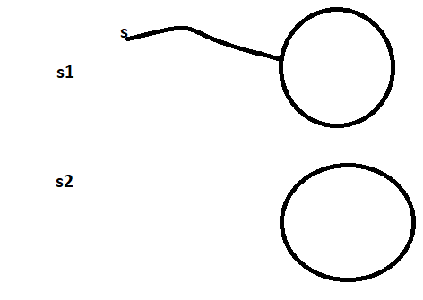
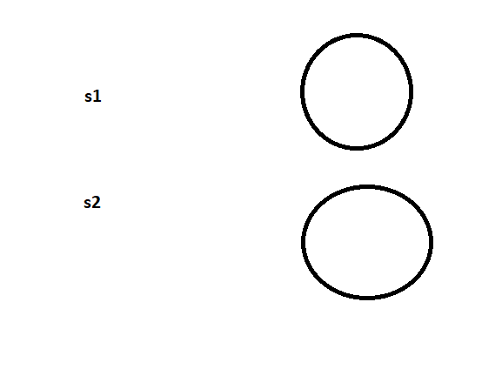
Example 2 :
class Test{
p s v main(String[] args){
Student s = m1(); // only one object is eligible for gc
}
public static Student m1(){
Student s1 = new Student();
Student s2 = new Student();
return s1;
}
}
Example 3 :
class Test{
p s v main(String[] args){
m1();
// Both the objects is eligible for gc
}
public static Student m1(){
Student s1 = new Student();
Student s2 = new Student();
return s1;
}
}

Slide 6
class Test{
static Student s;
psv main(){
m1();
// In this only one object is eligible for GC :
}
psv m1(){
s = new Student();
Student s1 = new Student();
}
}

Slide 7
4. Island of Isolation :
Class Test{
Test i ;
psv main(String[] args){
Test t1 = new Test();
Test t2 = new Test();
Test t3 = new Test();
t1.i = t2 ;
t2.i = t3;
t3.i = t1;
t1 = null;
t2 = null;
t3 = null;
}
}
No Objects are eligible for GC
Island
of
Isolation
i
t1
i
t2
All Are eligible for GC
i
t3

Slide 8
Conclusions:
If an object does n’t contain any reference variable then it is eligible for garbage collection always.
Eventhough Objects having references sometimes it is eligible for garbage collection.(if all references are internal references e.g. Island of Isolation . )
The ways for requesting JVM to run Garbage Collector :
Once we made an object eligible for GC it may not be destroyed immediately by garbage collector . Whenever JVM runs GC then only the objects will be destroyed but when exactly JVM runs Garbage collector we can’t expect it is Varied from JVM to JVM
Instead of waiting until JVM runs Garbage Collector we can request JVM to run Garbage collector programmatically but whether JVM accept our request or not there is no guarantee. But most of the times JVM accepts our request .
The following are two ways for requesting jvm to run garbage collector .
By using System class.
System class contains static method gc() for this purpose ======== System.gc();
2. By using Runtime Class :
Runtime r = Runtime.getRuntime();
Java application can communicate with JVM by using Runtime object . Runtime Class present in Java.lang package and It is a
Singleton class we can create Runtime Object by using
Runtime r = Runtime.getRuntime();

Slide 9
Once we got Runtime object we can call the following method on Runtime object
totalMemory();
It returns no. of `bytes of total Memory present in the heap i.e Heap size
FreeMemory() : It returns no. of bytes of free memory present in the heap;
gc() : Requesting JVM to run garbage collector.
class RuntimeDemo{
psv main(String[] args){
RunTime r = Runtime.getRuntime();
sopln(r.totalMemory()); // 100
sopln(r.freeMemory());
for(int I = 1;i<=10000;i++){
Date d = new Date();\
d = null;
}
Sopln(r.freeMemory());
r.gc();
Sopln(r.freeMemory());
}
}

Slide 10
gc(): method present in System class is a static method whereas gc() method present in Runtime class is instance method .
Q1 which of the following is valid way for requesting the JVM to run Grabage collector .
System.gc(); // valid
Runtime.gc(); // Not Valid
(New Runtime).gc(); // not Valid
RunTime.getRuntime().gc(); // Valid
Note:
It is convenient to use System class gc method when compared with Runtime class gc() method
With respect to performance . It is highly recommended to use Runtime class gc() method when compared with System class gc() method because System class internally call Runtime class gc() method
Class System {
public static void gc(){
Runtime.getRuntime().gc();
}
}

Slide 11
Finalization :
Just Before destroying an Object garbage collector calls finalize method to perform cleanup activities . Once Finalize method completes automatically garbage collector destroys that Object .
Finalize method present in Object class with the following declaration
protected void finalize () throws Throwable {}
We can override finalize method in our class to define our own cleanup activities.
Case 1 :
Just Before destroying an Object Garbage collector calls Finalize method on the object which is eligible for gc. Then the corresponding class Finalize method will be executed . If String Object eligible for gc . String class finalize method will be executed but not Test class finalize method
Example:
Class Test{
psv main(String[] args){
String s = new String(“Akhil”);
s = null;
System.gc();
sopln(“End Of main ”); // Output // End of main
}
public void finalize(){
sopln(“Finalize Method called ”)
}
}

Slide 12
In the above example String Object is eligible for gc and Hence String class finalize method got executed which has empty implementation . Hence , the output is // end of main
If we replace String object with Test Object then Test class finalize method will be executed In this case the ouput will be
// End of main
// finalize method called
or
// Finalize method called
// end of main
Case 2:
Based on our requirement we can call finalize method explicitly then it will be executed just like a normal method call and object won’t be destroyed

Slide 13
Example :
Class Test{
psv main(String[] args){
Test t = new Test();
t.finalize();
t.finalize();
t = null;
System.gc();
sopln(“End of main”);
}
public void finalize(){
sopln(“Finalize Method called ”);
}
}
In the above program finalize method got executed 3 times two times explicitly by the programmer and one time by the garbage collector In this case output is :
// output
Finalize method called
Finalize method called
End of main
Finalize method called

Slide 14
If we are calling finalize method explicitly then it will executed like a normal method call and object won’t be destroyed. If Garbage collector calls finalize method then Object will be destroyed .
Note :
Init() service() and destroy() methods are considered as lifecycle methods servlet . Just before destroying servlet object web container calls destroy method to perform clean up activities. But based on our requirement from init and service method then destroy method will be executed just like a normal method call . And Servlet object won’t be destroyed.
Case #3
If we are calling finalize method and while excuting that finalize method exception raises which is uncaught then JVM terminates our program abnormally raising that exception .
If garbage collector calls finalize method and while excuting that finalize method exception raises which is uncaught Then JVM ignores that exception and program executes normally .

Slide 15
Case 4:
Eventhough object eligible for gc multiple times but garbage collector calls finalize method only once .
Example:
class FinalizeDemo{
static FinalizeDemo s;
psv main(String[] args) throws Exception{
FinalizeDemo f = new FinalizeDemo();
System.out.println(f.hashCode());
f = null;
System.gc();
Thread.sleep(5000);
System.out.println(s.hashCode());
s = null;
System.gc();
Thread.sleep(10000);
System.out.println(“End of Main Method”);
}
public void finalize(){
System.out.println(“finalize method called ”);
s = this;
}
}

Slide 16
// Output
25724761
Finalize method called
25724761
End of Main Method
In the above program . Eventhough Object eligible for gc() two times but garbage collector calls finalize method only once .
Case 5:
We can’t expect the exact behavior of Garbage collector it is varied from JVM to JVM . Hence for the following question we can’t provide exact answers .
Q1 when exactly JVM runs garbage collector?
Q2 In which order garbage collector identifies eligible Objects ?
Q3 In which order garbage collector destroys eligible Objects?
Q4 whether garbage collector destroys all eligible Objects or not ?
Q5 what is algorithm followed by garbage collector etc .. ?
Note :
Whenever program runs with low memory then JVM runs garbage collector but we can’t expect exactly at what time .
Most of the Garbage collectors follows standard algorithm( the mark and sweep principle ) . It doesn’t mean every garbage follow the same algorithm

Slide 17
package practuce1;
public class TestDemo1 {
static int count = 0;
public static void main(String[] args) {
for(int i = 0;i<100; i++) { // if we increase the upper limit of I then GC will be called
TestDemo1 t = new TestDemo1();
t = null;
}
}
public void finalize() {
System.out.println("Finalize method Called !! "+ ++count);
}
}
If we keep on increasing this number at certain Point memory problem will be raised . Then JVM runs garbage collector . GC calls finalize method on every Object separately and destroys that Object .

Slide 18
Memory Leaks :
The Objects which are not using in our program and which are not eligible for gc . Such type of useless Objects are called memory leaks . In our program if memory leaks present then the program will be terminated by raising OutOfMemory error Hence if an Object no longer required . It is highly recommended to make that Object eligible for gc .
There are certain third party tool to find memory leaks.
The following are various third party memory management tools to identify memory leaks
HP OVO
HP J Meter
JProbe
Patrol
IBM Tivoli

