Slide 1
Inner Classes
Sometimes we can declare a class inside another class such type of classes are called inner classes .
Inner classes concept introduced in 1.1 version to fix GUI bugs as a part of Event handling . But because of powerful features and benefits of inner classes slowly programmers started using in regular programming also .
With out existing one type of object if there is no chance of existing another type of object then we should go for inner classes.
Example 1 : University consist of several departments . Without existing universities there is no chance of existing departments . Hence we have declare departments class inside University class .
class University{
class Department{
}
}
Example 2 : without existing car object there is no chance of existing engine object Hence we have to declare engine class inside car class.
class Car{
class Engine{
}
}

Slide 2
Example 3 :
Map is group of key value pairs and each key value pair is called an entry without existing map object there is no chance of existing Entry object Hence interface entry is defined inside map interface.
Interface Map{
interface Entry{
}
}
Note :
Without existing outer class object there is no chance existing inner class object .
The relation between outer class and inner class is not is- a relation and it is has- a relationship .Composition or Aggrigation .
Based on position of declaration and behavior all inner classes are divided into 4 types :
Normal or Regular Inner class
Method local Inner class
Anonymous Inner class
Static Nested class

Slide 3
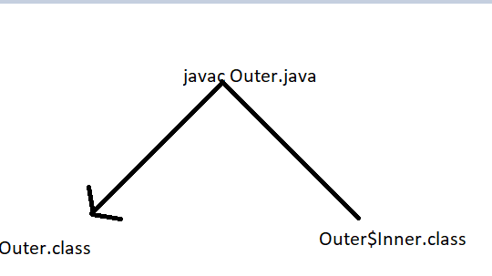
Normal or Regular Inner classes :
If we are declaring any named class directly inside a class without static modifier such type of inner classes are called normal or regular inner class.
Example 1
class Outer{
class Inner{
} Normal or Regular inner class.
}
Save as Outer.java
Java Outer === > RE : NoSuchMethodError: Main
Java Outer$Inner ==== > RE : NoSuchMethodError : Main

Slide 4
Example2 :
class Outer2{
class Inner{
}
public static void main(String[] args){
System.out.println("Inside the Outer class Main Method : ");
}
}
Javac Outer2.java ===== Outer2.classs / Outer2$Inner.class
Java Outer2 ===== Inside the outer class main method
Java Outer2$Inner === NoSuchMethodError : main

Slide 5
Inside Inner class we can’t declare any static members Hence we can’t declare main method and we can’t run inner class directly from cmd .
class Outer3{
class Inner{
public static void main(String[] args){
System.out.println("Inside the Inner class Main Method : ");
}
}
}
CE:

Slide 6
Case 1
Accessing Inner class code from static area of Outer class
class Outer4{
class Inner{
public void m1(){
System.out.println("Inner class method ");
}
}
public static void main(String[] args){
Outer4 o = new Outer4();
Outer4.Inner i = o.new Inner();
i.m1(); // === > shortcut code new Outer4().new Inner().m1();
}
}

Slide 7
Case2
Accessing Inner class code from Instance area of Outer class
class Outer{
class Inner{
public void m1(){
System.out.println("Inner class method : ");
}
}
public void m2(){
Inner i = new Inner();
i.m1();
}
public static void main(String[] args){
Outer o = new Outer();
o.m2();
}
}

Slide 8
Case3
Accessing Inner class code from Outside of Outer class
class Outer{
class Inner{
public void m1(){
System.out.println("Inner class method : ");
}
}
}
class Test{
public static void main(String[] args){
Outer o = new Outer();
Outer.Inner i = o.new Inner();
i.m1();
}
}

Slide 9
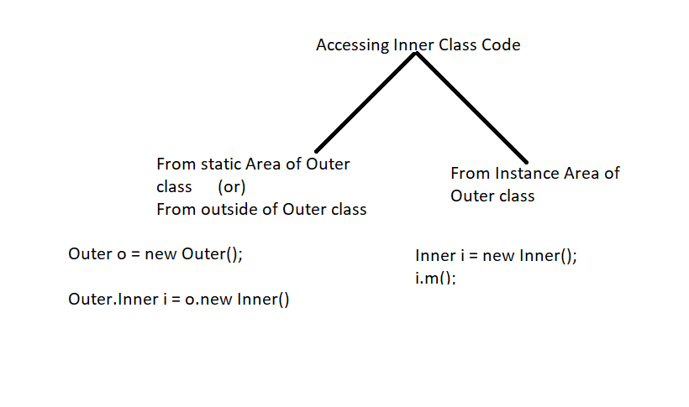
Summary :

Slide 10

From Normal or Regular Inner Class we can access both static and non-static members of Outer class directly .
class Outer{
int x = 10;
static int y = 20;
class Inner{
public void m1(){
System.out.println(x);
System.out.println(y);
}
}
public static void main(String[] args){
new Outer().new Inner().m1();
}
}

Slide 11

Within the inner class this always refers current Inner class Object . If we want to refer current Outer class Object we have use
OuterClassName.this
class Outer{
int x = 10;
class Inner{
int x = 100;
public void m1(){
int x = 1000;
System.out.println(x);
System.out.println(this.x);
System.out.println(Outer.this.x);
}
}
public static void main(String[] args){
new Outer().new Inner().m1();
}
}

Slide 12
For Outer classes Allowed modifiers are :
public,<default>,final,abstract,strictfp .
Inner class allowed modifiers are :
private , protected, static .
Nesting of Inner classes
Inside inner class we can declare another inner class i.e . Nesting of inner classes is possible .
class A{
class B{
class C{
public void m1(){
System.out.println("Inner Most Class Method : ");
}
}
}
}
class Test{
public static void main(String[] args){
A a = new A();
A.B b = a.new B();
A.B.C c = b.new C();
c.m1();
}
}

Slide 13
Method Local Inner Classes :
Sometimes we can declare a class inside a method such type of inner classes are called Method Local Inner classes .
II. The main purpose of method local inner class is to define method specific repeatedly required functionality .
III. Method local inner classes are best suitable to meet the nested method requirements.
IV. We can access method local inner classes only with in a method where we declare outside of the method we can’t access
Because of it’s less scope method local inner classes are most rarely used inner classes.

Slide 14

For Example
class Test{
public void m1(){
class Inner{
public void sum(int x, int y){
System.out.println("The Sum : "+(x+y));
}
}
Inner i = new Inner();
i.sum(10,20);
i.sum(1000,2000);
}
public static void main(String[] args){
Test t = new Test();
t.m1();
}
}

Slide 15

We can declare method Local inner class inside both instance and static method :
class Test{
int x = 10;
static int y = 20;
public void m1(){
class Inner{
public void m2(){
System.out.println(x);
System.out.println(y);
}
}
Inner i = new Inner();
i.m2();
}
public static void main(String[] args){
Test t = new Test();
t.m1();
}
}
If we declare inner class inside Instance method then from that method local Inner class we can access both static and non-static members of outer class directly .

Slide 16
If we declare Inner class Inside a static method then we can access only static members of Outer class directly from that method local Inner class .
class Test{
int x = 10;
static int y = 20;
public static void m1(){
class Inner{
public void m2(){
//System.out.println(x); == this will give error line 1
System.out.println(y);
}
}
Inner i = new Inner();
i.m2();
}
public static void main(String[] args){
Test t = new Test();
t.m1();
}
}
If we declare m1 method as static then at line 1 we will get compile time error saying nonstatic variable x can not be referenced from a static context .

Slide 17
From method local Inner class we can’t access local variables of the method in which we declare Inner class . If the local variable declared as final then we can access. // till jdk 7
For example : This works fine in JDK 8
class TestDemo1{
public void m1(){
int x = 10;
class Inner{
public void m2(){
System.out.println(x);
}
}
Inner i = new Inner();
i.m2();
}
public static void main(String[] args){
TestDemo1 t = new TestDemo1();
t.m1();
}
}
If we declare x as final Then we won’t get any compile time error == till jdk 7 But now if we don’t use final it also works fine in later versions

Slide 18
Consider the following code:
class Test{
int i = 10;
static int j = 20;
public void m1(){
int k = 30;
final int m = 40;
class Inner{
public void m2(){
// Line 1
}
}
}
}
At line 1 which of the following variables we can access directly :
JDK 1.7 or earlier == I,j,k
Jdk 1.8 or later === All are accessible
If we declare m1 method as static then at line which variables we can access directly .
J,m

Slide 19
If we declare m2 method as static then which variables are accessible at line 1 :
We will get compiletime error as Inside Inner class we can’t have static members .
Applicable modifiers for method local Inner classes are final , abstract strictfp . If we are trying to apply any other modifier then we will get compile time error .

Slide 20
Anonymous Inner Class
Sometimes we can declare inner class without name such type of Inner classes are called Anonymous Inner classes .
The main purpose of Anonymous class is just for instant use (Onetime usage)
Based on declaration and behaviour there are three types of Anonymous classes .
Anonymous Inner class that extends a class
Anonymous Inner class that implements an interface
Anonymous inner class that defined inside arguments .
Anonymous Inner class that extends a class :
Generated .class files are : Popcorn.class, AnonymousClassDemo.class, AnonymousClassDemo$1.class AnonymousClassDemo$2.class
Popcorn p = new Popcorn(); Just we are creating new popcorn Object
Popcorn p = new Popcorn(){
};
We are declaring a class that extends Popcorn without name (Anonymous Inner class )
for that child class we are creating an object with parent reference

Slide 21
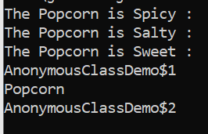
class Popcorn{
public void taste(){
System.out.println("The Popcorn is Salty : ");
}
}
class AnonymousClassDemo{
public static void main(String[] args){
Popcorn p = new Popcorn(){
public void taste(){
System.out.println("The Popcorn is Spicy : ");
}
};
p.taste();
Popcorn p1= new Popcorn();
p1.taste();
Popcorn p2 = new Popcorn(){
public void taste(){
System.out.println("The Popcorn is Sweet : ");
}
};
p2.taste();
System.out.println(p.getClass().getName());
System.out.println(p1.getClass().getName());
System.out.println(p2.getClass().getName());
}
}

Slide 22
Popcorn p = new Popcorn(){
public void taste(){
sopln(“Spicy”);
}
}
We are declaring a class that extends popcorn without name (Anonymous Inner class). In that child class we are overriding taste method . For that child class we are creating an object with Parent reference.
Defining a thread by extending Thread class.

Slide 23
Normal Class Approach | Anonymous Inner class Approach
class MyThread extends Thread{ public void run(){ for(int i = 0;i<10;i++){ System.out.println("Child Thread"); } } } Class ThreadDemo{ public static void main(String[] args){ MyThread t = new MyThread(); t.start(); for(int i = 0;i<10;i++){ System.out.println("Main Thread"); } } } | class ThreadDemo{ public static void main(String[] args){ Thead t = new Thread(){ public void run(){ for(int i =0;i<10;i++) System.out.println("Child Thread"); } } t.start(); for(int i = 0;i<10;i++) System.out.println("Main Thread ! "); } }

Slide 24
Anonymous Inner class That implements an Interface defining a thread by implementing Runnable :
Normal Class Approach | Anonymous Inner Class Approach
class MyRunnable implements Runnable{ public void run(){ for(int i= 0;i<10;i++) System.out.println("Child Thread"); } } class ThreadDemo{ public static void main(String[] args){ MyRunnable r = new MyRunnable(); Thread t = new Thread(r); t.start(); for(int i =0;i<10;i++) System.out.println("Main Thread ! "); } } | class ThreadDemo{ public static void main(String[] args){ Runnable r = new Runnable(){ public void run(){ for(int i = 0;i<10;i++) System.out.println("Child Thread !"); } }; Thread t = new Thread(r); t.start(); for(int i = 0;i<10;i++) System.out.println("Main Thread !! "); } }

Slide 25
Anonymous Inner class that defined inside arguments
class ThreadDemo{
public static void main(String[] args){
new Thread(new Runnable(){
public void run(){
for(int i = 0;i<10;i++)
System.out.println("Child Thread !! ");
}
}
).start();
for(int i = 0;i<10;i++)
System.out.println("Main Thread !! ");
}
}

