Slide 1
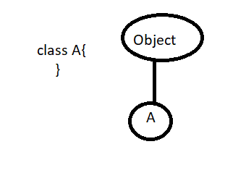
Java.lang Package
Introduction
For writing any java program whether it is simple or complex the most commonly required classes and interfaces are grouped into a separate package which is nothing but java.lang package .
We are not required to import java.lang package explicitly because all classes and interfaces present in lang package by default available to every program .
Java.lang.Object
The most commonly required methods for every java class (whether it predefined class or customized class) are defined in a separate class which is nothing but Object class .
Every class in java is the child class of Object either directly or indirectly so that Object class methods by default available to every java class .Hence, Object class is considered as root of all java classes .
Note
If our class doesn’t extend any other class then only our class is the direct child class of Object .

Slide 2
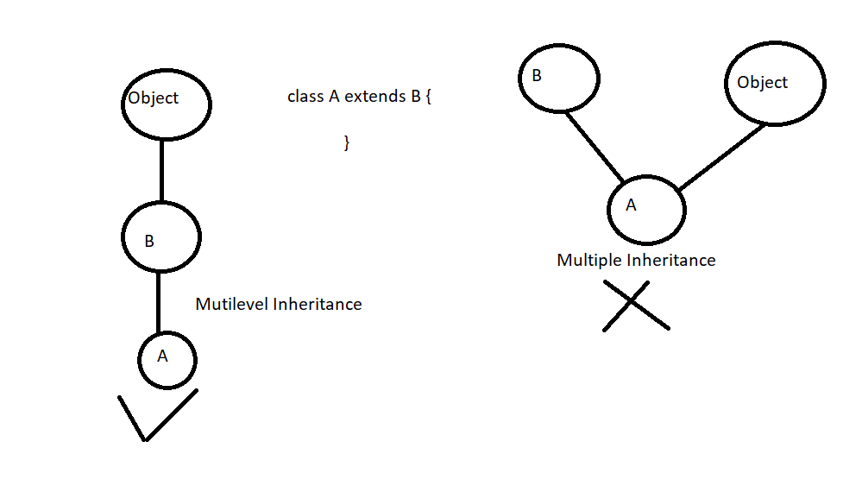
If our class extends any other class then our class is indirect child class of object.
Conclusion
Either directly or indirectly java won’t provide support for multiple Inheritance with respect to classes .
Object class defines the following 11 methods .
Public String toString()
public native int hashCode()
public Boolean equals()
protected native Object clone() throws CloneNotSupportedException
protected void finalize() throws Throwable
public final Class getClass()

Slide 3
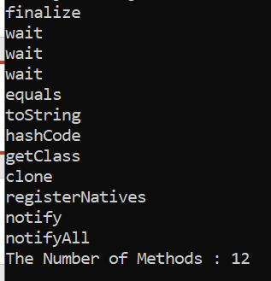
public final void wait() throws InterruptedException
public final native void wait(long ms) throws InterruptedException
public final void wait(long ms, int ns) throws InterruptedException
public native final void notify()
public native final void notifyAll()
// Getting methods of java.lang.Object class
import java.lang.reflect.*;
class Test{
public static void main(String[] args)throws ClassNotFoundException{
Class c = Class.forName("java.lang.Object");
Method[] m = c.getDeclaredMethods();
int count = 0;
for(Method m1: m){
count++;
System.out.println(m1.getName());
}
System.out.println("The Number of Methods : "+ count);
}
}

Slide 4
Strictly speaking java.lang.Object class contains 12 methods
The extra method is registerNatives
Private static native void registerNatives();
Note :
This method internally required for Object class and not available to the child classes and Hence we are not required to consider this method .
toString() Method .
We can use toString() method to get String representation of an Object .
String s = Obj.toString();
Whenever we are trying to print object reference internally toString() method will be called .
Example
Student s = new Student();
Sop(s) ==➔ sop(s.toString());
If our class doesn’t contains toString Method then Object class toString() method will be executed

Slide 5

Example:
class Student{
String name;
int rollno;
Student(String name,int rollno){
this.name = name;
this.rollno = rollno;
}
public static void main(String[] args){
Student s1 = new Student("Akhil",10);
Student s2 = new Student("Manoj Kumar",20);
System.out.println(s1);
System.out.println(s2);
}
}
public String toString(){
return getClass().getName()+”@”+Integer.toHexString(hashCode());
}
In the above example Object class toString method is executed which implemented as follows :
public String toString() {
return getClass().getName() + "@" + Integer.toHexString(hashCode());
} // ClassName@HashCode in hexadecimal form

Slide 6

Based on our requirement we can override toString() Method to provide our own String representation
For example :
Whenever we are trying to print Student Object reference to print his name and roll no we have to override toString() method as follows .
public String toString(){
//return name+"--"+rollno;
return "This is Student with name : "+name+" and RollNo : "+rollno;
}
Note:
In all wrapper classes,Collection classes , String class, StringBuffer and StringBuilder classes toString is overridden for meaningful String representation . Hence it is highly recommended to override in our class also .

Slide 7
import java.util.ArrayList;
class Demo{
public String toString(){
return "test";
}
public static void main(String[] args){
String s = new String("Akhil Kumar");
System.out.println(s);
Integer i = new Integer(10);
System.out.println(i);
ArrayList l = new ArrayList();
l.add("A");
l.add("B");
System.out.println(l);
Demo d = new Demo();
System.out.println(d);
}
}

Slide 8
2 . hashCode() Method :
For every Object a unique number generated by jvm which is nothing but hashcode. hashCode won’t represent address of object jvm will use hashCode while saving object into hashing related data structures like hashtable , HashMap,HashSet etc.. The main advantage of saving objects based on hashCode is search operation will become easy . The most powerful search algorithm upto today is Hashing .
Public native int hashCode(); : If you are giving the chance to object class hashCode method It will generate hashCode based on address of the object . It doesn’t mean hashCode represents address of the object . Based on our requirement we can override hashCode() method in our class to genearate our own hashCode
Overriding hashCode() method is said to be proper if and only if for every object we have to generate a unique number as hashCode().
Improper way | Proper way
class Student{ /* -- -- */ public int hashCode(){ return 100; } /* -- -- */ } : It is improper way of overriding hashCode() method because for all students Objects we are generating same number as hashCode() | class Student{ /* -- -- */ public int hashCode(){ return rollno; } /* -- -- */ } : This is proper way of overriding hashCode() method because we are generating a different number (hashCode) for every Object

Slide 9



toString() vs hashCode()
If we are giving the chance to object class toString() method it will internally calls hashCode method . If we are overriding toString method. Then our toString() method may not call hashCode() method
Default toString of Object class
class Demo{ int i; Demo(int i){ this.i = i; } public static void main(String[] args){ Demo d1 = new Demo(10); Demo d2 = new Demo(20); System.out.println(d1); System.out.println(d2); } } | class Demo{ int i; Demo(int i){ this.i = i; } public int hashCode(){ return i; } public static void main(String[] args){ Demo d1 = new Demo(10); Demo d2 = new Demo(100); System.out.println(d1); System.out.println(d2); } } | class Demo{ int i; Demo(int i){ this.i = i; } public String toString(){ return i+" "; } public int hashCode(){ return i; } public static void main(String[] args){ Demo d1 = new Demo(10); Demo d2 = new Demo(100); System.out.println(d1); System.out.println(d2); } }
Object toString() Object hashCode() | Object toString() Demo hashCode() | Demo toString()

Slide 10
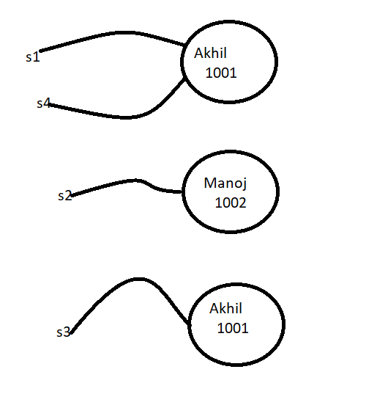

Equals() Method
We can use equals method to check equality of two objects .
Example obj1.equals(obj2)
If our class doesn’t contain equals method then object class equals method will be executed .
class Student{
String name;
int rollno;
Student(String name,int rollno){
this.name = name;
this.rollno = rollno;
}
public static void main(String[] args){
Student s1 = new Student("Akhil",1001);
Student s2 = new Student("Manoj",1002);
Student s3 = new Student("Akhil",1001);
Student s4 = s1;
System.out.println(s1.equals(s2));
System.out.println(s1.equals(s3));
System.out.println(s1.equals(s4));
}
}
In the above example object class equals method got executed which is meant for reference comparison(address comparison) i.e. if two references pointing to the same object then only .equals() method returns true .

Slide 11
1. Base on our requirement we can override equals() method for content comparison .
2. While overriding equals() method for content comparison we have to take care about the following
1. what is the meaning of equality (i.e. whether we have to check only names only rollnos or both )
2. If we are passing different types of object then our equals method should not raise classCastException (i.e . We have to handle classcastException to return false)
3. if we are passing null argument then our equals method should not raise NullPointerException(i.e. we have to handle NPE to return false).
The following is the proper way of overriding equals() method for Student class content Comparison
Simplified version of equals() method
@Override
public boolean equals(Object obj){
try{
Student s = (Student)obj;
if(tname.equals(s.name) && rollno == s.rollno)
return true;
return false;
}catch(ClassCastException e){
return false;
}catch(NullPointerException e){
return false;
}
}

Slide 12
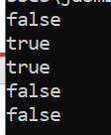
class Student{
String name;
int rollno;
Student(String name,int rollno){
this.name = name;
this.rollno = rollno;
}
@Override
public boolean equals(Object obj){
try{
Student s = (Student)obj; // CCE
if(this.name.equals(s.name) && this.rollno == s.rollno) // NPE
return true;
return false;
}catch(ClassCastException e){
return false;
}catch(NullPointerException e){
return false;
}
}
public static void main(String[] args){
Student s1 = new Student("Akhil",1001);
Student s2 = new Student("Manoj",1002);
Student s3 = new Student("Akhil",1001);
Student s4 = s1;
System.out.println(s1.equals(s2));
System.out.println(s1.equals(s3));
System.out.println(s1.equals(s4));
System.out.println(s1.equals("Akhil"));
System.out.println(s1.equals(null));
}
}

Slide 13
More simplified version of equals method :
@Override
public boolean equals(Object obj){
if(obj instanceof Student){
Student s = (Student)obj;
if(name.equals(s.name) && rollno == s.rollno)
return true;
}
return false;
}
Note
To make above equals method more efficient we have to write the following code at the beginning inside equals method .
if(obj==this)
return true;
According to this if both references pointing to the same object then without performing any comparison .equals() method returns true directly .

Slide 14


String | StringBuffer
class Demo{ public static void main(String[] args){ String s1 = new String("Durga"); String s2 = new String("Durga"); System.out.println(s1==s2); System.out.println(s1.equals(s2)); } } | class Demo{ public static void main(String[] args){ StringBuffer sb1 = new StringBuffer("Durga"); StringBuffer sb2 = new StringBuffer("Durga"); System.out.println(sb1==sb2); System.out.println(sb1.equals(sb2)); } }

Slide 15
In String class .equals() method is overridden for content comparison Hence , even though the objects are different but if the content is same then .equals() method returns true .
In StringBuffer .equals() method is not overridden for content comparison . Hence, if Objects are different .equals() method returns false even though content is same .
getClass() Method
We can use getClass() method to get runtime class definition of an object
public final Class getClass(){}
By using this class Class object we can access class level properties like fully qualified name of the class methods information, constructors information etc..

Slide 16
For Example:
class Demo{
public static void main(String[] args){
Object o = new String("Akhil Kumar");
Class c = o.getClass();
System.out.println("Fully Qualified name of the class: "+c.getName());
Method[] m = c.getDeclaredMethods();
System.out.println("Methods Information ");
int count = 0;
for(Method m1: m){
System.out.println(m1.getName());
count++;
}
System.out.println("The number of Methods : "+ count);
}
}
Total methods of String class : 77

Slide 17
To display database vendor specific connection interface implemented classname
Connection con = DriverManager.getConnection();
System.out.println(con.getClass().getName());
Note:
After loading every .class file JVM will create an Object of the type java.lang.Class in the heap Area.
Programmer can use this class object to get class level information .
We can use getClass() method very frequently in reflections .
Finalize() Method
Just before destroying an object garbage collector calls finalize() method to perform cleanup activities . Once finalize method completes automatically garbage collector destroys that object .
Wait(), notify(),notifyAll() == Inter Thread Communication
We can use these methods for Inter Thread communication the thread which is expecting updation is responsible to call wait() method . Then , immediately the thread will enter into waiting state. The Thread which is responsible to perform updation, after performing updation the thread can call notify() method . The waiting thread will get that notification and continue its execution with those updates .

