Slide 1
Synchronization
I. Synchronised is a modifier applicable only for methods and blocks but not for classes and variables .
II. If multiple threads are trying to operate on the same java object then there may be a chance of data inconsistency problem
III. To overcome this problem we should go for synchronized keyword .If a method or block declared as synchronized then at a time only one thread is allowed to execute that method or block so that data inconsistency problem will be resolved.
The main advantage of synchronized keyword is we can resolve data inconsistency problem . But the main disadvantage of synchronized keyword is it increases waiting time of threads and creates performance problem . Hence if there is no specific requirements then it is not recommended to use synchronized keyword.
Internally synchronization concept is implemented by using lock .
Every object in java has a unique lock .
Whenever we are using synchronized keyword then only lock concept will come into the picture.
If a thread wants to execute synchronized method on the given object first it has to get lock of that object once thread got the lock then it is allowed to execute any synchronized method on that object
Once method execution completes automatically thread releases lock .
Acquiring and releasing lock internally taken care by jvm and programmer not responsible for this activity.
While a thread executing synchronized method on the given object the remaining threads are not allowed to execute any synchronized method simultaneously on the same object but the remaining threads are allowed to execute non-synchronized method simultaneously .

Slide 2
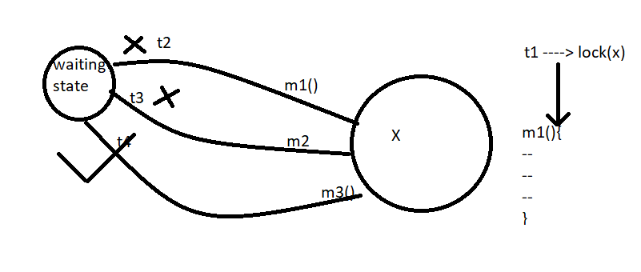
For example :
class Test{
synchronized m1(){
}
synchronized m2(){}
m3()
}
Object level locking = synchronized
Lock concept is implemented based on object but
Not based on method

Slide 3
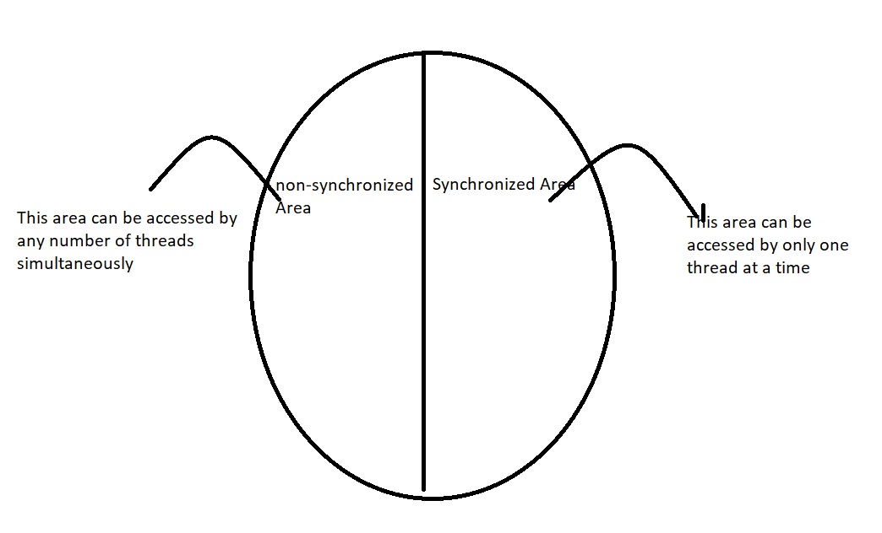
Class X{
synchronized {
wherever we are performing update operation (Add/Remove/delete/replace)
where state of object is changing
}
Non-synchronized{
wherever Object state won’t be changed like read operation
}
}
Object

Slide 4
Class ReservationSystem{
non-Synchronized checkAvailability(){
//just read operation
}
synchronized bookTicket(){ //update
}
}

Slide 5
class Display{
public synchronized void wish(String name){
for(int i = 0;i<10;i++){
System.out.print("Good Morning !!: ");
try{
Thread.sleep(2000);
}catch(InterruptedException e){}
System.out.println(name);
}
}
}
class MyThread extends Thread{
Display d;
String name;
MyThread(Display d, String name){
this.name = name;
this.d = d;
}
public void run(){
d.wish(name);
}
}
class SynchronizedDemo{
public static void main(String[] args){
Display d = new Display();
MyThread t1 = new MyThread(d,"Dhoni");
MyThread t2 = new MyThread(d,"Yuvraj");
t1.start();
t2.start();
}
}
If we are not declaring wish method as synchronized then both threads will be executed simultaneously and Hence we will get irregular output .

Slide 6
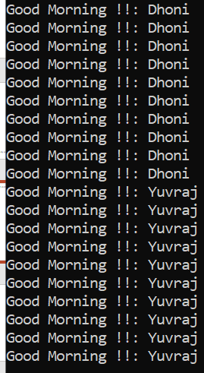

If we declare wish method as synchronized then at a time only one thread is allowed to execute wish method on the given display object Hence we will get regular output .
Regular output
Irregular Output

Slide 7
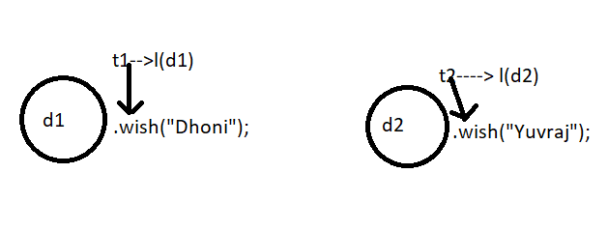
Case Study:
Display d1 = new Display();
Display d2 = new Display();
MyThread t1 = new MyThread(d1,"Dhoni");
MyThread t2 = new MyThread(d2,"Yuvraj");
t1.start();
t2.start();
Even though wish method is synchronized we will get irregular output because threads are operating on different java objects
Conclusion
If multiple threads are operating on same java object then synchronization is required .
If multiple threads are operating on multiple java object then synchronization is not required.

Slide 8
Class Level Lock
Every class in java has a unique lock which is nothing but class-level lock
If a thread wants to execute a static synchronized method then thread required class level lock . Once thread got class level lock then it is allowed to execute any static synchronized method of that class.
Once method execution completes automatically thread releases a lock .
While a thread executing static synchronized method the remaining threads are not allowed to execute static synchronized method of that class simultaneously but remaining threads are allowed to execute the following method simultaneously .
I. Normal static method
II. Sychronized instance methods
III. Normal instance methods

Slide 9
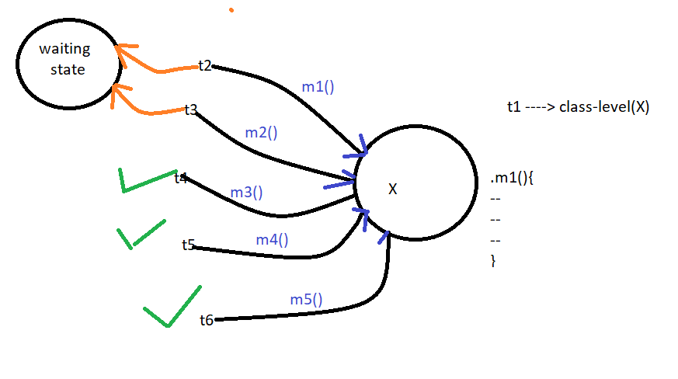
Class X{
static sync m1(){}
static sync m2(){}
static m3(){}
sync m4(){}
m5(){}
}

Slide 10
class Display{
public synchronized void displayn(){
for(int i = 1;i<=10;i++){
System.out.print(i);
try{
Thread.sleep(2000);
}catch(InterruptedException e){}
}
}
public synchronized void displayc(){
for(int i = 65;i<=75;i++){
System.out.print((char)i);
try{
Thread.sleep(2000);
}catch(InterruptedException e){}
}
}
}
class MyThread1 extends Thread{
Display d;
MyThread1(Display d){
this.d = d;
}
public void run(){
d.displayn();
}
}

Slide 11
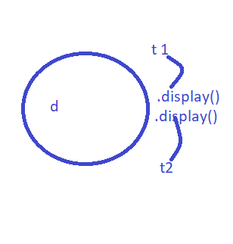
class MyThread2 extends Thread{
Display d;
MyThread2(Display d){
this.d = d;
}
public void run(){
d.displayc();
}
}
class SynchronizedDemoMultiThread{
public static void main(String[] args){
Display d = new Display();
MyThread1 t1 = new MyThread1(d);
MyThread2 t2 = new MyThread2(d);
t1.start();
t2.start();
}
}

Slide 12
Synchronized Blocks
If very few lines of the code required synchronization then it is not recommended to declare entire method as synchronized we have to enclose those few lines of the code by using synchronized block .
The main advantage of synchronized block over synchronized method is it reduces waiting time of threads and improves the performance of the system .
We can declare synchronized block as follows
To get lock of current object Sychronized(this){ --- ----- } If a thread got lock of current object then only it is allowed to execute this Area. | 2.To get Lock of Particular object‘b’ Sychronized(b){ ------ ----- } If a thread got the lock of particular Object ‘b’ then only it is allowed to execute this area. | 3. To get the class Level lock Synchronized(Display.class){ ------ -----} If a thread got class level lock of“display” class then only it is allowed to execute this area .

Slide 13
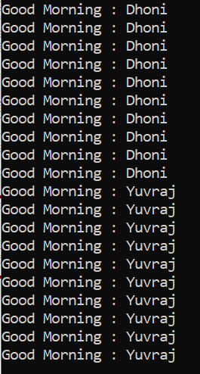
class Display{
public void wish(String name){
;;;;;;;;;;;;;; // 1 lakh lines of code
synchronized(this){
for(int i = 1;i<=10;i++){
System.out.print("Good Morning : ");
try{
Thread.sleep(2000);
}catch(InterruptedException e){
}
System.out.println(name);
}
};
;;;;;;;;;;;;;; // 1 lakh lines of code
}
}
class MyThread extends Thread{
Display d;
String name;
MyThread(Display d,String name){
this.d = d;
this.name = name;
}
public void run(){
d.wish(name);
}
}
class SynchronizedBlockDemo{
public static void main(String[] args){
Display d = new Display();
MyThread t1 = new MyThread(d,"Dhoni");
MyThread t2 = new MyThread(d,"Yuvraj");
t1.start();
t2.start();
}
}

Slide 14
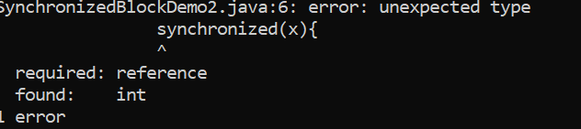
Conclusion:
Lock concept applicable for object types and class types but not for primitives Hence we can’t pass primitive as argument to synchronized block otherwise we will get compile time error saying Unexpected type found : int required : reference
If try to pass primitive in synchronized block
We can use class level lock by passing Display.class inside the synchronized method as parameter

Slide 15
FAQ’s
Q1. What is synchronized keyword where we can apply ?
modifier applicable for method or blocks but not for variables and class
Q2. Explain advantage of synchronized keyword ?
to resolve data inconsistency problems
Q3.Explain disadvantage of synchronized keyword ?
Only single thread is allowed to execute which causes performance problem
Q4. What is Race condition ?
if multiple threads are operating simultaneously on same java object then there may be a chance of data inconsistency problem this called race condition . We can overcome this problem by using synchronized keyword.
Q5. What is object lock and when it is required ?
Q6. What is class level lock and when it is required ?
Q7. what is the difference between class level lock and object level lock ?
Q8. while a thread executing synchronized method on the given object is the remaining threads are allowed to execute any other synchronized method simultaneously on the same object .
No
Q9 what is synchronized block?
Q10.How to declare synchronized block to get a lock of current object ?
Q11.How to declare Synchronized block to get class level lock ?
Q12. What is the advantage of Synchronized block over synchronized method ?
Q13. Is a Thread can acquire multiple locks simultaneously?

Slide 16
Ans 13 = Yes of course from different object
Example
class x{
public synchronized void m1(){
// Here Thread has lock of 'X'
Y y = new Y();
synchronized(y){
//Here Thread has the lock of 'X' and 'Y';
Z z = new Z();
synchronized(z){
// Here Thread has the lock of 'X','Y' and 'Z'
}
}
}
}
X x = new X();
x.m1();

Slide 17
Q . What is Sychronized statement ?
The statements present inside the synchronized block or synchronized method are called synchronized statements.

Slide 18
Inter Thread Communication:
1. Two threads can communicate with each other by using wait(), notify() and notifyAll() method .
The thread which is expecting updation is responsible to call wait method then immediately the thread will enter into waiting state .
The thread which is responsible to perform updation, after performing updation it is responsible to call notify() method then waiting thread will get that notification and continue its execution with those updated items .
2. wait(), notify() and notifyAll() methods are present in Object class .
Why these methods are present in Object class but not in Thread class ?
Ans : Because thread can call these methods on any java object .
3. To call wait or notify or notifyAll methods on any object thread should be owner of that object i.e . The thread should has lock of that object i.e. the thread should be inside synchronized area . Hence we can call wait() notify and notifyAll() methods only from synchronized area . Otherwise we will get runtime Exception saying IllegalMonitorStateException
4. If a thread calls wait method on any object it immediately releases lock of that object and entered into waiting state .
If a thread calls notify method on any object it releases lock of that object but may not immediately except wait notify() and notifyAll() . There is no other method where thread releases a lock .

Slide 19
Method | Is Thread releases a lock ?
Yield() | No
Join() | No
Sleep() | No
Wait() | Yes
Notify() | Yes
notifyAll() | Yes

Slide 20
Which of the following is valid ?
If a thread calls wait() method immediately it will enter into waiting state without releasing any lock . == Invalid
If a thread calls wait() method it releases lock of that object but may not immediately === Invalid
If a thread calls wait() method on any object it releases all locks acquire by that thread and immediately entered into waiting state . == invalid
If a thread calls wait method on any object it immediately releases the lock of that particular object . And entered into waiting state . === Valid
If a thread calls notify() method on any object it immediately releases the lock of that object . == invalid
If a thread calls notify() method on any object it releases the lock of that object but my not immediately == Valid
What are various methods present inside object class related to ITC ?
public final void wait()throws InterruptedException
public final native void wait(long ms )throws IE
public final void wait(long ms,int ns)throws IE
public final native void notify()
public final native void notifyAll()
Note :
Every wait method throws InterruptedException which is checked Exception Hence whenever we are using wait method compulsory we should handle this Exception either by try catch or by throws keyword otherwise we will get CE

Slide 21
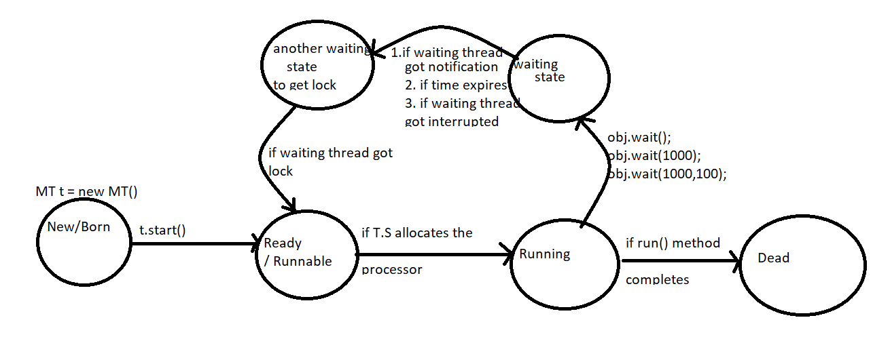

Slide 22
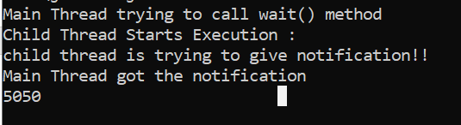
class ThreadB extends Thread{
int total = 0;
public void run(){
synchronized(this){
System.out.println("Child Thread Starts Execution : ");
for(int i = 1;i<=100;i++){
total +=i;
}
System.out.println("child thread is trying to give notification!! ");
this.notify();
}
}
}
class InterThreadCommDemo{
public static void main(String[] args) throws InterruptedException{
ThreadB b = new ThreadB();
b.start();
synchronized(b){
System.out.println("Main Thread trying to call wait() method");
b.wait();
System.out.println("Main Thread got the notification");
System.out.println(b.total);
}
}
}

Slide 23
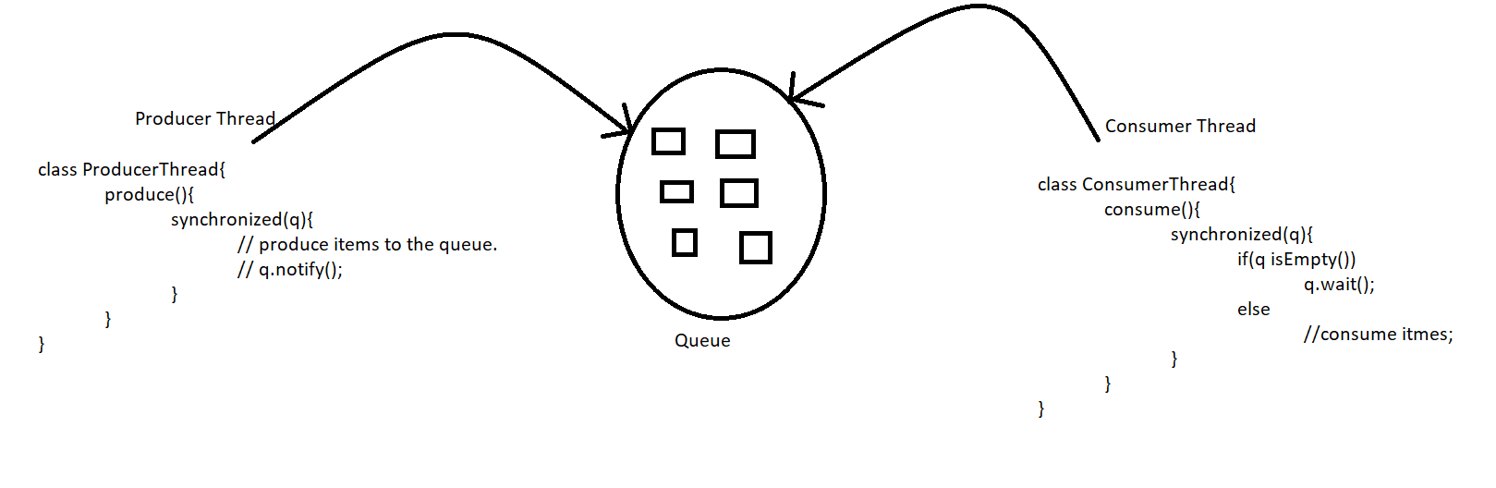
Producer Consumer Problem
Producer thread is responsible to produce items to the queue and consumer thread is responsible to consume items from the queue .
If queue is empty then consumer thread will call wait method and entered into waiting state
After producing items to the queue producer thread is responsible to call notify() method then waiting consumer will get that notification and continue its execution with updated items .

Slide 24
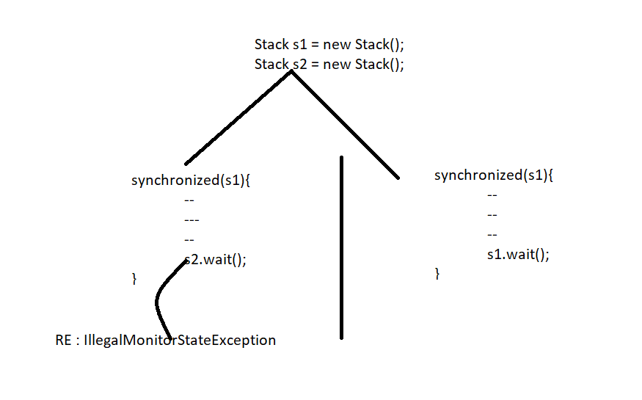
What is the difference between notify() and notifyAll() ?
We can use the notify() method to give the notification for only one waiting thread . If multiple threads are waiting then only one thread will be notify and the remaining threads have to wait for further notifications. Which thread will be notify() we can’t expect . It depends on JVM .
We can use notifyAll() to give the notification for all waiting threads of particular object eventhough multiple threads notified but execution will be performed one by one because threads require lock and only one lock is available .
On which object we are calling wait method thread required the lock of that particular object for example if we are calling wait method on s1 then we have to get lock of s1object but not s2 object

Slide 25
Deadlock:
If two threads are waiting for each other forever such type of infinite waiting is called deadlock.
Synchronized keyword is the only reason for deadlock situation Hence while using synchronized keyword we have to take special care .
There are no resolution techniques for deadlock but several prevention techniques are available .
DeadLock Example :
class DeadLockDemo extends Thread {
A a = new A();
B b = new B();
public void m1(){
this.start();
a.d1(b);
}
public void run(){
b.d2(a);
}
public static void main(String[] args){
DeadLockDemo t = new DeadLockDemo();
t.m1();
}
}

Slide 26
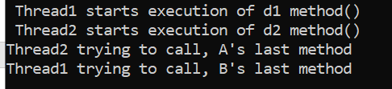
class A{
public synchronized void d1(B b){
System.out.println(" Thread1 starts execution of d1 method() ");
try{
Thread.sleep(5000);
}catch(InterruptedException e){}
System.out.println("Thread1 trying to call, B's last method");
b.last();
}
public synchronized void last(){
System.out.println("Inside B's last method !! ");
}
}
class B{
public synchronized void d2(A a){
System.out.println(" Thread2 starts execution of d2 method() ");
try{
Thread.sleep(5000);
}catch(InterruptedException e){}
System.out.println("Thread2 trying to call, A's last method");
a.last();
}
public synchronized void last(){
System.out.println("Inside A's last method !! ");
}
}

Slide 27
In the above program if we remove atleast one synchronized keyword then the program won’t entered into deadlock . Hence Synchronized keyword is the only reason for deadlock situation due to this while using synchronized keyword we have to take special care .
Deadlock vs Starvation :
Long waiting of a thread where waiting never ends is called deadlock
whereas long waiting of a thread where waiting ends at certain point is called starvation . For example low priority thread has to wait until completing all high priority threads .it may be long waiting but ends at certain point , which is nothing but starvation

Slide 28
Daemon Thread:
The Threads which are executing in the background are called daemon threads Example : Garbage collector , attach listener, signal dispatcher etc…
Purpose/Objective of Daemon Thread:
The main objective of daemon threads is to provide support for non-daemon threads (Main Thread ) for example if main thread runs with low memory then jvm runs GC to destroy useless objects so that number of bytes of free memory will be improved with this free memory main thread can continue it’s execution .
Usually daemon threads having low priority but based on our requirement daemon threads can run with high priority also .
public boolean isDaemon()
public boolean setDaemon(boolean b)
We can check daemon nature of thread by using isdaemon method of thread class
public boolean isDaemon()
We can change Daemon nature of thread by using setDaemon method .
But changing daemon nature is possible before starting of a thread only . After starting a thread if we are trying to change daemon nature then we will get RunTimeException saying IllegalThreadStateException

Slide 29
Default Nature of Thread :
By default main thread is always non daemon . And for all remaining thread the daemon nature will be inherited from parent to child i.e if parent thread is daemon then automatically child thread is also daemon and if parent is non-daemon then child thread is also non-daemon
It is impossible to change daemon nature of main thread because it is already started by jvm at beginning .
Daemon Thread Example:
class MyThread extends Thread{
}
class TestDemo{
public static void main(String[] args){
System.out.println(Thread.currentThread().isDaemon()); // false
//Thread.currentThread().setDaemon(true); // IllegalThreadStateException
MyThread t = new MyThread();
System.out.println(t.isDaemon()); // false
t.setDaemon(true);
System.out.println(t.isDaemon()); // true
}
}

Slide 30
Whenever last non-daemon thread terminates automatically all daemon threads will be terminated irrespective of their position
Example
class MyThread extends Thread{
public void run(){
for(int i = 0;i<10;i++){
System.out.println("Child Thread");
try{
Thread.sleep(2000);
}catch(InterruptedException e){}
}
}
}
class DaemonThreadDemo{
public static void main(String[] args){
MyThread t = new MyThread();
t.setDaemon(true); // line 1
t.start();
System.out.println("End of main Thread ");
}
}

Slide 31
If we are commenting line 1 both main and child threads are non-daemon . Hence both threads will be executed until their completion . If we are not commenting line 1 then main thread is non-daemon and child thread is daemon Hence whenever main Thread terminates automatically child thread will be terminated in this case output will be :
End of Main Thread Child thread | End of Main Thread | Child thread End of Main Thread
Green Thread:
Java multithreading concept is implemented by following two models
Green thread model
Native OS model
Green Thread Model :
The Thread which is managed completely by JVM without taking underline os support is called green thread . Very few os like Sun solaris provide support for green thread model any way green thread model is deprecated and not recommended to use .
The thread which is managed by the jvm with the help of underlined os is called native os model . All windows based os provide support for native os model .

Slide 32
How to stop a thread ?
We can stop a thread execution by using stop method of thread class .
public void stop()
If we call stop() method then immediately that thread will enter into dead state . Anyway stop() method is deprecated and not recommended to use .
How to suspend() and resume() of a thread ?
We can suspend a thread by using suspend() method of thread class then immediately the thread will be entered into suspended state . We can resume a suspended thread by using resume method of thread class then suspended thread can continue it’s execution.
public void suspend();
public void resume();
Any way these methods are deprecated and not recommended to use .

Slide 33
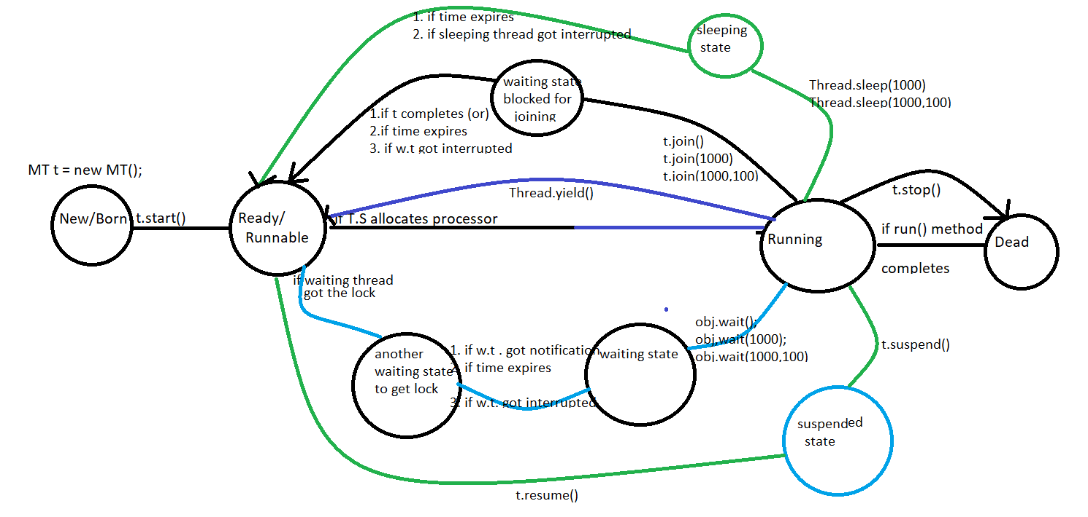
Thread Life-Cycle

