Slide 1
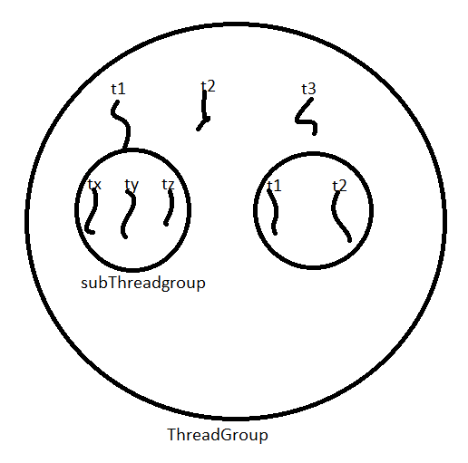
ThreadGroup:
Based on functionality we can group threads into a single unit which is nothing but thread group i.e . Thread group contains a group of threads .In addition to threads thread group can also contain subthread groups
The main advantage of maintaining threads in the form of threadgroup is we can perform common operations very easily
Every thread in java belongs to some group main thread belongs to main group .
Every thread group in java is the child group of system group either directly or indirectly .
Hence system group acts as root for all thread groups in java .
System group contain several system level threads for example : finalizer , reference handler , signal dispatcher , Attach Listener … etc..

Slide 2
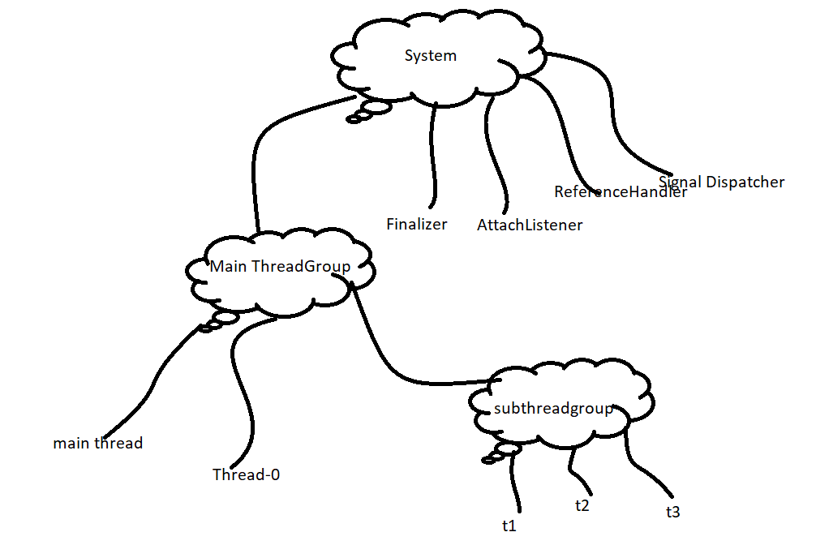
For Example :
class ThreadGroupDemo{
public static void main(String[] args){
System.out.println(Thread.currentThread().getThreadGroup().getName()); // main
System.out.println(Thread.currentThread().getThreadGroup().getParent().getName()); // system
mainthread mainthreadgroup System
systemThread group
}
}

Slide 3

Thread Group is a java class present in java.lang package and it is direct child class of object .
Constructors :
ThreadGroup g = new ThreadGroup(String name);
Creates a new threadgroup with the specified groupname
1. The parent of this new group is the thread group of currently executing thread
For example : ThreadGroup g = new ThreadGroup(“First Group”);
ThreadGroup g = new ThreadGroup(ThreadGroup pg, String Groupname);
For example : ThreadGroup g = new ThreadGroup(g,”Second Group”);
Creates a new thread group with the specified group name the parent of this new thread group is specified parent group .
class ThreadGroupDemo2{
public static void main(String[] args){
ThreadGroup g1 = new ThreadGroup("First Group");
System.out.println(g1.getParent().getName()); // main
ThreadGroup g2 = new ThreadGroup(g1,"Second Group");
System.out.println(g2.getParent().getName()); // First Group
}
}

Slide 4
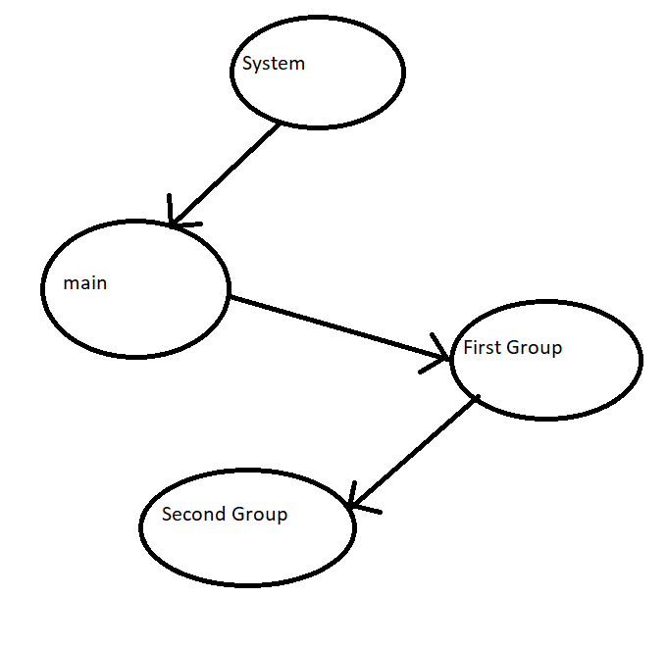

Slide 5

Important Methods of ThreadGroup Class
String getName();
Returns name of the thread group
2. Int getMaxPriority();
Returns max priority of thread group
3. void setMaxPriority(int p);
To set the maximum priority of thread group
The default max priority is 10
Threads in the threadgroup that already have higher priority won’t be affected but for newly added threads this max priority is applicable
Exapmple:
class ThreadGroupDemo3{
public static void main(String[] args){
ThreadGroup g1 = new ThreadGroup("tg");
Thread t1 = new Thread(g1,"Thread1");
Thread t2 = new Thread(g1,"Thread2");
g1.setMaxPriority(3);
Thread t3 = new Thread(g1,"Thread3");
System.out.println(t1.getPriority()); // 5
System.out.println(t2.getPriority()); // 5
System.out.println(t3.getPriority()); // 3
}
}

Slide 6
IV . ThreadGroup getParent();
Returns parent group of current thread
void list();
It prints information about thread group to the console .
int activeCount();
Returns number of active threads present in the thread group
int activeGroupCount();
It returns number of active groups present in the current thread group .
int enumerate(Thread[] t);
To copy all active threads of this thread group into provided thread[] ;
In this case sub threadgroup threads also will be considered .
int enumerate(ThreadGroup[] g)
To copy all active sub threadgroups into threadgroup [] array
boolean isDaemon()
To check whether the threadgroup is daemon or not
void setDaemon(boolean b)
void interrupt() : To interrupt all waiting or sleeping threads present in the thread group .

Slide 7
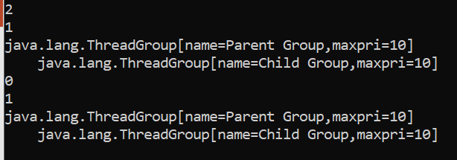
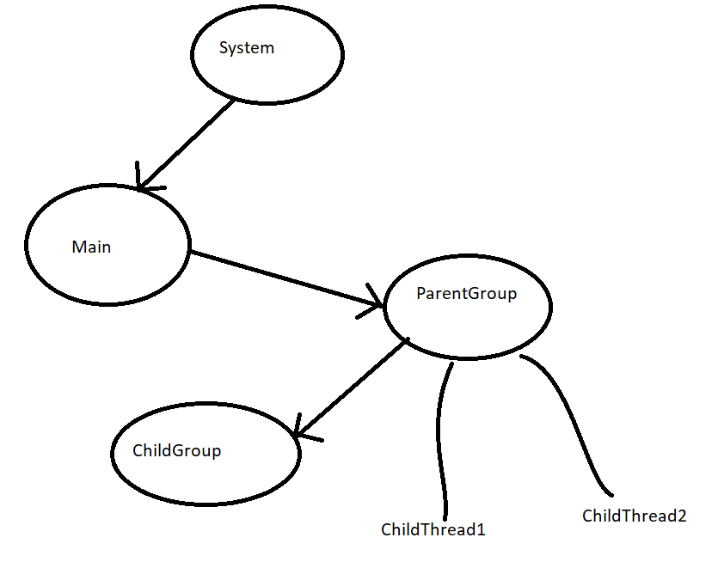
void destroy();
To destroy threadgroup and its subthread groups
class MyThread extends Thread{
MyThread(ThreadGroup g, String name){
super(g,name);
}
public void run(){
System.out.println("Child Thread");
try{
Thread.sleep(5000);
}
catch(InterruptedException e){}
}
}
class ThreadGroupDemo4{
public static void main(String[] args)throws Exception{
ThreadGroup pg = new ThreadGroup("Parent Group");
ThreadGroup cg = new ThreadGroup(pg,"Child Group");
Thread t1 = new Thread(pg,"Child Thread1");
Thread t2 = new Thread(pg,"Child Thread2");
t1.start();
t2.start();
System.out.println(pg.activeCount());
System.out.println(pg.activeGroupCount());
pg.list();
Thread.sleep(10000);
System.out.println(pg.activeCount());
System.out.println(pg.activeGroupCount());
pg.list();
}
}

Slide 8
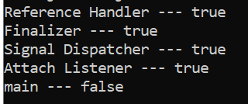
Write a program to display all active thread name belongs to system groups and it’s child groups ?
class ThreadDemo2{
public static void main(String[] args){
ThreadGroup system = Thread.currentThread().getThreadGroup().getParent();
Thread[] t = new Thread[system.activeCount()];
system.enumerate(t);
for(Thread t1: t)
System.out.println(t1.getName()+" --- "+t1.isDaemon());
}
}

Slide 9
Java.util.concurrent
The problems with traditional synchronized keyword :
We are not having any flexibility to try for a lock without waiting .
There is no way to specify maximum waiting time for a thread to get lock so that thread will wait until getting the locks which may create performance problems which may cause deadlocks
If a thread releases a lock then which waiting thread will get this lock we are not having any control on this .
There is no API to list out all waiting threads for a lock .
The synchronized keyword compulsory we have to use either at method level or within a method and it is not possible to use across multiple methods .
To overcome these problems Sun people introduced java.util.concurrent.locks package in 1.5 version
It also provides several enhancements to the programmer to provide more control on concurrency.
Lock(I)Interface:
Lock object is similar to implicit lock acquired by a thread to execute synchronized method or synchronized block .
Lock implementations provides more extensive operations then traditional implicit locks
Important methods of Lock interface :
void lock()
We can use this method to acquired a lock if lock is already available then immediately current thread will get that lock .
If the lock is not already available then it will wait until getting the lock .it is exactly same behavior of traditional synchronized keyword.

Slide 10
boolean tryLock()
To acquire the lock without waiting . If the lock is available then the thread acquires that lock and returns true . If the lock is not available then this method returns false and can continue its execution without waiting . In this case thread never be entered into waiting state
If(l.trylock())
{
perform safe operations
}
else{
perform alternative operations
}
boolean tryLock(long time,TimeUnit unit )
If lock is available then the thread will get the lock and continue its execution if the lock is not available then the thread will wait until specified amount of time still if the lock is not available then thread can continue its execution .
TimeUnit : TimeUnit is an enum present in java.util.concurrent package .

Slide 11
enum TimeUnit{
NANOSECONDS,
MICROSECONDS,
MILLISECONDS,
SECONDS,
MINUTES,
HOURS,
DAYS;
}
If(l.tryLock(1000,TimeUnit.MILLISECONDS));
void lockInterruptibly();
Acquires the lock if it is available and returns immediately . If the lock is not available then it will wait while waiting if the thread is interrupted then thread won’t get the lock .
void unlock()
To call this method compulsory current thread should be owner of the lock otherwise we will get RunTime Exception saying
IllegalMonitorStateException

Slide 12
Reentrant Lock()
It is the implementation class of lock interface and it is the direct child class of object .
Reentrant means a thread can acquire same lock multiple times without any issue internally re-entrant lock increments threads personal count whenever we call lock method and decrements count value whenever thread calls unlock method and lock will be released whenever count reaches zero .
Reentrant Lock l = new ReentrantLock();
l.lock() // holdcount = 1;
l.Lock() // holdcount = 2
l.lock() // holdcount = 3;
l.unlock() // holdcount = 2;
l.unlock() // holdcount = 1;
---
Conctructors:
1. ReenterantLock l = new ReenterantLock();
Creates an instance of ReenterantLock;
2. ReenterantLock l = new ReenterantLock(boolean fairness);
Creates reenterant lock with the given fairness policy if the fairness is true then longest waiting thread can acquire the lock if it is available i.e. it follows first come first serve policy . If fairness is false then which waiting thread will get the chance we can’t expect . The default value for fairness is false .

Slide 13
Which of the following declarations are equal ?
I. ReenterantLock l = new ReenterantLock();
II. ReenterantLock l = new ReenterantLock(true);
III. ReenterantLock l = new ReenterantLock(false);
All the above
Important Methods of ReenterantLocks:
void lock();
boolean tryLock();
boolean tryLock(long I,TimeUnit t);
void lockInterruptibly();
void unlock();
int getHoldCount();
Returns number of holds on this lock by current thread.
boolean isHeldByCurrentThread();
Returns true if and only if lock is hold by current thread .
int getQueueLength();
Returns number threads waiting for the lock .

Slide 14
Collection getQueuedThreads ()
It returns collection of threads which are waiting to get the locks
boolean hasQueuedThreads()
Returns true if any threads waiting to get the lock.
boolean isLocked()
Returns true if the lock is acquired by some thread.
boolean isFair()
Returns true if the fairness policy is set with true value .
Thread getOwner();
Returns the thread which acquires the lock ;

Slide 15
import java.util.concurrent.locks.*;
class ReentrantLockDemo{
public static void main(String[] args){
ReentrantLock l = new ReentrantLock();
l.lock();
l.lock();
System.out.println(l.isLocked()); // true
System.out.println(l.isHeldByCurrentThread()); // true
System.out.println(l.getQueueLength()); // 0
l.unlock();
System.out.println(l.getHoldCount()); // 1
System.out.println(l.isLocked()); // true
l.unlock();
System.out.println(l.isLocked()); // false
System.out.println(l.isFair()); // false
}
}

Slide 16
ReentrantLock in place of Synchronized :
import java.util.concurrent.locks.*;
class Display{
ReentrantLock l = new ReentrantLock();
public void wish(String name){
l.lock(); ---- line 1
for(int i = 0;i<10;i++){
System.out.print("Good Morning : ");
try{
Thread.sleep(2000);
}catch(InterruptedException e){}
System.out.println(name);
}
l.unlock(); -- line 2
}
}
class MyThread extends Thread{
Display d;
String name;
MyThread(Display d, String name){
this.d = d;
this.name = name;
}
public void run(){
d.wish(name);
}
}
class ReentrantLockDemo2{
public static void main(String[] args){
Display d = new Display();
MyThread t1 = new MyThread(d,"Dhoni");
MyThread t2 = new MyThread(d,"Yuvraj");
MyThread t3 = new MyThread(d,"Rohit");
t1.start();
t2.start();
t3.start();
}
}

Slide 17
If we comment line 1 and line 2 then the threads will be executed simultaneously and we will get irregular output .
If we are not commenting lines 1 and 2 then the threads will be executed one by one and we will get regular output .
Demo Program for try lock method

Slide 18
import java.util.concurrent.locks.*;
class MyThread extends Thread{
String name;
static ReentrantLock l = new ReentrantLock();
MyThread(String name){
super(name);
}
public void run(){
if(l.tryLock()){
System.out.println(Thread.currentThread().getName()+"..... got lock and performing safe operations");
try{
Thread.sleep(2000);
}catch(InterruptedException e){}
l.unlock();
}else
{
System.out.println(Thread.currentThread().getName()+"....... unable to get the lock and hence performing alternative operations !! ");
}
}
}
class ReentrantLockDemo3{
public static void main(String[] args){
MyThread t1 = new MyThread("First Thread");
MyThread t2 = new MyThread("Second Thread");
t1.start();
t2.start();
}
}

Slide 19
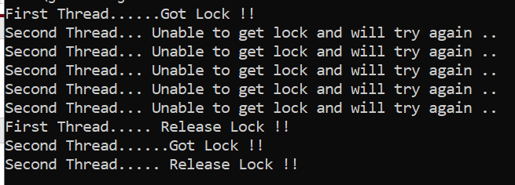
Demo program try with time :
import java.util.concurrent.locks.*;
import java.util.concurrent.*;
class MyThread extends Thread{
String name;
static ReentrantLock l = new ReentrantLock();
MyThread(String name){
super(name);
}
public void run(){
do{
try{
if(l.tryLock(5000,TimeUnit.MILLISECONDS)){
System.out.println(Thread.currentThread().getName()+"......Got Lock !! ");
Thread.sleep(30000);
l.unlock();
System.out.println(Thread.currentThread().getName()+"..... Release Lock !! ");
break;
}
else{
System.out.println(Thread.currentThread().getName()+"... Unable to get lock and will try again .. ");
}
}
catch(Exception e){}
}while(true);
}
}
class ReentrantLockDemo4{
public static void main(String[] args){
MyThread t1 = new MyThread("First Thread");
MyThread t2 = new MyThread("Second Thread");
t1.start();
t2.start();
}
}

Slide 20
ThreadPools(Executor Framework):
Creating a new thread for every job may create performance and memory problem . To overcome this we should go for threadpool .
Threadpool is a pool of already created threads ready to do our job .
Java 1.5 version introduces ThreadPool framework to implement threadpools .
ThreadPool framework also known as Executor framework .
We can create a threadpool as follows
ExecutorService service = Executors.newFixedThreadPool(3);
We can submit a runnable job by using a submit method .
service.submit(job);
We can shutdown Executors service by using Shutdown method ;
service.shutdown();

Slide 21
Example :
import java.util.concurrent.*;
class PrintJob implements Runnable{
String name;
PrintJob(String name)
{
this.name = name;
}
public void run()
{
System.out.println(name+"...... Job started by Thread : "+ Thread.currentThread().getName());
try{
Thread.sleep(5000);
}catch(InterruptedException e){}
System.out.println("... Job Completed by Thread : "+Thread.currentThread().getName());
}
}
class ExecutorDemo{
public static void main(String[] args){
PrintJob[] jobs = {new PrintJob("Akhil"),
new PrintJob("Ravi"),
new PrintJob("Shiva"),
new PrintJob("Pawan"),
new PrintJob("Suresh"),
new PrintJob("Anil")};
ExecutorService service = Executors.newFixedThreadPool(3);
for(PrintJob job : jobs)
{
service.submit(job);
}
service.shutdown();
}
}

Slide 22
In the above example three threads are responsible to execute six jobs so that a single thread can reused for multiple jobs .
Note
While designing web servers and application servers we can use threadpool concept .
Callable and Future
In the case of runnable job thread won’t return anything after completing the job if a thread is required to return some result after execution then we should go for callable .
Callable interface contains only one method call()
public object call() throws Exception
If we submit callable object to executor then after completing the job thread returns an object of the type Future
i.e. future object can be used to retrieve the result from callable job .

Slide 23
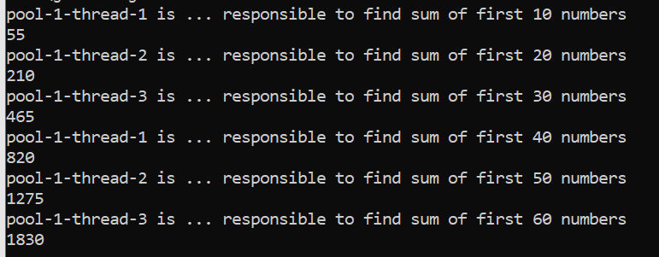
Callable Future Demo :
import java.util.concurrent.*;
class MyCallable implements Callable{
int num;
MyCallable(int num)
{
this.num = num;
}
public Object call()
{
System.out.println(Thread.currentThread().getName()+" is ... responsible to find sum of first "+num + " numbers");
int sum = 0;
for(int i = 1;i<=num;i++){
sum+=i;
}
return sum;
}
}
class ExecutorCallableDemo{
public static void main(String[] args) throws Exception{
MyCallable[] jobs = {new MyCallable(10),
new MyCallable(20),
new MyCallable(30),
new MyCallable(40),
new MyCallable(50),
new MyCallable(60)};
ExecutorService service = Executors.newFixedThreadPool(3);
for(MyCallable job : jobs)
{
Future f = service.submit(job);
System.out.println(f.get());
}
service.shutdown();
}
}

Slide 24
Differences between Runnable and callable :
Runnable | Callable
1. If a thread is not required to return anything after completing a job then we should go for runnable | 1. If a thread required to return something after completing the job then we should go for callable .
2.Runnable interface contains only one method called run() method | 2. Callable interface contains only one method call().
3. Runnable job not required to return anything and Hence return type of run method is void . | 3. Callable job is required to return something and hence return type of callable object is Object .
With in the run method if there is any chance of raising checkeed Exception Compulsory we should handle by using try catch because we can’t use throws keyword for run method | With in call method if there is any chance of raising checked exception we are not required to handle by using try catch because call method already throws exception .
Runnable interface present in java.lang package Intorduced in 1.0 version | Callable interface present in java.util.concurrent package Introduced in 1.5 version

Slide 25
ThreadLocal:
ThreadLocal class provides threadLocal variable Thread Local class maintains values per thread basis . Each threadlocal object maintains a separate value like user id , transaction id etc .. For each thread that accesses that Object thread can access its local value can manipulate its value and even can remove its value .
In every part of the code which is executed by the thread we can access its local variable .
Example . Consider a servlets which invokes some business method we have requirement to generate a unique transaction id for each and every request and we have to pass this transaction id to the business method . For this requirement we can use thread local to maintain a separate transaction id for every request i.e for every thread .
Note :
I. Threadlocal class introduced in 1.2 version and enhanced in 1.5 version .
II. ThreadLocal can be associated with threadscope total code which is executed by the thread has access to the corresponding thread local variable .
III. Thread can access its own local variables and can’t access other threads local variables.
IV . Once the thread entered into dead state all its local variables are by default eligible for garbage collection .

Slide 26
Constructor:
ThreadLocal tl = new ThreadLocal();
Methods :
1. Object get()
Returns the value of thread local variable associated with current thread.
2. Object initialValue()
Returns initial value of thread local variable associated with current thread .
The default implementation of this method returns NULL
To customize our own initial value we have to override this method.
3. void set(Object newValue);
To set a new value
4. Void remove()
To remove the value of threadlocal associated with current thread .
It is newly added method in 1.5 version . After removal if we are trying to access it will be reinitialized once again by invoking its initial value method .

Slide 27

Example 1 :
class ThreadLocalDemo{
public static void main(String[] args){
ThreadLocal tl = new ThreadLocal();
System.out.println(tl.get()); // null
tl.set("Akhil Kumar");
System.out.println(tl.get()); // Akhil
tl.remove();
System.out.println(tl.get()); // null
}
}
Overriding of Initial Value Method :
class ThreadLocalDemo1A{
public static void main(String[] args){
ThreadLocal tl = new ThreadLocal(){
public Object initialValue(){
return "ABS";
}
};
System.out.println(tl.get()); // null
tl.set("Akhil Kumar");
System.out.println(tl.get()); // Akhil
tl.remove();
System.out.println(tl.get()); // null
}
}

Slide 28
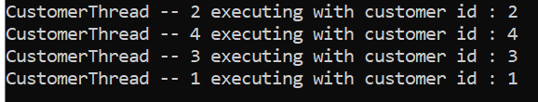
In the below program for every customer thread a separate customer id will be maintained by ThreadLocal Object
class CustomerThread extends Thread{
static Integer custId = 0;
private static ThreadLocal tl = new ThreadLocal(){
protected Integer initialValue(){
return ++custId;
}
};
CustomerThread(String name){
super(name);
}
public void run(){
System.out.println(Thread.currentThread().getName()+"executing with customer id : "+ tl.get());
}
}
class ThreadLocalDemo2{
public static void main(String[] args){
CustomerThread c1 = new CustomerThread("CustomerThread -- 1 ");
CustomerThread c2 = new CustomerThread("CustomerThread -- 2 ");
CustomerThread c3 = new CustomerThread("CustomerThread -- 3 ");
CustomerThread c4 = new CustomerThread("CustomerThread -- 4 ");
c1.start();
c2.start();
c3.start();
c4.start();
}
}

Slide 29
ThreadLocal vs Inheritance
Parent Threads Thread local variable by default not available to the child thread . If we want to make parent threads ThreadLocal value available to the child thread then we should go for InheritableThreadLocal class .
By default child threads value exactly same as parent thread value but we can provide customized value child thread by overriding child value method .
Constructor :
InheritableThreadLocal tl = new InheritableThreadLocal();
Methods :
Inheritable ThreadLocal is a child class of Thread Local hence all methods present in threadlocal by default available to Inheritable threadlocal
In addition to these methods it contains only one method :
Public Object childValue(Object parentValue)

Slide 30

Example
class ParentThread extends Thread{
public static InheritableThreadLocal tl = new InheritableThreadLocal(){
public Object childValue(Object p){
return "cc";
}
};
public void run(){
tl.set("pp");
System.out.println("Parent Thread value == "+tl.get());
ChildThread ct = new ChildThread();
ct.start();
}
}
class ChildThread extends Thread{
public void run(){
System.out.println("Child Thread Value: --"+ ParentThread.tl.get());
}
}
class ThreadLocalDemo4{
public static void main(String[] args){
ParentThread pt = new ParentThread();
pt.start();
}
}

Slide 31
In the above program if we replace InheritableThreadLocal with ThreadLocal and if we are not overriding child value method then the output is :
Parent Thread value = PP
Child Thread Value = null
In the above program if we are maintaining Inheritable Threadlocal and If we are not overriding childValue method then the output is :
ParentThread value = pp
Child Thread value = pp

