Slide 1
Wrapper classes
The main objectives of wrapper classes are :
To wrap primitive into object form so that we can handle primitives also just like objects .
To define several utility methods which are required for primitives .
Constructors
Almost all wrapper classes contains two constructors one can take corresponding primitive as argument and the other can take String as argument
Ex1
Integer I = new Integer(10) // int primitive
Integer I = new Integer(“10”); // String args
Ex2
Double d = new Double(10.5);
Double d = new Double(“10.5”);
If String argument not representing a number then we will get RuntimeException saying NumberFormatException
Integer I = new integer(“ten”);
RE: NumberFormatException

Slide 2
Float class contains 3 constructors with float,double and String args.
Float f = new Float(10.5f);
Float f = new Float(“10.5f”);
Float f = new Float(10.5);
Float f = new Float(“10.5”);
Character class contains only one constructor which can take char argument .
Character ch = new Character(‘a’); == valid
Character ch = new Character(“a”); == Invalid .
Boolean class contains two constructors one can take primitive as argument and the other can take String argument .
If we pass Boolean primitive as argument the only allowed values are true or false where case is important and content is also important .
Boolean b = new Boolean(true);
Boolean b = new Boolean(false);
Boolean b = new Boolean(True) /// Invalid
Boolean b = new Boolean(durga) // Invalid

Slide 3
public class Test{
public static void main(String[] args){
Boolean x = new Boolean("yes");
Boolean y = new Boolean("no");
System.out.println(x.equals(y));
}
} ///true
If we are passing String type as an argument then case and content both are not important if the content is case insensitive String of true then it is treated as true otherwise it is treated as false .
Boolean b = new Boolean(“true”) == true
Boolean b = new Boolean(“True”) == true
Boolean b = new Boolean(“TRUE”) == true
Boolean b = new Boolean(“malaika”) == false
Boolean b = new Boolean(“mallika”) == false
Boolean b = new Boolean(“jareena”) == false
public class Test{
public static void main(String[] args){
Boolean x = new Boolean("yes"); // false
Boolean y = new Boolean("True"); /// true
System.out.println(x+" "+y);
System.out.println(x.equals(y));
}
} ///false

Slide 4
Wrapper class | Corresponding Constructor arguments
Byte | byte or String
Short | short or String
Integer | int or String
Long | long or String
Float | float or String or double
Double | double or String
Character | char
Boolean | boolean or String

Slide 5
In all wrapper classes toString method is overridden to return content directly .In all wrapper classes .equals() methos is overridden for content comparison .
Utility Methods
valueOf()
xxxValue()
parseXxx()
toString()
valueOf() : we can use valueOf() methods to create wrapper object for the given primitive or String .
Form1 :
Every wrapper class except character class contains static valueOf method to create wrapper object for the given String
public static Wrapper valueOf(String s)
E.g.
Integer I = Integer.valueOf(“10”);
Double D =Double.valueOf(“10.5”);
Boolean b = Boolean.valueOf(“true”);

Slide 6
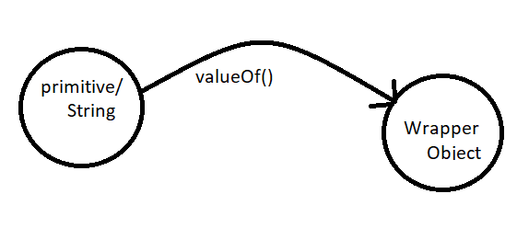
Form-2
Every Integral type wrapper class (Byte , Short , Integer , Long ) contains the following valueOf() method to create wrapper object for the given specified radix String
public static wrapper valueOf(String s, int radix)
The allowed range of radix is : 2 to 36
E.g.
Integer I = Integer.valueOf(“1111”,2);
System.out.println(I) = 15
Integer I = Integer.valueOf(“101”,4);
System.out.println(I)// 17
Form-3
Every wrapper class including character class contains static valueOf() method to create wrapper object for the given primitive
public static wrapper valueOf(primitive p);
Eg
Integer I = Integer.valueOf(10);
Character ch = Character.valueOf(‘a’);
Boolean b = Boolean.valueOf(true);

Slide 7
2. xxxValue():
We can use xxxValue() methods to get primitive for the given wrapper object .
Every Number type wrapper class(Byte, Short, Integer, Long , Float ,Double) contains the following six methods to get primitive for the given wrapper object .
public byte byteValue()
public short shortValue()
public int intValue()
public long longValue()
public float floatValue()
public double doubleValue()
E.g.
Integer I = new Integer(130);
System.out.println(I.byteValue()); // -126
System.out.println(I.shortValue()); // 130
System.out.println(I.intValue()); // 130
System.out.println(I.longValue()); // 130
System.out.println(I.floatValue()); // 130.0
System.out.println(I.doubleValue()); // 130.0

Slide 8
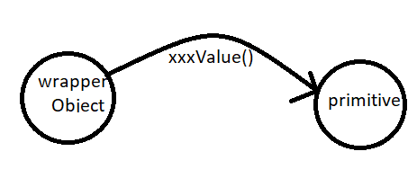
charValue()
public char charValue()
Character class contains charValue method to get char primitive for the given character Object
E.g.
Character ch = new Character(‘a’);
char c = ch.charValue();
System.out.println(c) == ‘a’
booleanValue()
Boolean Class contains booleanValue() method to get Boolean primitive for the given boolean Object .
public boolean booleanValue();
E.g.
Boolean B = Boolean.valueOf(“durga”);
Boolean b = B.booleanValue();
System.out.println(b) // false

Slide 9
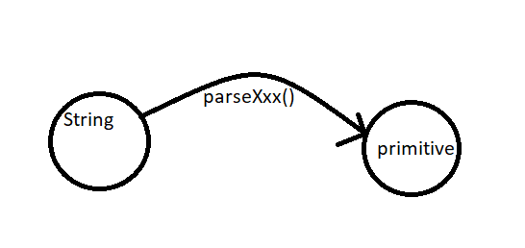
Note:
In total 6 x 6+1+1 == 38 xxxValue() Methods are possible
parseXxx() Method
We can use parseXxx() methods to convert String to primitive .
Form-1
Every wrapper class except character class contains the following parseXxx() methods to find primitive for the given String Object
public static primitive parseXxx(String s);
E.g.
int I = Integer.parseInt(“10”);
double d = Double.parseDouble(“10.5”);
boolean b = Boolean.parseBoolean(“true”);
Form-2
Every integral type wrapper class(Byte, short, Integer , Long ) contains the following parsexxx() method to convert specified radix to primitive

Slide 10
public static primitiveparseXxx(String s,int radix);
The allowed range of radix is : 2 to 36
E.g.
int I = Integer.parseInt(“1111”,2);
System.out.println(i); // 15
toString() method
We can use toString() method to convert wrapper object or primitive to String
Form-1
Every wrapper class contains the following toString() method to convert wrapper object to String. It is the overriding version of Object class toString() method . Whenever we are trying to print wrapper object reference internally this toString() method will be called.which overridden to return the content .
public String toString()
E.g.
Integer I =new Integer(10);
String s = I.toString();
Sopln(s); == 10
Sopln(i) == sopln(I.toString()); == 10;

Slide 11
Every wrapper class including Character class contains the following static toString() method to convert primitive to String
public static String toString(primitive p);
E.g.
String s = Integer.toString(10);
String s = Boolean.toString(true);
String s = Character.toString(‘a’);
Form-3
Integer and Long classes contains the following toString() method to convert primitive to specified radix String.
public static String toString(primitive p,int radix);
The allowed range of radix is : 2 to 36
E.g.
String s = Integer.toString(15,2);
Sopln(s); // 1111

Slide 12
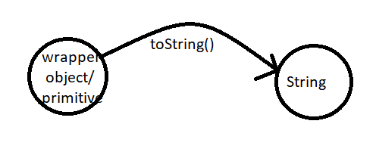
Form-4
toXxxString() method:
Integer and Long classes contains the following toXxxString methods
public static String toBinaryString(primitive p);
public static String toOctalString(primitive p);
public static String toHexString(primitive p);
E.g.
String s = Integer.toBinaryString(10);
System.out.println(s); // 1010
String s = Integer.toOctalString(10);
System.out.println(10); // 12
String s = Integer.toHexString(10);
System.out.println(s); // a

Slide 13
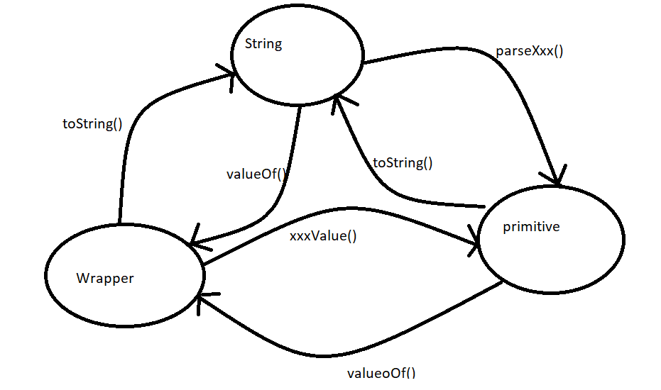
Dancing b/w String, primitive and wrapper Object

Slide 14
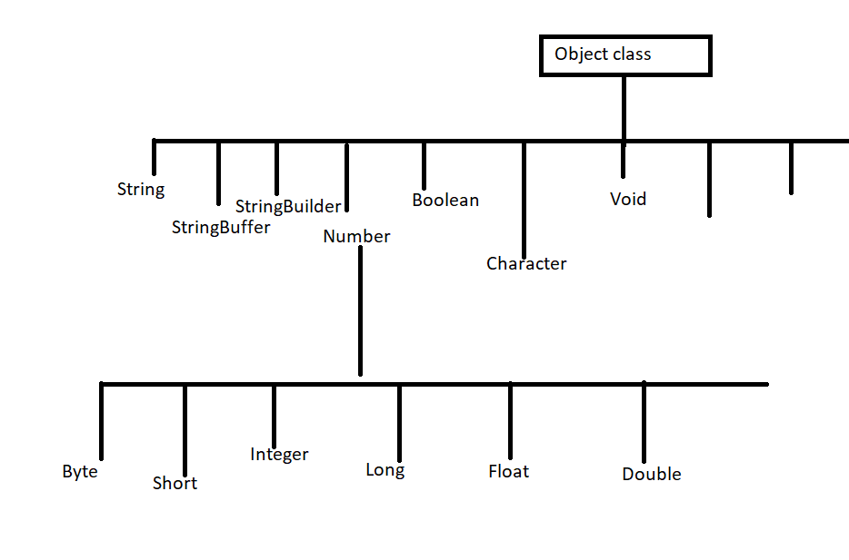
Partial Hierarchy of java.lang package :

Slide 15
Conclusions :
The wrapper classes which are not child classes of Number are : Character and Boolean
The wrapper classes which are not direct child class of Object are : Byte Short Integer Long Float Double
String , StringBuffer and StringBuilder and all wrapper classes are final classes
In addition to String Objects all wrapper class object also immutable .
Sometimes Void class is also considered as wrapper class .
Void class :
It is a final class and It is the direct child class of Object it doesn’t contain any methods and it contain only one variable Void.TYPE
2. In general we can use void class in reflections to check whether the method return type is void or not .
If(getMethod(“m1”).getReturnTyepe() == Void.TYPE){
--------
-----
}
Void is the class representation of void keyword in java

