Slide 1
Overloading with respect to Autoboxing,widening & var-args :
Case I
Autoboxing vs Widening:
Example:
public class Test{
public static void m1(Integer I){
System.out.println("Autoboxing");
}
public static void m1(long l){
System.out.println("widening");
}
public static void main(String[] args){
int x = 10;
m1(x);
}
} // widening
Widening dominates Autoboxing

Slide 2
Case II
Widening vs Var-args :
public class Test{
public static void m1(int... x){
System.out.println("Var-args Method ");
}
public static void m1(long l){
System.out.println("widening");
}
public static void main(String[] args){
int x = 10;
m1(x);
}
} // widening
Widening dominates the var-args methods .

Slide 3
Case III
Autoboxing vs Var-args :
public class Test{
public static void m1(int... x){
System.out.println("Var-args Method ");
}
public static void m1(Integer I){
System.out.println("Autoboxing");
}
public static void main(String[] args){
int x = 10;
m1(x);
}
} // Autoboxing
Autoboxing dominates var-args methods
Conclusion :
In general var-args method will get least priority i.e. if no other method match then only var-arg method will get the chance . It is exactly same as default case inside switch.
*** While resolving overloaded methods compiler will always keeps the precedence in following order :
Widening
Autoboxing
Var-args

Slide 4
public class Test{
public static void m1(int... x){
System.out.println("Var-args Method ");
}
public static void m1(Integer I){
System.out.println("Autoboxing");
}
public static void m1(long l){
System.out.println("Widening");
}
public static void main(String[] args){
int x = 10;
m1(x);
}
} // Widening

Slide 5
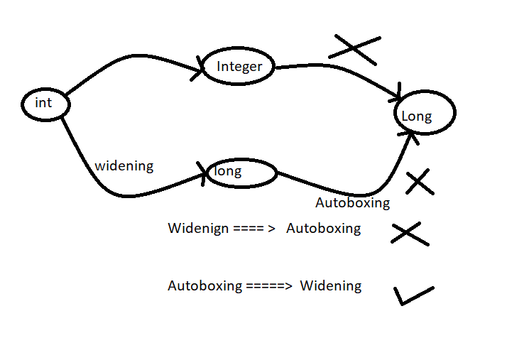
Case IV
public class Test{
public static void m1(Long l){
System.out.println("Long");
}
public static void main(String[] args){
int x = 10;
m1(x);
}
} CE: incompatible types: int cannot be converted to Long
Widening followed by Autoboxing is not allowed in java whereas
Autoboxing followed by widening is allowed .
Example :
Long l = 10;
CE: incompatible types found : int required : java.lang.Long
long l = 10 ; // valid == widening

Slide 6
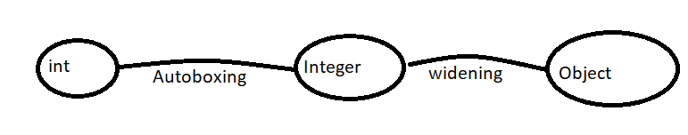
public class Test{
public static void m1(Object o){
System.out.println("Object Version");
}
public static void main(String[] args){
int x = 10;
m1(x);
}
}
// Object Version == valid
Object o = 10 ;
Number n = 10 ;
Which of the following assignments are legal ?
int I = 10;
Integer I = 10;
int I = 10L; // CE : possible loss of precision found long required int
Long l = 10L valid
Long l = 10; CE : incomapatible type
long l = 10; valid == widening
Object o = 10; Autoboxing === widening
double d = 10; widening
Double d = 10; invalid : incompatible types
Number n = 10; valid

