Slide 1
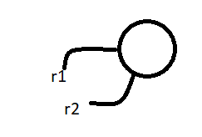
Relation between == operator and .equals() method
if two objects are equal by == operator then these objects are always equal by .equals() method
== If r1 == r2 is true then r1.equals(r2) is always true :
If two objects are not equal by == operator then we can’t conclude anything about .equals() method it may returns true or false .i.e.
if r1== r2 is false then r1.equals(r2) may returns true or false and we can’t expect exactly .
3.If two objects are equal by .equals() method then we can’t conclude anything about == operator it may returns true or false i.e . If r1.equals(r2) is true then we can’t conclude r1== r2 it may returns true or false .
4. If two objects are not equal by .equals() method then these objects are always not equal by == operator . I.e. if r1.equals(r2) is false then r1== r2 is always false .

Slide 2
Difference between == operator and .equals() method :
To use == operator compulsory there should be some relation between argument types (either child to parent or parent to child or same type) other wise we will get CE : saying imcompatible types
If there is no relation between argument types then .equals() method won’t raise any runtime or compiletime errors simply it returns false .
public class Test{
public static void main(String[] args){
String s1 = new String("Akhil");
String s2 = new String("Akhil");
StringBuffer sb1 = new StringBuffer("Akhil");
StringBuffer sb2 = new StringBuffer("Akhil");
System.out.println(s1 == s2); // false
System.out.println(s1.equals(s2)); // true
System.out.println(sb1 == sb2); // false
System.out.println(sb1.equals(sb2)); // false
//System.out.println(s1 == sb1); CE : incomaptible types
System.out.println(s1.equals(sb1)); // false
}
}

Slide 3
== Operator | Equals Method
It is an operator in java . Applicable for both primitive and object types | It is an method applicable only for object types but not for primitives .
In the case of object references == operator meant for reference comparison (address comparison) | By default .equals() method present in object class also meant reference comparison
We can’t override == operator for content comparison | We can override .equals() method for content comparison
To use == operator compulsory there should some relation between argument types(Either parent to child or child to parent or same types) otherwise we will get compiletime error saying imcomapatible types | If there is no relation between argument types then .equls() method won’t raise compiletime or Runtime error and simply returns false .

Slide 4
In general we can use == operator for reference comparison and .equals() method for content comparison .
Note:
For any object reference r ,
r== null
r.equals(null)
Always returns false
Thread t = new Thread();
System.out.println(t==null); // false
System.out.println(t.equlas(null));// false
Hashing related data structure follow the following fundamental rule . Two equivalent objects should be placed in same bucket , But all objects present in the same bucket need not be equal.

Slide 5
Contract between .equals() and hashCode() method .
If two objects are equal by .equals() method then there hashCode must be equals i.e. two equivalent objects should have same hashCode .
if r1.equals(r2) is true then , r1.hashCode() == r2.hashCode() is always true
2. Object class .equals() method and hashCode() methods follow above contract hence whenever we are overriding .equals() method compulsory we should override hashCode() method to satisfy above contract (i.e two equivalent object should have same hashCode())
1. If two objects are not equal by .equals() method then there is no restriction on hashCodes may be equal or may not be equal
2. If hashCodes() of two objects are equal then we can’t conclude anything about .equals() method it may return true or false.
3. If hashCodes of two objects are not equal then these objects are always not equal by .equals() method
Note***
To satisfy contract between equals() and hashCode methods .whenever we are overriding .equals() method compulsory we have to override hashCode methods otherwise we won’t get any compiletime and Runtime errors But it is not a good programming practice.

Slide 6


In String class .equals() method is overridden for content comparison and hence hashCode() method is also overridden to generate hashCode based on content
public class Test{
public static void main(String[] args){
String s1 = new String("Akhil");
String s2 = new String("Akhil");
System.out.println(s1.equals(s2));
System.out.println(s1.hashCode());
System.out.println(s2.hashCode());
}
}
In StringBuffer .equals() method is not overridden for content comparison .and hence hashCode method is also not overridden
public class Test{
public static void main(String[] args){
StringBuffer sb1 = new StringBuffer("Akhil");
StringBuffer sb2 = new StringBuffer("Akhil");
System.out.println(sb1.equals(sb2));
System.out.println(sb1.hashCode());
System.out.println(sb2.hashCode());
}
}

Slide 7
Consider the following person class :
class Person{
public boolean equals(Obect obj){
if(obj instanceof Person){
Person p = (Person)obj;
if(name.equals(p.name) && age==p.age)
return true;
else
return false;
}
return false;
}
}
Which of the following hashCode method is appropriate for the Person class?
1.public int hashCode()
return 100;
2. public int hashCode()
return age+ssno;
3. public int hashCode()
return name.hashCode()+age; // correct
4. No Restriction

Slide 8
Note:
Based on which parameter we override .equals() method , it is highly recommended to use same parameters while overriding hashCode method also .
Note***
In all Collection classes , in all wrapper classes and in String class .equals() method is overridden for content comparison Hence it is highly recommended to override equals method in our class also for content comparison

Slide 9

Clone() Method
The process of creating exactly duplicate object is called cloning the main purpose of cloning is to maintain a backup copy and to preserve state of an object .
We can perform cloning by using clone method of Object class .
protected native Object clone() throws CloneNotSupportedException
public class Test implements Cloneable{
int i = 10;
int j = 20;
public static void main(String[] args) throws CloneNotSupportedException{
Test t1 = new Test();
Test t2 = (Test)t1.clone();
t2.i = 888;
t2.j= 999;
System.out.println(t1.i+"=="+t1.j);
System.out.println(t2.i+"=="+t2.j);
}
}

Slide 10
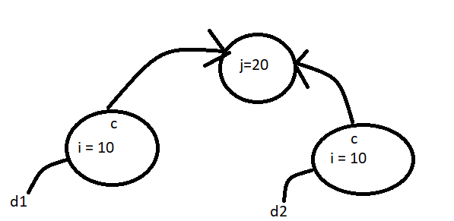
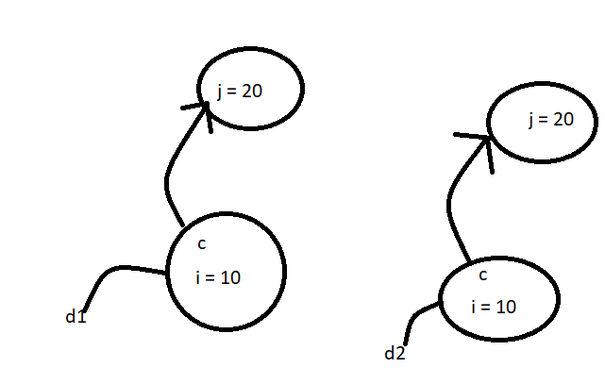
We can perform cloning only for cloneable objects an object is said to be cloneable if and only if the corresponding class implements cloneable interface .
Cloneable interface present in java.lang package and it doesn’t contain any methods . It is a marker interface . If we are trying to perform cloning for non-cloneable objects then we will get RuntimeException saying CloneNotSupportedException
Shallow Cloning Vs Deep Cloning
Shallow cloning Dog d2 = (Dog) d1.clone(); | Deep cloning Dog d2 = (Dog) d1.clone();

Slide 11
Shallow Cleaning
The process of creating bitwise copy is called shallow cloning . If the main object contain primitive variables then exactly duplicate copies will be created in the cloned object . If the main object contain any reference variable then corresponding object won’t be created just the duplicate reference will be created pointing to old content object.
Object class clone method meant for shallow cloning .
In Shallow cloning by using cloned object reference if we perform any change to the contained object then those changes will be reflected to the main object . To overcome this problem we should go for deep cloning .
Deep Cloning :
The process of creating exactly duplicate independent copy including contained object is called deep cloning in deep cloning if the main object cotains any primitive variables then in the cloned object duplicate copies will be created . If the main object contains any reference variable then the corresponding contained object also will be created in the cloned copy .
By default object class clone() method meant for shallow cloning but we can implement deep cloning explicitly by overriding clone method in our class .

Slide 12

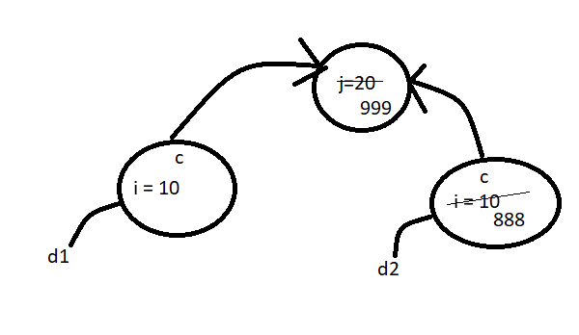

class Cat{
int j ;
Cat(int j){
this.j = j;
}
}
class Dog implements Cloneable{
Cat c;
int i;
Dog(Cat c, int i){
this.c = c;
this.i = i;
}
public Object clone() throws CloneNotSupportedException{
return super.clone();
}
}
class ShallowCloningDemo{
public static void main(String[] args)throws CloneNotSupportedException{
Cat c = new Cat(20);
Dog d1 = new Dog(c,10);
Dog d2 = (Dog)d1.clone();
d2.i = 888;
d2.c.j = 999;
System.out.println(d1.i+" === "+d1.c.j); //
}
}

Slide 13
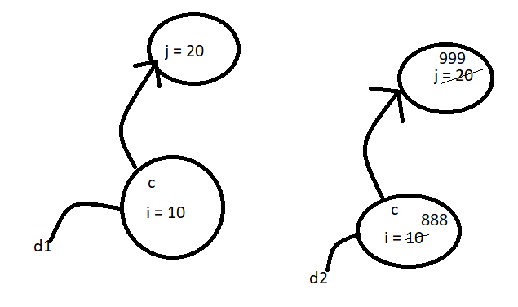

Deep Cloning
class Cat{
int j ;
Cat(int j){
this.j = j;
}
}
class Dog implements Cloneable{
Cat c;
int i;
Dog(Cat c, int i){
this.c = c;
this.i = i;
}
public Object clone() throws CloneNotSupportedException{
Cat c1 = new Cat(c.j);
Dog d = new Dog(c1,i);
return d;
}
}
class DeepCloningDemo{
public static void main(String[] args)throws CloneNotSupportedException{
Cat c = new Cat(20);
Dog d1 = new Dog(c,10);
System.out.println(d1.i+" === "+d1.c.j);
Dog d2 = (Dog)d1.clone();
d2.i = 888;
d2.c.j = 999;
System.out.println(d1.i+" === "+d1.c.j);
}
}

Slide 14
By using cloned object reference if we perform any change to the contained object then those changes won’t be reflected to the main object .
Which cloning is best ?
If object contains only primitive variable then shallow cloning is the best choice . If object contains reference variables then deep cloning is the best choice .

