Slide 1


File I/O
File :
File f = new File(“abc.txt”) //
This line won’t create any physical file first it will check is there any physical file named with abc.txt is available or not . If it is available then f simply refers that file. If it is not available then we are just creating java file object to represent the name abc.txt.
import java.io.*;
class Test{
public static void main(String[] args) throws IOException{
File f = new File("abc.txt");
System.out.println(f.exists());
f.createNewFile();
System.out.println(f.exists());
}
}
1st run 2nd run

Slide 2
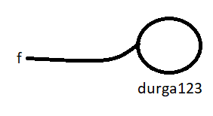


We can use java file object to represent directory also .
File f = new File(“durga123”);
import java.io.*;
class Test{
public static void main(String[] args) throws IOException{
File f = new File("durga123");
System.out.println(f.exists());// false
f.mkdir();
System.out.println(f.exists()); // true
}
}
1st run 2nd run
Note **
In unix everything is treated as file java file io concept is implemented based on unix operating system. Hence java file object can be used ti represent both files and directories .

Slide 3
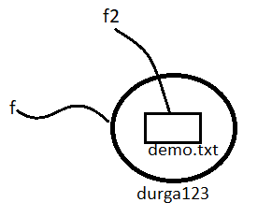
File class Constructors :
File f = new File(String name);
creates a java file object to represent the name of the file or directory in current working directory.
2. File f = new File(String subdirname,String name);
Creates a java file object to represent name of the file or directory present in specified subdirectory
3. File f = new File(File subdir, String name);
Example 1
Write code to create a file named with abc.txt in current working directory .
File f = new File(“abc.txt”);
f.createNewFile();
2. Write code to create a directory named with durga123 in current working directory and create a file named with demo.txt in that directory .
File f = new File(“durga123”);
f.mkdir();
File f2 = new File(“durga123”,”demo.txt”);
File f2 = new File(f,”demo.txt”);
F2.createNewFile();

Slide 4
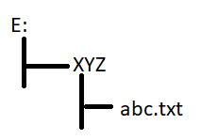
Example 3 .
Write code to create a file named with abc.txt in E:xyz folder
Assume that E:/xyz folder is already available in your system.
Important methods present in File class
1. boolean exists();
Returns true if the specified file or directory available .
2. boolean createNewFile();
First this method will check whether the specified file is already available or not . If it is already available then this method returns false without creating any physical file . If the file is not already available then this method creates new file and returns true .
3. boolean mkdir()
4. boolean isFile();
Returns true if the specified file object pointing to physical file .
5. boolean isDirectory()

Slide 5
6. String[] list();
This method returns the names of all files and subdirectories present in specified directory .
7. Long length();
Returns number of character present in the specified file .
8.boolean delete()
To delete specified file or directory .
Q write a program to display names of all files and directories present in C:\\Users
import java.io.*;
class Test{
public static void main(String[] args) throws IOException{
int count =0;
File f = new File("c:\\Users");
String[] s = f.list();
for(String s1:s){
count++;
System.out.println(s1);
}
System.out.println("The Total number: "+count);
}
}

Slide 6
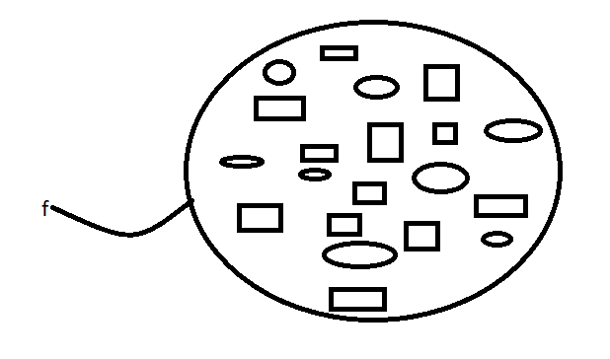
Q. WAP to display only filenames
import java.io.*;
class Test{
public static void main(String[] args) throws IOException{
int count =0;
File f = new File("c:\\Users");
String[] s = f.list();
for(String s1:s){
File f1 = new File(f,s1);
if(f1.isFile()){ // (f1.isDirectory())
count++;
System.out.println(s1);
}
}
System.out.println("The Total number: "+count);
}
}
WAP to display only directory names
In the program we have to replace isFile() method with the isDirectory() Method

Slide 7
FileWriter:
We can use FileWriter to write character data to the file .
Constructors:
1 . FileWriter fw = new FileWriter(String fname);
2. FileWriter fw = new FileWriter(File f);
The above Filewriters meant for overriding of existing data . Instead of overriding if we want append operation then we have to create FileWriter by using the following constructors .
3. FileWriter fw = new FileWriter(String fname,boolean append);
4. FileWriter fw = new FileWriter(File f,boolean append);
Note **
If the specified file is not already available then all the above constructors will create that file .

Slide 8
Important methods
public void write(int ch);
To write a single character
2. public void write(char[] ch);
To write an array of characters
3. public void write(String s);
To write String to the file
4. public void flush();
To give the guarantee that total data including last character will be written to the file .
5. public void close();
To close the writer

Slide 9
Example :
import java.io.*;
class FileWriterDemo2{
public static void main(String[] args)throws IOException {
FileWriter fw = new FileWriter("abc.txt");
fw.write(100);// adding a single character
fw.write("urga\nSoftware Solutions");
fw.write('\n');
char[]ch1 = {'a','b','c'};
fw.write(ch1);
fw.write('\n');
fw.flush();
fw.close();
}
}
abc.txt
durga
SoftwareSolutions
abc
In the above program Filewriter can perform overriding of existing data .Instead of overriding if we want append operation then we have to create FileWriter object as follows .
FileWriter fw = new FileWriter("abc.txt“,true);

Slide 10
Note***
The main problem with filewriter is we have to insert line (\n) separator manually. Which is varied from system to system . It is difficulty to the programmer . We can solve this problem by using BufferedWriter and PrintWriter classes .
FileReader:
we can use FileReader to read character data from the file
Constructors:
FileReader fr = new FileReader(String fname);
FileReader fr = new FileReader(File f);
Methods :
1. public int read()
It attempts to read next character from the file and returns its Unicode value . If the next character not available then this method returns -1;
As this method returns Unicode value(int) at the time of printing we have to perform typecasting
2. public read(char[] ch);
It attempts to read enough characters from the file into char array and returns number of characters copied from the file .

Slide 11
Example of FileReader:
1st Appoach
import java.io.*;
class Test{
public static void main(String[] args) throws IOException{
FileReader fr = new FileReader("abc.txt");
int i = fr.read();
while(i !=-1){
System.out.print((char)i);
i = fr.read();
}
}
}
2nd Approach 2nd method
import java.io.*;
class Test{
public static void main(String[] args) throws IOException{
File f = new File("abc.txt");
char[] ch = new char[(int)f.length()];
FileReader fr = new FileReader(f);
fr.read(ch);
for(char ch1:ch)
System.out.print(ch1);
}
}

Slide 12
3. public void close();
After read or write operation it is recommended to close .
Note***
By using FileReader we can read data character by character which is not convenient to the programmer
Usage of Filereader and FileWriter is not recommended because while writing data by filewriter we have to insert line separator \n manually which varied from system to system . It is difficult to the programmer .
By using FileReader we can read data character by character, which is not convenient to the programmer . To overcome these problem we should go for BufferedReader and BufferedWriter
BufferedWriter:
1.We can use BufferedWriter to write character data to the file .
BufferedWriter bw = new BufferedWriter(Writer w)
BufferedWriter bw = new BufferedWriter(Writer w, int buffersize);
Note***
BufferedWriter can’t communicate directly with the file it can communicate via some Writer object

Slide 13
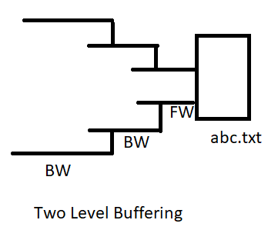
Q1 Which of the following is Valid ?
1. BufferedWriter bw = new BufferedWriter(“abc.txt”); // invalid
2. BufferedWriter bw = new BufferedWriter(new File(“abc.txt”)) ; // not valid
3. BufferedWriter bw = new BufferedWriter(new FileWriter(“abc.txt”)); // VALID
4. BufferedWriter bw = new BufferedWriter(new BufferedWriter(new FileWriter(“abc.txt”))); // VALID
Methods :
public void write(int ch);
public void write(char[] ch);
public void write(String s);
public void flush();
public void close();
public void newLine();
To Insert a line separator
When compared with FileWriter which of the following capability available extra in method form in BufferedWriter.
Writing data to the file
Close the file
Flushing the file
Inserting a new line character

Slide 14
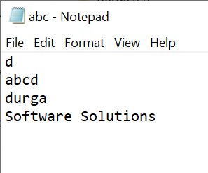
Example of BufferedWriter:
import java.io.*;
class BufferedWriterDemo{
public static void main(String[] args)throws IOException {
FileWriter fw = new FileWriter("abc.txt");
BufferedWriter bw = new BufferedWriter(fw);
bw.write(100);
bw.newLine();
char[] ch1 = {'a','b','c','d'};
bw.write(ch1);
bw.newLine();
bw.write("durga");
bw.newLine();
bw.write("Software Solutions");
bw.flush();
bw.close();
}
}
Note **
Whenever we are closing BufferedWriter automatically internal FileWriter will be closed . And we are not required to close explicitly.

Slide 15
BufferedReader:
We can use BufferedReader to read character data from the file .The main advantage of BufferedReader when compared with FileReader is we can read data line by line in addition to character by character.
Constructors:
BufferedReader br = new BufferedReader(Reader r);
BufferedReader br = new BufferedReader(Reader r, int buffersize)
Note**
BufferedReader can’t communicate directly with the file and it can communicate by a some reader object .
Methods:
1.public int read();
2. public int read(char[] ch);
3. public void close();
4. public String readLine();
It attempts to read next line from the file and returns it . If the nextLine not available then it returns null .

Slide 16
FileReader Example:
import java.io.*;
class BufferedReaderDemo{
public static void main(String[] args)throws IOException {
FileReader fr = new FileReader("abc.txt");
BufferedReader br = new BufferedReader(fr);
String line = br.readLine();
while(line != null){
System.out.println(line);
line = br.readLine();
}
br.close();
}
}
Note**
Whenever we are closing BufferedReader automatically underline FileReader will be closed and we are not required to close explicitly .
The most enhanced reader to read character data from the file is BufferedReader .

Slide 17
PrintWriter:
It is the most enhanced writer to write character data to the file the main advantage of PrintWriter over FileWrtier and BufferedWriter is we can write any type of primitive data directly to the file .
Constructors:
PrintWriter pw = new PrintWriter(String Filename);
PrintWriter pw = new PrintWriter(File f);
PrintWriter pw = new PrintWriter(Writer w);
Note**
PrintWriter can communicate directly with the file and can communicate by a some writer object also .
Methods:
1. public void write(int ch);
2. public void write(char[] ch);
3. public void write(String s);
4. public void flush();
5. public void close();
=======
public void print(char ch);
public void print(int i);
public void print( double d);
public void print(boolean b);
public void print(String s);

Slide 18
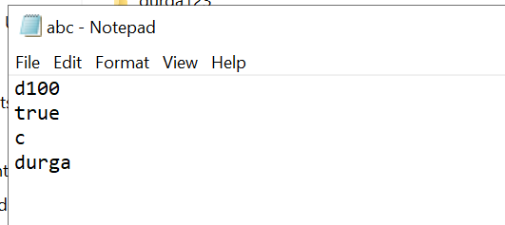
=======================
public void println(char ch);
public void println(int i);
public void println( double d);
public void println(boolean b);
public void println(String s);
Example PrintWriter:
import java.io.*;
class PrintWriterDemo{
public static void main(String[] args)throws IOException {
FileWriter fw = new FileWriter("abc.txt");
PrintWriter out = new PrintWriter(fw);
out.write(100);
out.println(100);
out.println(true);
out.println('c');
out.println("durga");
out.flush();
out.close();
}
}

Slide 19
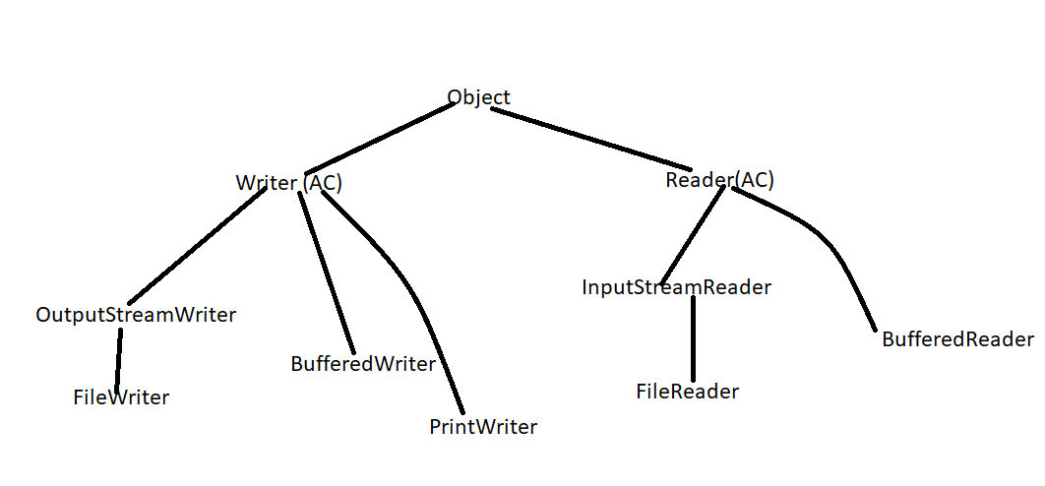
What is the difference between write(100) and print(100)?
Ans. In the case of write(100) the corresponding character d will be added to the file . But in the case of print of 100 the int value 100 will be added to the file directly .
Note**
The most enhanced writer to write character data to the file is Printwriter whereas the most Reader to read character data from the file is BufferedReader .
Note
In general we can use readers and writers to handle character data (text data) whereas we can use streams to handle binary data like images , pdf file , video file audio files etc.. We can use outputStream to write binary data to the file , InputStream to read binary data from the file

Slide 20
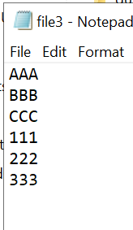
Write a program to merge a data from two files into a third file .
import java.io.*;
class MergeTwoFileContent{
public static void main(String[] args)throws IOException {
PrintWriter out = new PrintWriter("file3.txt");
BufferedReader br = new BufferedReader(new FileReader("file1.txt"));
String line = br.readLine();
while(line != null){
out.println(line);
line = br.readLine();
}
br = new BufferedReader(new FileReader("file2.txt"));
line = br.readLine();
while(line != null){
out.println(line);
line = br.readLine();
}
out.flush();
out.close();
br.close();
}
}

Slide 21
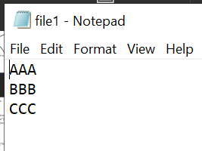
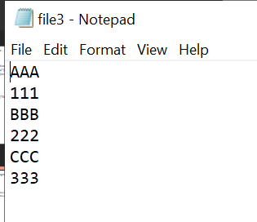
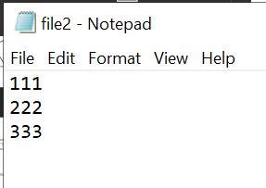
Write a program to perform file merge operation where merging should be done line by line alternatively .
import java.io.*;
class FileMergerDemo{
public static void main(String[] args) throws IOException{
PrintWriter out = new PrintWriter("file3.txt");
BufferedReader br1 = new BufferedReader(new FileReader("file1.txt"));
BufferedReader br2 = new BufferedReader(new FileReader("file2.txt"));
String line1 = br1.readLine();
String line2 = br2.readLine();
while((line1!=null)||(line2 !=null)){
if(line1!= null)
{
out.println(line1);
line1 = br1.readLine();
}
if(line2!=null){
out.println(line2);
line2 = br2.readLine();
}
}
out.flush();
br1.close();
br2.close();
out.close();
}
}

Slide 22
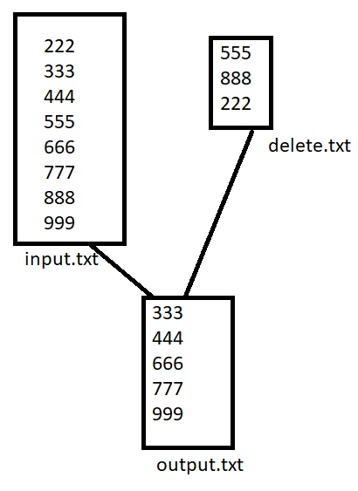
Examples of PrintWriter and BufferedReader :
Write a program to perform file extraction operation .
Output = input – delete
import java.io.*;
class FileExtractionDemo{
public static void main(String[] args) throws IOException{
PrintWriter out = new PrintWriter("output.txt");
BufferedReader br = new BufferedReader(new FileReader("input.txt"));
String line = br.readLine();
while(line != null){
boolean available = false;
BufferedReader br2 = new BufferedReader(new FileReader("delete.txt"));
String target = br2.readLine();
while(target!=null){
if(line.equals(target)){
available = true;
break;
}
target = br2.readLine();
}
if(available == false){
out.println(line);
}
line = br.readLine();
}
out.flush();
}
}

Slide 23
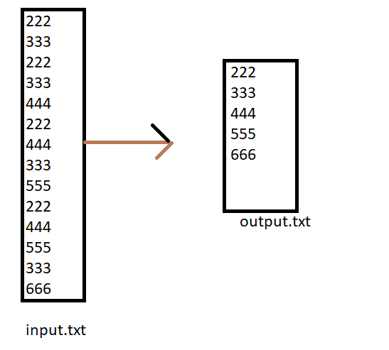
Write a java program to remove duplicates from the given input file .
import java.io.*;
class FileRemoveDuplicates{
public static void main(String[] args) throws IOException{
PrintWriter out = new PrintWriter("output.txt");
BufferedReader br = new BufferedReader(new FileReader("input.txt"));
String line = br.readLine();
while(line != null){
boolean available = false;
BufferedReader br2 = new BufferedReader(new FileReader("output.txt"));
String target = br2.readLine();
while(target!=null){
if(line.equals(target)){
available = true;
break;
}
target = br2.readLine();
}
if(available == false){
out.println(line);
out.flush();
}
line = br.readLine();
}
}
}

