Slide 1
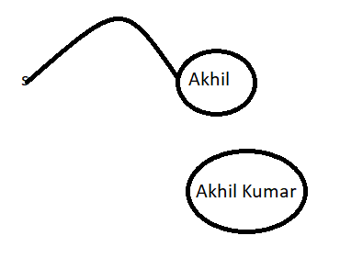
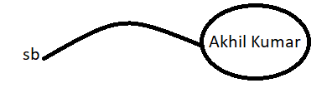
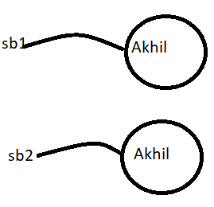
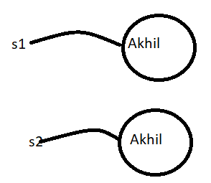
Java.lang.String()
Case 1 :
Case2 :
String | StringBuffer
String s = new String("Akhil"); s.concat("Kumar"); System.out.println(s); // Akhil Once we create String Object we can’t perform any changes in the existing object If we are trying to perform any change, with those changes a new object will be created. This non-changeable is nothing but immutability of String String s1 = new String("Akhil"); String s2 = new String("Akhil"); System.out.println(s1==s2); //false System.out.println(s1.equals(s2)); // true In String class .equals() method is overridden for content comparison Hence, eventhough objects are different if content is same .equals() method returns true | StringBuffer sb = new StringBuffer("Akhil"); sb.append(" Kumar"); System.out.println(sb); // Akhil Kumar Once we create StringBuffer object we can perform any change in the existing object this changeable behaviour is nothing but mutability of StringBuffer object StringBuffer sb1 = new StringBuffer("Akhil"); StringBuffer sb2 = new StringBuffer("Akhil"); System.out.println(sb1==sb2); // false System.out.println(sb1.equals(sb2)); // false In StringBuffer .equals() method is not overridden for content comparison . Hence,Object class .equals method is executed which is meant for reference comparison(Address comparison) due to this if objects are different .equals method returns false eventhough content is same

Slide 2
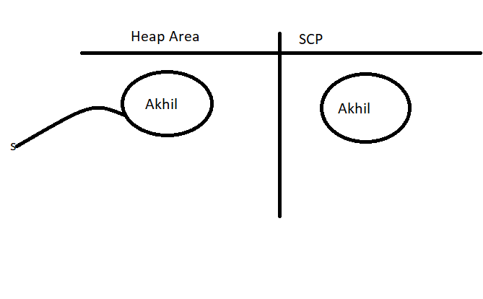
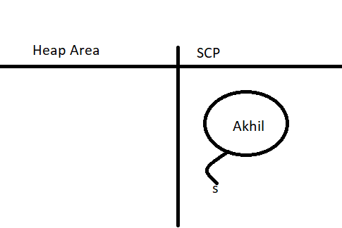
String s = new String(“Akhil”); In this case two objects will be created one in the heap area and the other is in SCP and S is always pointing to heap object. | String s = “Akhil”; In this case only one object will be created in scp and s is always pointing to that object .
Note:
Object creation in scp is optional first it will check is there any object is already present in scp with required content . If object already present then existing object will be reused . If object not already available then only a new Object will be created . But this rule is applicable only for scp but not for the heap.
Garbage collector is not allowed to access scp area Hence, eventhough object doesn’t contain reference variable it is not eligible for gc if it is present in scp area.
All scp objects will be destroyed automatically at the time of JVM shutdown .

Slide 3
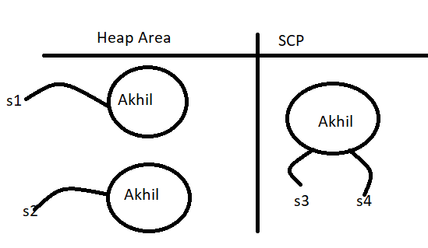
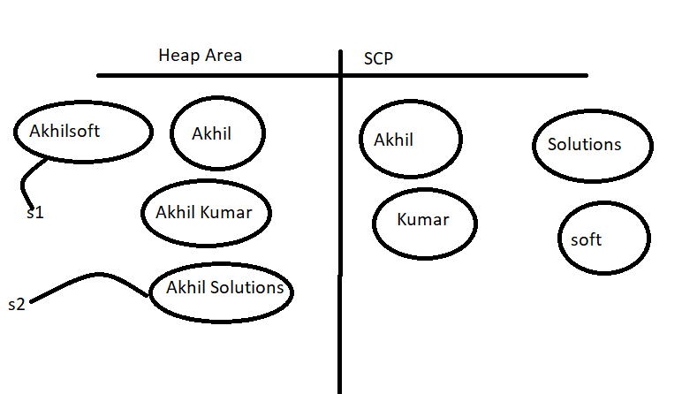
Example :
String s1 = new String("Akhil");
String s2 = new String("Akhil");
String s3 = "Akhil";
String s4 = "Akhil"; // Total 3 objects will be created .
Note:
Whenever we are using new operator compulsory a new object will be created in Heap Area . Hence, there may be a chance of existing two objects with same content in the Heap area but not in SCP . i.e. duplicate objects are possible in the Heap area but not in SCP
String s1 = new String("Akhil");
s1.concat("Kumar");
String s2 = s1.concat("Solutions");
s1 = s1.concat("soft");
System.out.println(s1); // AkhilSoft
System.out.println(s2); // Akhil Solutions
// Total 8 objects will be created

Slide 4
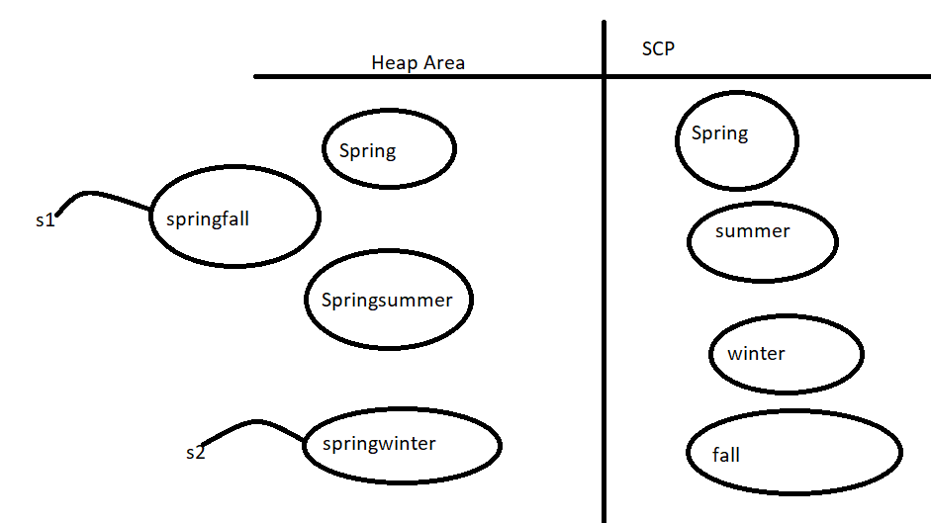
Note :
For every String constant one Object will be placed in scp area .
Because of some runtime operation if an object is required to create then that object will be placed only in the heap area But not in SCP area .
Fo example :
String s1 = new String("Spring");
s1.concat("summer");
String s2 = s1.concat("winter");
s1 = s1.concat("fall");
System.out.println(s1);// Springfall
System.out.println(s2); // Springwinter

Slide 5
Constructors of String class
String s = new String();
creates an empty String object
2. String s = new String(String literal);
Creates a String object on the Heap for a given String literal
3. String s = new String(StringBuffer sb);
Creates an equivalent String object for the given StringBuffer / StringBuilder
4. String s = new String(Char[] ch);
Creates an equivalent String object for the given char[] array
Example char[] ch ={‘a’,’b’,’c’,’d’};
String s = new String(ch);
System.out.println(s); // abcd
5. String s = new String(byte[] b)
Creates an equivalent String object for the given byte Array
byte[] b = {100,101,102,103};
String s = new String(b);
System.out.println(s) // defg

Slide 6
Important Methods of String class
1. public char charAt(int index);
Returns the character locating at specified index .
Example :
String s = “durga”;
System.out.println(s.charAt(3));// g
System.out.println(s.charAt(30)); // RE : StringIndexOutOfBoundsException
2. public String concat(String s):
The overloaded + and += operator meant for concatenation purpose only .
String s = “Akhil”;
S = s.concat(“Kumar”);
//S = s+”Kumar”;
// s+=“kumar”;
3. public boolean equals(Object o);
To perform content comparison where case is important. this is overridden version of object class equals() method .
4. public boolean equalsIgnoreCase(String s)
To perform content comparison where case is not important .
String s = “JAVA”;
System.out.println(s.equals(“java”)) // false
System.out.println(s. equalsIgnoreCase(“java”))// true

Slide 7
Note:
In general we can use equalsIgnoreCase() method to validate usernames where case is not important . Whereas, we can use equals() method to validate password where case is important.
5. public String substring(int begin );
Returns String from begin index to end of the String.
6. public String substring(int begin,int end);
Returns substring from begin index to end-1 index
Example
String s = “abcdefg”
System.out.println(s.substring(3)); // defg
System.out.println(s.substring(2,6));// cdef
7. Public int length()
Returns number of characters present in the string.
Example :
String s = “Akhil”
System.out.println(s.length) // CE : can not find symbol symbol: variable length . Location : java.lang.String
System.out.println(s.length())// 5
Note : length variable applicable for arrays but not for String objects whereas length() method applicable for String object not for arrays

Slide 8
public String replace(char oldCh,char newCh)
Example :
String s = “ababa”;
System.out.println(s.replace(‘a’,’b’))// bbbbb
public String toLowerCase();
public String toUpperCase();
=======================
public String trim();
To remove blank spaces present at beginning and end of the string but not middle blank spaces .
public int indexOf(char ch);
Returns index of first occurrence of specified character
public int lastIndexOf(char ch);
Returns index of last occurrence of specified character
Example:
String S = “ababa”;
System.out.println(s.indexOf(‘a’)); // 0
System.out.println(s.lastIndexOf(‘a’)) //4

Slide 9
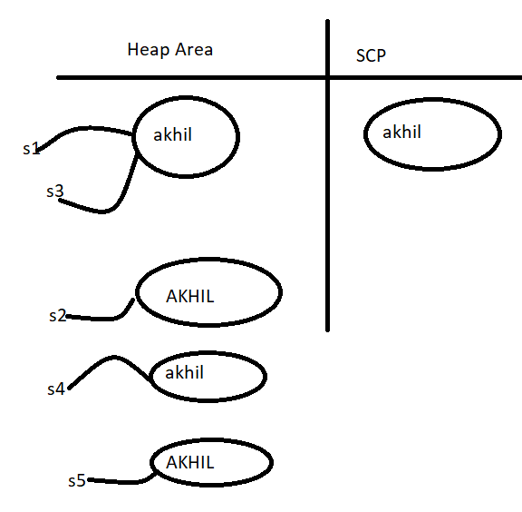
Note *** :
Because of Runtime Operation if there is a change in the content then with those changes a new object will be created on the heap . If there is no change in the content then existing object will be reused and new object won’t be created .
Whether the object present in Heap or SCP the rule is same .
String s1 = new String(“akhil”);
String s2 = s1.toUpperCase();
String s3 = s2.toLowerCase();
System.out.println(s1==s2); // false
System.out.println(s1==s3); // true
String s4 = s2.toLowerCase();
String s5 = s4.toUpperCase()

Slide 10
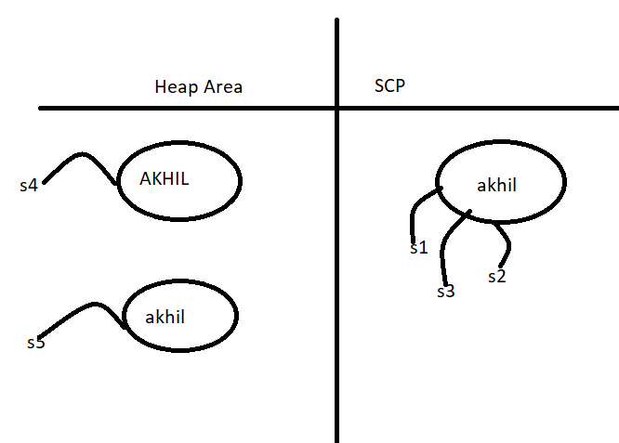
Example 2:
String s1 = “akhil”;
String s2 = s1.toString();
System.out.println(s1==s2);
String s3 = s1.toLowerCase();
String s4 = s1.toUpperCase();
String s5 = s4.toLowerCase();

Slide 11
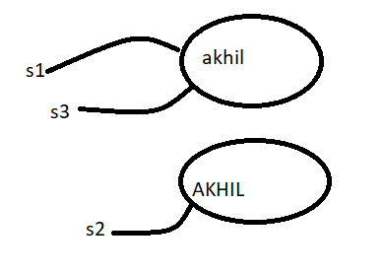
How to create our own immutable class ?
Once we creates an object we can’t perform any changes in that object if we are trying to perform any change and if there is change in the content then with those changes a new object will be created . If there is no change in the content then existing object will be reused .
This behavior is nothing but immutability
String s1 = “akhil“
String s2 = s1.toUpperCase();
String s3 = s1.toLowerCase();
We can create our own immutable class .

Slide 12
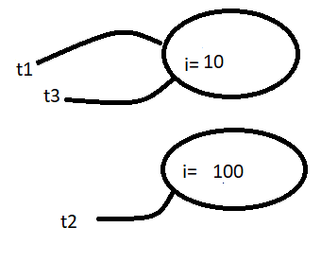
Creating immutable class Example
final public class Test{
private int i;
Test(int i){
this.i = i;
}
public Test modify(int i){
if(this.i == i)
return this;
else
return (new Test(i));
}
public static void main(String[] args){
Test t1 = new Test(10);
Test t2 = t1.modify(100);
Test t3 = t1.modify(10);
System.out.println(t1==t2); // false
System.out.println(t1==t3); // true
}
}

Slide 13
Once we creates a test object we can’t perform any change in the existing object if we are trying to perform any change and if there is a change in the content then with those changes a new object will be created . And if there is no change in the content then existing object will be reused
Final vs Immutability :
public class Test{
public static void main(String[] args){
final StringBuffer sb = new StringBuffer("akhil");
sb.append("software");
System.out.println(sb);
// sb = new StringBuffer("solutions"); Error :cannot assign a value to final variable sb
}
}
Final applicable for variables but not for objects whereas immutability applicable for objects but not for variables.
By declaring a reference variable as final we won’t get any immutability nature eventhough reference variable is the final we can perform any type of change in the corresponding object but we can’t perform reassignment for that variable .
Hence final and immutable both are different concept .

Slide 14
Which of the following are meaningful ?
Final variable == Valid
Immutable variable == Invalid
Final Object == Invalid
Immutable Object == Valid

Slide 15
String vs StringBuffer vs StringBuilder
StringBuffer:
If the content is fixed and won’t change frequently then it is recommended to go for String.
If the content is not fixed and keep on changing then it is not recommended to use String because for every change a new object will be created which affects performance of the system . To handle this requirement we should go for StringBuffer . The main advantage of StringBuffer over String is all required changes will be performed in the existing object only .
Constructors:
1. StringBuffer sb = new StringBuffer();
Creates an empty StringBuffer object with default Initial capacity 16 once Stringbuffer reaches its max capacity a new StringBuffer object will be created with new Capacity = (currentCapacity+1) *2
Example:
public class Test{
public static void main(String[] args){
StringBuffer sb = new StringBuffer();
sb.append("abcdefghijklmnop");
System.out.println(sb.length()); // 16
System.out.println(sb.capacity()); // 16
sb.append("q");
System.out.println(sb.length()); // 17
System.out.println(sb.capacity()); // 34
}
}

Slide 16
2. StringBuffer sb = new StringBuffer(int initialCapacity);
Creates an empty StringBuffer object with specified initial capacity .
3.StringBuffer sb = new StringBuffer(String s);
Creates an equivalent StringBuffer for the given String with capacity is equal to (s.length +16)
Example:
public class Test{
public static void main(String[] args){
StringBuffer sb = new StringBuffer("akhil");
System.out.println(sb.capacity());// 21
}
}

Slide 17
Important Methods of StringBuffer
public int length();
public int capacity();
public char charAt(int index)
Example :
StringBuffer sb = new StringBuffer("akhil");
System.out.println(sb.charAt(3)); // 3
System.out.println(sb.charAt(30)); // RE : StringIndexOutOfBoundsException
public void setCharAt(int index, char ch);
// To replace the character located at specified index with provided character .
public StringBuffer append(String s); // (int i),(long l),(char ch),(Boolean b)== Overloaded methods .
Example:
public class Test{
public static void main(String[] args){
StringBuffer sb = new StringBuffer();
sb.append("PI Value is : ");
sb.append(3.14);
sb.append(" It is exactly: ");
sb.append(true);
System.out.println(sb);
}
}

Slide 18
public StringBuffer insert(int index, String s);// (int index, int i), (int index, double d) (int index, Char ch) (int index, Boolean b)
=== overloaded Methods .
Example :
StringBuffer sb = new StringBuffer(“abcdefgh”);
sb.insert(2,”xyz”);
System.out.println(sb);// abxyzcdefgh
public StringBuffer delete(int begin,int end)
// to delete characters located from begin index to end -1 index
public StringBuffer deleteCharAt(int index)
// To delete the character located at specified index
public StringBuffer reverse();
StringBuffer sb = new StringBuffer(“Akhil”);
System.out.println(sb.reverse()); // lihkA

Slide 19
public void setLength(int length);
Example:
StringBuffer sb = new StringBuffer(“aishwaryaabhi”);
sb.setLength(8);
System.out.println(sb);// Aishwarya
public void ensureCapacity(int capacity);
// to increase capacity on fly based on our requirement .
StringBuffer sb = new StringBuffer()
System.out.println(sb.capacity()); // 16
Sb.ensureCapacity(1000);
System.out.println(sb.capacity());
public void trimToSize();
// to deallocate extra allocated free memory.
StringBuffer sb = new StringBuffer(1000);
sb.append(“abc”);
sb.trimToSize(3);
System.out.println(sb.capacity()); // 3

Slide 20
StringBuilder:
1 . Every method present in StringBuffer is synchronized and hence only one thread is allowed to operate on StringBuffer object at a time which may create performance problem . Sun people introduced StringBuilder concept in 1.5 version
Buffer === Builder
Synchronized == removed
2. StringBuilder is exactly same as StringBuffer except the following differences

Slide 21
StringBuffer | StringBuilder
1. Every method present in StringBuffer is synchronized . | 1. Every method present StringBuilder is non-Synchronized .
2. At a time only one thread is allowed to operate on StringBuffer object . Hence stringBuffer object is Thread Safe | At a time multiple threads are allowed to operate and Hence StringBuilder is not thread safe
3. Threads are required to wait to operate on StringBuffer object and hence relatively performance is low | 3. Threads are not required to wait to operate on StringBuilder object and Hence relatively performance is high .
Introduced in 1.0 version | Introduced in 1.5 version
Note:
Except above differences everything is same in StringBuffer and StringBuilder including methods and constructors .

Slide 22
String vs StringBuffer vs StringBuilder
If the content is fixed and won’t change frequently .then we should go for String
If the content is not fixed and keep on changing but thread safety required then we should go for StringBuffer .
If the content is not fixed keep on changing but thread safety is not required then we should go for StringBuilder .
Method Chaining:
For most of the method in String, StringBuffer and StringBuilder return types are same type . Hence, After applying a method on the result we can call another method which forms method chaining
sb.m1().m2().m3().m4().m5()…….;
In method chaining method calls will be executed from left to right
Example :
public class Test{
public static void main(String[] args){
StringBuffer sb = new StringBuffer();
sb.append("akhil").append("software").append("Solutions").insert(5,"Durga").delete(13,21).append(" Manoj Kumar").append(" Mohd. Salman").reverse();
System.out.println(sb);
}
}

Slide 23
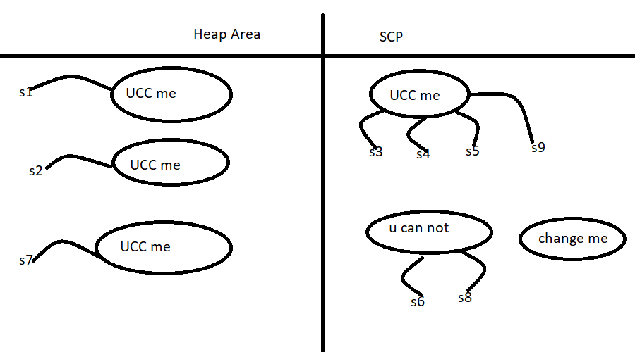
String Postmortem Example :
public class Test{
public static void main(String[] args){
String s1 = new String("you can not change me");
String s2 = new String("you can not change me");
System.out.println(s1==s2); // false
String s3 = "you can not change me";
System.out.println(s1==s3); // false
String s4 = "you can not change me";
System.out.println(s3==s4); // true
String s5 = "you can not"+" change me"; // if both are constants then the addition operation will took place at compile time
System.out.println(s4==s5); // true
String s6 = "you can not";
String s7 = s6+" change me"; // if there is atleast one variable in operation then the expression will be evaluated at runtime .
System.out.println(s4==s7); // false
final String s8 = "you can not";
String s9 = s8+" change me"; // final variable will be treated as constants hence the expression will be evaluated at compiletime
System.out.println(s4==s9); // true
}
}

Slide 24
Advantage / Importance of SCP :-
In SCP single object can be referenced with multiple references .
In this way memory utilization and performance will be improved .
But there is a problem …..
If any reference is allowed to change the content of the object then all the references will be impacted that’s why sun people made the String objects as immutable .
If any reference wants to change it’s content then with those changes a new object will be created . And particular reference pointing to the new object . Immutability is required for SCP

Slide 25
FAQ’s
Why scp concept is available only for String object but not for StringBuffer ?
String is most commonly used datatype in java . 90 % of the variables in every project are String objects only . Whereas StringBuffer is we might not be using in application .
2. Why String objects are immutable whereas StringBuffer objects are mutable ?
Because SCP we can reuse single object for multiple references .
In addition to String objects any other objects are immutable in java ?
All Wrapper class objects are also immutable .
String Comprehensive Example :
public class Test{
public static void main(String[] args){
String ta = "A";
ta = ta.concat("B");
String tb = "C";
ta = ta.concat(tb);
ta.replace('C','D');
ta = ta.concat(tb);
System.out.println(ta);
}
} /// ABCC

Slide 26
String Example
public class Test{
public static void main(String[] args){
String str = " ";
str.trim();
System.out.println(str.equals("")+" "+ str.isEmpty());
}
} /// false false
2.
public class Test{
public static void main(String[] args){
String s = "Akhil Kumar";
int len = s.trim().length();
System.out.println(len);
}
} /// 11
3.
public class Test{
public static void main(String[] args){
String s = "Hello world";
s.trim();
int i = s.indexOf(" ");
System.out.println(i);
}
} /// 5

Slide 27
Examples Of StringBuilder and StringBuffer
public class Test{
public static void main(String[] args){
StringBuilder sb = new StringBuilder(5);
String s = "";
if(sb.equals(s))
System.out.println("Match1");
else if(sb.toString().equals(s.toString()))
System.out.println("Match2");
else
System.out.println("No Match ");
}
} ///Match2
2.
public class Test{
public static void main(String[] args){
StringBuilder sb = new StringBuilder("Durga");
String str1 = sb.toString();
String str2 = str1;
System.out.println(str1 == str2);
}
} ///true

Slide 28
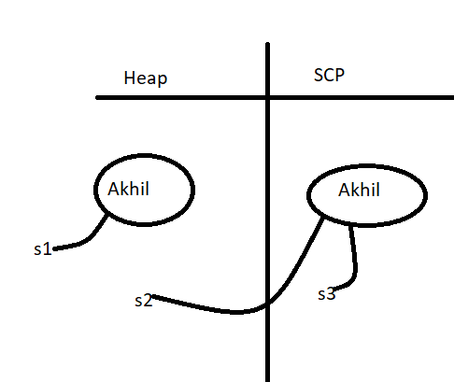
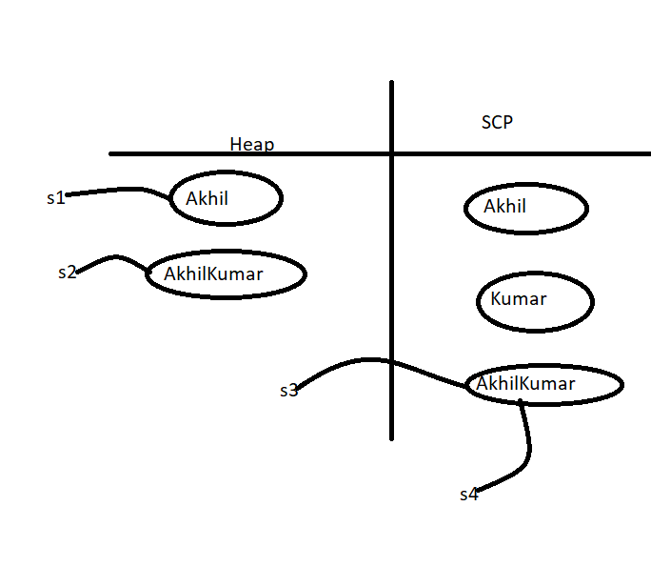

Interning of String Objects :
By using heap object reference if we want to get corresponding SCP object reference then we should go for intern method .
public class Test{
public static void main(String[] args) {
String s1 = new String("Akhil");
String s2 = s1.intern();
System.out.println(s1==s2); // false
String s3 = "Akhil";
System.out.println(s2==s3);
}
}
If the corresponding scp object is not available then intern method itself will create the corresponding scp object
public class Test{
public static void main(String[] args) {
String s1 = new String("Akhil");
String s2 = s1.concat("Kumar");
String s3 = s2.intern();
System.out.println(s2==s3);
String s4 = "AkhilKumar";
System.out.println(s3==s4);
}
}

Slide 29

Importance of SCP :
Voter Registration form :
In our program if a String object is repeatedly required then it is not
Recommended to create separate object for every requirement
Because it creates performance and memory problems
Instead of creating a separate object for every requirement we have to create
Only one object and we can reuse the same object for every requirement so
That performance and memory utilization will be improved
This thing is possible because of SCP . Hence the main advantages of SCP are:
Memory Utilization and performance will be improved .
But the main problem with SCP is as several references pointing to the same
Object . By using one reference if we are trying to change the content then
Remaining references will be affected . To overcome this problem Sun people
Implemented String objects as Immutable . i.e . Once we creates a string
Object we can’t perform any change in the existing object . If we are trying
To perform any changes with those changes a new object will be created. Hence SCP is the only reason for
String objects .

Slide 30
FAQs
Difference between String and StringBuffer
Explain about immutability and mutability with an example .
What is the difference between String s = new String(“durga”); and String s = “durga”;
Other than immutability and mutability is any other difference between String and StringBuffer?
What is SCP?== It is specially designed memory area for String Objects
What is the advantage of SCP?
Why SCP like concept is available only for String but not for StringBuffer ? = Since String is most commonly used object and hence sun people provided special memory management for String Object where as StringBuffer is not commonly used .
What is the disadvantage of SCP?
Why String Objects are immutable whereas StringBuffer Objects are mutable? In the case of String because of SCP a single object can be referenced by multiple references .By using one reference if we are allowed to change the content in the existing object then remaining references will be affected . To overcome this problem sun people implemented String objects as immutable .According to this once we creates a string object we can’t perform any changes in the existing object if we are trying to perform any changes with those changes a new object will be created . But in StringBuffer there is no concept like SCP . Hence for every requirement a separate object will be created . By using one reference if we are trying to change the content then there is no effect on remaining references Hence immutability concept not required for StringBuffer
In addition to String Objects any other Objects are immutable in java? All Wrapper classes
Is it possible to create our own immutable class. ?
How to create our own Immutable class . Explain with an example .
Immutable means non-changeable whereas final means also non-changeable . Then what is the difference between final and immutable ?

Slide 31
