Slide 1
ASSEMBLY LANGUAGE 8085/86
PYTHON
C
JAVA

Slide 2


Slide 3


Slide 4


Slide 5
SOLIDWORKS
PROTEUS
PROCESSING
TINA
MATLAB
DIPTRACE
MIKROC
SIMULINK

Slide 6
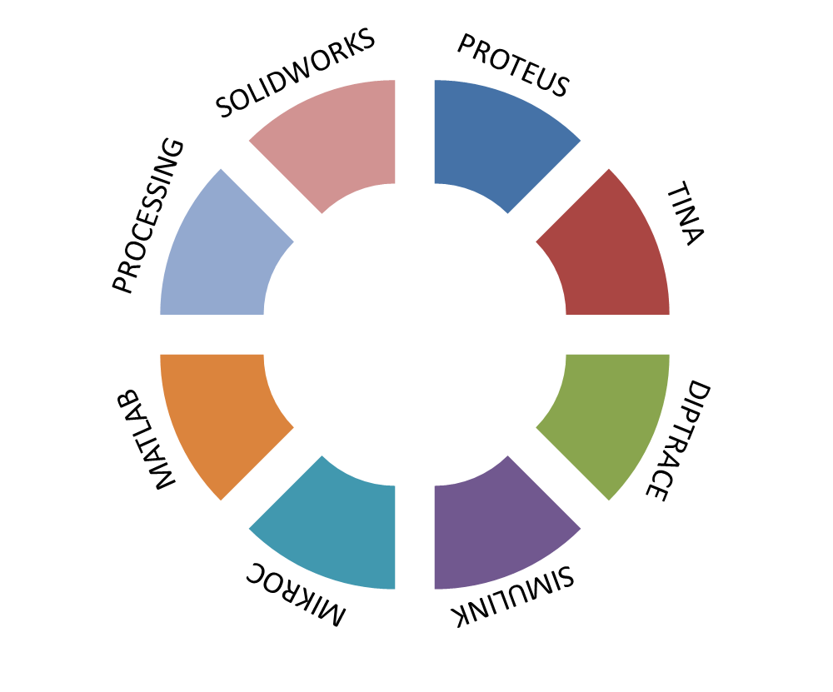

Slide 7


Slide 8


