Slide 1
Detection of Anatomical Bounds from Foetus Ultrasound Images using YOLO architecture
Kumaramangalam Vangavolu -50496493

Slide 2
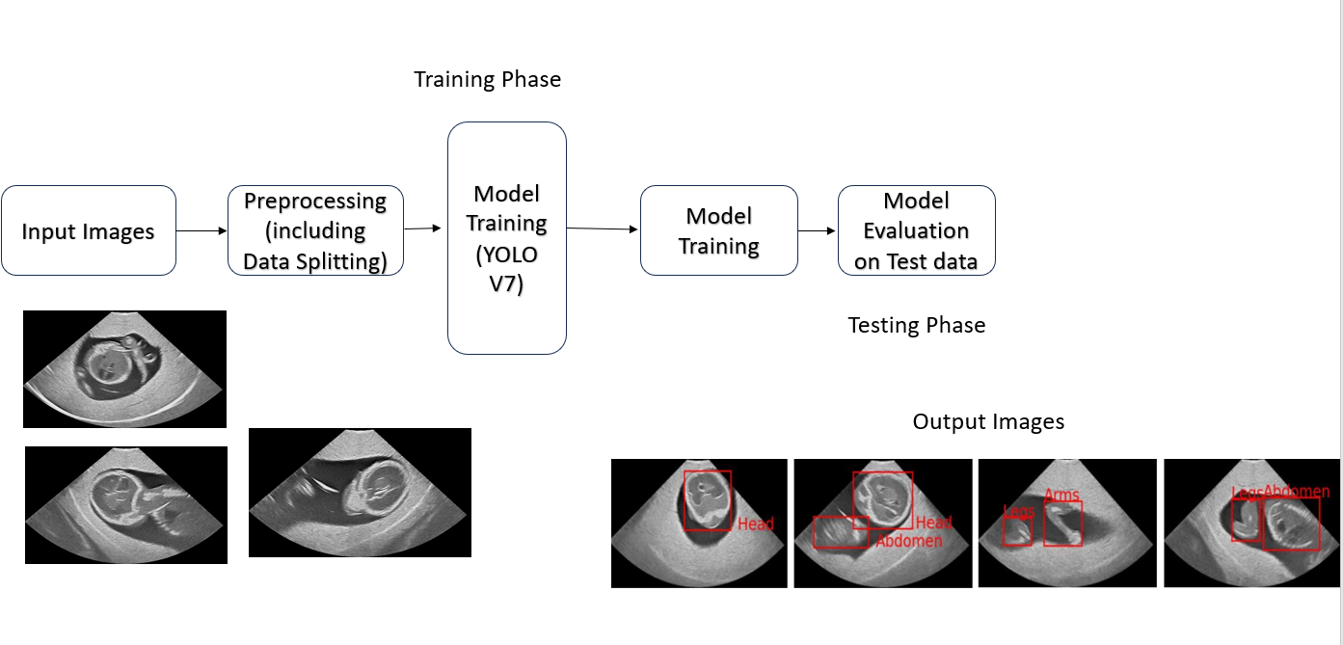
Overview of the project:
Dataset: Fetus Phantom Ultrasound dataset (FPUS23), 9455 images, 672*389

Slide 3
Data Source: Ultrasound Fetus Phantom Dataset (https://arxiv.org/pdf/2303.07852.pdf, https://github.com/bharathprabakaran/FPUS23)
Scale of Data: 9,455 labelled anatomical bounds(Train- 6618, Test-1418, Validation -1418)
Coding Resource Requirements:
Libraries: PyTorch, OpenCV, Tensorflow, XMLtree
Success Definition: Accurate identification and demarcation of anatomical bounds in the ultrasound images and the model mAP should outperform the baseline model’s mAP
Model: YOLOv7-tiny

Slide 4
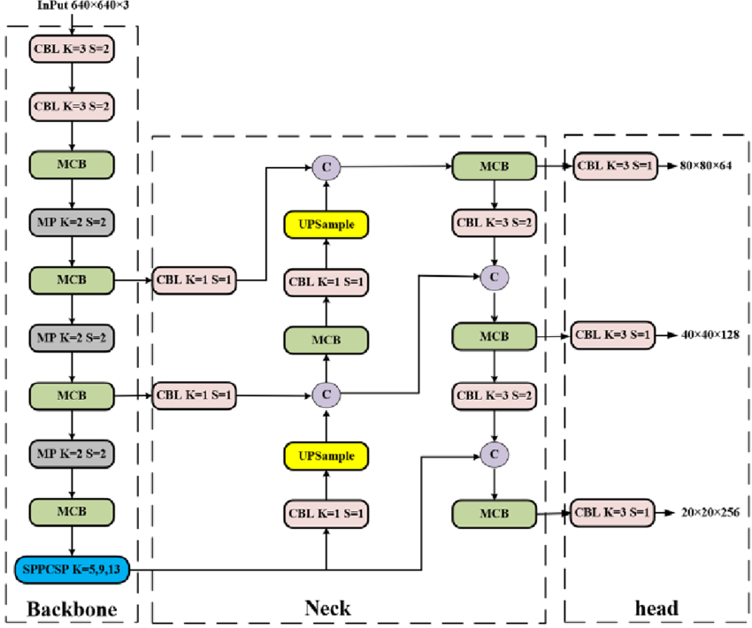
YOLO v7-tiny model architecture
Ref: https://www.researchgate.net/figure/Structure-diagram-of-the-YOLOv7-tiny_fig1_371511115

Slide 5
Using Pretrained Weights: The objective was to assess how well the model could adapt its pre-learned features to ultrasound images. This model is trained for 77 epochs.
Training From Scratch: To observe how the model learns and adapts when it is exclusively exposed to the FPUS23 dataset from the beginning of its training. This model is trained for 213 epochs
Training From Scratch with Modified Hyperparameters and Preprocessed Images with median blur: The HSV image augmentation parameter was set to a value of 0, while other parameters like mixup and mosaic augmentation, momentum, translation, and learning rate were maintained at their original values, as adjustments to these parameters resulted in a decrease in performance. This model is trained for 75 epochs.
Using Pretrained Weights with Modified Hyperparameters and Preprocessed Images: The above mentioned approach was also applied while utilizing pretrained weights.This model is trained for 109 epochs

Slide 6
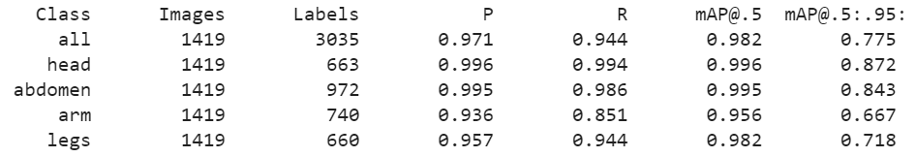
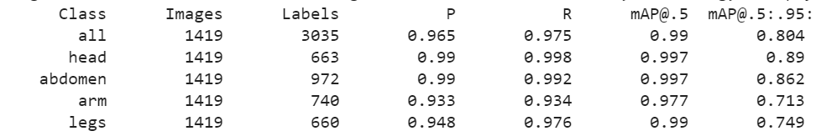
Results:
Using Pretrained Weights:
Training From Scratch with default hyperparameters:

Slide 7
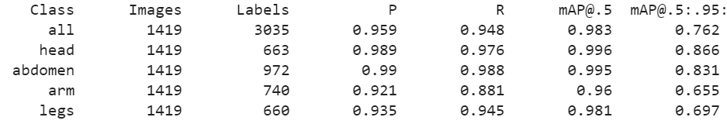
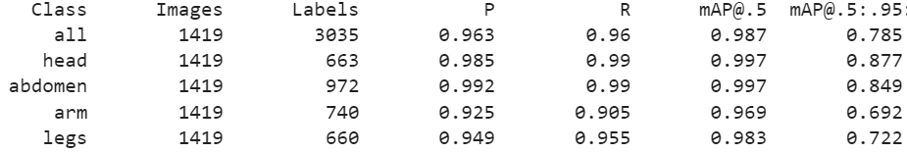
Training From Scratch with Modified Hyperparameters and Preprocessed Images with median blur:
Using Pretrained Weights with Modified Hyperparameters and Preprocessed Images with median blur:

Slide 8
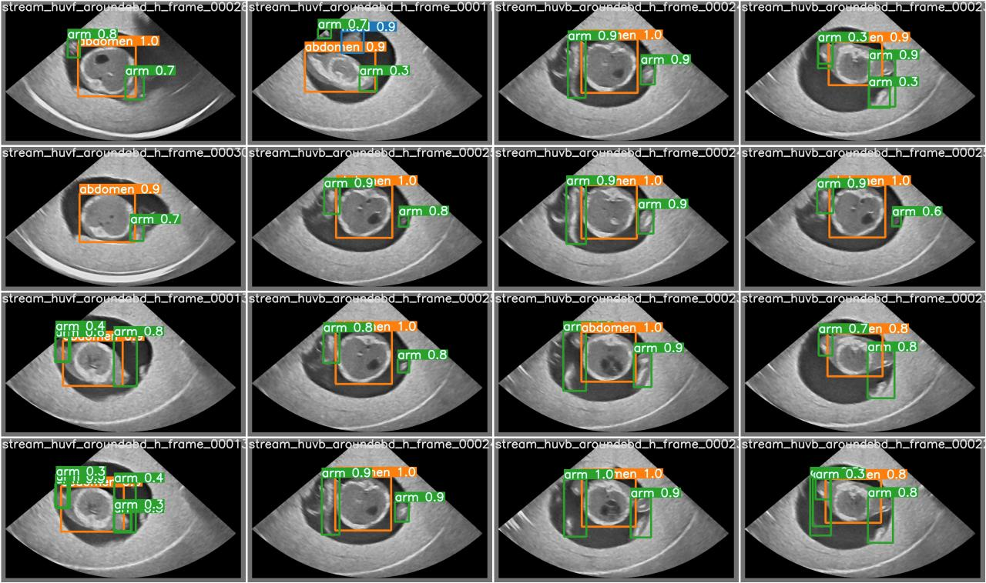

Slide 9
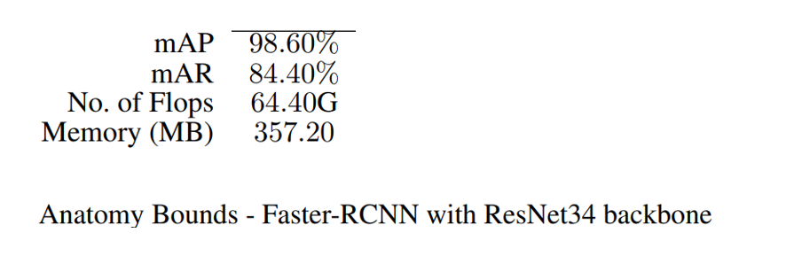
Baseline Results
Conclusion: When these results are compared with baseline results, with from the paper by the authors of FPUS23 , with Faster RCNN and ResNet 34 as backbone, the model trained using YOLOv7 -tiny seems to performs better with mAP of 0.99

Slide 10
Discussion and Lessons Learned:
Some of the models are not trained for longer epochs because of resources constraints. But the training is done till proper accuracies are obtained.
Given this, all the different models will outperform the baseline model when trained for longer epochs.
The YOLOv7-tiny seems to better because of its speed during inference and it can be easily integrated with Ultrasound scanner for faster processing of images and for instant results. The models can be tested on real world dataset from hospitals to check its effectiveness and more advanced YOLO models such as YOLO-NAS and objection detection algorithms such as Detectron can be tested for their effectiveness as continuing research.
Different other variations of YOLO v7 model such as Yolo v7 e2e and main YOLO v7 models might be much more efficient and they are not used because of resource constraints
The backbone of the YOLO model can be changed and can be tested as a future research item ,but this might be complex as it involves changing the YOLO model code as a whole completely.

Slide 11
References
https://github.com/bharathprabakaran/FPUS23
“FPUS23: An Ultrasound Fetus Phantom Dataset with Deep Neural Network Evaluations for Fetus Orientations, Fetal Planes, and Anatomical Features” Bharath Srinivas Prabakaran, Paul Hamelmann, Erik Ostrowski, Muhammad Shafique. https://arxiv.org/abs/2303.07852
“YOLOv7: Trainable bag-of-freebies sets new state-of-the-art for real-time object detectors.” Chien-Yao Wang, Alexey Bochkovskiy, Hong-Yuan Mark Liao. https://arxiv.org/abs/2207.02696
https://github.com/WongKinYiu/yolov7?tab=readme-ov-file

