Slide 2
The Problem
Let us assume an imaginary company (Hospital/Insurance) has approached The Team Alpha with their member dataset.
According to them, they need some desperate help gaining insight on the available data and offer various Health & Insurance plans to their members.
Their main area of focus were the Group Median Percentile Risk Score.
Available Datasets were cardio_train.csv which gives information about the Member’s health and the dailySteps_merged.csv which gives information about the Member’s steps(Walk/Run/Jog).

Slide 3
The Challenge
Both the datasets were not straight forward with the information we needed.
We had to clean and transform most of the data in order to calculate the Risk Score and to provide them with some kind of visualization web application.
Cloud platform must be used either fully/partially.

Slide 4
Data Cleaning & Transformation
Member ID - This value was taken from 1. So if it is 0 in the dataset, it corresponds to 1. Basically cleaned value is one plus the actual value from the dataset.
Age - Blank values were filled with zeros and then the average was substituted before the score calculation. The final age value was calculated based of year 2016.
Height, Weight, ap_hi & ap_low - They were changed based of the existing values in the dataset, either multiplied or divided appropriately.
Medication - NA values under Medication were set based of other relating values such as Cholesterol, Glucose, Smoke, Alcohol, Blood pressure etc.
BMI - This information was not provided directly hence we had to calculate it. Body Mass Index is a simple calculation using a person's height and weight. The formula is BMI = kg/m2

Slide 5
Technologies Used
GCP - App Engine
GCP - Compute Engine
GCP - Cloud SQL
GCP - Cloud Functions
GCP - Cloud Storage
GCP - Secret Manager
Python
Django
Django Rest Framework
HTML
CSS
Javascript
Chart.js

Slide 6
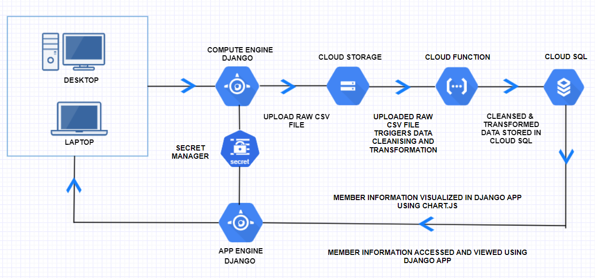
Technical Flow

Slide 7
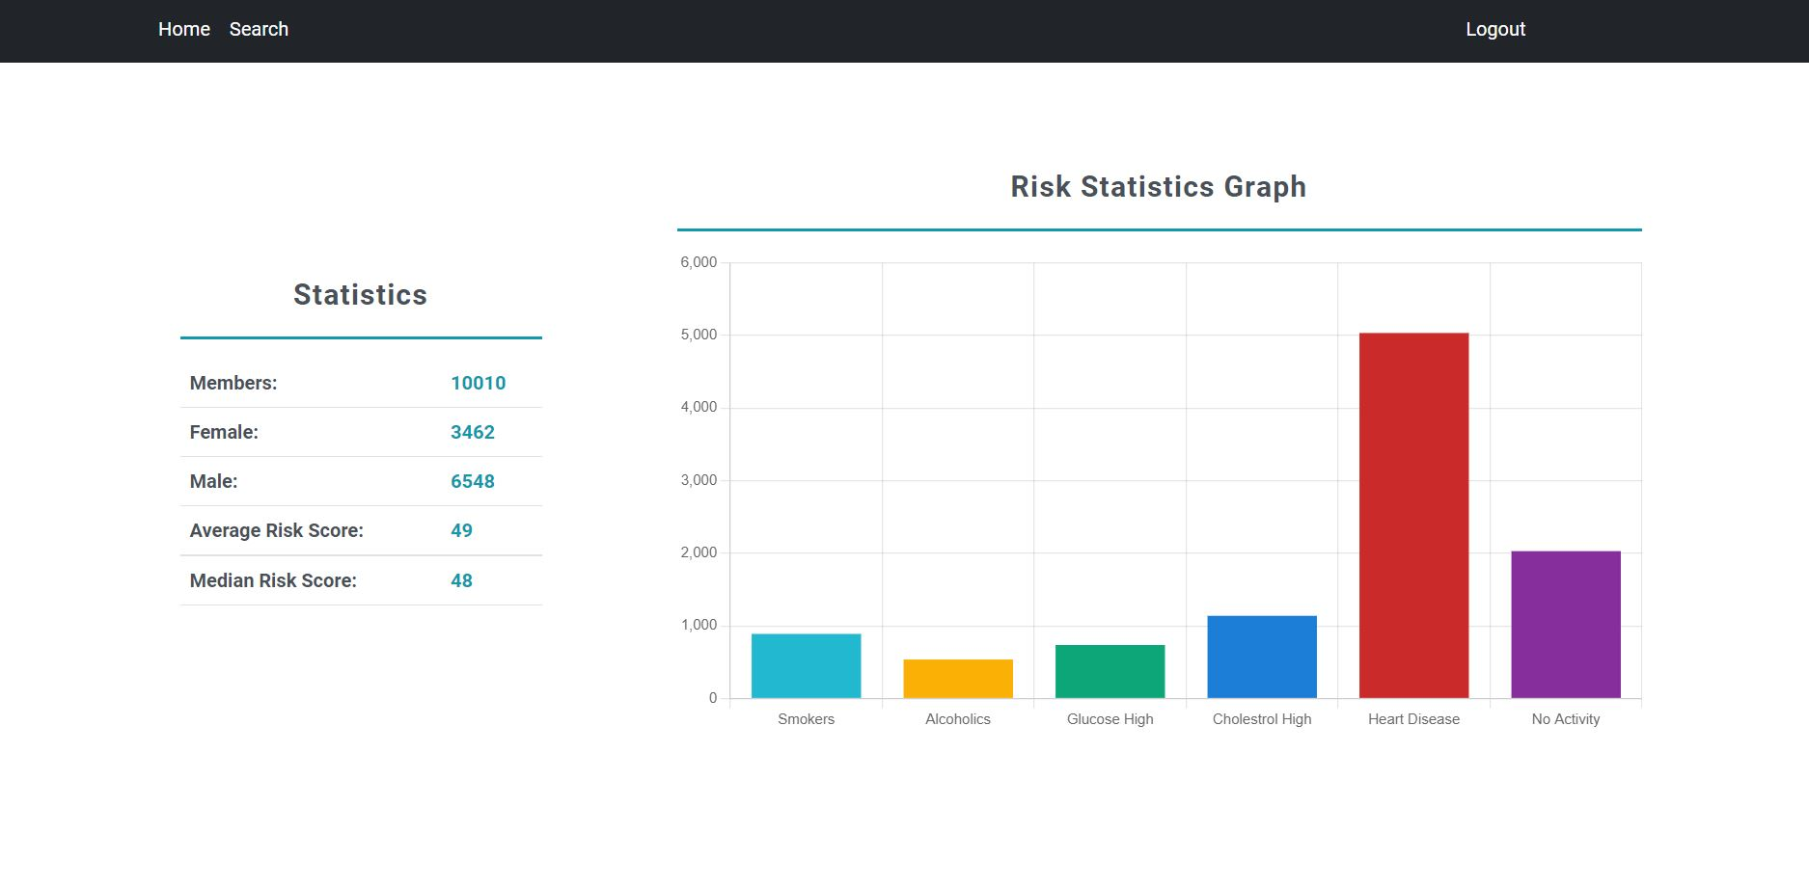
Screenshot - Home page

Slide 8
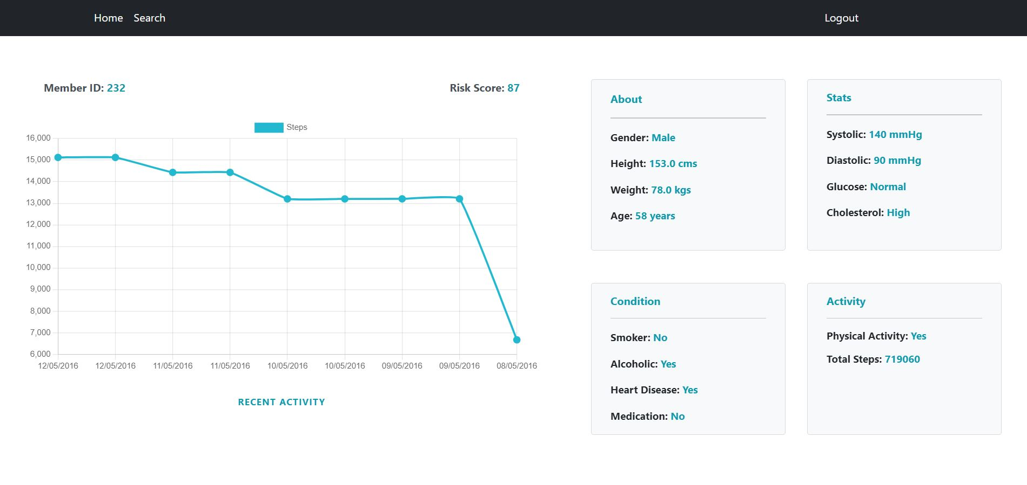
Screenshot - Member page

