Slide 1
Digital Portfolio
STUDENT NAME: G. Kumaran
REGISTER NO AND NMID: 24132251802521025
DEPARTMENT: B.sc. Computer science COLLEGE: Government arts and science College OLLEGE/ UNIVERSITY

Slide 2
PROJECT TITLE
*A clear and concise nema for the project .
*Smart Attendance system using face

Slide 3


AGENDA
Problem Statement
Project Overview
End Users
Tools and Technologies
Portfolio design and Layout
Features and Functionality
Results and Screenshots
Conclusion
Github Link
3/21/2024 Annual Review

Slide 4

PROBLEM STATEMENT *Briefly describe the issue or gap your project is addressing . *Manual attendance tracking is time -consuming and prone to errors.

Slide 5

PROJECT OVERVIEW *A short summary of the project idea, purpose, and scope . *This project automates the attendance process using face

Slide 6

WHO ARE THE END USERS *who will benefit from this project ? *Example : *Students *Teachers *College administrators

Slide 7

TOOLS AND TECHNIQUES
List the software, programming languages, and methods used. Example: Languages: Python, JavaScript Frameworks: OpenCV, Flask, TensorFlow Database: MySQL Techniques: Image processing, Machine Learning

Slide 8
POTFOLIO DESIGN AND LAYOUT
Describe how the portfolio is presented (digital, website, PDF, etc.). Example: Clean, professional layout with sections for problem, solution, and results Visual elements like charts, wireframes, and screenshots Consistent font and color scheme
8

Slide 9
FEATURES AND FUNCTIONALITY
List what your project does. Example: Face detection and recognition Automatic attendance marking Report generation for admins Secure login for users

Slide 10
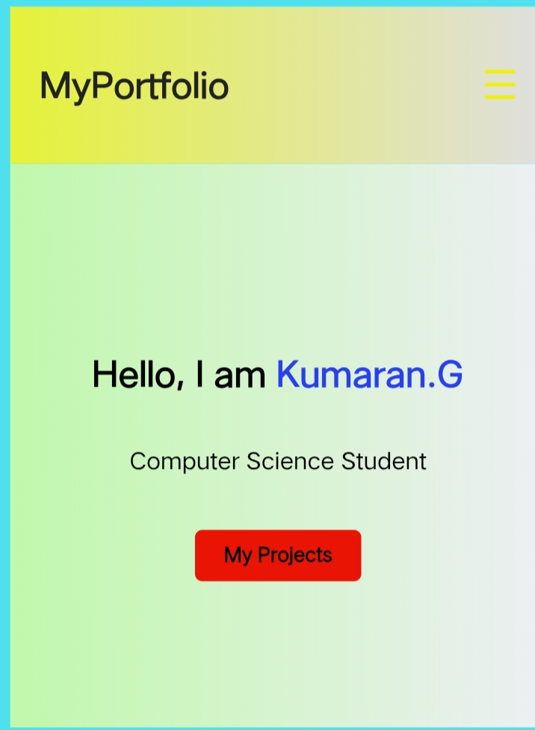
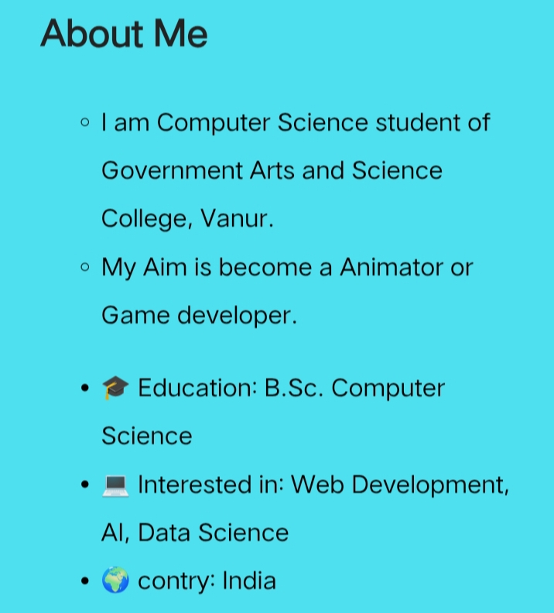

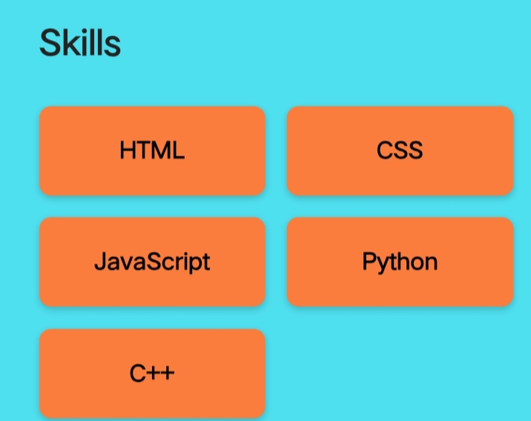
RESULTS AND SCREENSHOTS
3/21/2024 Annual Review
10

Slide 11
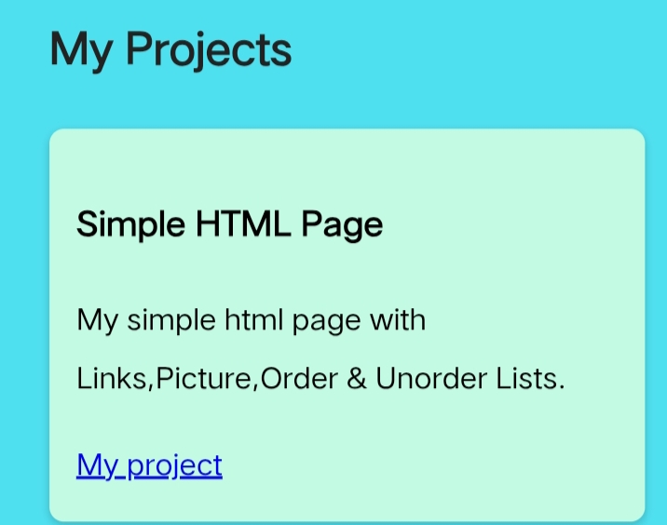
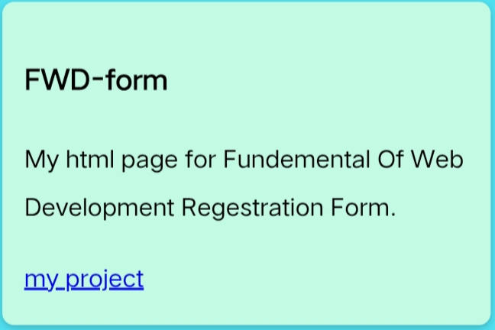
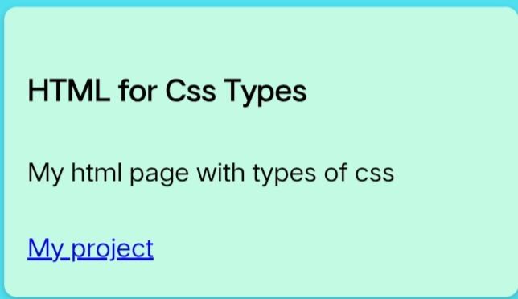
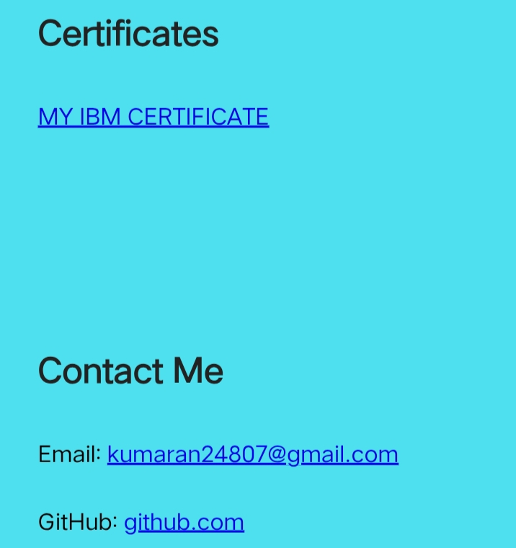

Slide 12
CONCLUSION
Wrap up with what you achieved and future improvements. Example: The project successfully automated attendance with high accuracy. Future improvements may include mobile app integration and cloud-based storage.
11

