Slide 1
Countries in Need
Clustering Assignment
Submitted by :
P ANIL KUMAR

Slide 2
Problem Statement
There is a high need to figure out which countries in the world are very much in need of support for reviving their current socio economic status.
There is need to provide aid to these nations by analysing their current economic status using their GDPP and INCOME statistics.
By the help of mortality rate data and health related expenditure we can access these countries and plan the delivery of needed resources to make these countries perform better.

Slide 3
Solution APPROACH
We have the countries major indices data like(mortality rate, gdpp, income, health etc.)
By using certain methods like Hopkins statistics we check this data for feasibility of cluster analysis. Hopkins statics score of 90% suggests this data is highly suitable for clustering
By using this data we made cluster analysis to check the countries which fall into the clusters of low scores.
We used k-means clustering, Hierarchical clustering(single linkage, complete linkage) based on all these techniques we identified the most underdeveloped countries.
The decision of total number of cluster required made using different approaches like ‘elbow method’ and ‘silhouette score’. Based on these results the final cluster of under developed countries identified.

Slide 4
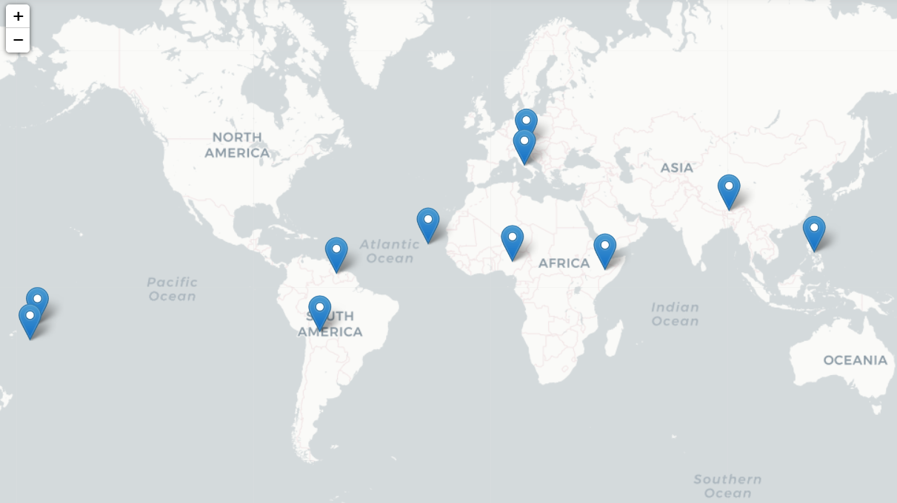
Clustering Results
There are total of 11 countries found from the clustering analysis which are in need of help.
The countries are:
Angola
Bhutan
Bolivia
Cape Verde
Congo, Rep.
Guyana
Morocco
Nigeria
Philippines
Samoa
Tonga

Slide 5
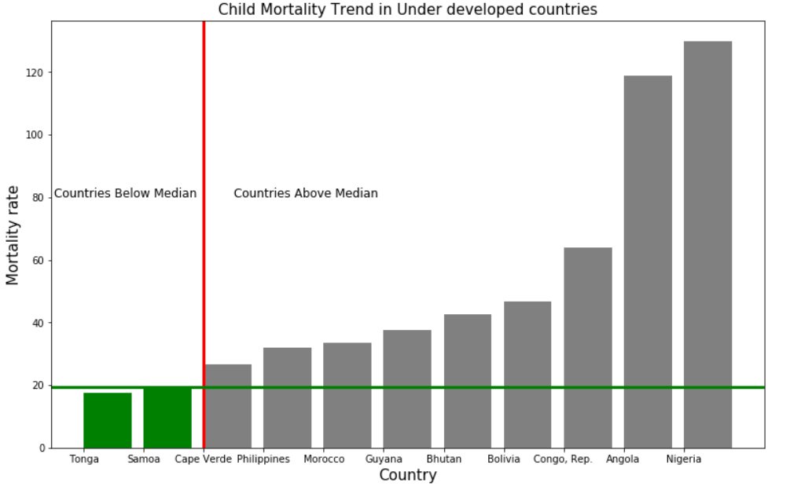
Child Mortality
The child mortality of these underdeveloped countries are at alarming rate compared to the median values of the world.

Slide 6
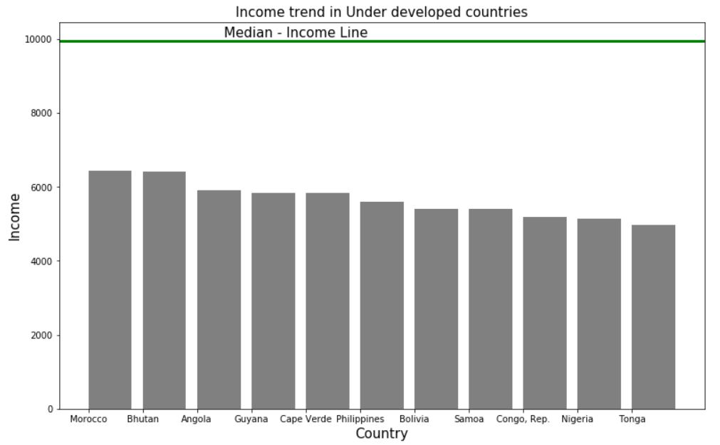
Income Index
The income index of these underdeveloped countries low compared to the median values of the world.

Slide 7
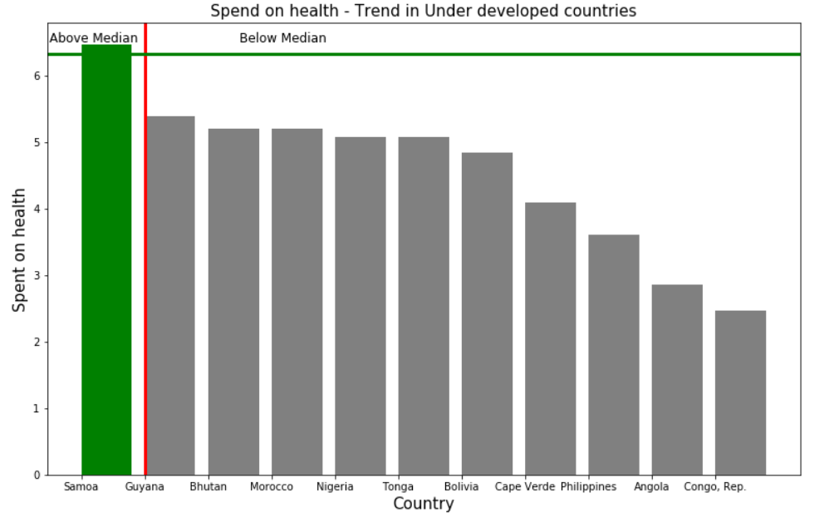
SPEND ON HEALTH
The amount spent on health in these underdeveloped countries is at nadir compared to the median values of the world.

Slide 8
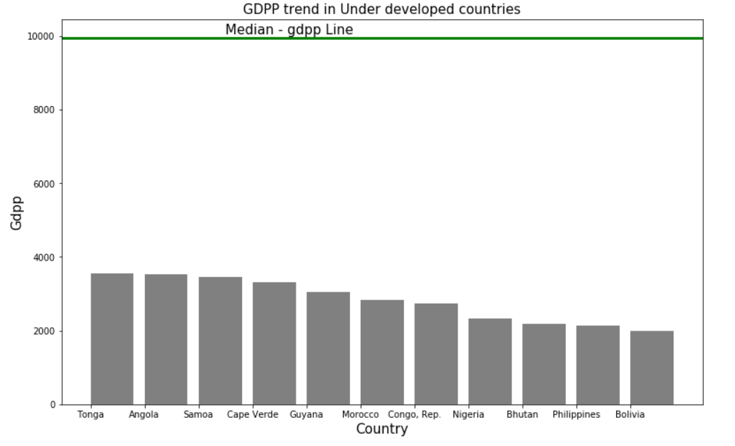
GDP - PercAPITA
The GDP per capita in these underdeveloped countries is very low compared to the median values of the world.

Slide 9
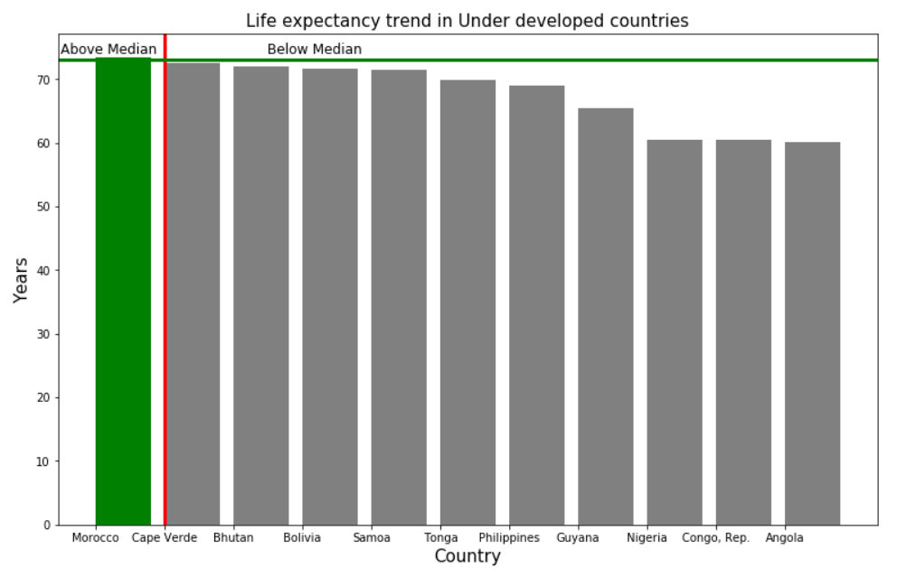
Life Expectancy
The life expectancy in these underdeveloped countries is less compared to the median values of the world.

Slide 10
CONCLUSION
These eleven countries are in need of economic aid in terms of mortality rate of children.
Majority of the countries are in African continent.
These countries GDP percapita can be increased by reducing the supply demand gap caused by low exports and high imports.
These countries need to spend more money on health care so as to increase the life expectancy of people and decreasing the children mortality rate,

