Slide 1

Brave Hearts
Team Members
VenKat
Yogesh
Sarath
Niveditha
Joe
Prakashram
Ganesh
Marimuthu
Ankit

Slide 2
Problem Statement
A telephonic campaigns conducted by Portuguese banking institution to identify the clients whether they will subscribe a term deposit based on certain information given.
Solution
We have performed a descriptive analytics on the given data, and applied various ML algorithm to predict possibilities of client whether they will subscribe a term deposit.

Slide 3
Data Set Information:
The data is related with direct marketing campaigns of a Portuguese banking institution. The marketing campaigns were based on phone calls. Often, more than one contact to the same client was required, in order to access if the product (bank term deposit) would be ('yes') or not ('no') subscribed.
The data describes the information of the various individual based on job, age, education, their living standard, having loan or not, number of times people has been contacted for the product, contacts details and duration and country’s and back’s economic details.
This data describes the above mentioned information from May 2008 to November 2010.
https://archive.ics.uci.edu/ml/datasets/bank+marketing

Slide 4
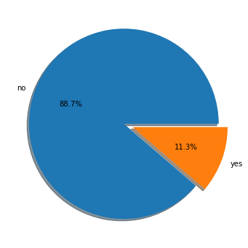
Total Distribution
The chat describes the overall distribution of the data i.e out of 41188 people 4640 people has subscribed the term deposit which is the 11.3% of the population.

Slide 5
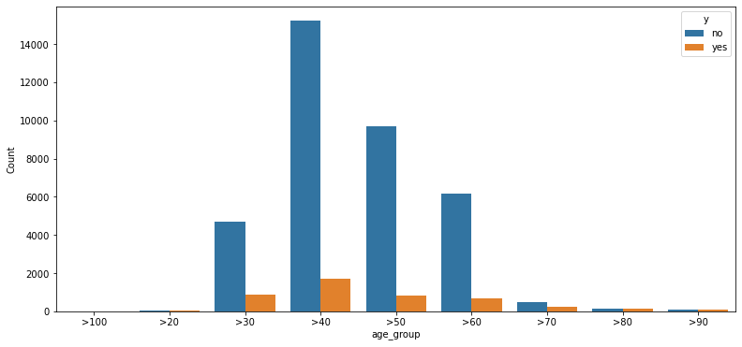
Age Distribution
The chat describes the distribution of subscriber’s of different age group

Slide 6
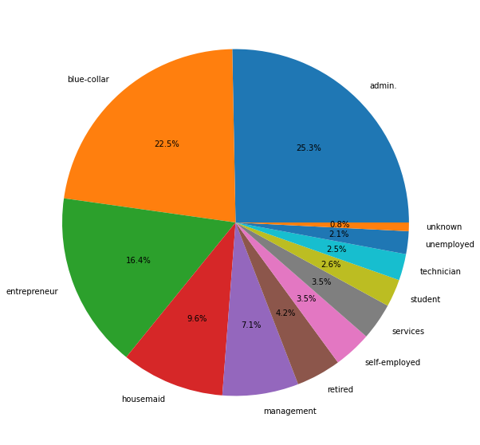
Job Distribution
The chat describes the overall distribution of job profile

Slide 7
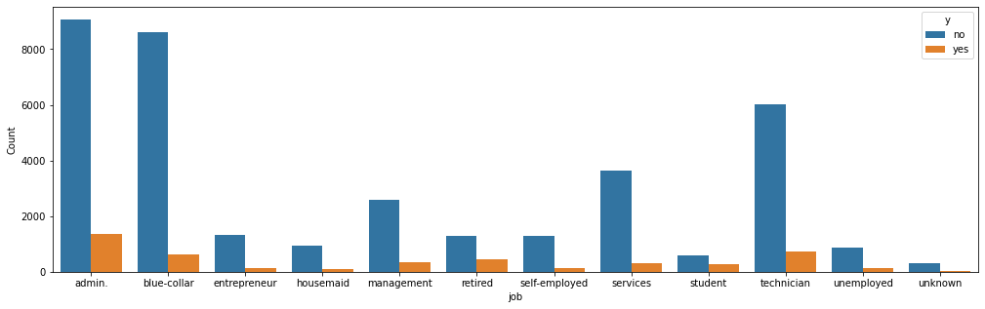
The chat describes the distribution of subscriber’s of different job profile

Slide 8
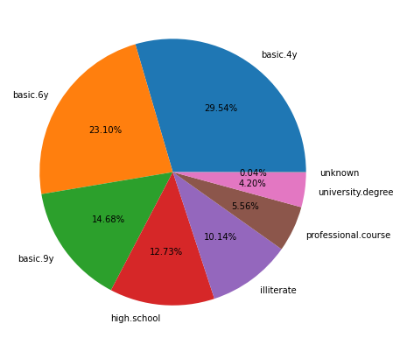
Qualification Distribution
The chat describes the overall distribution of education qualification of the population

Slide 9
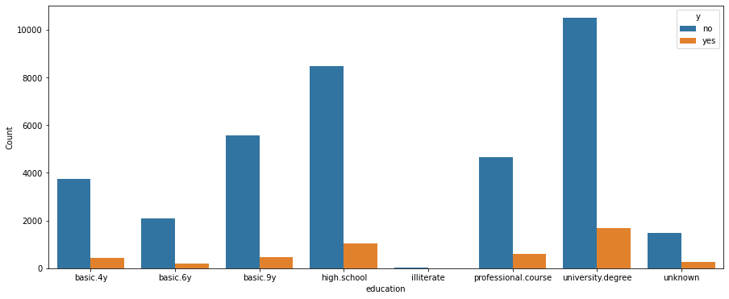
The chat describes the overall distribution of subscriber’s of different education qualification

Slide 10
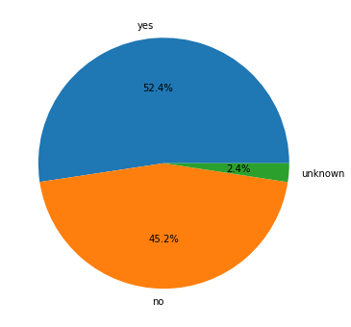
House loan Distribution
The chat describes the overall distribution whether the people have housing loan or not.

Slide 11
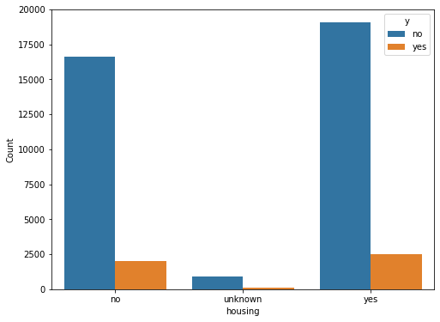
The chat describes the distribution whether the people have housing loan or not.

Slide 12
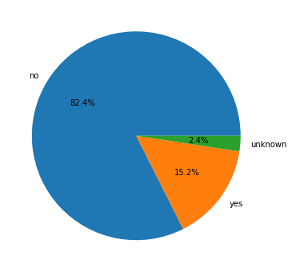
Loan Distribution
The chat describes the overall distribution whether the people have loan or not.

Slide 13
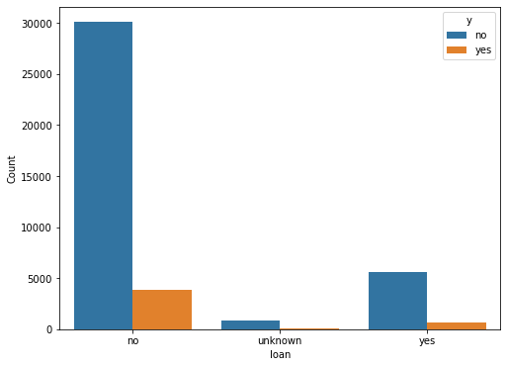
The chat describes the overall distribution whether the people have loan or not.

Slide 14
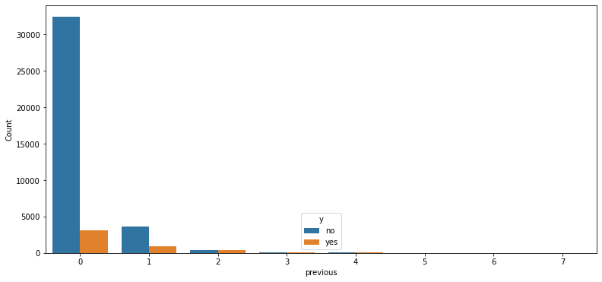
No. of times client was contacted in previous campaigns

Slide 15
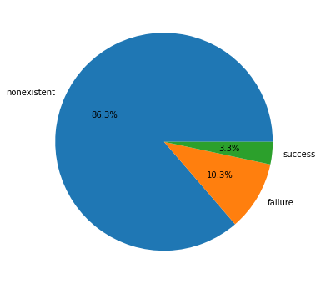
Outcome of previous campaigns

Slide 16
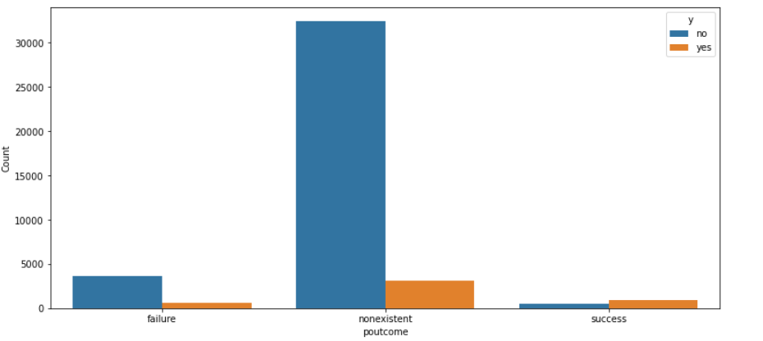
Outcome of previous campaigns

Slide 17
Data Cleaning
Preparing features for Machine learning:
Removed unwanted feature – Duration
Converted feature ‘age’ into categorical by binning the feature
Converted numerical feature ‘pdays’ and ‘previous’ into categorical
Encode the categorical columns into numbers. The models works with only numbers.
Encoded nominal values as dummy variable
Normalize the data using Standard Scaler.

Slide 18
Machine learning Algorithms
Models considered for this excercise:
Logistic Regression
Random Forest
Adaboost Classifier
Gradient Boosting Classifier
XGB Classifier
LightGBM Classifier

Slide 19
Training the Model
The data is split into ‘Train set’ (80%) and ‘Test set’ (20%)
(S)ynthetic (M)inority (O)versampling (TE)echnique is used for duplicating minority class in training set.
Training set will be used for training the model. Model scans the data to look for pattern using statistical technique.
Test set will be used for testing the model without exposing the actual outcome. Model prediction is compared with actual outcome to evaluate the model performance.

Slide 20
Model performance evaluation
Each Model is evaluated based on below metrics
Accuracy Score
Precision
Recall
F1 Score
Confusion matrix
Classification report
Scoring parameter – cross_val_score

Slide 21
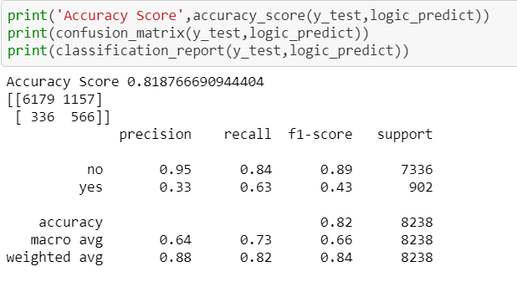
Logistic Regression performance

Slide 22
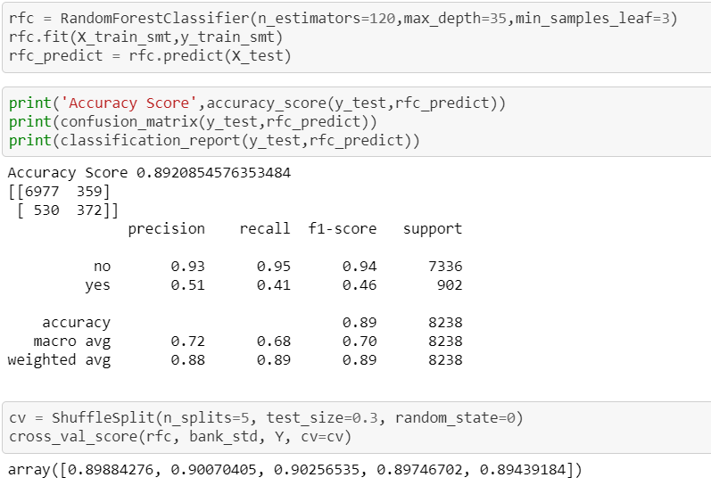
Random Forest performance

Slide 23
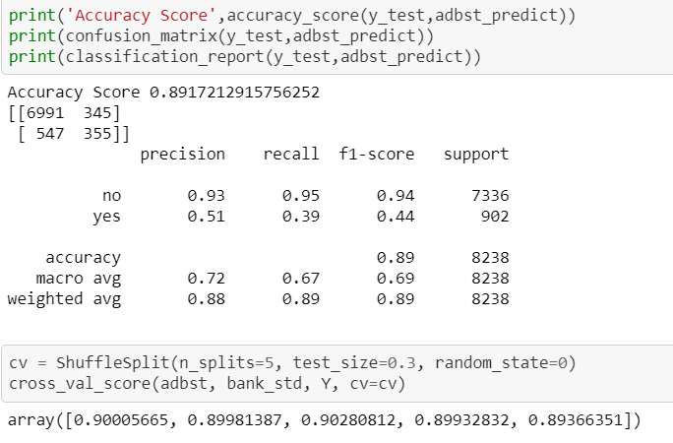
Adaboost Classifier performance

Slide 24
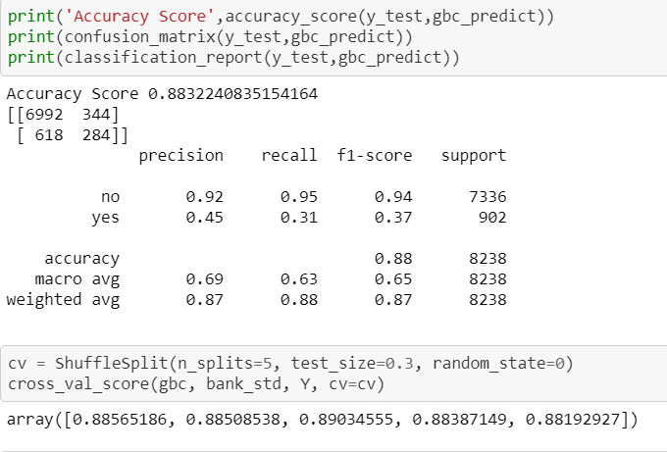
Gradient Boosting Classifier performance

Slide 25
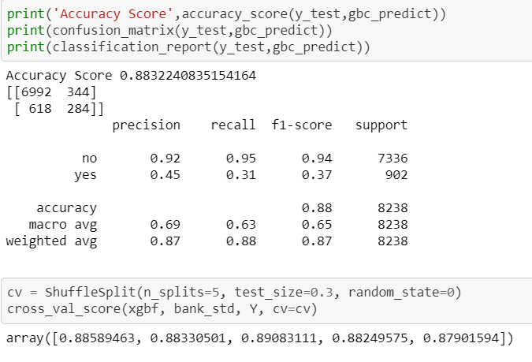
XGB Classifier performance

Slide 26

Light GBM Classifier performance

