Slide 1

Brave Hearts
Team Members
VenKat
Yogesh
Sarath
Niveditha
Joe
Prakashram
Ganesh
Marimuthu
Ankit

Slide 2
Problem Statement
A telephonic campaigns conducted by Portuguese banking institution to identify the clients whether they will subscribe a term deposit based on certain information given.
Solution
We have performed a descriptive analytics on the given data, and applied various ML algorithm to predict possibilities of client whether they will subscribe a term deposit.

Slide 3
Data Set Information:
The data is related with direct marketing campaigns of a Portuguese banking institution. The marketing campaigns were based on phone calls. Often, more than one contact to the same client was required, in order to access if the product (bank term deposit) would be ('yes') or not ('no') subscribed.
The data describes the information of the various individual based on job, age, education, their living standard, having loan or not, number of times people has been contacted for the product, contacts details and duration and country’s and back’s economic details.
This data describes the above mentioned information from May 2008 to November 2010.

Slide 4
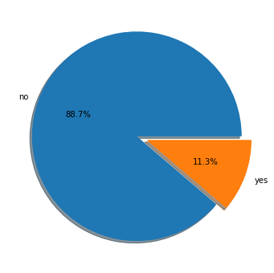
Total Distribution
The chat describes the overall distribution of the data i.e out of 41188 people 4640 people has subscribed the term deposit which is the 11.3% of the population.

Slide 5
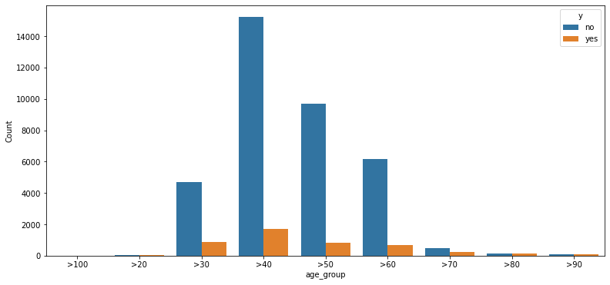
Age Distribution
The chat describes the overall distribution of the data i.e out of 41188 people 4640 people has subscribed the term deposit which is the 11.3% of the population.

Slide 6
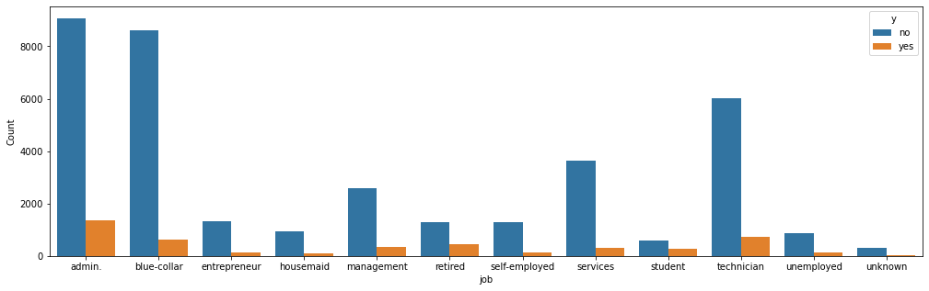

Slide 7
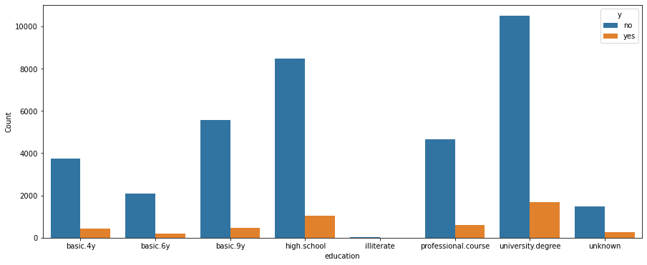

Slide 8
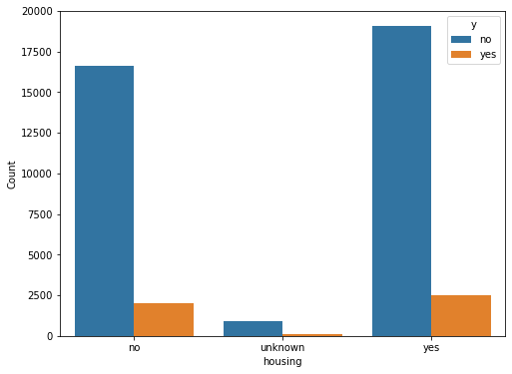

Slide 9
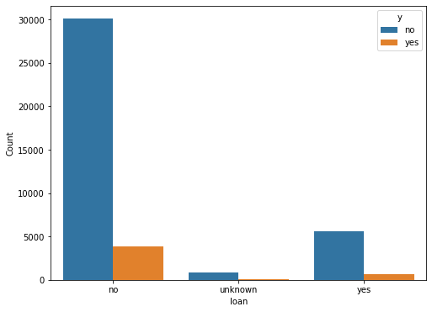

Slide 10
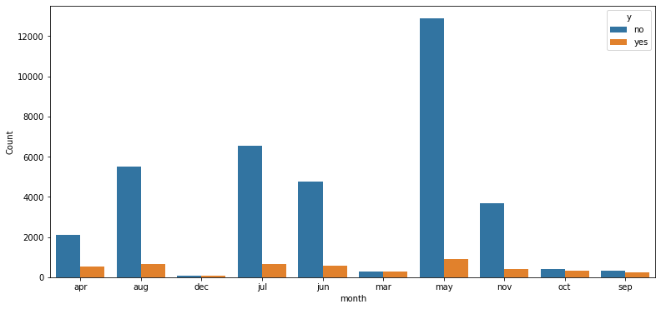

Slide 11
