Slide 1


Image Based Encryption System
PANIMALAR ENGINEERING COLLEGE
DEPARTMENT OF COMPUTER SCIENCE AND ENGINEERING
CS8811 PROJECT WORK
REVIEW NO:1
Roshan VS(211418104220) Kumaran KM(211418104132) Kishore Rajan K(211418104127)
Guide Name: Mr. Mohan M
Batch: D9

Slide 2
Problem Definition
In today's world of modernization and the web, client confirmation and security have been the foremost imperative need in many organizations and companies.
There's a considerable inquiry within the field of information privacy. Unfortunately, the strategies of putting away and covering up touchy data like passwords and personal data have fizzled to fetch enough consideration from the analysts.
Within the last decade, a parcel of analysts recommended the utilization of a combination of security strategies like steganography and cryptography to elevate the security of the framework. In any case, it still does not guarantee sufficient information security.
In this paper, we propose a framework that executes numerous encryption strategies with a decentralized and distributed capacity of delicate data of clients and offers multi-layered security to the system.

Slide 3
Abstract
Keeping in mind of the problem statement, we propose image based encryption system which consists of a multi-layer encryption layers.
The execution of the proposed system was separated into 3 stages- encryption and encoding, steganography, and unscrambling. Within the to begin with stage, the secret word was scrambled utilizing AES-128 and encoded in Base64 i.e. different of 4, as we part the secret word into 4 pieces. In stage II we performed steganography by covering up the scrambled pieces of watchword behind the pictures by implementing another lever of AES-128 encryption. Within the last stage III, we recovered the password by unscrambling the pieces of the secret word and combining them within the redress arrangement.
It is evident that keeping the delicate data at the decentralized area by executing a more grounded encryption calculation like AES-128 and combining it with other security strategies like steganography upraises the security of the system.

Slide 4
Literature Survey

Slide 5
S.No | Author and Paper | Proposed Work | Drawbacks
1 | V. Venukumar and V. Pathari, “Multi-factor authentication using threshold cryptography,” in 2016 International Conference on Advances in Computing, Communications, and Informatics (ICACCI), Jaipur, India, Sept 21-24, 2016 | MFA plans require all middle of road One Time passwords(OTPs) to be put away for the lifetime of the verification process. They include security dangers at whatever point a confirmation prepare requires the user’s secret word at an open put like a Point-of-Sale terminal or an open ATM booth. | Setting up MFA improves overall business continuity, but for a high level of security, there comes a price tag, Smartphones and physical tokens can get stolen and If your MFA requires an SMS code, and you don’t have your phone, you are out of luck

Slide 6
S.No | Author and Paper | Proposed Work | Drawbacks
2 | E. S. I. Harba, “Advanced password authentication protection by hybrid cryptography & audio steganography,” Iraqi Journal of Science, vol. 59, no. 1C, pp. 600-606, 2018 | The proposed strategy is utilized sound steganography and AES Cryptography. The authentication key (watchword) is spilled into two parts, the first half is utilized as input content to the stego-crypto handle whereas the second half is utilized as the crypto the key is scrambled utilizing the HMAC-SHA256 hash algorithm | The confidentiality of information is maintained by the algorithms, and if the algorithms are known then this technique is of no use. Password leakage may occur and it leads to the unauthorized access of data.

Slide 7
S.No | Author and Paper | Proposed Work | Drawbacks
3 | J. H. Kennedy, M. T. A. Khan, M. J. Ahmed and M. Rasool, “Image steganography based on AES algorithm with huffman coding,” International Journal of Engineering Science and Computing, April 2017, vol. 7, no. 4, pp. 6352-6355, 2017 | This paper presents an algorithm, in which the picture is input to AES Encryption to urge the scrambled picture, at that point, it is compressed with Huffman Coding, and the encrypted image is uncompressed and given as the input to AES Decryption to urge the initial image using AES (Advanced Encryption Standard)the algorithm, LSB algorithm, and compression and decompression of that image using Huffman Coding | Extended Huffman coding is not that effective at all. It can be very slow when rebuilding the entire tree for each symbol.

Slide 8
S.No | Author and Paper | Proposed Work | Drawbacks
4 | L. Sharma and A. Gupta, “Image encryption using Huffman Coding for steganography,,” International Journal of Advance research , Ideas and Innovations in Technology, vol. 2, no. 5, pp. 1-10, 2016 | Encrypt the message by Huffman code and apply the In Steganography. We separate the picture into multiple pieces which are non-overlapped in nature and the block estimate is 3×3 pixel which is able to consider a framework. For every value from the network can be spoken to in eight-bit where two-bit will utilize as the slightest noteworthy bit (LSB) substitution and quotient esteem differencing (QVD) is connected to other bits. | compression data with lowest size to decrease the size of secrete message

Slide 9
S.No | Author and Paper | Proposed Work | Drawbacks
5 | D. R. I. M. Setiadi, E. H. Rachmawanto2 and C. A. Sari, “Secure image steganography algorithm based on DCT,” Journal of Applied Intelligent System, vol. 2, no. 1, pp. 1-11, April 2017 | The combination of steganography utilizing discrete cosine change (DCT) and cryptography using the one-time cushion or vernal cipher executed on a computerized picture. The measurement method utilized to decide the quality of stego picture is the crest | If your OTP device is ever stolen or lost, multiple login attacks by the hacker can permanently lock you out of your account.

Slide 10


Technology Stack
1) Python 3 2) Pyinstaller
3) Tkinter UI
Encryption model 1) AES 128
2) Steganography algorithm
3) Base 64 encoding

Slide 11
System Architecture
Encryption/Decryption Platform
Cipher data
User with secret data
Passing for decryption
Retrieved data

Slide 12
Encryption/ Decryption Platform
AES 128 encryption
AES 128
decryption
Base 64 encoding
Base 64 decoding
Splitter
Joiner
Data Base
Steganography
Process
Steganography Process
Img1
Img2
Img1
Img2
Img3
Img4
Img3
Img4

Slide 13

Algorithms

Slide 14
Advanced Encryption Standard-128
The AES algorithm is the industry-standard encryption protocol that protects sensitive information from traditional brute-force attacks.
The two most common versions are 256-bit AES (providing greater security) and 128-bit AES (providing better performance during the encryption and decryption process).
With current technology, AES is uncrackable through straightforward, brute-force attacks, and it is used in countless applications, from protecting top-secret or classified information in government agencies to keeping your personal data safe when stored on the cloud.

Slide 15
Image Steganography
Steganography refers to the process of hiding a secret message within a larger one in such a manner that someone cannot know the presence or contents of the hidden message.
The objective of Steganography is to maintain secret communication between two parties.
Unlike Cryptography, where we can conceal the contents of a secret message, Steganography conceals the fact that a message is transmitted.
Even though Steganography differs from Cryptography, there are various analogies between the two. Some authors classify Steganography as a form of Cryptography as hidden communication seems like a secret message.

Slide 16
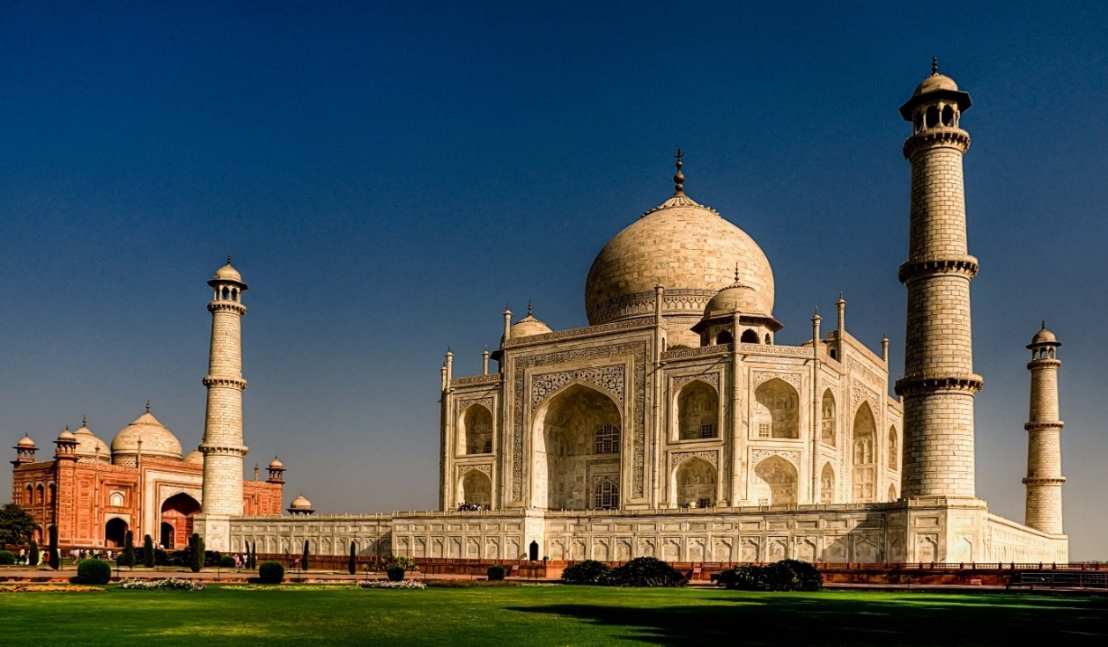
Decentralization of the Image
The Image is converted into respective arrays and are stored separately.
[(225,54,67),(78,54,90),….]
[…(57,34,67),(32,15,4),(67,5,67),…]
[…(67,45,89),(56,43,12),(59,90,255)]

Slide 17
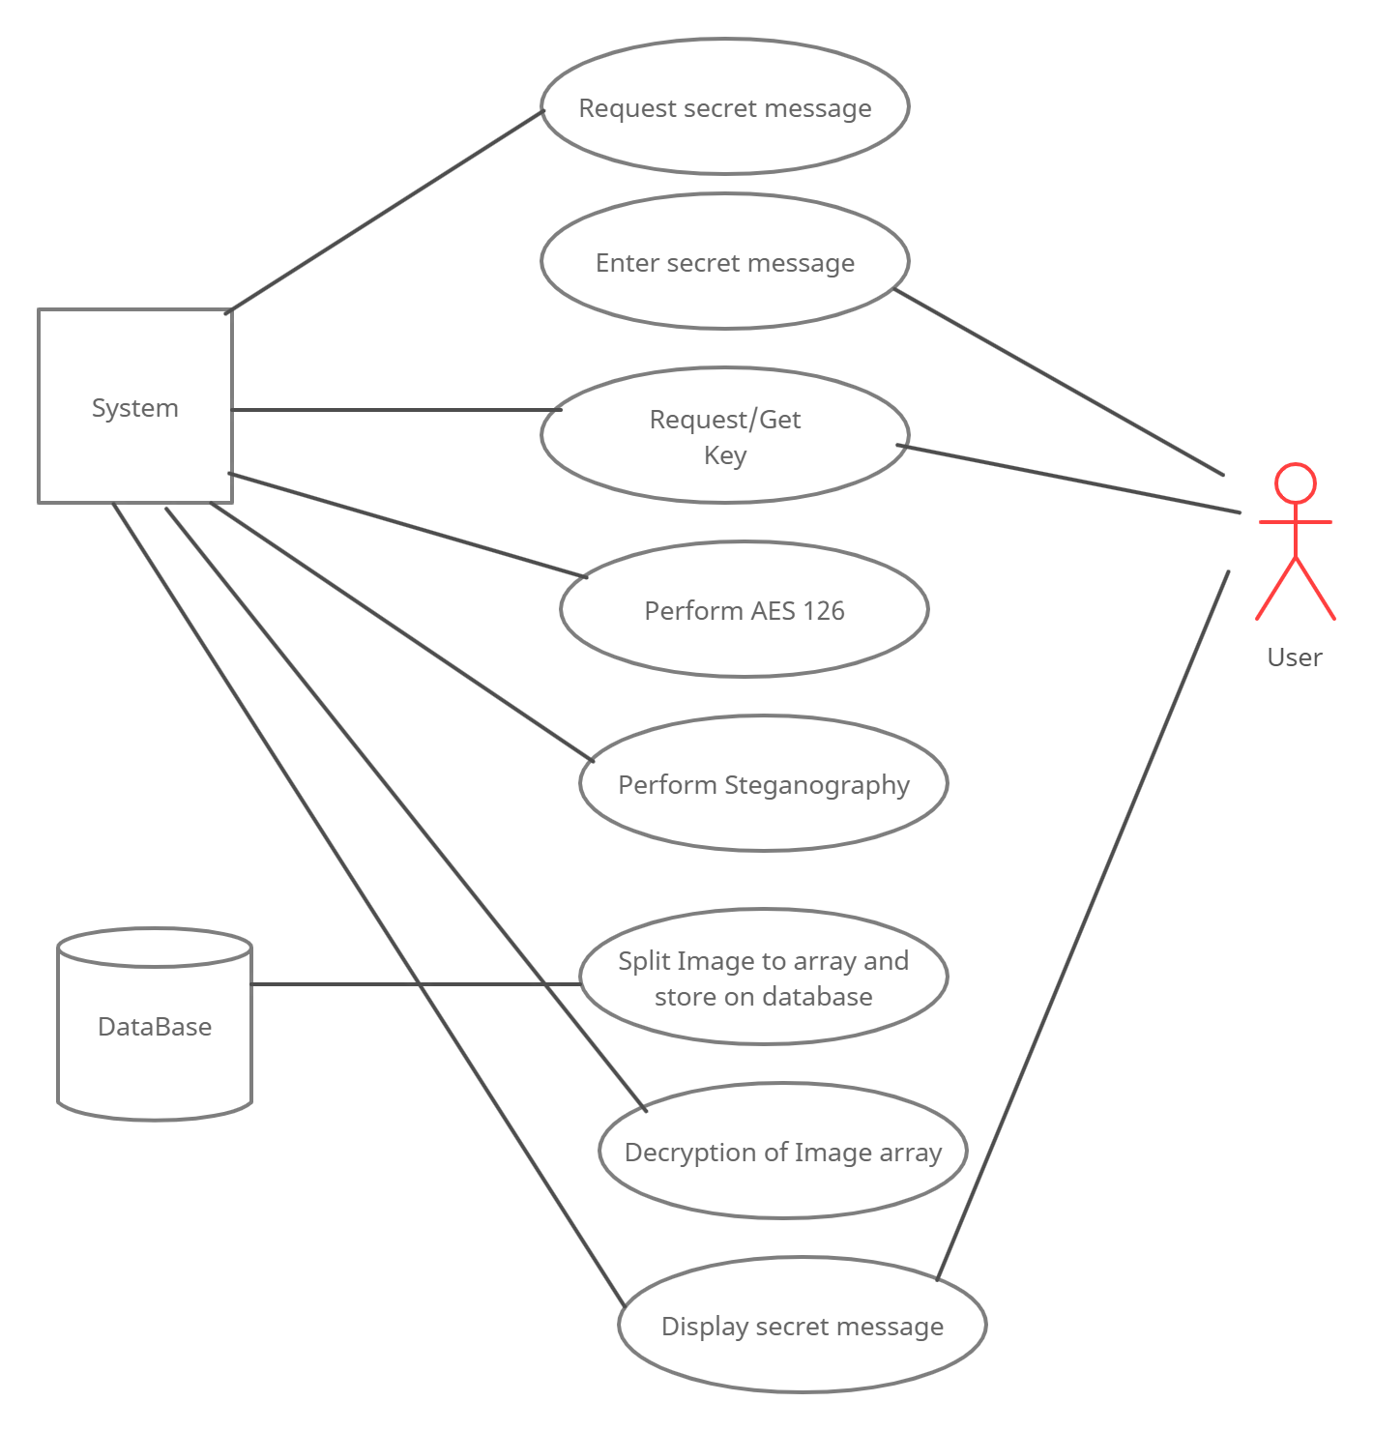
Use Case Diagram

Slide 18
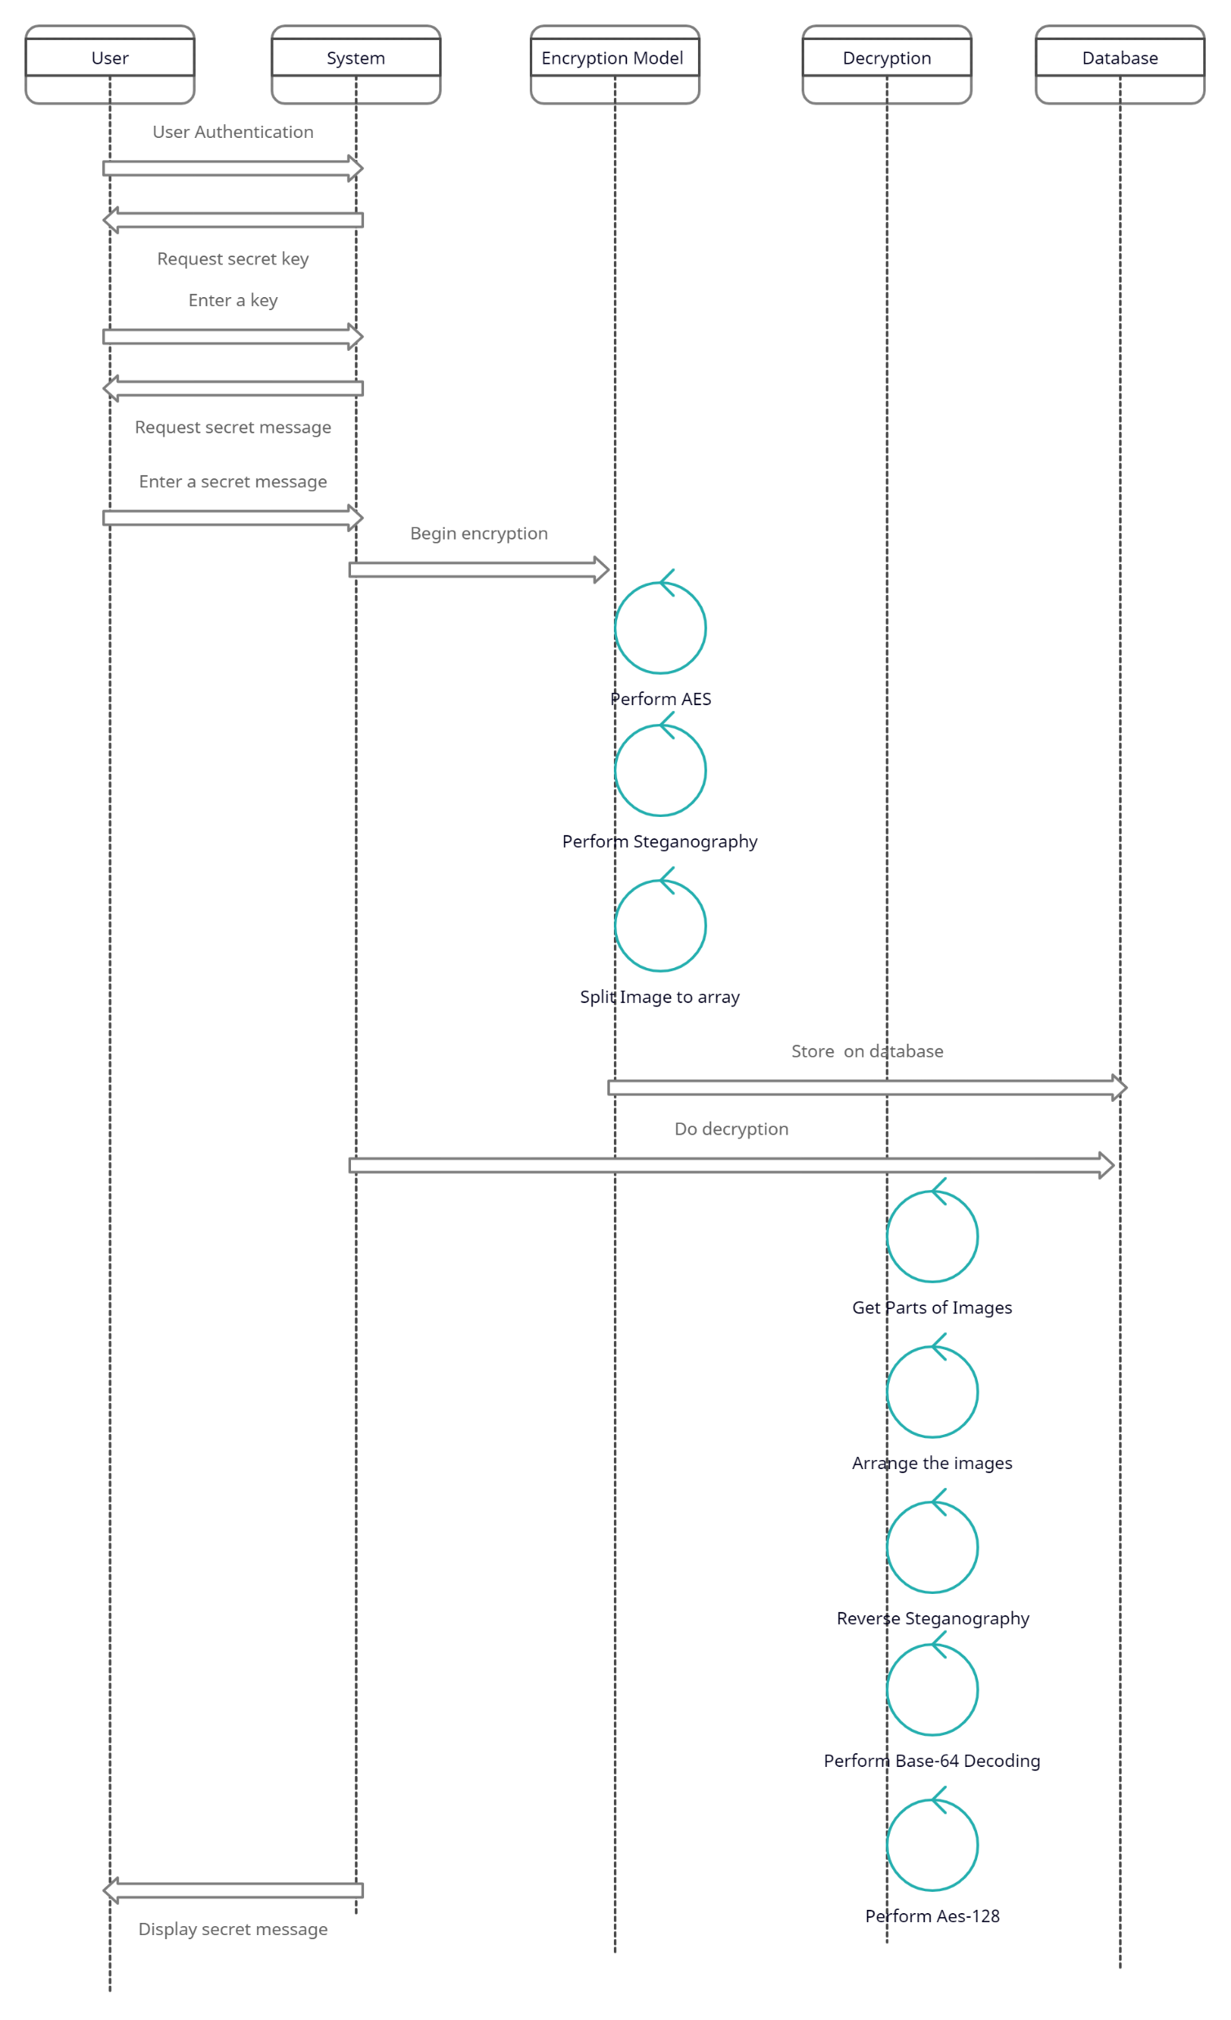
Sequence Diagram

Slide 19
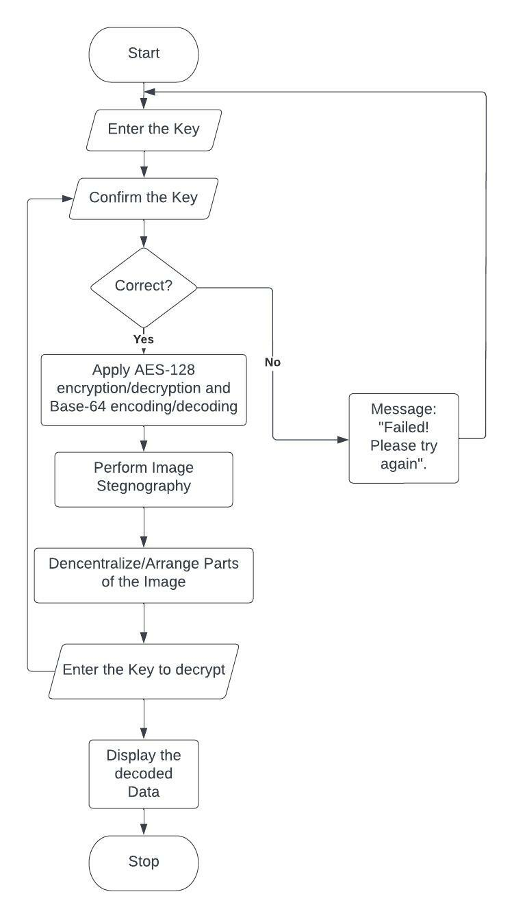
Program Flow

Slide 20
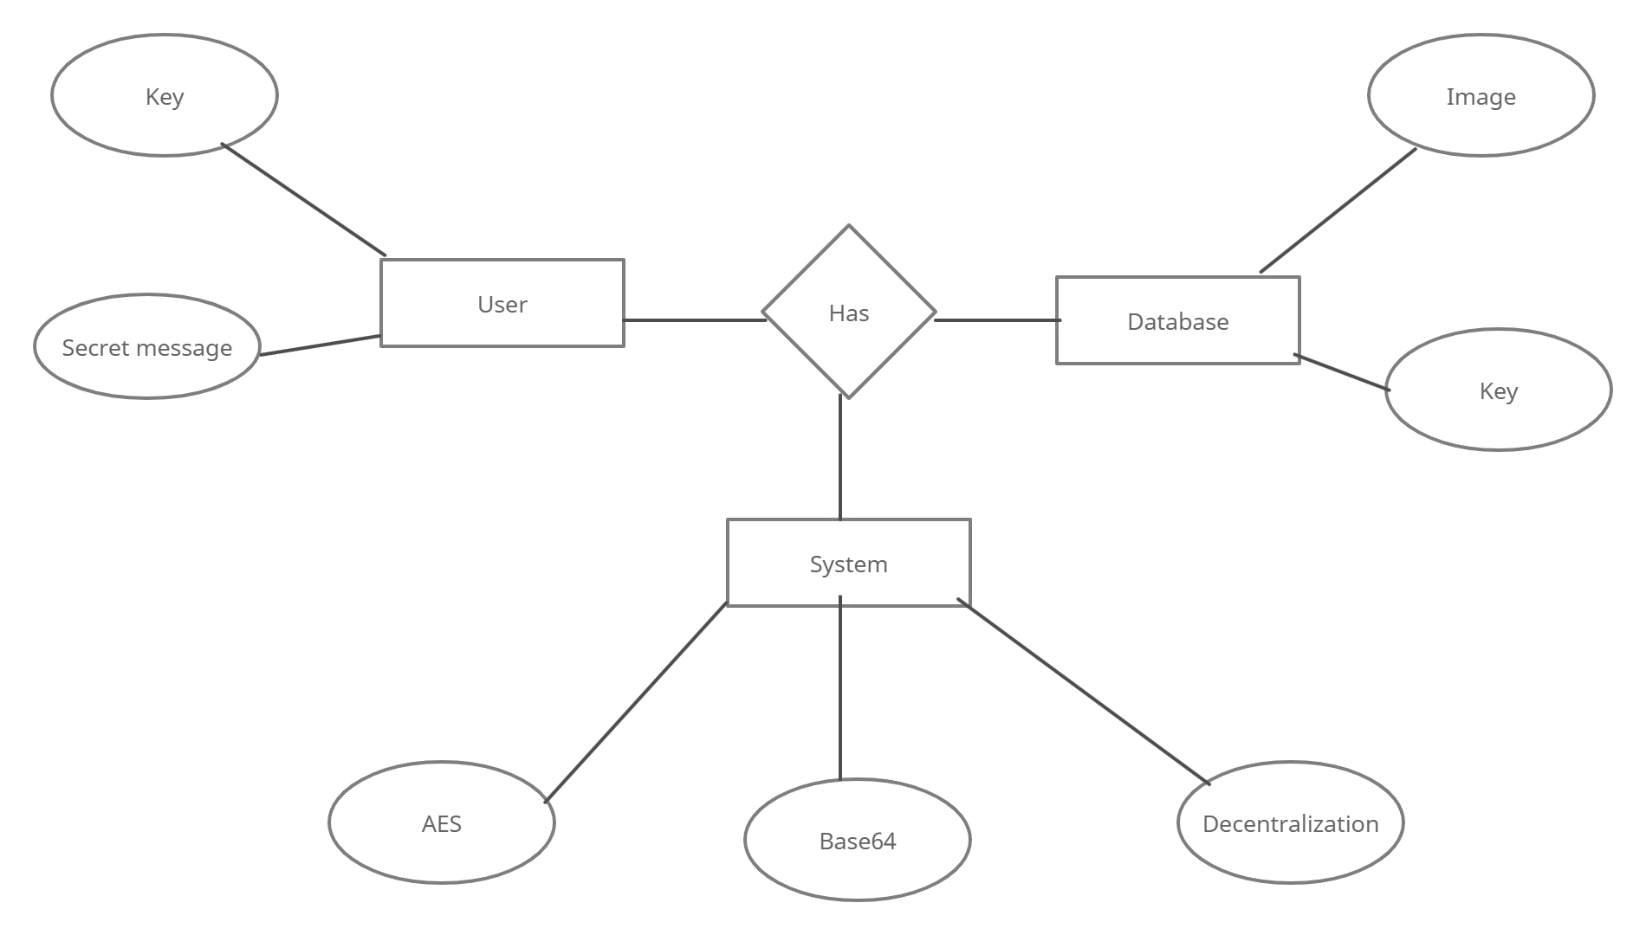
ER Diagram

Slide 21
Feasibility Study
Economic Feasibility:
Here, we find the total cost and benefit of the proposed system over current system. The main cost of this project is the cost of building and maintaining a database. Other than that, the computational power required to run our program is feasible and efficient.
Technical Feasibility:
In consideration to the technologies used in this project, all the software modules are open-sourced Even Large-Scale Implementation requires less financial support
Social Feasibility:
There is always an on-demand for Security and Privacy. Since our product proves to be faster and safer than other proposed systems, the end-users , companies amd business ventures will adopt to our project.

Slide 22
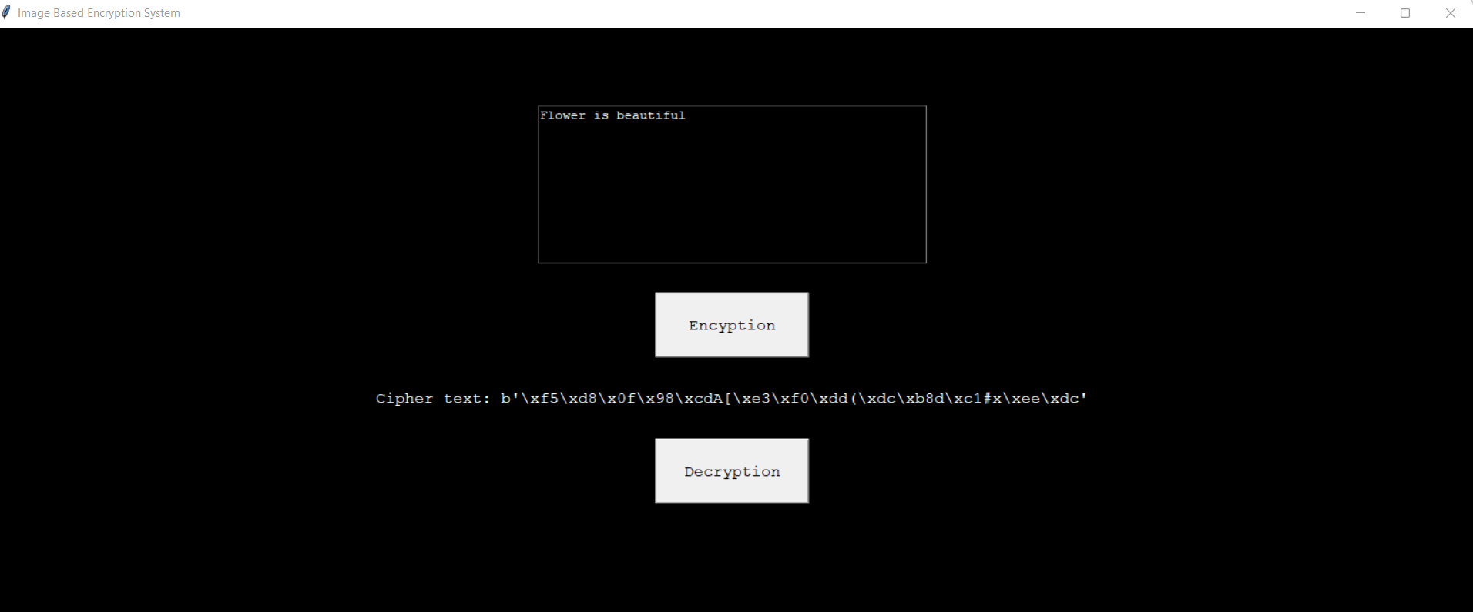
Sample Output Screen
Encryption

Slide 23
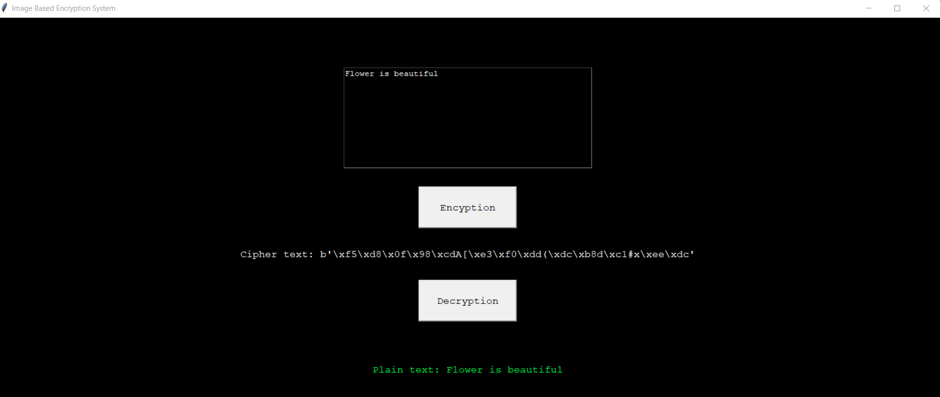
Sample Output Screen
Decryption

Slide 24
Conclusion
The main objective of this research was to determine if the security of the system can be enhanced by combining the security methods such as, steganography, encryption and splitting the confidential data which is password in our case. Also, by doing this, we wanted to test whether storing the confidential data in decentralized fashion helps to improve security. Referring to the results that we obtained by implementing the proposed solution on various platforms, we conclude that the solution is highly adaptable as Python programming is cross-platform. In addition, implementing multi-layered encryption with the use of stronger encryption methods like AES-128 boosts the difficulty level for the hackers to penetrate through the system.

Slide 25
References
V. Venukumar and V. Pathari, “Multi-factor authentication using threshold cryptography,” in 2016 International Conference on Advances in Computing, Communications, and Informatics (ICACCI), Jaipur, India, Sept 21-24, 2016
L. Sharma and A. Gupta, “Image encryption using Huffman Coding for steganography,,” International Journal of Advance research , Ideas and Innovations in Technology, vol. 2, no. 5, pp. 1-10, 2016
E. S. I. Harba, “Advanced password authentication protection by hybrid cryptography & audio steganography,” Iraqi Journal of Science, vol. 59, no. 1C, pp. 600-606, 2018
J. H. Kennedy, M. T. A. Khan, M. J. Ahmed and M. Rasool, “Image steganography based on AES algorithm with huffman coding,” International Journal of Engineering Science and Computing, April 2017, vol. 7, no. 4, pp. 6352-6355, 2017
D. R. I. M. Setiadi, E. H. Rachmawanto2 and C. A. Sari, “Secure image steganography algorithm based on DCT,” Journal of Applied Intelligent System, vol. 2, no. 1, pp. 1-11, April 2017
https://www.researchgate.net/publication/334636671_Image_Steganography_Basic_Concepts_and_Proposed_Algorithm
https://medium.com/codex/aes-how-the-most-advanced-encryption-actually-works-b6341c44edb9
https://pycryptodome.readthedocs.io/en/latest/src/cipher/aes.html

