Slide 1

SAP 3-Tier Extensibility Model
Deloitte Consulting LLP

Slide 2
Agenda
Conventional Extensions in SAP & issues
Clean Core Introduction
Benefits of Clean Core approach
Tier-1 ON-STACK
Tier-2
Tier-3
New Clean core extensibility guidelines
References

Slide 3
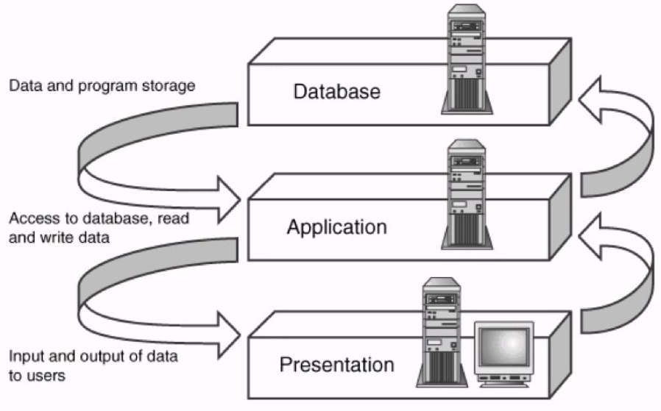
Conventional Extensions in SAP & issues
In SAP ABAP development, data is retrieved from the database layer, processed in the application layer using ABAP logic, and then displayed to users through the presentation layer. This three-tier structure ensures that data handling, business logic, and user interface are clearly separated, making SAP applications efficient and maintainable.

Slide 4
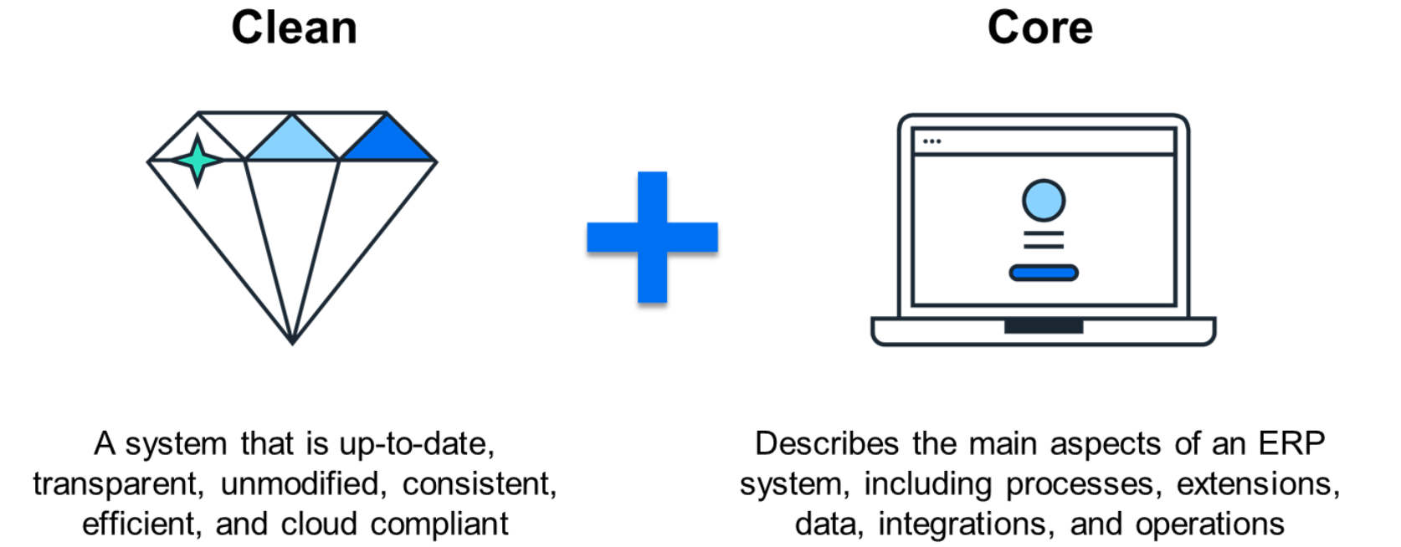
Clean Core Introduction
Clean core is a modern approach of designing business processes and extensions that are standardized and stable. If the business processes and data underlying ERP operations are standardized, the software can flexibly grow and evolve over time without causing any issues in the core system.

Slide 5
Why Extensibility?
Agility (speed of innovation)
Stability (upgrade safety)
Scalability (cloud-readiness)
Businesses need to adapt enterprise software to unique requirements.
SAP S/4HANA provides standard functionality + flexible extensibility framework.
Three-Tier Extensibility Model = structured approach to balance.

Slide 6
Benefits of Clean Core approach:
Benefits for customers are as follows:​
Ease of upgrade
Fast consumption of innovation and Agility
Lower Technical Debt and Costs
Benefits for partners are as follows:​
Future-proof and cloud-ready solutions.
Promoting fit-to-standard compliance with clean core modular innovation.​
Reduction of complexity with simplified consumption of out-of-the-box SAP solutions.
Notes:
Ease of Upgrade
Upgrades become simpler and faster because fewer custom changes mean fewer conflicts and less rework during SAP updates.
Maintenance is easier, with reduced system downtime and fewer unexpected errors caused by legacy code.
Faster Innovation and Agility
Organizations can more rapidly adopt new SAP features, security patches, and cloud innovations, staying future-ready and competitive.
Lower Technical Debt and Costs
Fewer customizations decrease long-term maintenance and support expenditure, reducing total cost of ownership (TCO).
IT teams spend less time and resources managing custom code, freeing focus for value-added activities.

Slide 7
Tier-1 ON-STACK(Recommended First Choice)
Cloud ready and upgrade stable developments.
Only approved ABAP Cloud object types supported.
Released APIs enforced via syntax checks.
Uses ABAP Development Tools (ADT) in Eclipse.
Available for both Public & Private Edition customers.
Examples:
Adding a custom field via CFL or released includes.
Implementation of released BADI or utilizing released API
Usage of application jobs Fiori application for job related requirements and its corresponding artifacts.
Custom RAP side by side extension Interface developments.
Complete custom CDS views.

Slide 8
Tier 2
Enabling the usage of objects which are not released but upgrade stable.
Available only for Private Edition customers and On-premise customers.
For cases where non-released APIs are needed.
Examples:
Creating a custom wrapper class object to use unreleased BAPI to achieve a functionality.
Creating a wrapper CDS view for a standard SAP table or a CDS view this is not released.
Creating a custom CDS view on top of an unreleased standard CDS view.

Slide 9
Tier 3 (Last Resort)
Legacy custom ABAP code for extensions that cannot does not fall in Tier 1 or Tier 2. We need to try to avoid usage of such objects.
Examples:
Implementing a BADI which is not released.
Using customer exits, user exists and implicit enhancements.
Modifying any SAP standard objects.
GUI based reports.
Extending a Fiori application built based on classical ODATA.

Slide 10
New Clean core extensibility guidelines
Level A are the cleanest custom extensions built either on-stack with ABAP Cloud development model or side-by-side using any option of SAP Build on SAP BTP – ABAP Cloud, CAP or low-code/no-code tools
Levels B-D relate to all classic ABAP developments and can be reached as follows:
Level B can be achieved by custom extensions that comply with SAP recommendations for the use of classic ABAP development technologies and the frameworks offered as classic SAP APIs
Level C contains custom extensions which cannot be qualified for Level B because of usage of arbitrary SAP internal objects. Under the condition that dedicated checks are performed before the release upgrade (following the changelog for SAP objects approach), these custom extensions can be considered conditionally clean.
Level D is not clean core and includes custom extensions with severe violations of SAP development recommendations like modifications, usage of not recommended SAP objects or extension technologies (e.g. implicit enhancements).

Slide 11
References
https://me.sap.com/notes/3578329
https://community.sap.com/t5/technology-blog-posts-by-sap/abap-extensibility-guide-clean-core-for-sap-s-4hana-cloud-august-2025/ba-p/14175399
https://www.sap.com/documents/2024/09/20aece06-d87e-0010-bca6-c68f7e60039b.html

Slide 12
About Deloitte Deloitte refers to one or more of Deloitte Touche Tohmatsu Limited, a UK private company limited by guarantee, and its network of member firms, each of which is a legally separate and independent entity. Please see www.deloitte.com/about for a detailed description of the legal structure of Deloitte Touche Tohmatsu Limited and its member firms. Please see www.deloitte.com/us/about for a detailed description of the legal structure of Deloitte LLP and its subsidiaries. Certain services may not be available to attest clients under the rules and regulations of public accounting. Copyright © 2020 Deloitte Development LLC. All rights reserved. Member of Deloitte Touche Tohmatsu Limited
Notes:
12

