Slide 1
IDOCS
SAP IDOC Training – (12th Sep)
- Vinay Shenoy

Slide 2
Course Content
DAY 1
IDOC Overview
IDOC Content & IDOC Structure
ALE – Application Link Enabling
Application Link Enabling Components
Application Link Enabling Configuration / Steps
IDOC Statuses Numbers
Change Pointers
IDOC Extensions
IDOCS Monitoring
IDOCS Filtering
Q&A

Slide 3
IDOC Overview
IDoc is an SAP object that carries data of a business transaction from one system to another in the form of electronic message.
IDoc is an acronym for Intermediate Document. The purpose of an IDoc is to transfer data or information from SAP to other systems and vice versa.
The transfer from SAP to non-SAP system is done via EDI (Electronic Data Interchange) subsystems whereas for transfer between two SAP systems, ALE is used.
IDocs sent outside the system are termed as Outbound IDocs and the ones that are received into the system, are called as Inbound IDocs.

Slide 4
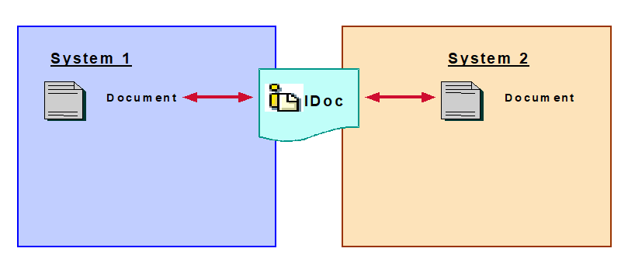
IDOC Concept

Slide 5
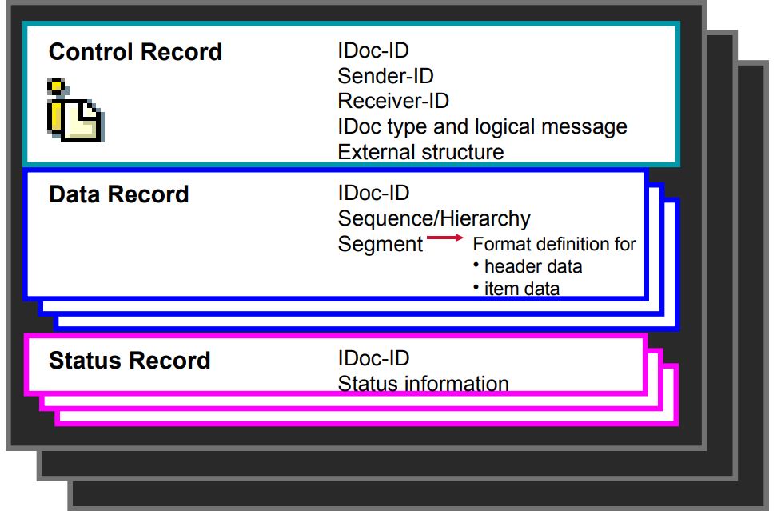
IDOC Structure

Slide 6
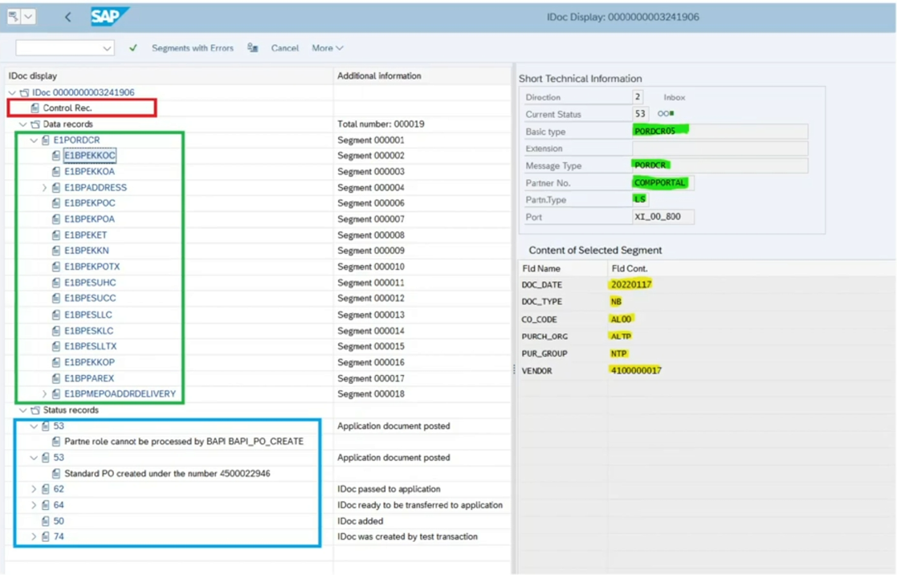
IDOC Structure ( Contd. )..

Slide 7
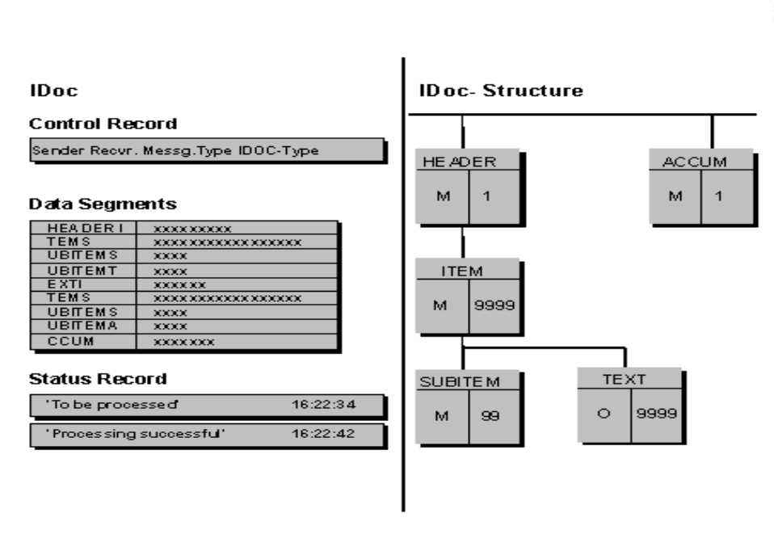
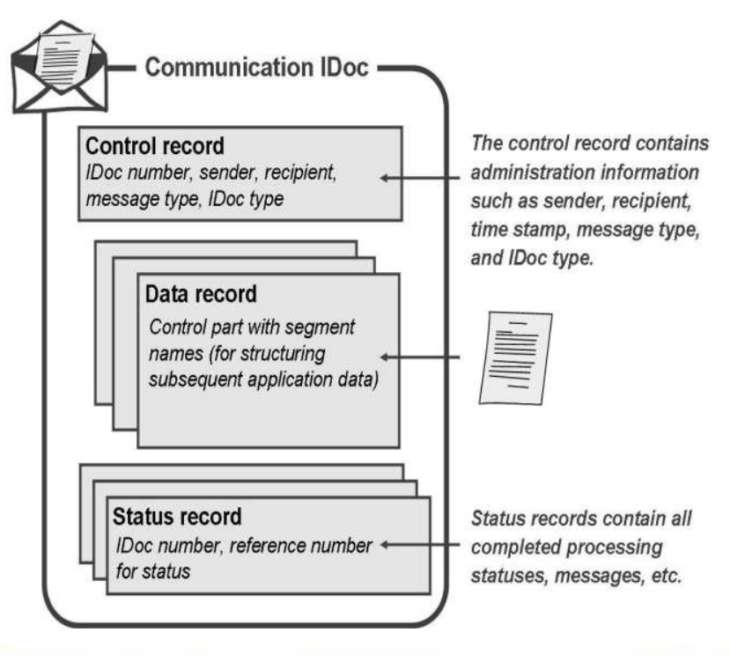
IDOC Structure ( Contd. )..

Slide 8
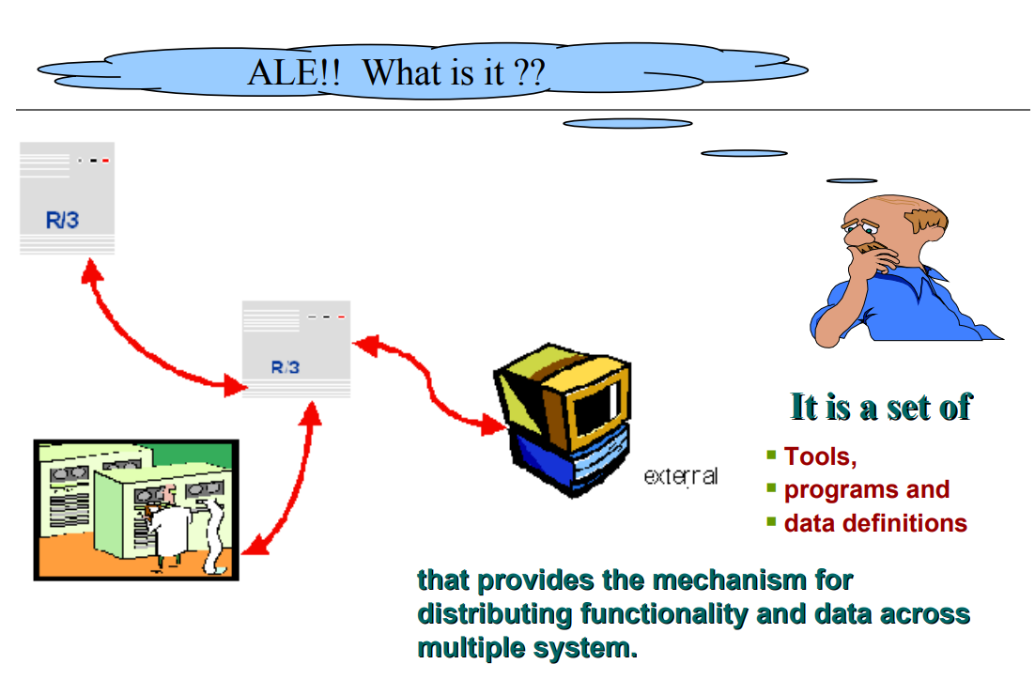
Application Link Enabling
ALE is SAP’s proprietary technology for integrating/ distributing business processes across several SAP systems

Slide 9
IDOC Terminologies
Logical System
Message Type
IDoc Type
Segments
RFC Destination
Ports
Partner Profiles
Process Codes
Customer Distribution Model

Slide 10
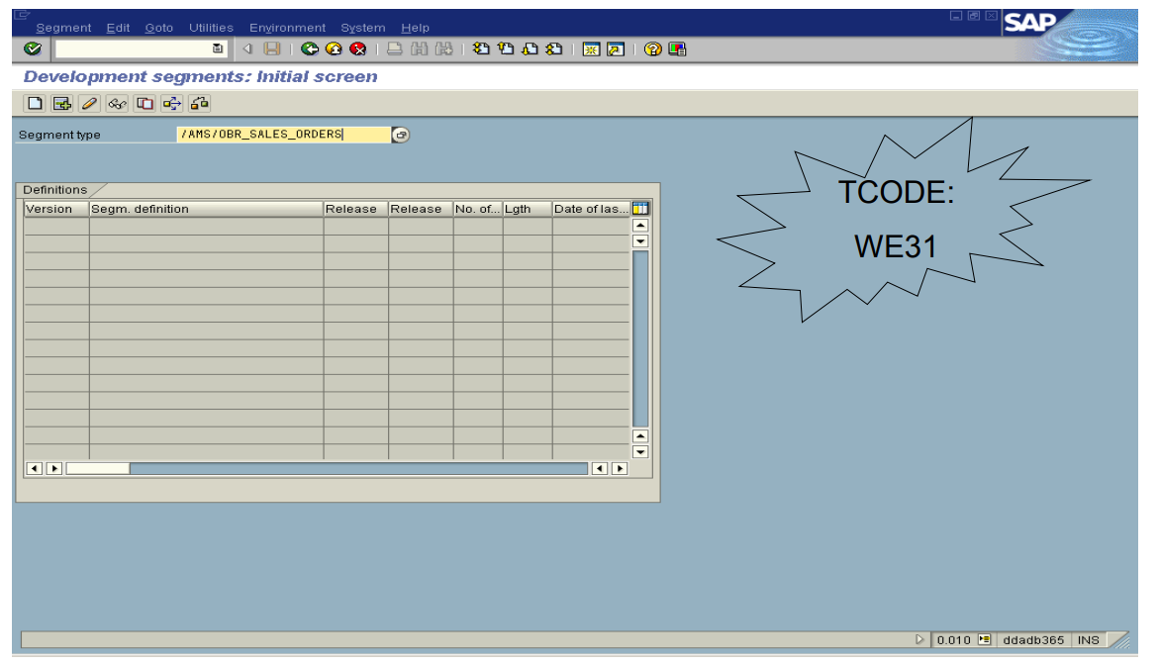
IDOC Segments

Slide 11
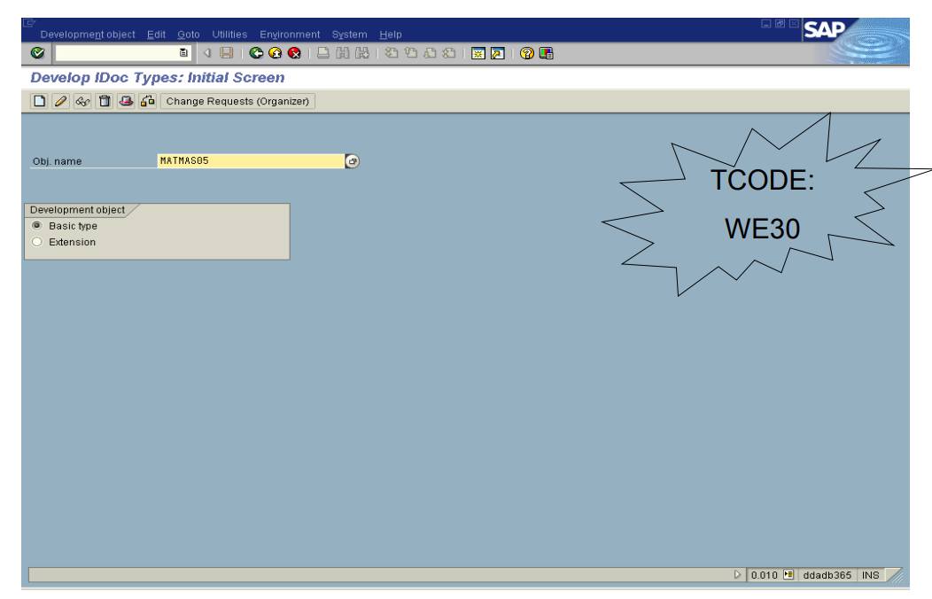
IDOC Type

Slide 12
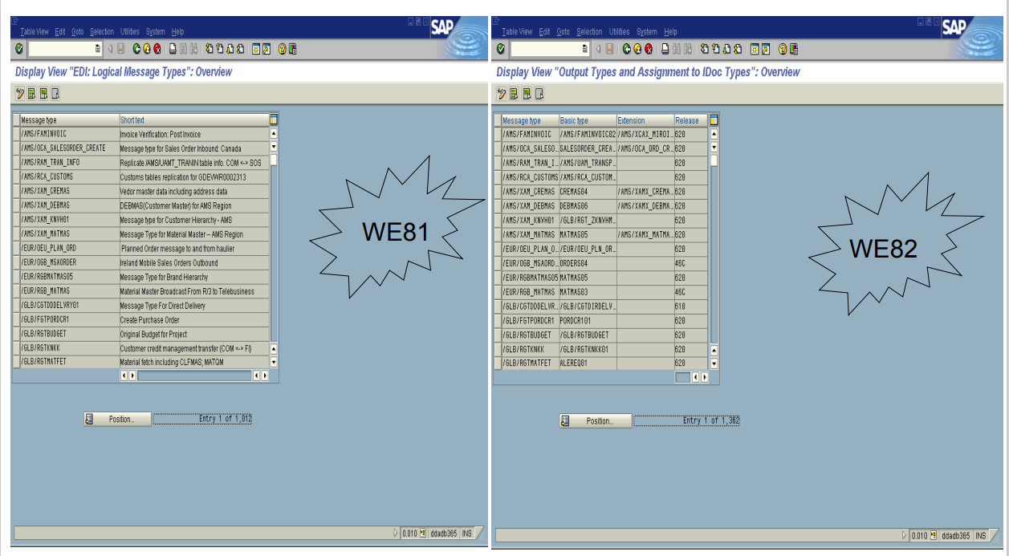
Message Type

Slide 13
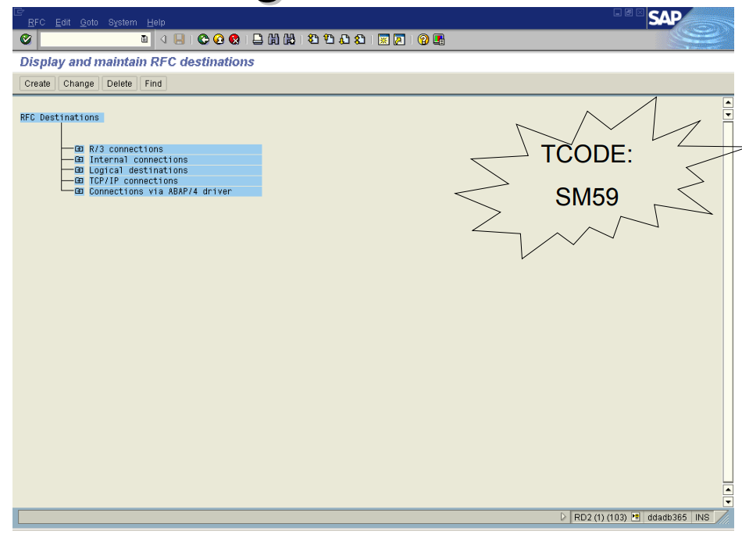
Maintain RFC Destinations

Slide 14
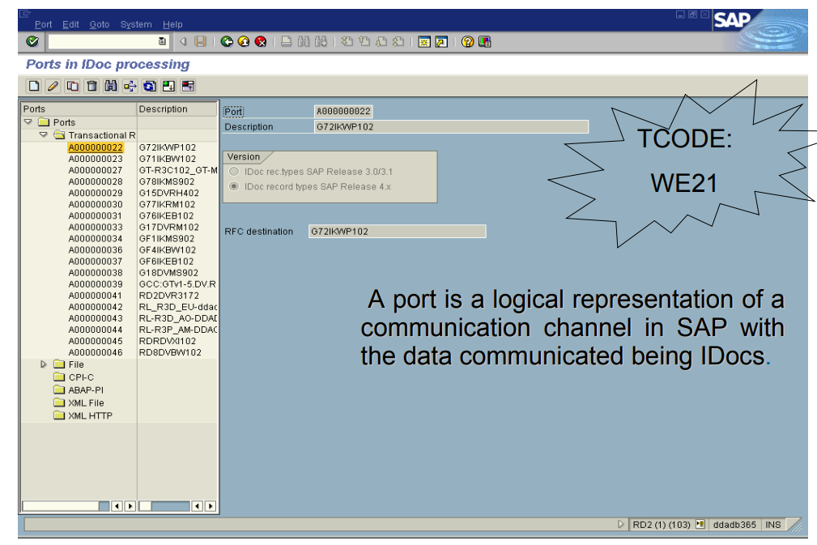
Ports

Slide 15
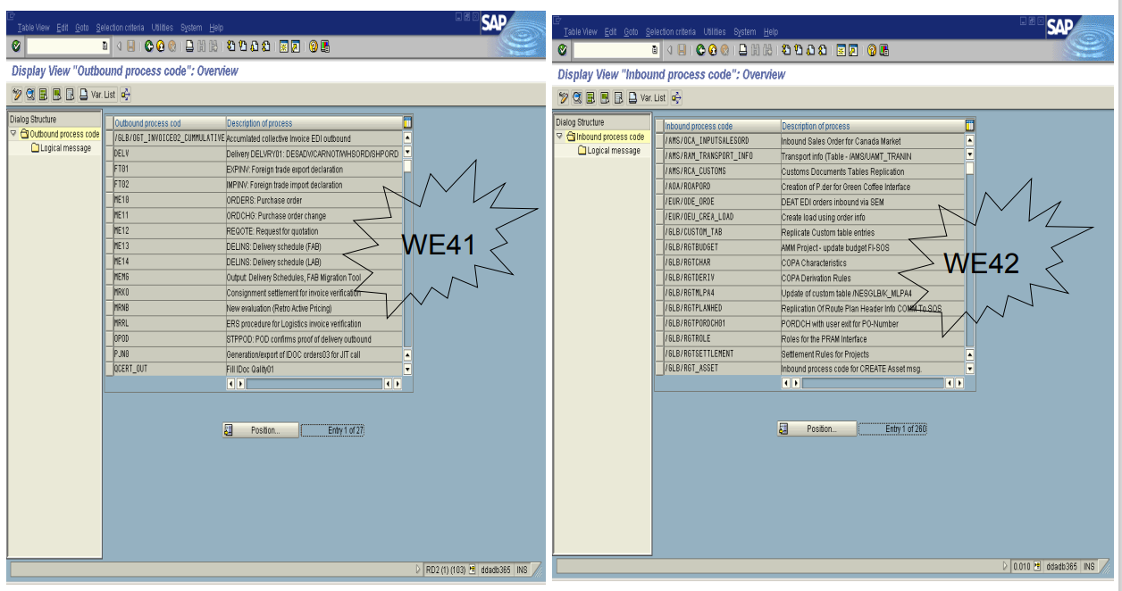
Process Code

Slide 16
ALE Configuration Steps
Logical Systems (SALE or BD54)
Assign Logical Systems to Clients (SALE or SCC4)
Create RFC Destination (SM59)
Define Port Definition (WE21)
Generate Partner Profile (WE20)
Maintain Distribution Model (BD64)

Slide 17
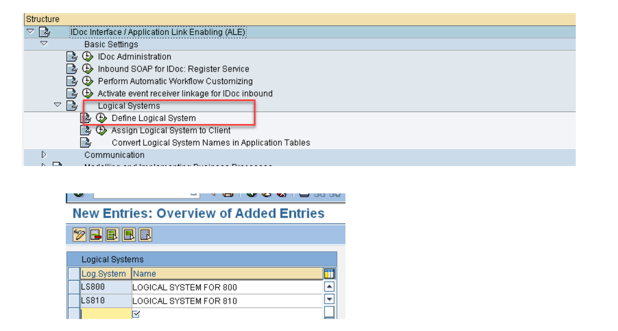
Define Logical System

Slide 18
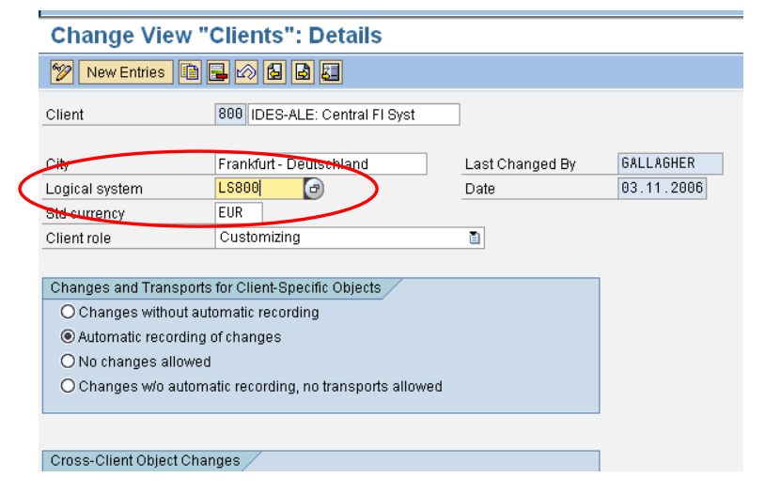
Allocate Logical System to Client

Slide 19
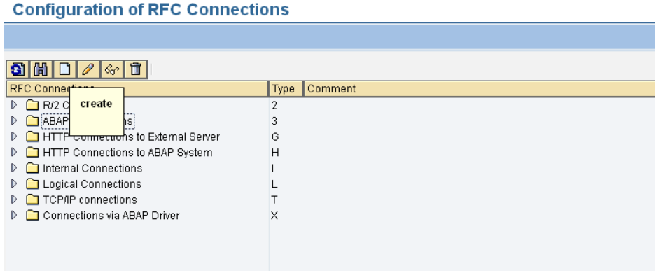
Create RFC Destination
Go to Transaction SM59
Select ABAP Connections and click on ‘Create’

Slide 20
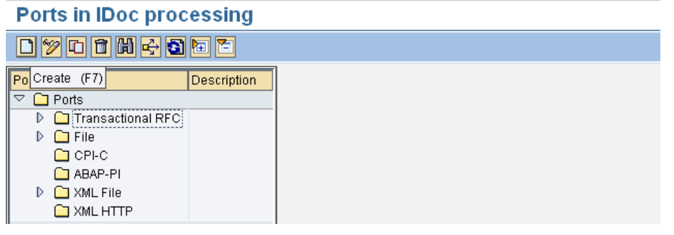
Define Port Definition
Go to Transaction WE21
Select Transaction RFC and click on ‘Create’

Slide 21
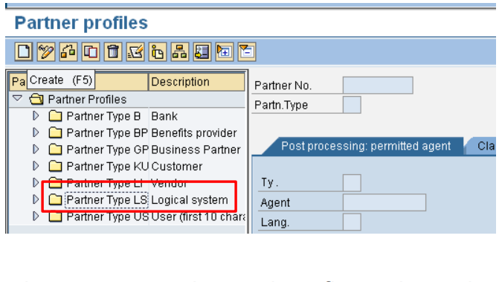
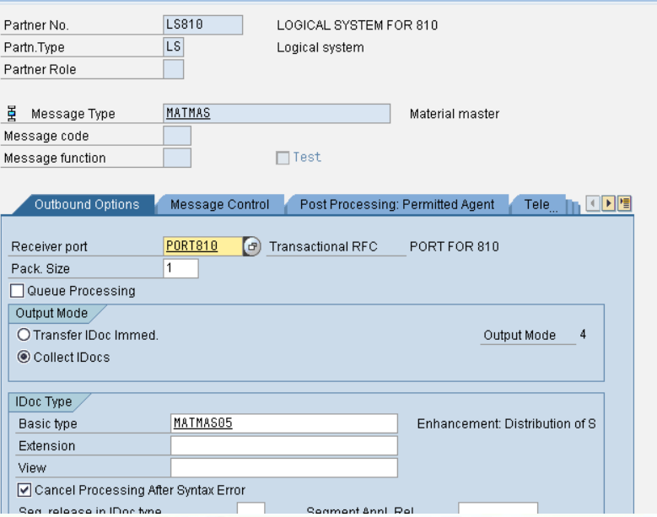
Define Partner Profiles
Go to Transaction WE20
Select Partner type LS and Create
Enter the partner number and configure the outbound parameter
Enter the Message Type, Receiver port name, Output Mode & Basic Type

Slide 22
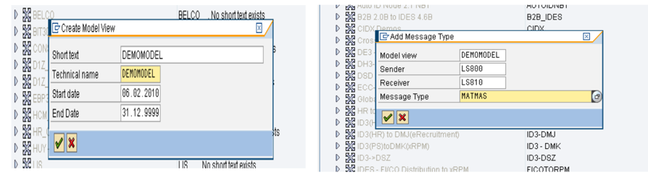
Maintain Distribution Model
Go to Transaction BD64
Create Model View
Add Message Type
Generate Partner Profiles
Distribute Model View
Save Model View
Go-to Environment -> Generate Partner Profiles

Slide 23
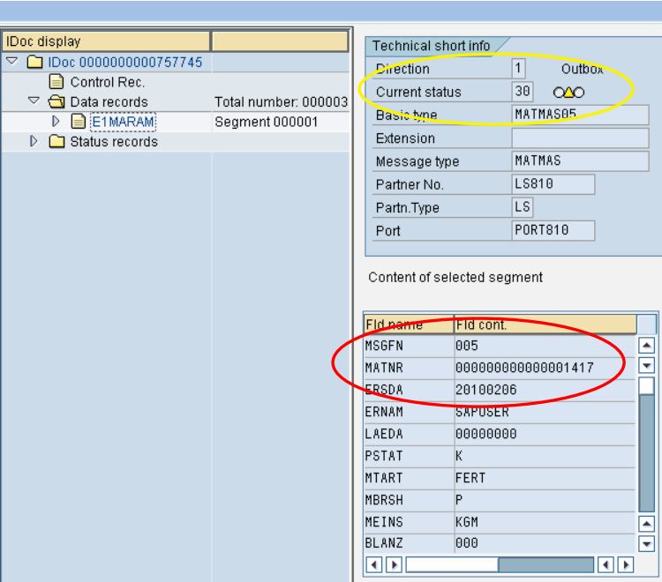
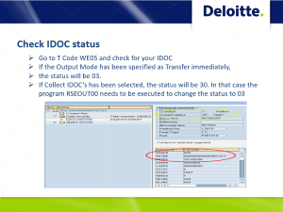
Check IDOC status
Go to T Code WE05 and check for your IDOC
If the Output Mode has been specified as Transfer immediately,
the status will be 03.
If Collect IDOC’s has been selected, the status will be 30. In that case the program RSEOUT00 needs to be executed to change the status to 03

Slide 24
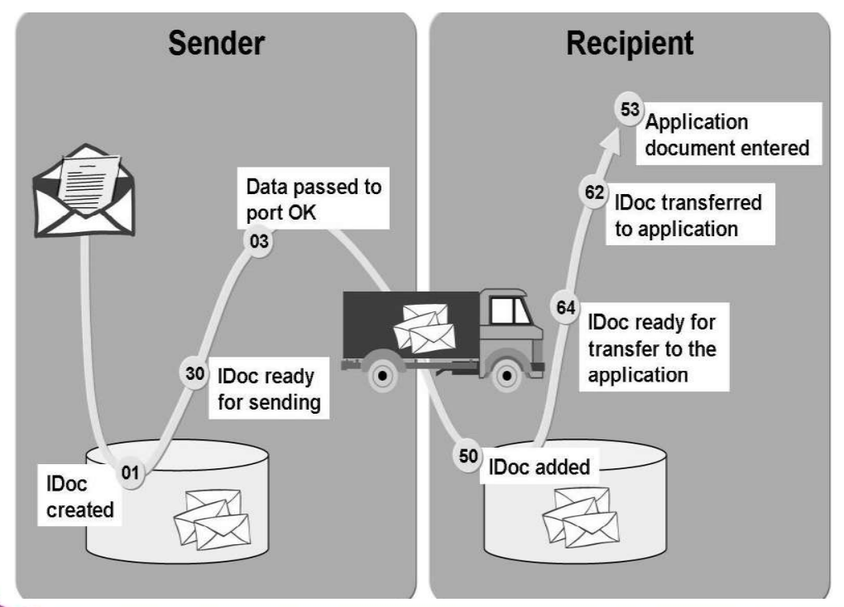
IDOC Status Numbers

Slide 25
Change Pointers
Change Pointers are R/3 objects that mark changes to SAP Master data.
CD objects record the changes in table CDHDR & CDPOS.
Internal mechanisms update table BDCP & BDCPS which host the change pointer.
Activate change pointers for message type or generally.
Enable Change Pointers globally - Transaction – BD61
Enable Change Pointer for a Message Type - Transaction BD50
Change pointer Configuration has to be done in Receiver system also

Slide 26
IDOC Extensions
An SAP IDoc structure can be extended by appending new subsegments with additional data.

Slide 27
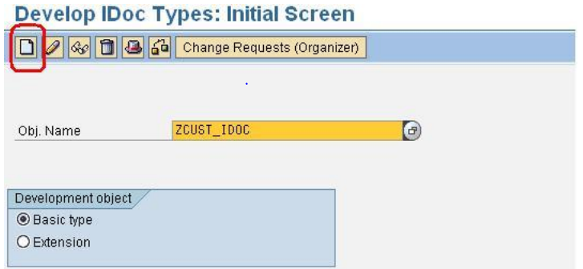
IDOC Extensions Steps
Transaction : WE30 – Create Custom IDOC type

Slide 28
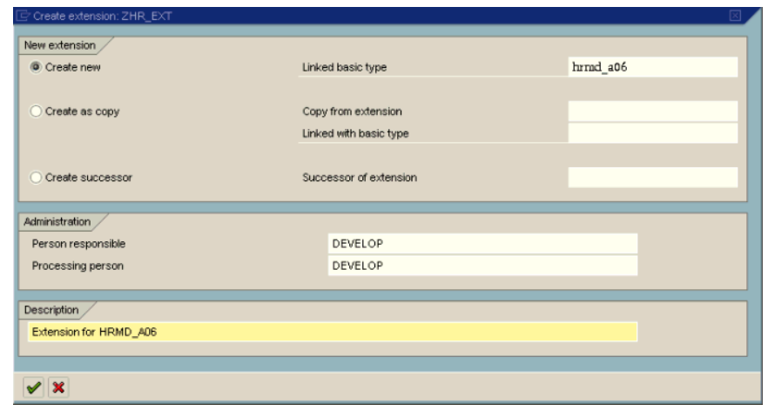
IDOC Extensions Steps
Transaction : WE30 – Create Custom IDOC type

Slide 29
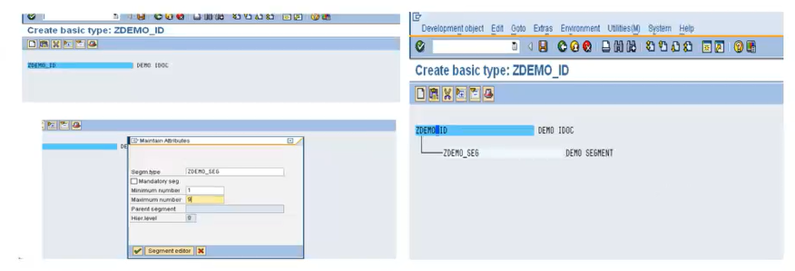
IDOC Extensions Steps
Transaction : WE30 – Create Custom IDOC type

Slide 30
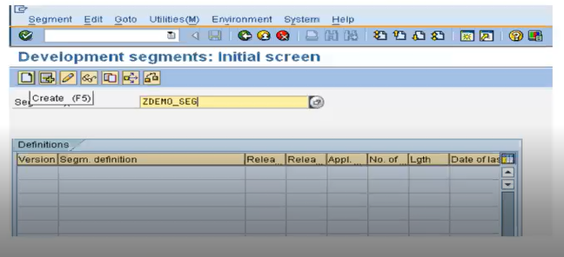
IDOC Extensions Steps
Transaction : WE31 – Create Segment

Slide 31
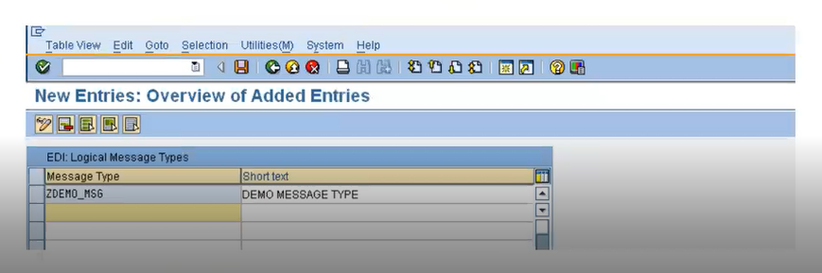
IDOC Extensions Steps
Transaction : WE81 – Create Message Type

Slide 32
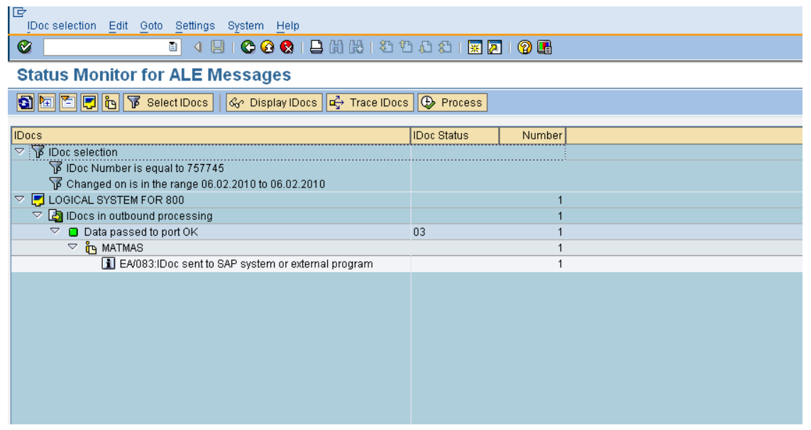
Monitoring IDOCS
Transaction: BD87

Slide 33
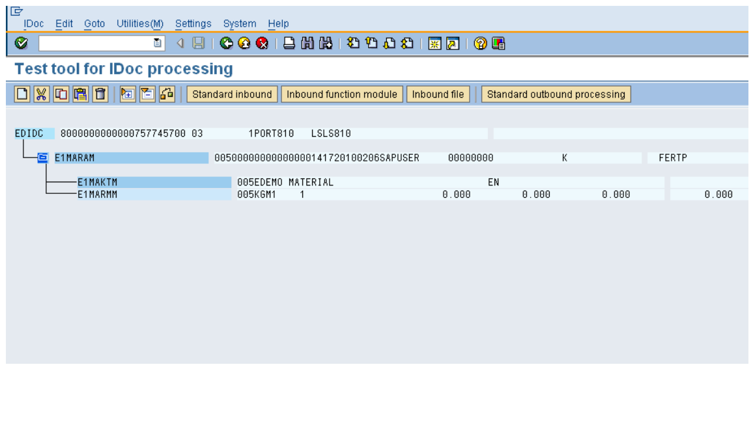
Monitoring IDOCS
Transaction: WE19

Slide 34
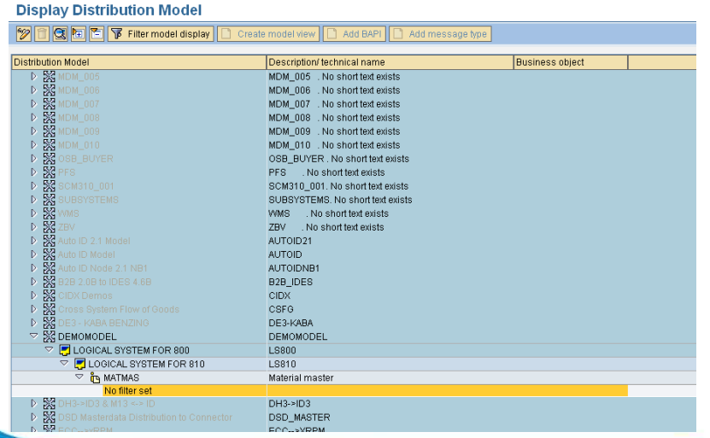
IDOCS Filtering
Filters can be set in the ALE configuration in the many ways:
Segment Level Filtering
Field Level Filtering
Filters in the Distribution Model

Slide 35
Q & A
Questions?

Slide 36
Thank You

