Slide 1
SAP Open Data(ODATA)
Maheswar Bonthu
Deloitte Consulting LLP
October 2023

Slide 2
Introduction of Open Data (ODATA)
Key Features:
Data Modeling
Service Definition
CRUD Operations
Security
Batch Operation

Slide 3
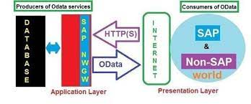
SAP ODATA Architecture

Slide 4
Some of the T-Codes used for the Creation & Maintenance of OData
SEGW - SAP Gateway Service Builder
/IWFND/MAINT_SERVICE - Service Maintenance in SAP Gateway:
/IWFND/GW_CLIENT - SAP Gateway Client
/IWFND/ERROR_LOG - Error Log in SAP Gateway
/IWFND/CACHE_CLEANUP - Cache Cleanup in SAP Gateway

Slide 5
SAP ODATA Flow Diagram

Slide 6
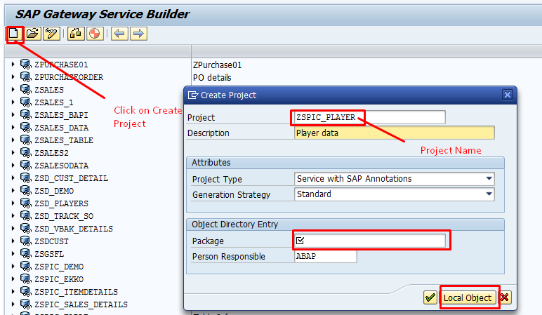
Ex1: Steps to Create Odata for fetching the data from Custom table
Notes:
Step1 : Go to T-Code – “SEGW” & Click on Create Button an give the Project name with ‘Z’ or ‘Y’ and save it in Local Object.

Slide 7

Ex1: Steps to Create OData for fetching the data from Custom table
Notes:
Step2 : After Saving under Local Object, by Default Data Model, Service Implementation, Run time Artifacts, Service Maintenance will generate.

Slide 8
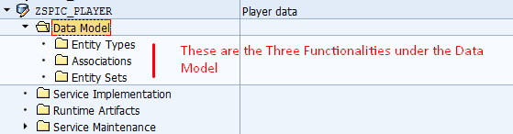
Ex1: Steps to Create OData for fetching the data from Custom table
Notes:
Step3 : Just Expand the Data Model, U Will find the Entity Types, Associations, Entitysets. Entity Types : It is like the Structure what fields we have to store for that entity type.
Associations : if u want to Give link between 2 Entitysets .
Entity Sets : It is like the Internal Tables by Default based on entity types it will generate that many entity sets it will be generated.

Slide 9
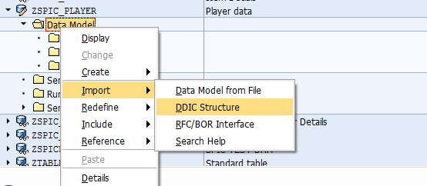
Ex1: Steps to Create OData for fetching the data from Custom table
Notes:
Step4 : Right Click on the Data Model and select Import as DDIC Structure.

Slide 10
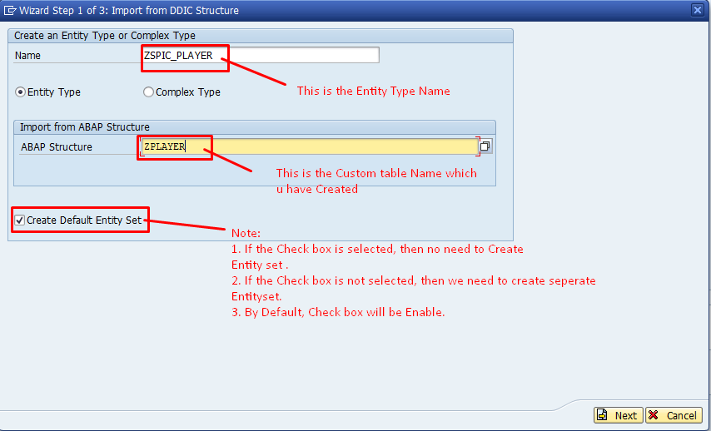
Ex1: Steps to Create OData for fetching the data from Custom table
Notes:
Step5 : 1.Need to give the Entity Name with “Z” or “Y” . 2. Need to give the structure Name which u Created.
3. Check box should be Enable. 4. After that click on Next Button.

Slide 11
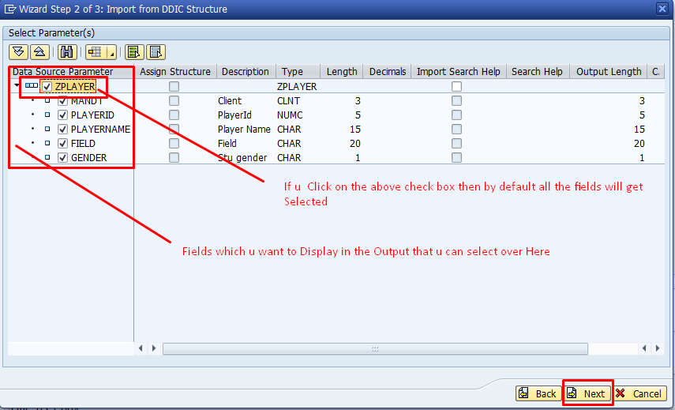
Ex1: Steps to Create OData for fetching the data from Custom table
Notes:
Step6 : After that we can select which ever the Fields, we want that we can select using check box & click Next .

Slide 12
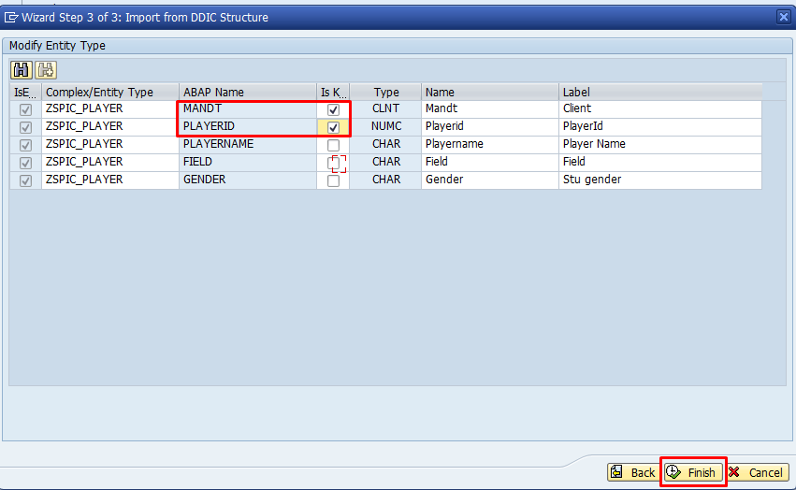
Ex1: Steps to Create OData for fetching the data from Custom table
Notes:
Step7 : After that Kindly Click on the primary key Fields which u Want that u can Select Over Here click on the Finish.

Slide 13
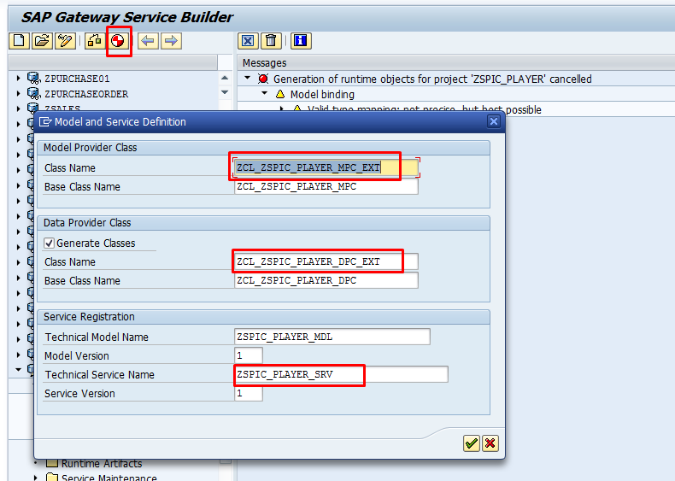
Ex1: Steps to Create OData for fetching the data from Custom table
Notes:
Step8 : After that Click on the Generate Button, By Default Data Provider Class, Model Provider Class and Service Name will Generate and click on the local object .

Slide 14
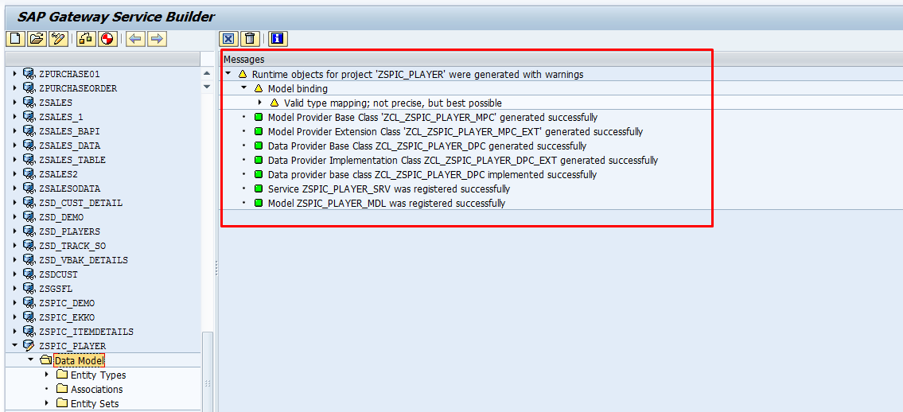
Ex1: Steps to Create OData for fetching the data from Custom table
Notes:
Step9: After that It will Activate, and it will Show in the Green Color. If any error Comes it will show in Red Color, that need to rectify .

Slide 15
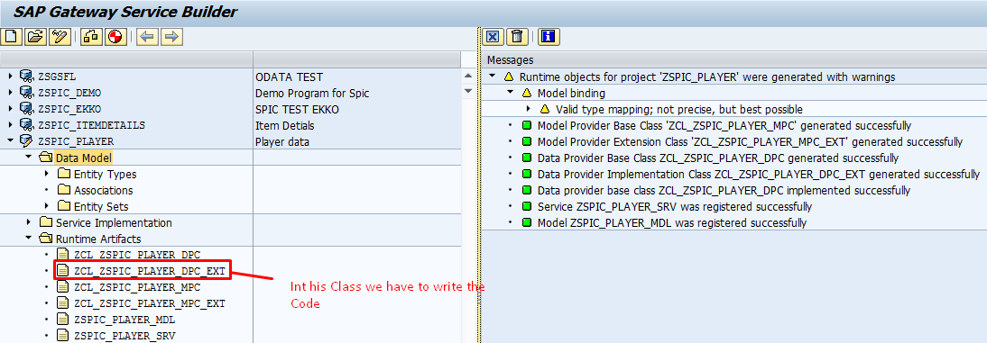
Ex1: Steps to Create OData for fetching the data from Custom table
Notes:
Step10 : After that Expand Runtime Artifacts and Select Data Provider Class Extension. Data Provider Class : If u Want to write any Code, then this Class is Required.
Model Provider Class : By Default, which ever the Structures, Internal Tables U have Created in the Data Provider Class that will appear here.
Service Name : OData Service Name we must register in the Front-end system.

Slide 16
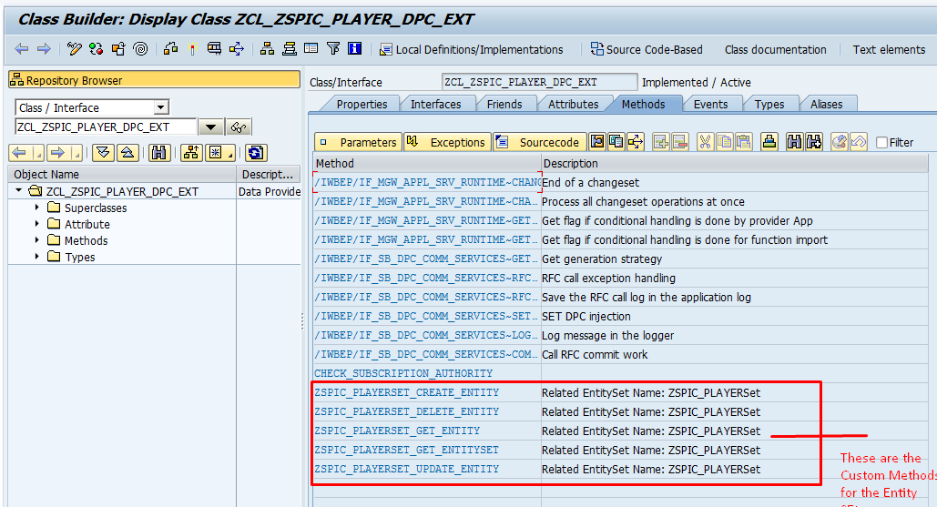
Ex1: Steps to Create OData for fetching the data from Custom table – CRUD operations
Notes:
Step11 : for Writing the Code need to double click on the Data Provider Class Extension it will take to u to the respective standard classes and methods. There we must redefine methods which we want to use and there we need to write the Code.

Slide 17
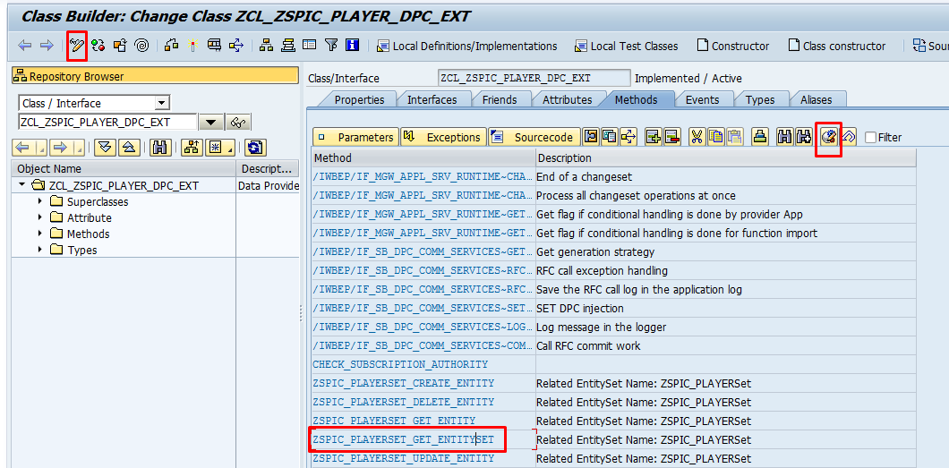
Ex1: Steps to Create OData for fetching the data from Custom table
Notes:
Step12 : After that now as per the Requirement, I am fetching the data so enable the Method Get_entityset.
For Enabling the Method just Click on the Edit button and select the method which u want to use then place cursor and click on redefine Method.

Slide 18
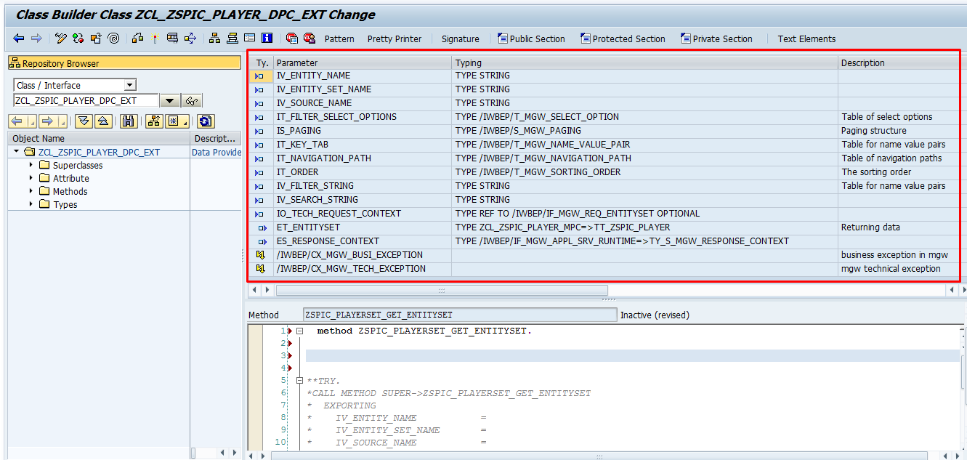
Ex1: Steps to Create OData for fetching the data from Custom table
Notes:
Step13 : In the Marked Screen Shot we can use it as Importing and Exporting Parameter. Importing : this Parameters we can use like Inputs. Exporting : this Parameters we can use like Display

Slide 19
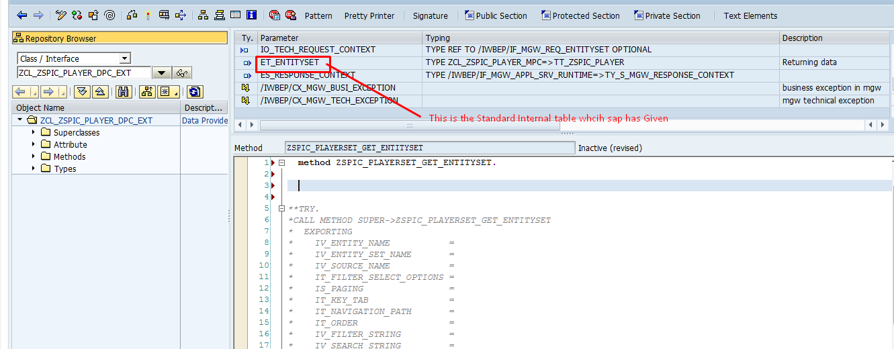
Ex1: Steps to Create OData for fetching the data from Custom table
Notes:
Step14 : Here as I mentioned in the above slide, there will be importing and exporting parameters so now as per the requirement I need to display the bulk of records so whole values need to store in the respective Entityset ET_ENTITYSET. It is like the final structure.

Slide 20
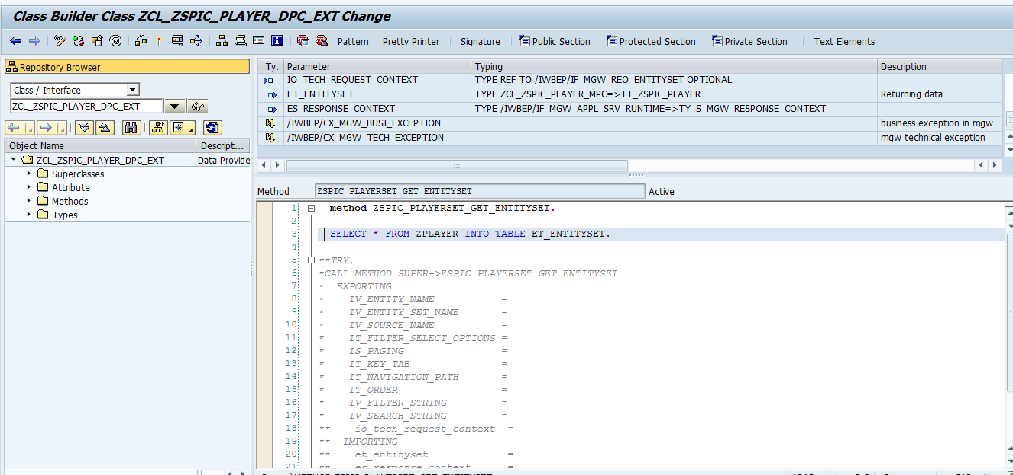
Ex1: Steps to Create OData for fetching the data from Custom table
Notes:
Step15 : Code which u need to write that u can write in between method and end method. If u want to debug the program, we have to Put external break-point because from one system we are writing and running in the other system so session breakpoint will not work. Note: Only 30 session break-points we can use.

Slide 21
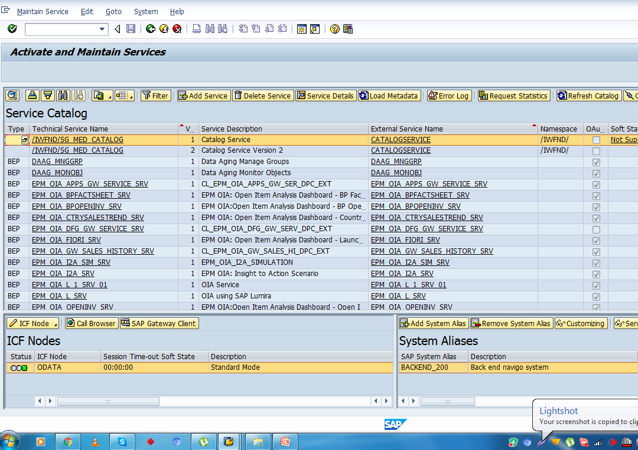
Ex1: Steps to Create OData for fetching the data from Custom table “/n/iwfnd/maint_service”
Notes:
Step16:
After that we have to go to Front end System to register service. For registering & Activating the service, Go to T-Code “/N/IWFND/MAINT_SERVICE”.

Slide 22
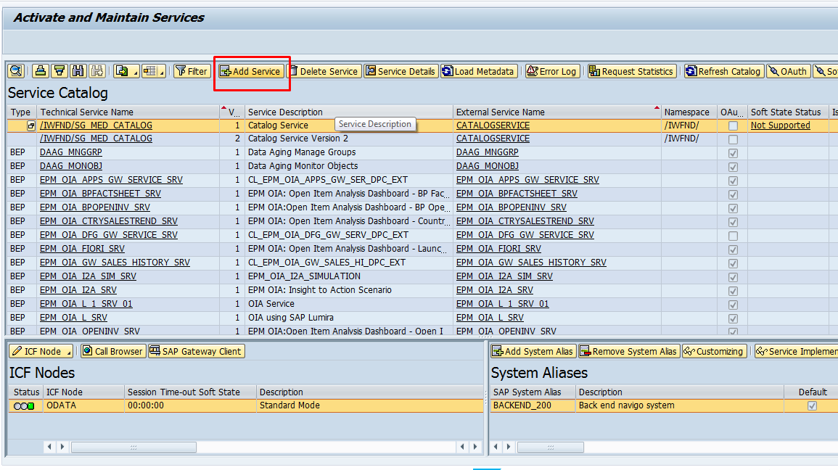
Ex1: Steps to Create OData for fetching the data from Custom table
Notes:
Step17:
First need to add the Service, for that we have to click on Add Service.

Slide 23
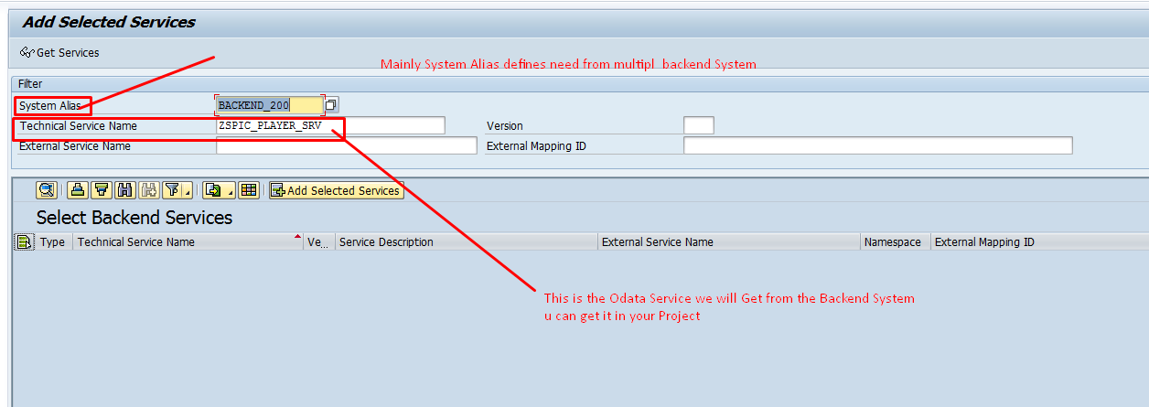
Ex1: Steps to Create OData for fetching the data from Custom table
Notes:
Step18: Need to register the Service.

Slide 24
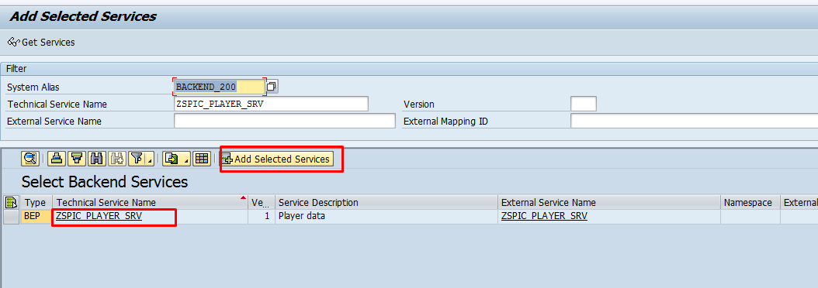
Ex1: Steps to Create OData for fetching the data from Custom table
Notes:
Step19: After that If u click on add service, then we must save under local Object.

Slide 25
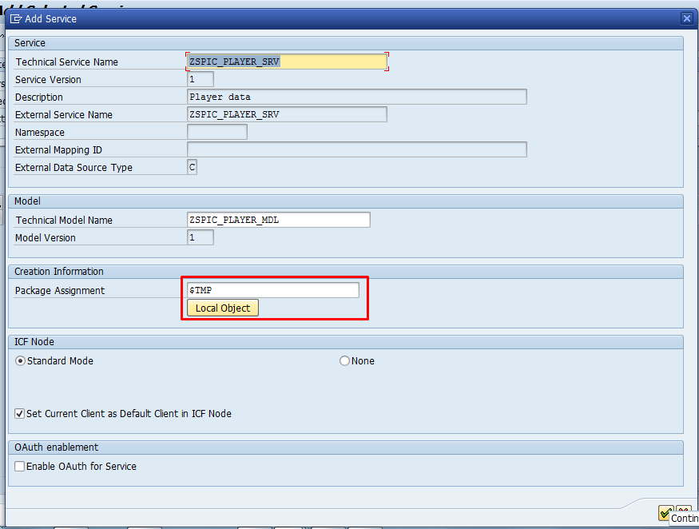
Ex1: Steps to Create OData for fetching the data from Custom table
Notes:
Step20: After that need to save under local object and click on enter.

Slide 26
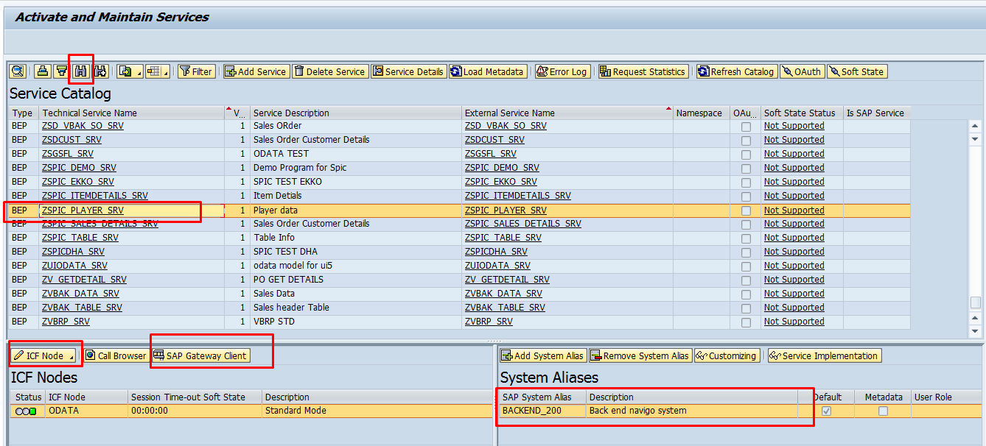
Ex1: Steps to Create OData for fetching the data from Custom table
Notes:
Step21: After that To find the service , go to t-code : “/n/iwfnd/maint_service “
By using the find symbol u can check the service and activate the ICF Node .
Before adding the service kindly check the system alias they have assigned or not. After that need to select the service and click on sap gateway client.

Slide 27
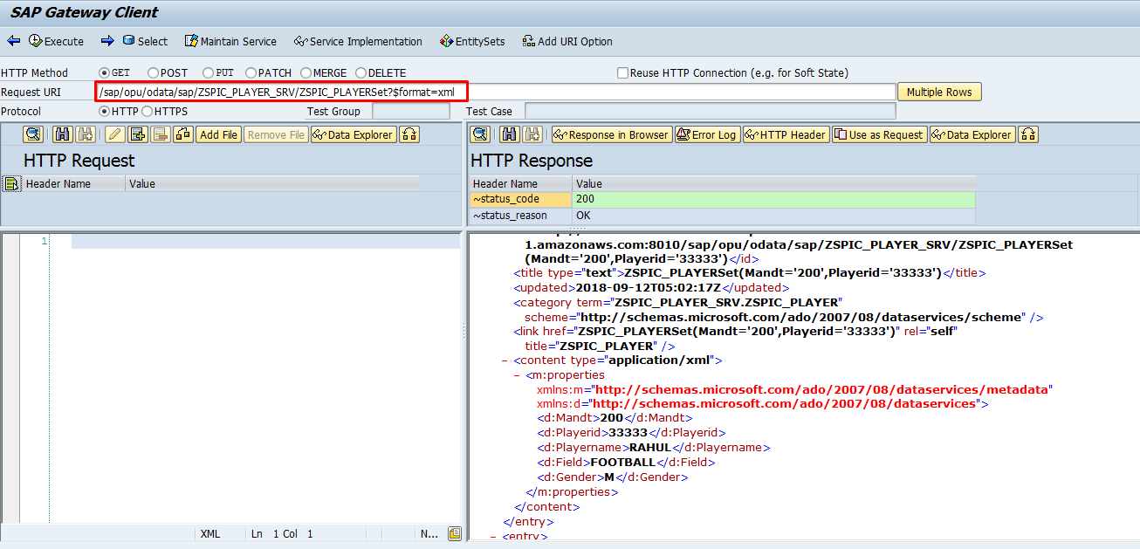
Ex1: Steps to Create OData for fetching the data from Custom table
Notes:
Step22: Syntax : /sap/opu/odata/sap/ZSPIC_PLAYER_SRV/ZSPIC_PLAYERSet?$format=xml in the above Syntax ZSPIC_PLAYER_SRV is your Service Name ZSPIC_PLAYERSet is your Entity Set Note it should be case sensitive

Slide 28
About Deloitte Deloitte refers to one or more of Deloitte Touche Tohmatsu Limited, a UK private company limited by guarantee, and its network of member firms, each of which is a legally separate and independent entity. Please see www.deloitte.com/about for a detailed description of the legal structure of Deloitte Touche Tohmatsu Limited and its member firms. Please see www.deloitte.com/us/about for a detailed description of the legal structure of Deloitte LLP and its subsidiaries. Certain services may not be available to attest clients under the rules and regulations of public accounting. Copyright © 2020 Deloitte Development LLC. All rights reserved. Member of Deloitte Touche Tohmatsu Limited
Notes:
28

