Slide 1
JOB REVIEWS ANALYSIS & PREDICTION

Slide 2
PROBLEM STATEMENT
Predict the Overall Rating provided by a Reviewer.

Slide 3
POTENTIAL BUSINESS PROBLEM
Ratings of a company may be affected by Human Behavior as different people have different perception of grading system.
Ex-employees may rate lower due to some personal reasons.
Ambiguity of reviews in the review section.
Notes:
xyz

Slide 4
DATA
The Dataset contains 30363 records of reviews. The target variable is Overall Score.
Feature | Data Type | Description
ID | Numerical | Review Identification Number
Place | Categorical | Company were the reviewer is working or earlier worked.
Location | Categorical | Location of Reviewer
Date | Date-Time | Review Date
Status | Categorical | Current status of reviewer with the startup
Job Title | Categorical | Position of work at the company
Summary | Text | Overall summary
Positives, Negatives | Text | Pros and Cons of Job
Advice to Management | Text | Comments given by the reviewer to the management
Overall Score | Numerical | Overall rating provided by the reviewer
Score_1 – Score_5 | Numerical | Rating which reflects the condition of work at the company.
Likes | Numerical | Number of likes received by the reviewer of the review.

Slide 5

EVALUATION METRIC
Accuracy will be used as the evaluation metric for this project.
It works well when equal number of samples belonging to each class.
It is the ratio of number of correct predictions to the total number of input samples.
$$Accuracy=\frac{Number of Correct Predictions}{Total Number of Predictions}=\frac{True Positives+True Negatives}{Sample size}$$

Slide 6
PIPELINE
Model Building
Pre-processing
EDA
Feature Engineering
Feature Elimination & Scaling
Analyze the data
Missing value Imputation, Encoding
Model Building & parameter Tuning

Slide 7
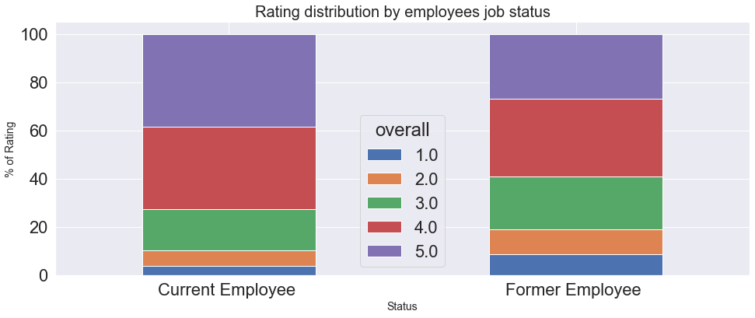
EDA – Hypothesis Testing
Ex-employees tend to rate lower
Null Hypothesis: Mean of ratings of Ex-employees is equal to the mean review ratings.
Alternative Hypothesis: Mean of ratings of Ex-employees is Lower than the mean review ratings.
Through hypothesis testing, it was proved that ex-employees tend to rate lower compared to current employees.

Slide 8
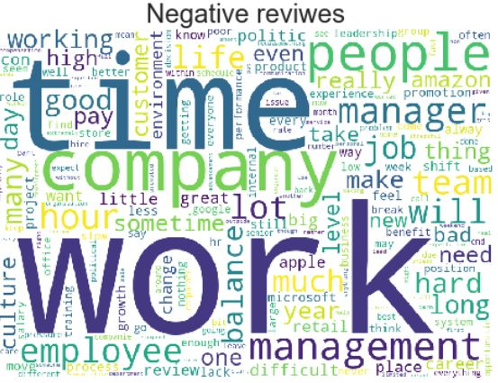

EDA
Word Cloud Representation of Most common words found in Positive and Negative Reviews

Slide 9
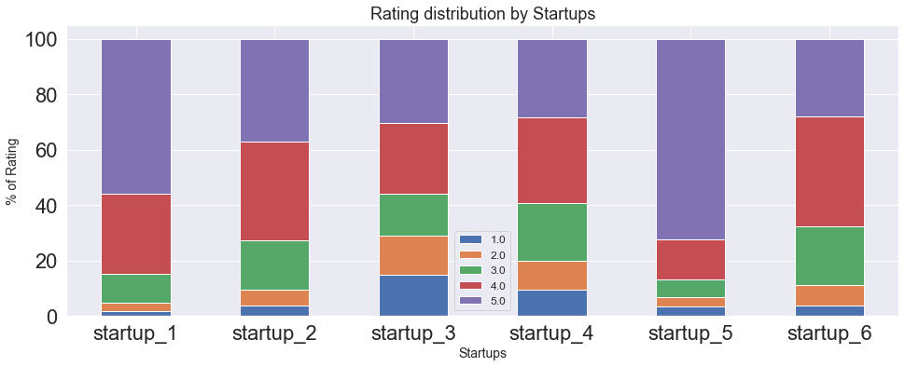
EDA

Slide 10
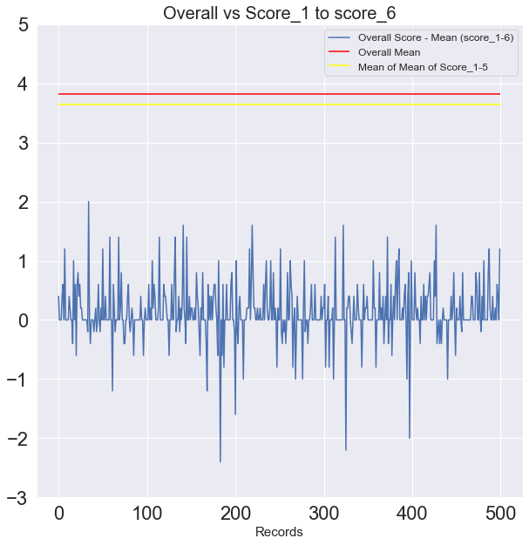
EDA
Overall Score and Score1 to Score 5 were highly correlated.
Majority of Scores1-5 lies within 1 rating from overall rating.
Overall Score was used for missing value imputation of missing values in Score1 – 5.

Slide 11
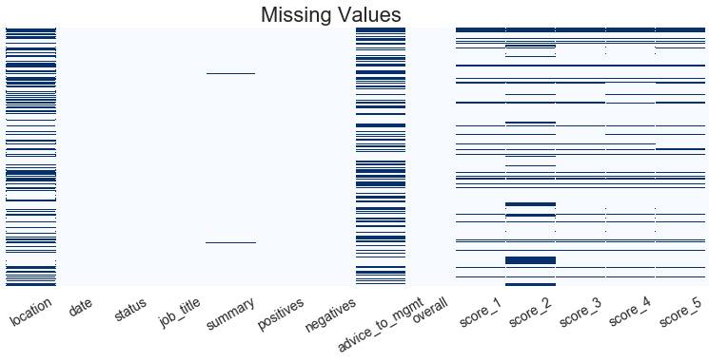
EDA – Missing Values
9 Features have some missing values

Slide 12
Missing Values Treatment
Feature | Missing Values (%) | Strategy
Advice to management | 43.50 | Feature dropped after testing
Location | 36.99 | Replaced with NA
Score_2 | 19.94 | Imputed using Overall Score
Score_5 | 11.40 | Imputed using Overall Score
Score_4 | 10.54 | Imputed using Overall Score
Score_1 | 10.51 | Imputed using Overall Score
Score_3 | 10.42 | Imputed using Overall Score
Summary | 0.21 | Replaced with NA
Negatives | 0.001 | Replaced with NA

Slide 13
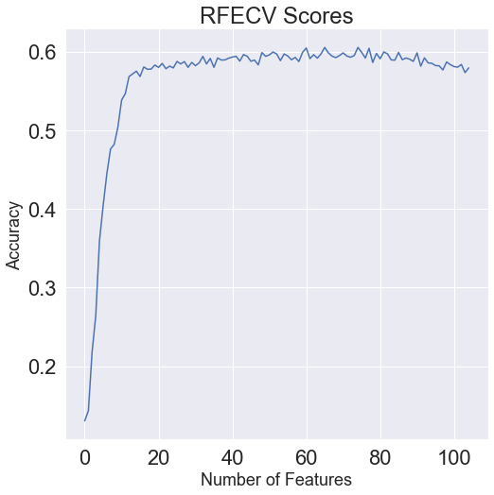
FEATURE SELECTION
Feature selection was performed using RFECV ( Recursive Feature Elimination with cross-validation).
Best Accuracy score is obtained using 76 out of 105 features.
ORIGINAL DATASET (30363,105)
After Feature Elimination (30363,76)

Slide 14
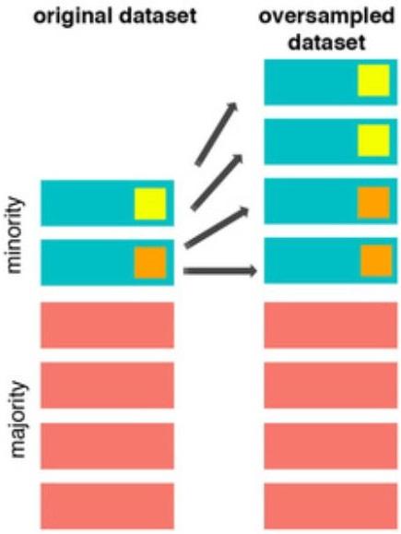
Over-Sampling
Synthetic Minority Over-Sampling Technique (SMOTE) was used for oversampling with respect to the target variable.
Over-sampling added 17305 synthetic records.
After Feature Elimination (47668,79)
ORIGINAL DATASET (30363,105)
After Feature Elimination (30363,76)

Slide 15
MODELS & APPROACHES
The following models were tested:
Logistic Regression
Random Forest Classifier
XGBoost Classifier
Accuracy of Tree Based model improved significantly after over sampling.
Model | Accuracy (Before Oversampling) | Accuracy (After Oversampling)
Logistic Regression | 0.694 | 0.705
Random Forest | 0.703 | 0.84
XGBoost | 0.707 | 0.823

Slide 16

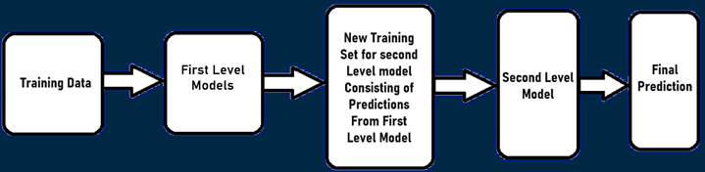
MODEL STACKING
1
Logistic Regression
To further enhance the model performance, 3 models were used stacked together with Logistic regression meta-classifier.
The Cross validation Accuracy after stacking was 0.844.
2
Random Forest
3
XGBoost

Slide 17
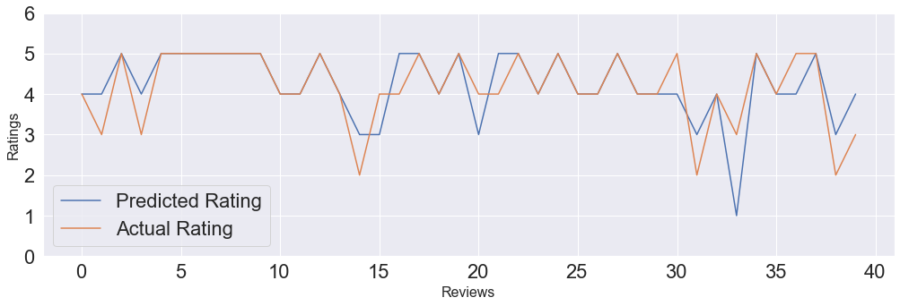
MODEL PERFORMANCE
Model | Accuracy | Precision | Recall | F1-Score
Stacking Classifier | 0.7177 | 0.6887 | 0.6876 | 0.6877

Slide 18
INSIGHTS & DECISIONS
Most of the negative reviews focused on the topics related to work, time, management etc.
Reliable reviews should be given priority in the ratings/reviews section on the website.
Overall rating of company can be calibrated using the predicted overall scores.
Provide suggestion related to data collection for reducing missing values in future reviews.

Slide 19
NEXT STEP
Test & add more models with stacking regressor model.
Imputation of missing Location values using a ML algorithm.
Add more features like, number of reviews provided by the reviewer.
Explore more efficient over sampling techniques.

Slide 20

THANKS
Do you have any questions?
anurag6840@gmail.com
+91 7004872935
Please keep this slide for attribution

