Slide 1
Clustering of Chennai Neighbourhoods
G S Kumarasamy

Slide 2
Chennai
Chennai is the capital of Tamilnadu, a southern state in India.
According to the 2011 Indian census, it is the sixth-most populous city and fourth-most populous urban agglomeration in India. The city together with the adjoining regions constitutes the Chennai Metropolitan Area, which is the 36th-largest urban area by population in the world.
As part of this project, we will be analysing the Chennai neighbourhood by taking the Chennai neighbourhood data from Wikipedia and scrapping the data for further analysis.
By using Four square API, the geographic data will also be taken and it will be merged with scrapped Wikipedia data on neighbourhoods.
Once it is done, clustering the neighbourhood data using K-Means clustering Algorithm will be carried out.. Finally these clusters help the various stake holders to establish their businesses, to sell the houses so on.

Slide 3
Data
These are the sources from which the data will be taken:
From the Wikipedia page about the Chennai neighbourhoods
From the four square API about the Geographic data
Clustering the Chennai neighbourhood using K-Means clustering Algorithm

Slide 4
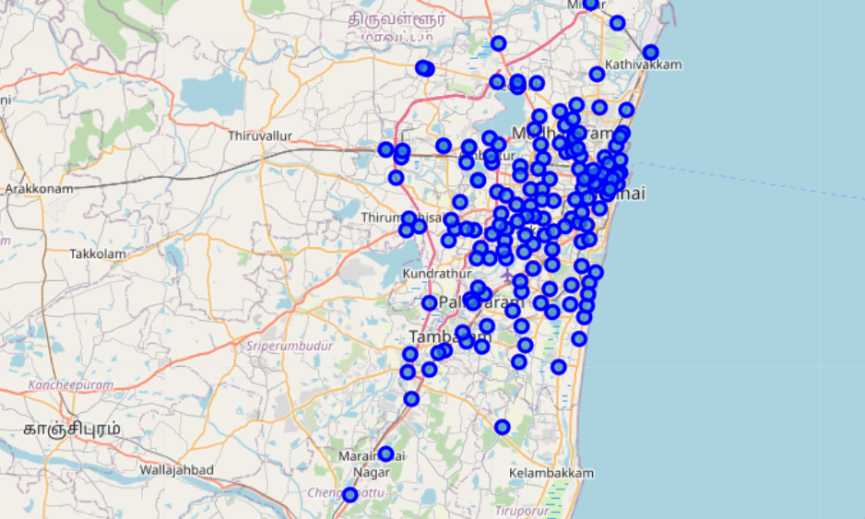
Chennai Map

Slide 5
Methodology
From the Wikipedia page , the neighbourhood data is taken
From the four square API about the Geographic data is taken and merged with neighbourhood data
Clustering the Chennai neighbourhood using K-Means clustering Algorithm

Slide 6
Results
The entire neighbourhood is clustered into 5 clusters using K-Means clustering algorithm
From the cluster information, we can conclude that the North west region of the Chennai neighbourhood will find more activities with respect to Infrastructure development, institutions and shopping places.

