Slide 1
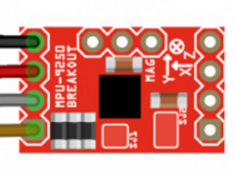
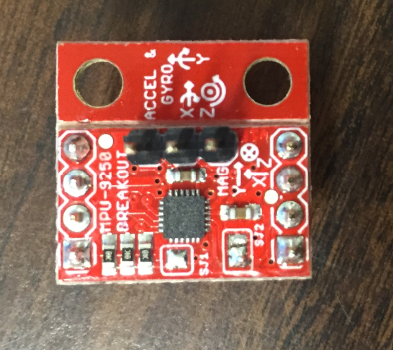
MPU9250- Wiring
The Sparkfun breakout board comes with the ADO/SDO soldered to ground. So you have to desolder this SJ2 jumper and solder it to the left side in order to use SPI.
MOSI
/SDI
MyRio
3.3 V
SCL
GND
NC
GND/NC (I found it makes no difference)
NC
NC
MISO
/SDO
CS
NC
Left side.
Right side.
https://learn.sparkfun.com/tutorials/mpu-9250-hookup-guide?_ga=1.36286626.343963501.1485985923

Slide 2
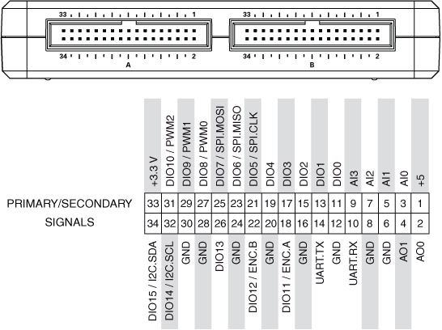
myRIO- Wiring
Labview program provided uses
connector B.
CS
http://zone.ni.com/reference/en-XX/help/373197D-01/myriodriverhelp/ni_myrio-1900/

Slide 3
MPU9250- program instructions (Labview myRIO 2015 & 2016)
Wire the sensor on a bread board (as shown in slide 1 and 2) and place it horizontally on a table
Open MPU9250_manualoffset.lvproj (see slide 4)
Run FPGA_MPU_rev1.vi. It will take few minutes to compile. I noticed that the NI cloud servers are fast. This can be implemented by responding to the prompts when compiling (you need to be registered with NI for this).
The range of accelerometer is set to ±4 g and the Gyroscope is 250 deg/s by default.
The sensor values need to be closer to zero except for the Z axis acceleration (1 g), because of the earth’s gravity. To do this, run RT_FPGA_manualoffset_v8.vi and manually adjust the offset control (slide5) until the readings are 0 (X,Y) and 1 (Z). The maximum and minimum values of the control can be viewed by right clicking the control -> properties -> Data entry (slide 6). These values are written to the offset register of the chip.
Setting the time delay to 500 ms (slide 6) gives you 10 minutes to do the offset. These offset values are stored in on-chip memory, after 10 minutes the memory overflows and the chip stops working. If offset is completed within 10 minutes and hit “stop offset” the data collection will run continuously for unlimited time.
Turning OFF the indicators will increase the processing speed of myRIO, which will be helpful during the feedback control of the stage housing the laser. (see slide 6)

Slide 4
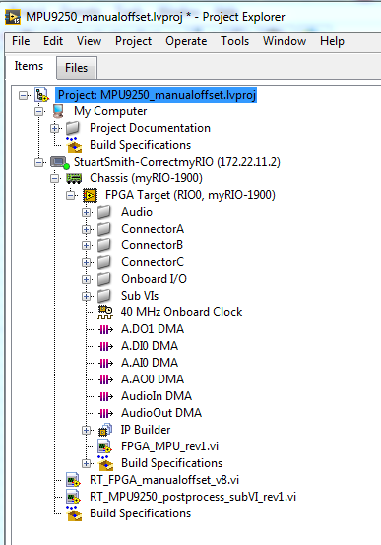
Labview project
Version: Labview myRIO 2015 & 2016

Slide 5
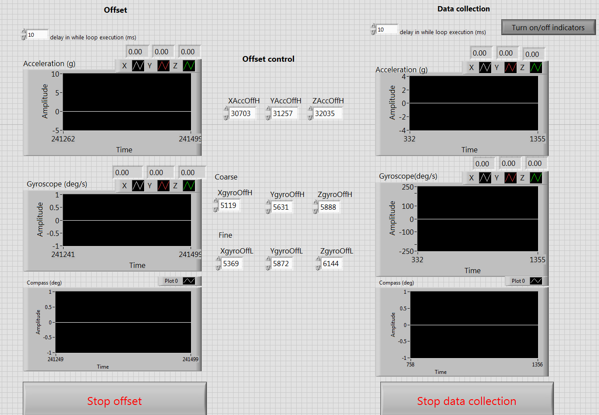
MPU9250- offset
If you are unable to achieve the zero offset even
after reaching the maximum value of the coarse
control, change the coarse control to minimum
and thenuse the fine control.

Slide 6
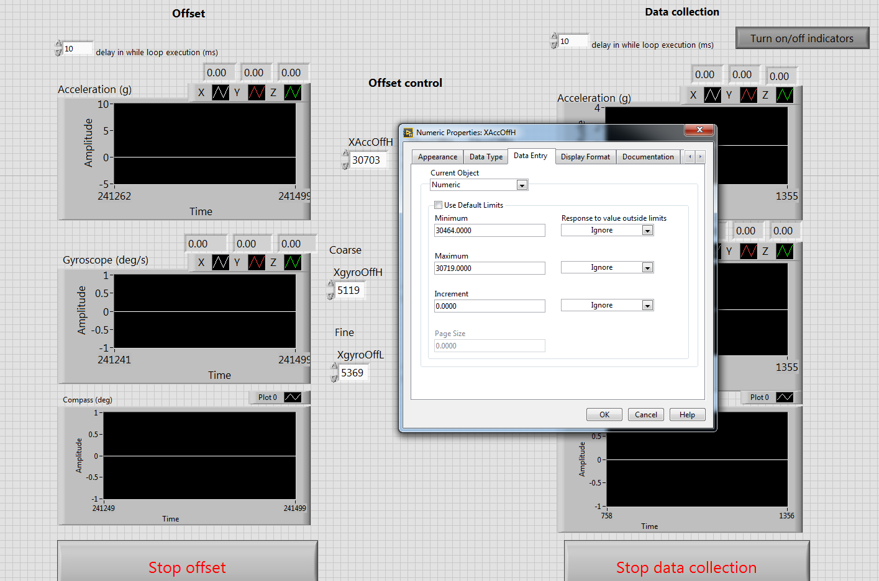
MPU9250- offset
500

