Slide 1
Smart Home System Architecture
A S Puneeth Kumar
2024mt13102
Understanding the design and components of intelligent residences
Notes:
---

Slide 2
Goals of the Smart Home System
Automation of Tasks
  The system automates daily household tasks like lighting and gate management for convenience.
Secure Communication
  Ensures secure, reliable communication between devices with user authentication to prevent unauthorized access.
User-Friendly Interface
  Provides an easy-to-use interface for control and monitoring of home systems.
High Availability and Interoperability
  Supports seamless operation with existing smart home technologies and protocols.
Notes:
---
This slide references information from the following file: https://office.com?path=7cb16f1f-6594-4796-a23a-6337ac2db911
The primary goals of the Smart Home System include automating daily household tasks, ensuring secure and reliable communication between devices, and providing a user-friendly interface for control and monitoring. The system aims to enhance convenience by allowing users to set instructions that respond to sensor events, thereby streamlining operations such as lighting adjustments, weather control, and gate management. Security is a key focus, with mechanisms in place to authenticate users and prevent unauthorized access. The system also emphasizes high availability and interoperability, ensuring that it can function seamlessly with existing smart home technologies and protocols.

Slide 3
Utility Tree of Top ASRs
Attribute | Refinement | Example Tactic
Security | Authentication and access control | SSO, OAuth
Availability | Fault detection and recovery | Redundancy, ping checks
Interoperability | Protocol support | ZigBee, Bluetooth LE
Notes:
---
This slide references information from the following file: https://office.com?path=7cb16f1f-6594-4796-a23a-6337ac2db911
The Utility Tree diagram illustrates the top three architectural quality attributes—Security, Availability, and Interoperability—and their respective refinements. It serves as a visual representation of how these attributes are prioritized and addressed within the Smart Home System. Each branch of the tree details specific scenarios and tactics employed to meet the quality goals, providing a structured overview of the system’s architectural considerations.

Slide 4
Tactics to Achieve ASRs
Quality Attribute | Scenario | Tactics | Caching straegy | Tools
Security | Authorized user interaction with role-based permissions | SSO, OAuth, role-based access, encrypted communication | Cache user roles and permissions, Short-Lived tokens | Authentication Service, Redis or Memcached
 | Secure Communication Between Devices | Encrypted Communication, Device Authentication, Secure Boot and Firmware Validation | Cache Device credentials and session keys | MQTT with TLS, Hardware Security Modules, Local secure cache
Notes:
---
This slide references information from the following file: https://office.com?path=7cb16f1f-6594-4796-a23a-6337ac2db911
To achieve the top architectural quality attributes—Security, Availability, and Interoperability—the Smart Home System employs several tactics. For Security, the system uses Single Sign-On (SSO) and OAuth integration for user authentication, along with role-based access controls. Communication between devices is encrypted, and new devices are securely paired using unique identifiers. For Availability, the hub monitors system health using ping/echo messages and triggers fault recovery mechanisms when failures are detected. Redundant systems and scalable cloud services ensure continuous operation. Interoperability is achieved by supporting standard communication protocols like ZigBee, Bluetooth LE, and Z-Wave, allowing seamless integration with popular smart home devices.

Slide 5
Quality Attribute | Scenario | Tactics | Caching straegy | Tools
Availability | Fault detection and recovery | Ping/echo checks, redundancy, scalable cloud services | Cache device health status, fallback configurations | Prometheus or AWSCloudWatch, Redis, Load Balancers
 | High Availability of smart services | Failover Mechanisms, Service Replication, Graceful Degradation | Cache recent user commands and device states, replicated service metadata | Distributed cache e.g.Redis cluster, Kubernetes or Docker swarm, Local storage
Notes:
---
This slide references information from the following file: https://office.com?path=7cb16f1f-6594-4796-a23a-6337ac2db911
Tactics to Achieve ASRs

Slide 6
Quality Attribute | Scenario | Tactics | Caching straegy | Tools
Interoperability | Compatibility with standard protocols | Support for ZigBee, Bluetooth LE, Z-Wave | Cache protocol mappings, store device profiles | Open HAB, Redis or in-memory cache
 | Integration with Third party smart devices | API-Based integration, Service Discovery | Cache API endpoints and authentication tokens, device discovery results | MQTT broker, Redis, Service Registry

Slide 7
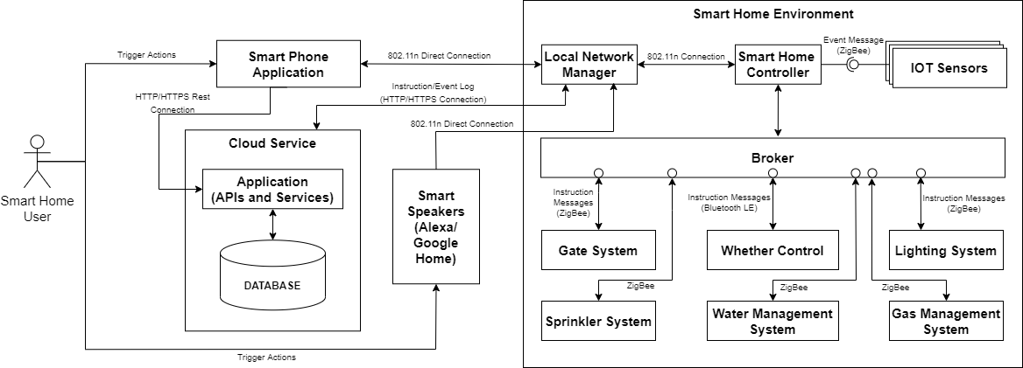
Component Connector Diagram
Core Smart Home Components
  The system includes mobile app, smart hub, IoT sensors, smart speakers, and broker components.
Communication Methods
  Instructions are sent via cloud services or local Wi-Fi for device interaction.
Low-Energy Device Protocols
  Devices communicate efficiently using low-energy wireless protocols for connectivity.
Notes:
---
This slide references information from the following file: https://office.com?path=7cb16f1f-6594-4796-a23a-6337ac2db911
The Component Connector Diagram showcases the interactions between major components of the Smart Home System. It includes the mobile application, smart hub, IoT sensors, smart speakers, and the broker. The diagram highlights how instructions are transmitted via cloud services or local Wi-Fi, and how devices communicate using low-energy protocols. This visual aids in understanding the system’s architecture and the flow of data between components.

Slide 8
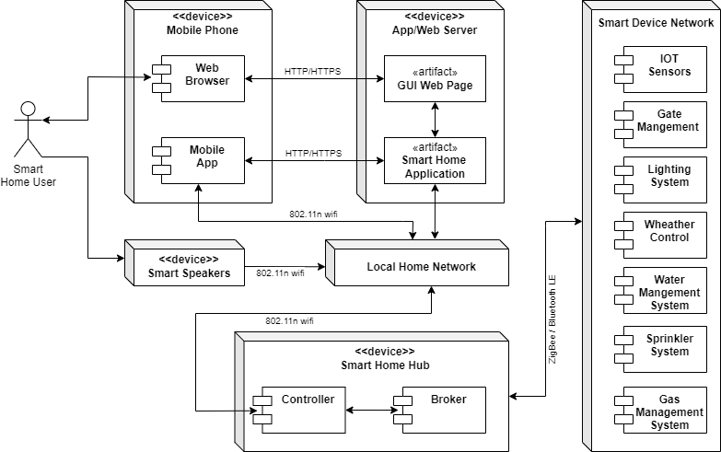
Deployment Diagram
Visualize System Deployment
Shows how components are deployed across environments including cloud and local hubs.
Operational Infrastructure Insight
Helps teams understand infrastructure setup for cost estimation and deployment planning.
Redundancy and Scalability
Illustrates built-in redundancy and scalability features supporting system reliability.
Notes:
---
This slide references information from the following file: https://office.com?path=7cb16f1f-6594-4796-a23a-6337ac2db911
The Deployment Diagram provides a visual representation of how the Smart Home System’s components are deployed across different environments. It includes cloud-hosted services, local hubs, and connected devices. This diagram helps operational teams understand the infrastructure setup, estimate costs, and plan deployments effectively. It also illustrates the redundancy and scalability features integrated into the system.

Slide 9
Labeled Connections & Communication Methods
1. Mobile App → Smart Hub
  Message: User commands (e.g., lighting rules, gate control)
  Communication Method:
    Cloud-based REST API (when remote)
    Local Wi-Fi (when on the same network)
  Label: UserCommandRequest (REST/Wi-Fi)
2. Smart Hub → IoT Sensors
  Message: Configuration updates, polling requests
  Communication Method:
    ZigBee / Bluetooth LE / Z-Wave
  Label: SensorConfigUpdate (ZigBee/BTLE)
4. Smart Hub → Smart Speakers
  Message: Voice command processing, status updates
  Communication Method:
    Local Wi-Fi / MQTT
  Label: VoiceCommandRelay (MQTT/Wi-Fi)
3. IoT Sensors → Smart Hub
  Message: Sensor events (e.g., motion detected, temperature change)
  Communication Method:
    Low-energy wireless protocols
  Label: SensorEventNotification (ZigBee/BTLE)

Slide 10
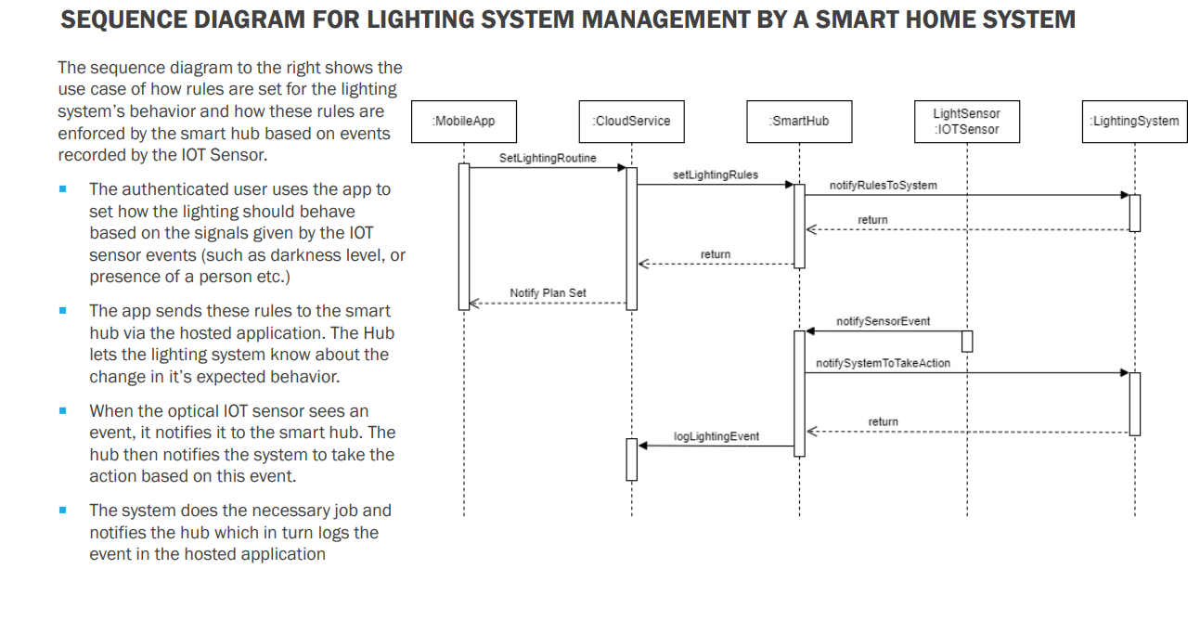
User Rule Configuration
  An authenticated user sets lighting behavior rules through a mobile application interface.
Hub Communication
  The hub receives and relays lighting rules from the app to the lighting system components.
Sensor-Triggered Actions
  Lighting system actions are activated in response to sensor input events automatically.
Dynamic Interaction Clarity
  The diagram clarifies component interactions and expected system behavior for developers.

Slide 11
Architectural Patterns
Broker Pattern Role
Facilitates decoupled communication between hubs and smart devices for smooth operation.
Client-Server Pattern Use
Manages cloud-hosted app requests linking mobile apps and home hubs efficiently.
Benefits of Patterns
Architectural patterns improve system scalability, reliability, and maintainability.
Notes:
---
This slide references information from the following file: https://office.com?path=7cb16f1f-6594-4796-a23a-6337ac2db911
The Smart Home System employs two primary architectural patterns: the Broker Pattern and the Client-Server Pattern. The Broker Pattern facilitates decoupled communication between hubs and smart devices, allowing for cohesive operation and easy integration of new devices. The Client-Server Pattern is used in the cloud-hosted application, which handles requests from multiple users and bridges communication between mobile apps and home hubs. These patterns enhance scalability, reliability, and maintainability of the system.

Slide 12
Key Learnings
High Availability Importance
  High availability is critical for systems like gas management to ensure safety and reliability.
Fail-Safe System Design
  Systems should default to safe modes or recover quickly from failures to protect users.
Future-Proof Architecture
  Design must accommodate evolving smart home technologies for long-term adaptability.
Visual Planning Tools
  Component and sequence diagrams help teams plan, estimate costs, and streamline development.
Notes:
---
This slide references information from the following file: https://office.com?path=7cb16f1f-6594-4796-a23a-6337ac2db911
Key learnings from the Smart Home System architecture include the importance of high availability, especially in critical systems like gas management. Ensuring that systems default to safe modes or recover quickly from failures is essential. The system must also be future-proofed to accommodate evolving smart home technologies. Visual tools like component diagrams, deployment views, and sequence diagrams aid in planning and development, particularly in Agile environments. These tools help developers and operational teams understand system expectations, estimate costs, and streamline implementation strategies.

