Slide 1
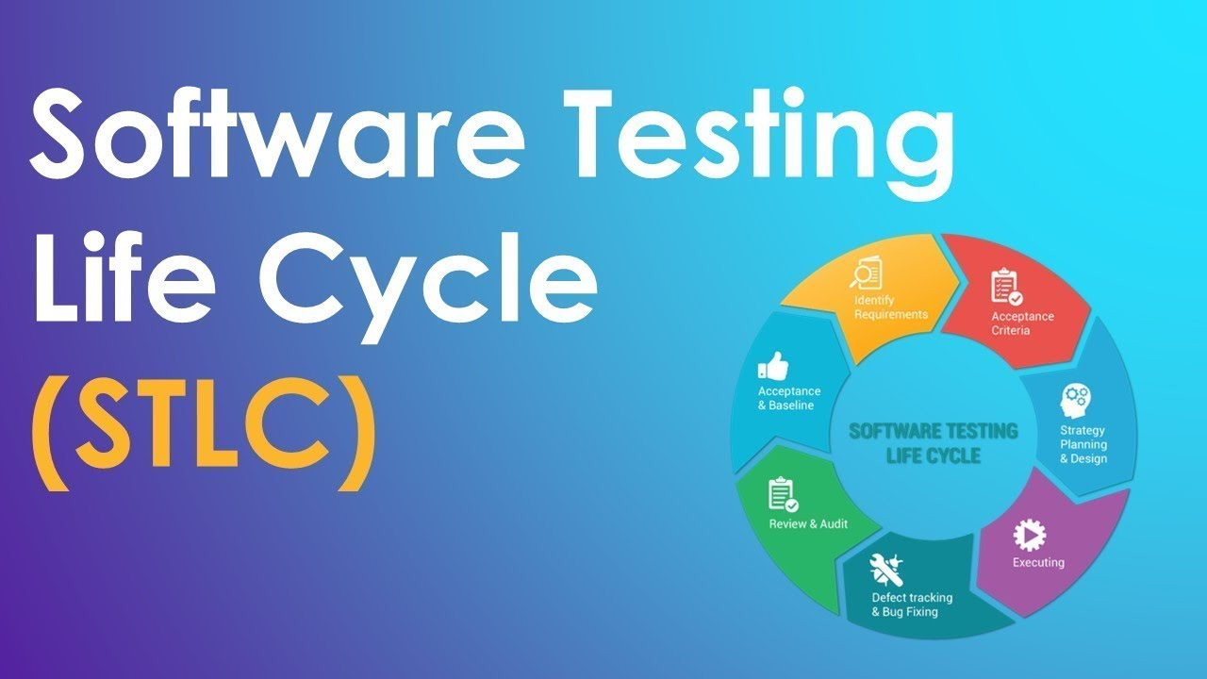

Slide 2
STLC
The Software Testing Life Cycle (STLC) is a systematic approach to testing software applications or products.
It encompasses all the activities carried out throughout the testing process, from the initiation of testing to its closure.

Slide 3
Requirement Analysis Phase
Objective
Activities
Deliverables
This phase involves understanding and analyzing the requirements provided by stakeholders, including functional and non-functional requirements.
Reviewing requirements documents such as Software Requirements Specification (SRS) or user stories.
Analyzing requirements to identify testable components and potential risks.
Requirement Traceability Matrix (RTM) mapping requirements to test cases.
Requirement Analysis Report documenting the analysis findings and potential test scenarios.

Slide 4
Test Planning Phase
Objective
Activities
Deliverables
Develop a comprehensive test plan outlining the testing approach, resources, schedule, and deliverables.
Defining testing objectives, scope, and strategy.
Estimating test effort and allocating resources.
Creating a test schedule and identifying dependencies.
Test Plan Document detailing the overall testing strategy, objectives, scope, resources, and schedules.
Effort Estimation Report providing estimates of resources and time required for testing.

Slide 5
Test Case Development Phase
Objective
Activities
Deliverables
Design and develop test cases based on the requirements and test plan.
Writing test scenarios and test cases covering both positive and negative scenarios.
Reviewing and refining test cases to ensure completeness and accuracy.
Test Case Specification documenting detailed test cases with steps, input data, expected results, and preconditions.
Test Data preparation documents specifying required test data for executing test cases.

Slide 6
Test Environment Setup Phase
Objective
Activities
Deliverables
Set up the testing environment to mimic the production environment.
Installing and configuring necessary hardware, software, and network components.
Verifying the setup to ensure it meets testing requirements.
Test Environment Setup Documentation detailing the configuration and setup of the testing environment.

Slide 7
Test Execution Phase
Objective
Activities
Deliverables
Execute test cases as per the test plan and record test results.
Running test cases manually or using automated testing tools.
Comparing actual results with expected results and reporting defects.
Test Execution Reports documenting test execution results, including pass/fail status and defects found.
Test Logs capturing detailed information about test execution activities for later analysis.

Slide 8
Defect Reporting and Tracking Phase
Objective
Activities
Deliverables
Identify and report defects found during test execution and track them until resolution.
Logging defects in a defect tracking system with detailed information such as steps to reproduce, severity, priority, and status.
Assigning defects to the development team for resolution and verifying fixes.
Defect Reports documenting identified defects and their current status.
Defect Tracking System containing information about defects throughout their lifecycle until closure.

Slide 9
Test Closure Phase
Objective
Activities
Deliverables
Evaluate completion criteria and summarize testing activities.
Reviewing test coverage, test execution results, and defect metrics.
Documenting lessons learned and recommendations for future projects.
Test Closure Report summarizing overall testing activities, including test results, test coverage, and lessons learned.
Final Test Metrics providing metrics such as test coverage, defect density, and test execution status.

Slide 10
Note!!!
Throughout the STLC, communication and collaboration among team members are essential to ensure that testing activities are aligned with project goals and objectives.
Additionally, each phase may overlap or iterate depending on project requirements and feedback received during testing.

