Slide 1
Android Application Framework
Review II
            S.Kumaravel
              1201FOSS0023
Guide : Mr. Sanjeev Kumar Shaini

Slide 2
Problem Definition
Creating Android Application UI will take time and requires sound knowledge of Android.
Need to write code for individual field value storage in sqlite database.
Apk generation through IDE

Slide 3
Solutions
Web page will be shown to capture what are fields need to create, its data type and size of the field
Based upon the fields, one Activity.xml will be created with appropriate controls.
Dynamic table will be created in Sqlite for each field as one column.
Through Android Build tool, Apk file will be generated and it will be easy to deploy the apk file in any one of android device.

Slide 4
Software to be Used
Software | Purpose
PHP | Web Page to capture user's parameters
Sqlite | Database storage and control binding
Android Tools | Used for apk file creation.

Slide 5
Work done so far
Dynamic logic for build UI from xml has been completed.
Binding field values in Sqlite.
Listing the records.

Slide 6
Work in progress
Dynamic Xml file generation from PHP is in progress
Unit test cases on PHP page.

Slide 7
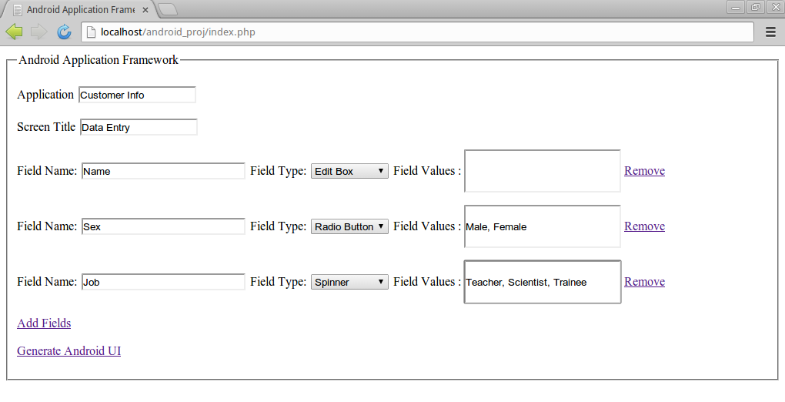
PHP Page

Slide 8
Dynamic fields in XML
              <?xml version="1.0" encoding="UTF-8"?>
              <fields>
              <application_name>Customer Info</application_name>
              <screen_name>Data Entry</screen_name>
              <field>
              <fieldname>Name</fieldname>
              <fieldtype>edittext</fieldtype>
              </field>
              <field>
              <fieldname>Sex</fieldname>
              <fieldtype>radiobutton</fieldtype>
              <values>
              <fieldvalue1>Male</fieldvalue1>
              <fieldvalue2>Female</fieldvalue2>
              </values>
              </field>
              <field>
              <fieldname>Job</fieldname>
              <fieldtype>spinner</fieldtype>
              <values>
              <fieldvalue1>Teacher</fieldvalue1>
              <fieldvalue2>Scientist</fieldvalue2>
              <fieldvalue3>Trainee</fieldvalue3>
              </values>
              </field>
              </fields>

Slide 9
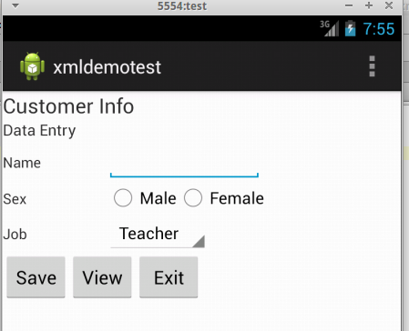
Dynamic Android Screen

Slide 10
              Q & A

Slide 11
              Thank you very much.

