Slide 1
🌿
EcoTrack AI
Carbon Footprint Intelligence Platform
Track Your Carbon Impact. Save The Planet.
Group members name
Bhavishya kumar
Aditya Singh
Atharv Pandey
4. Manish Ranjan
EcoTrack AI 🌿

Slide 2
⚠️ The Climate Crisis is NOW
India's carbon emergency — by the numbers
3.4B
37%
tonnes CO₂/yr
growth in a decade
India's annual emissions — 3rd largest globally
India per-capita emissions surge (2013–2023)
Source: IEA, 2023
Source: World Bank, 2023
70%
2070
unaware
Net Zero pledge
Indians don't know their personal carbon footprint
India's COP26 commitment — awareness tools are critical
Source: TERI Survey, 2022
Source: COP26 Agreement
India avg: 5.6t CO₂/person/yr
vs Global avg: 4.7t — but RISING FAST
EcoTrack AI 🌿

Slide 3
💡 Introducing EcoTrack AI
An AI-powered web platform that calculates, predicts, and helps reduce your personal carbon footprint — built specifically for India.
📊
🤖
🌱
MEASURE
PREDICT
REDUCE
Precise India-specific emission tracking
ML models forecast your next month
Gemini AI gives personalized green tips
Transport, electricity, LPG & food consumption mapped to real Indian emission factors from CEA, SIAM & PCRA
Scikit-learn regression trained on usage patterns predicts future footprint so you can act before it's too late
Google Gemini API generates custom, actionable recommendations based on your actual data and lifestyle
EcoTrack AI 🌿

Slide 4
🔬 Built on Verified Indian Data
Emission factors cross-validated with CPCB, CEA, BEE & IPCC AR6
Category | Emission Factor | Source
🚗 Petrol Car | 2.31 kg CO₂ / litre | SIAM / BIS
⚡ Grid Electricity | 0.82 kg CO₂ / kWh | CEA India, 2023
🔥 LPG Cylinder (14.2 kg) | 42.5 kg CO₂ / cylinder | PCRA India
🚇 Metro / Train | 0.03 kg CO₂ / km / person | Ministry of Railways
🥗 Vegetarian Diet | 1.8 kg CO₂ / day | Poore & Nemecek, Science 2018
🍗 Butter Chicken (per meal) | 3.0 kg CO₂ / meal | FAO / ICAR
All factors verified against CPCB, CEA, BEE & IPCC AR6 databases
EcoTrack AI 🌿

Slide 5
⚡ 7 Powerful Features
⚡
🤖
🏆
📊
Smart Carbon
AI/ML
EcoScore
Analytics
Calculator
Predictions
0 – 800
Dashboard
🌲
🎯
📱
🏛️
Offset
Campus
Emails
Govt. Data
Calculator
Leaderboard
Using EmailJS
Verified
EcoTrack AI 🌿

Slide 6
🛠️ Technology Behind EcoTrack AI
💻 Frontend
⚙️ Backend
🧠 AI / ML
HTML5 + CSS3 (Glassmorphism)
JavaScript
Google Gemini API
Responsive Design
Python Flask
MongoDB Atlas
JWT Authentication
Bcrypt Password Hashing
Google Gemini API
Groq API (Chat bot)
Scikit-learn (Regression)
Pandas & NumPy
EmailJS
Architecture Flow:
👤 User/Admin
→
🌐 Frontend
→
🐍 Flask API
→
🍃 MongoDB
+
🤖 Gemini AI
EcoTrack AI 🌿

Slide 7
💻 OOP Concepts in EcoTrack AI
How Object-Oriented Programming powers every layer of the platform
📐 Class & Object
Blueprint for chatbot, particles & local DB. Objects created at runtime from each class.
🔒 Encapsulation
Chat history & DB logic kept private inside classes, hidden from outside access.
🧬 Inheritance
Child class inherits MongoDB interface. Same methods, local JSON fallback when DB is offline.
🧩 Abstraction
Complex API calls & auth logic hidden behind simple functions. Caller needs no internal knowledge.
🎭 Polymorphism
Same method names work on MongoDB & FileCollection. Different behavior, identical interface.
EcoTrack AI 🌿

Slide 8
🏆 EcoScore — Your Green Credit Score
CRITICAL
HIGH
MODERATE
ECO HERO
0–200
200–400
400–600
600–800
India avg daily
5.2 kg CO₂
−40% reduction
750
among active EcoTrack users
EcoTrack heavy user avg
3.1 kg CO₂
ECO HERO
Top leaderboard users
< 2 kg CO₂
Gamification drives behavioral change — 34% higher engagement in sustainability apps with scoring systems (Nielsen, 2022)
EcoTrack AI 🌿

Slide 9
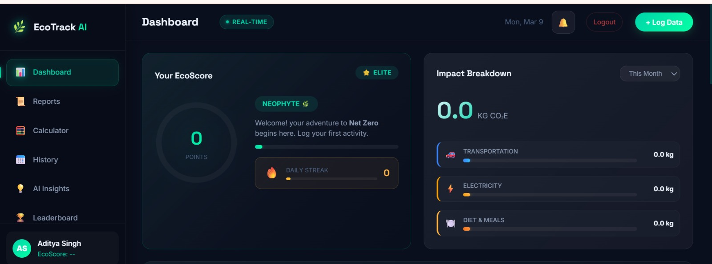
🖥️ Platform Walkthrough
● ● ●
🏠 Landing Page
Hero section with CTA, live emission ticker & India map
EcoTrack AI 🌿

Slide 10
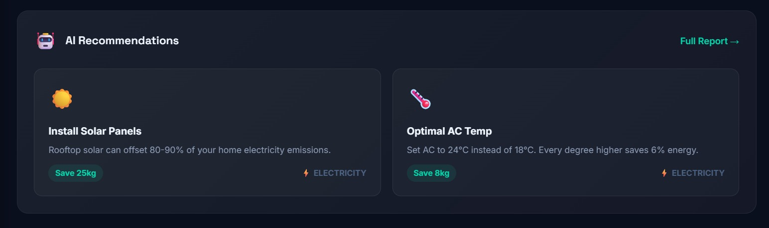
● ● ●
🤖 AI Recommendations
Gemini-generated personal
green tips ranked by impact
& ease
EcoTrack AI 🌿

Slide 11
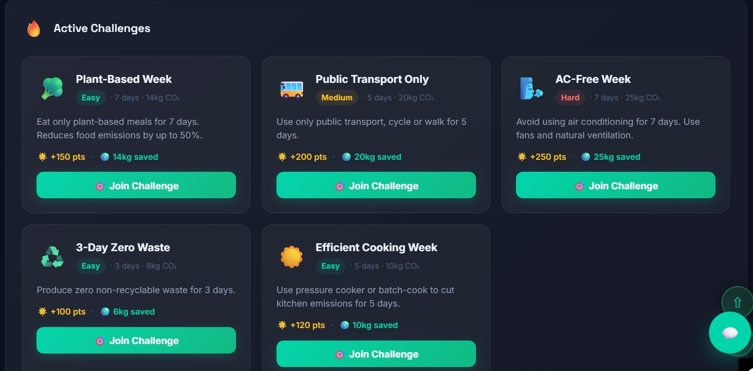
● ● ●
🤖 Challenges
Active challenges for
the user interaction.
EcoTrack AI 🌿

Slide 12
🌳 Offset. Neutralize. Contribute.
Real-world carbon neutralization pathways
🌳
☀️
💳
Tree Plantation
Rooftop Solar
Carbon Credits
86 trees needed
3,600 kg CO₂
$5 – $15 / tonne
to offset 150 kg CO₂/month
saved per year (3kW system)
voluntary carbon market price
1 mature tree absorbs ~21 kg CO₂/year
MNRE: 3kW panel fully offsets avg Indian household
Global carbon credit market growing rapidly post-Paris
Source: IPCC / FAO
Source: MNRE, 2023
Source: World Bank, 2023
EcoTrack AI 🌿

Slide 13
📈 Why Now? Why India?
A massive, underserved market at the intersection of climate & tech
$1.8B
23% CAGR
500M+
Global carbon mgmt software market by 2028
India ESG software growth through 2027
Smartphone users in India — mobile-first opportunity
— Mark Wide Research, 2025
— MAXIMIZE MARKET RESEARCH
— TRAI 2023
🎯 Target Users
📜 Policy
🎓 Students & young professionals
India CCUS Policy 2023 mandates carbon reporting for large industries
🏢 Corporates — ESG reporting
BEE Star Rating expanding to consumer appliances
🌿 NGOs & sustainability orgs
India's 2070 Net Zero pledge drives awareness campaigns
🏛️ Government institutions
Paris Agreement NDC: 45% emissions reduction by 2030
EcoTrack AI 🌿

Slide 14
🛣️ What's Next for EcoTrack AI
Challenges overcome & features on the horizon
⚔️ Challenges Faced
🚀 Future Roadmap
⚠ Sourcing accurate India-specific emission data across all categories
📷 AI food scanner via camera (image recognition)
⚠ Building reliable ML regression model with limited initial training data
🏢 B2B corporate ESG reporting dashboard
⚠ Bilingual (Hindi/English) NLP for AI chat interface
🛰️ IoT sensor integration for real-time home energy tracking
⚠ Real-time API rate management with Gemini and Twilio
🪙 Blockchain-based carbon credit NFTs
🌍 Expansion to Southeast Asia emission factors
EcoTrack AI 🌿

Slide 15

🌿 Join the Green Revolution
If 1 million Indians reduce their footprint by just 1 kg/day → 365,000 tonnes CO₂ saved/year
Equivalent to planting 17 million trees 🌳
India needs 455 GW of renewable energy by 2030 — individual awareness is the critical first step (MNRE Target)
📱 QR Code
[ Scan to Demo ]
Use this website in desktop mode
Built with ❤️ for a Greener Tomorrow • EcoTrack AI © 2026
EcoTrack AI 🌿

