Slide 1
Sketch Assistant
Human in the loop application to draw sketches

Slide 2
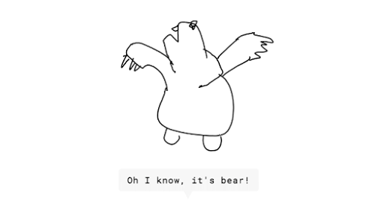
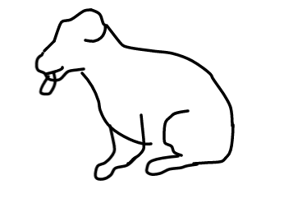
Why?
It’s hard to draw sketches
https://experiments.withgoogle.com/ai/quick-draw

Slide 3
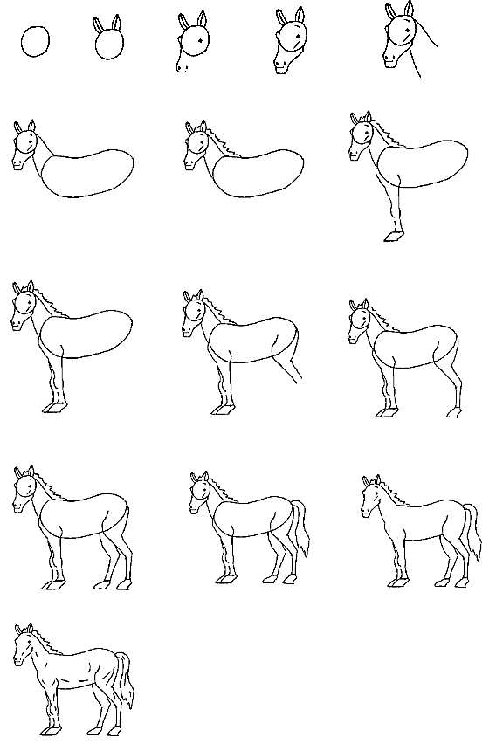
Intuition
Sketches are typically drawn based on a back and forth conversation/discussion about the attributes of the final sketch in mind.
An Iterative process

Slide 4
Proposal
build a assistant/chat bot which would generate an initial sketch based on the text description and User can modify the generated image by providing verbal feedback.

Slide 5
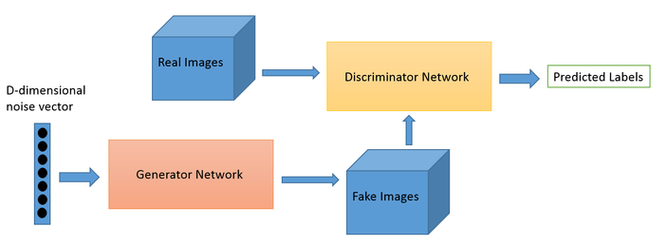
Approach
Generative Adversarial Networks
GAN is a combination of two networks:
A Generator - produces interesting data from input and noise
A Discriminator - detects fake data fabricated by the Generator.
Example GAN in Text Generation from Images.

Slide 6
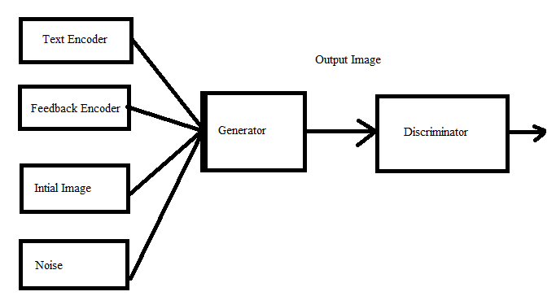
Approach
Input to GAN is combination of
Text Encoder
Feedback Encoder
Image Encoder
Noise
Output Image

Slide 7
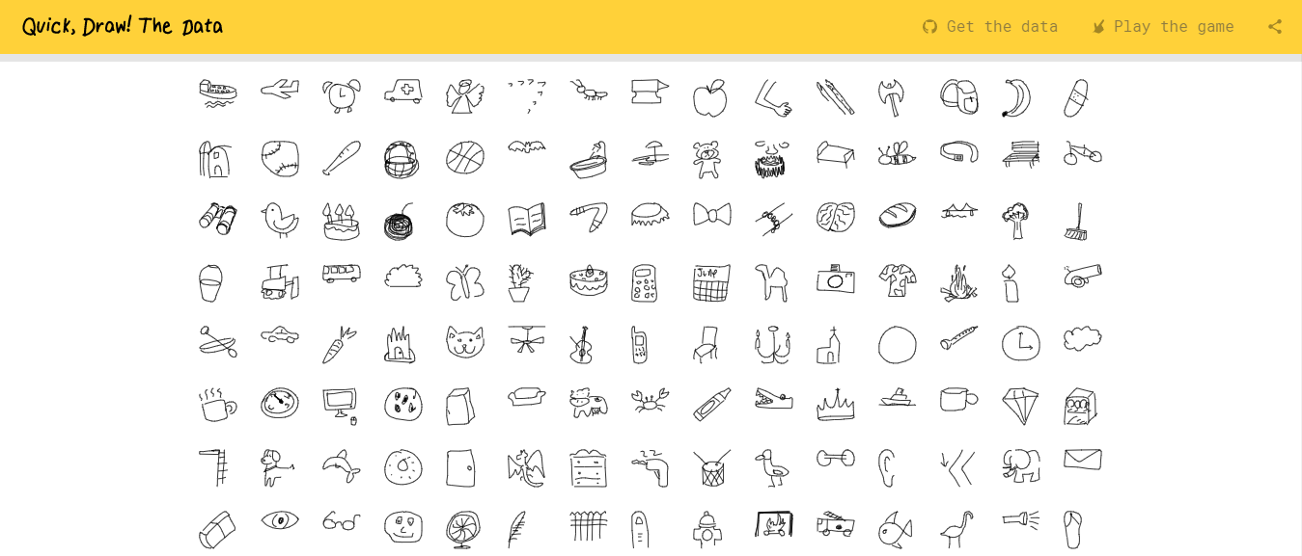
Data
Quickdraw dataset with 345 categories of 50 million images
key_id
word
recognized
timestamp
countrycode
drawing

Slide 8
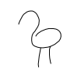
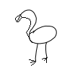
Dataset Preparation
Capture description of image
Capture edits of the image and with description
Bird without Beak
Bird without Feathers
Bird without eyes
Bird with two legs
Add beak and fingers to legs

Slide 9
References
AttnGAN: Fine-Grained Text to Image Generation with Attentional Generative Adversarial Networks
Interactive Image Manipulation with Natural Language Instruction Commands (Feb 2018)
StackGAN: Text to Photo-realistic Image Synthesis with Stacked Generative Adversarial Networks

Slide 10

Thank You

