Slide 1
Sketch assistant Human in the loop application to drawing sketches
Kumar . Omar

Slide 2
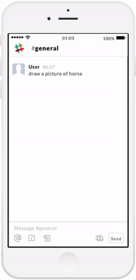

Slide 3
Dataset Preparation
Obtained data in the SVG format and generated strokes out the images.
Generates images with incremental strokes
Resize it to fit into the model
Dataset given was in RGBA format which needed to be converted to grayscale.

Slide 4
Dataset Annotations
Unsupervised learning
Supervised learning
Semi-supervised learning
cluster strokes
K-means clustering
no symmetry
Value of K
Hand annotate
input to GAN
1000 images
8 categories.
used hand annotated to identify unannotated
CNNs
Accuracy of 0.48

Slide 5
Modeling
Generative Adversarial Text to Image Synthesis paper

Slide 6
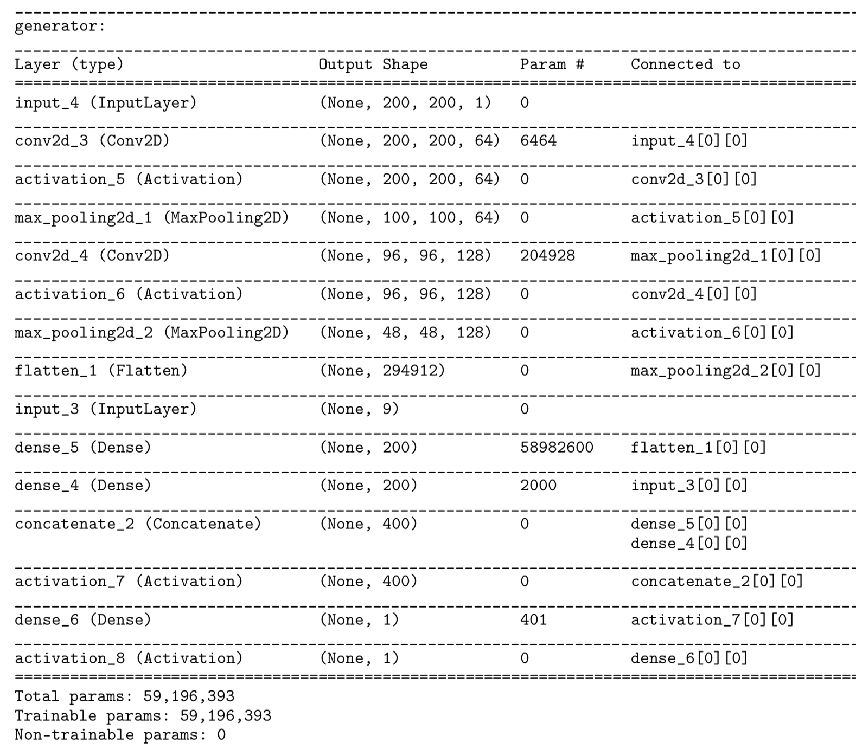

Slide 7
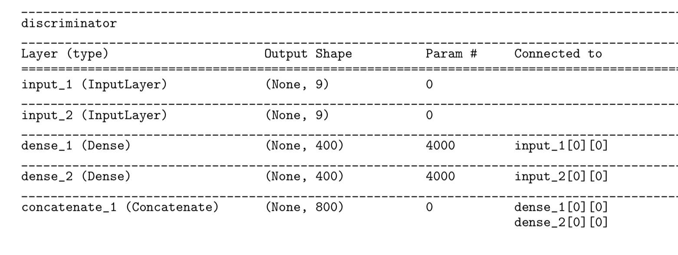
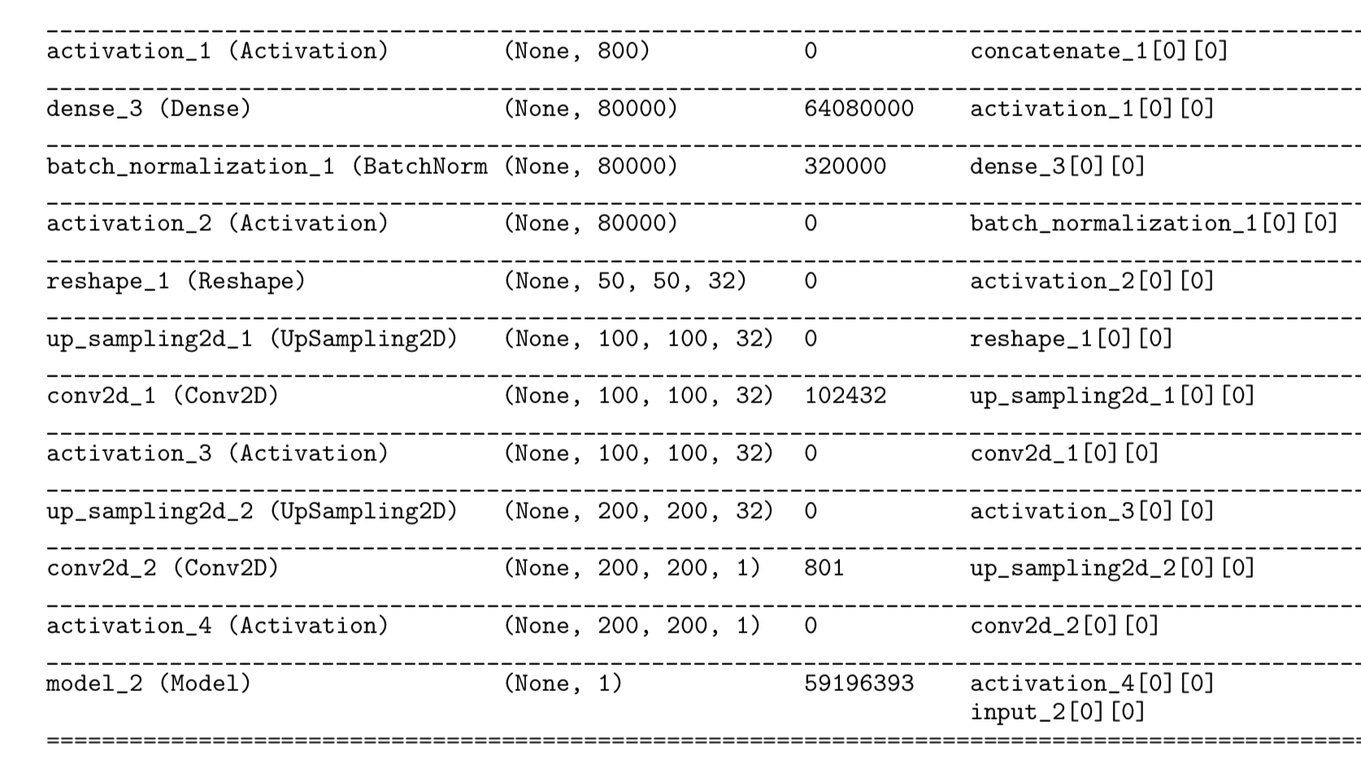

Slide 8
Evaluation
Evaluating the quality of these systems is a hard problem
Salimans propose to use an image classifier to evaluate the quality of generated images called Inception score
The intuition behind this that we want out model to generate meaningful objects.
We could use top-r metric for selecting r relevant images out of all the images generated by the network.

Slide 9
Dataset : Sketch Dataset
Pairs of images and sketches
125 Categories & 75,471 sketches.
Birds annotations : file, head, beak, wing, tail, body, leg, full eyes and image_id

Slide 10
References
[1] http://sketchy.eye.gatech.edu/
[2] Clustering Hand-Drawn Sketches via Analogical Generalization,Maria D. Chang, Kenneth D. Forbus ,Qualitative Reasoning Group, Northwestern University
[3] Generative Adversarial Text to Image Synthesis, Scott Reed, Zeynep Akata, Xinchen Yan, Lajanugen Logeswaran , Proceedings of the 33 rd International Conference on Machine Learning, New York, NY, USA, 2016

