Slide 1
STRX CALIBRATION API
Maxim Kulesh, Artur Burchard
NOVEMBER 2021

Slide 2
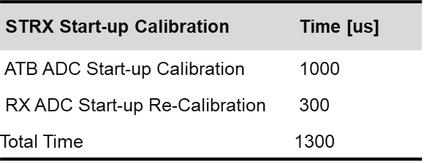
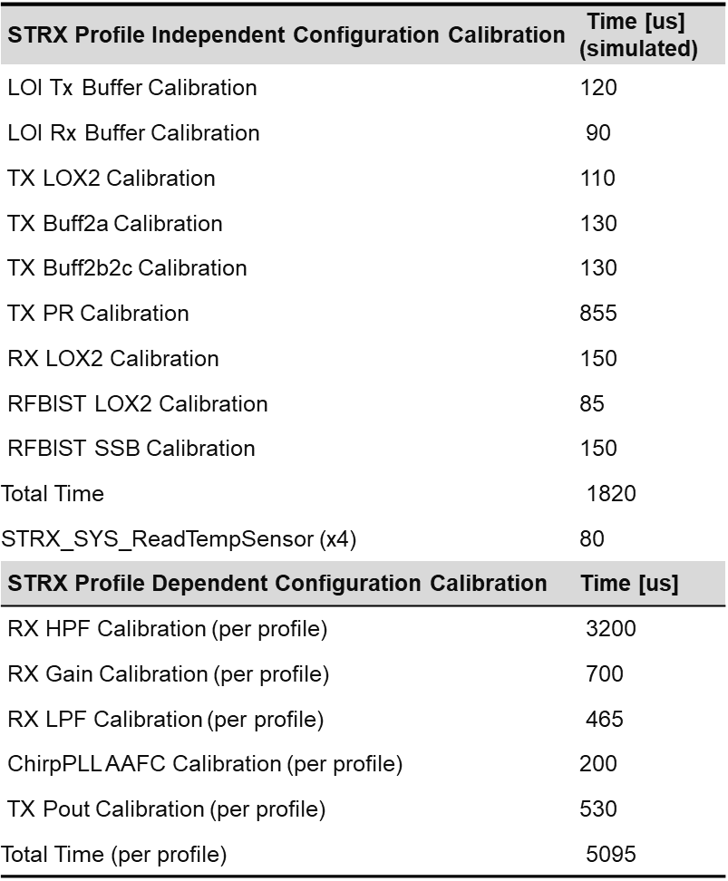
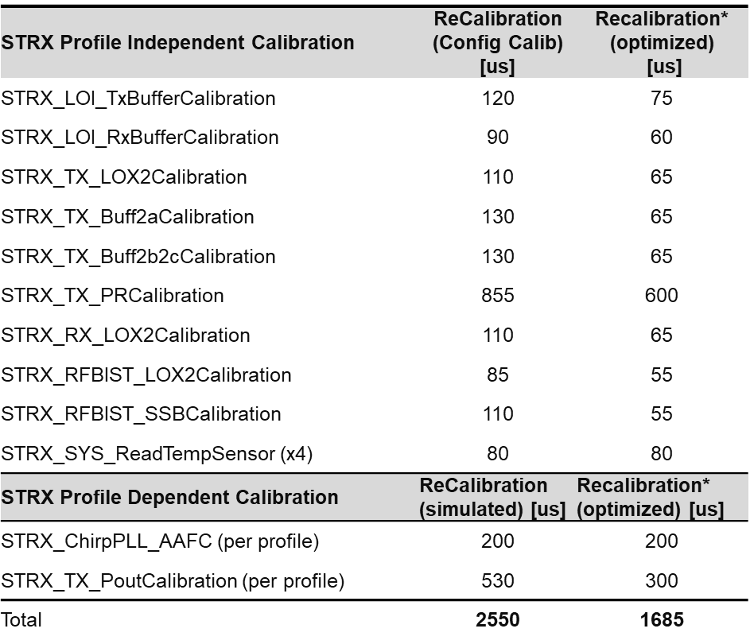
RFE SW: Dynamic View of Radar System Cycle
Radar Cycle
Init
Start up Calib.
FIT
Idle
Radar Config
Config. Calib.
Idle
(Re-) Calib.
Acquisition
Safety Timeslot
Sensor
Idle
[1ms]
Startup
Customer initiates radar re-configuration

Slide 3
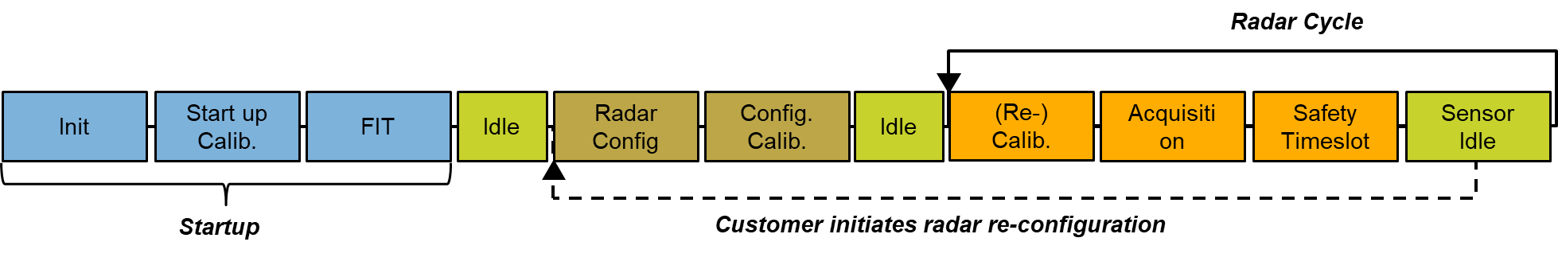
Smarttrx Start-Up calibration items
STRX Start-up Calibration | Time [us]
ATB ADC Start-up Calibration | 1000
RX ADC Start-up Re-Calibration | 300
Total Time | 1300

Slide 4
Smarttrx Configuration calibration itemS
STRX Profile Independent Configuration Calibration | Time [us] (simulated)
LOI Tx Buffer Calibration | 120
LOI Rx Buffer Calibration | 90
TX LOX2 Calibration | 110
TX Buff2a Calibration | 130
TX Buff2b2c Calibration | 130
TX PR Calibration | 855
RX LOX2 Calibration | 150
RFBIST LOX2 Calibration | 85
RFBIST SSB Calibration | 150
Total Time | 1820
STRX_SYS_ReadTempSensor (x4) | 80
STRX Profile Dependent Configuration Calibration | Time [us]
RX HPF Calibration (per profile) | 3200
RX Gain Calibration (per profile) | 700
RX LPF Calibration (per profile) | 465
ChirpPLL AAFC Calibration (per profile) | 200
TX Pout Calibration (per profile) | 530
Total Time (per profile) | 5095
To calculate the duration of configuration calibration phase the following shall be used:
total time = [profile independent calibrations] +
[profile dependent calibrations] * [number of profiles used]

Slide 5
Smarttrx calibration items
STRX Profile Independent Calibration | ReCalibration (Config Calib) [us] | Recalibration* (optimized) [us]
STRX_LOI_TxBufferCalibration | 120 | 75
STRX_LOI_RxBufferCalibration | 90 | 60
STRX_TX_LOX2Calibration | 110 | 65
STRX_TX_Buff2aCalibration | 130 | 65
STRX_TX_Buff2b2cCalibration | 130 | 65
STRX_TX_PRCalibration | 855 | 600
STRX_RX_LOX2Calibration | 110 | 65
STRX_RFBIST_LOX2Calibration | 85 | 55
STRX_RFBIST_SSBCalibration | 110 | 55
STRX_SYS_ReadTempSensor (x4) | 80 | 80
STRX Profile Dependent Calibration | ReCalibration (simulated) [us] | Recalibration* (optimized) [us]
STRX_ChirpPLL_AAFC (per profile) | 200 | 200
STRX_TX_PoutCalibration (per profile) | 530 | 300
Total | 2550 | 1685
To calculate the duration of re-calibration phase per chirp sequence[x] the following shall be used:
total time[x] = [profile independent re-calibrations] * [recalibrateProfileIndependent] +
[profile dependent re-calibrations] * [recalibrateProfileDependent[x]]
so taking into account RFE calibrations settings per given chirp sequence:
recalibrateProfileDependent[x]
recalibrateProfileIndependent
* Note: Optimised Calibration will be available June 2022 EAR 1.4, for the rest of the document we use simulated data

Slide 6
CALIBRATION CONFIGURATION / API
Single radar frame / system cycle could consist of multiple chirp sequences (LR / MR)
Calibration slot can be configured before any chirp sequence:
Calibration slot can be configured to perform profile independent calibrations
Calibration slot can be configured to perform profile dependent calibrations (AAFC, Pout)
Calibration slot is not limited to profiles used in subsequent chirp sequence only, i.e. calibration slot 1 can include profiles from chirp sequence 2.
idle
Cal 1
Chirp Sequence 1
Cal 2
Chirp Sequence 2
BIST
idle
Profile Independent calibrations: yes / no
Profile Dependent Calibrations
Profile 1: yes / no
Profile 2: yes / no
Profile 3: yes / no
Profile 4: yes / no
…
Profile 8: yes / no
Profile Independent calibrations: yes / no
Profile Dependent Calibrations
Profile 1: yes / no
Profile 2: yes / no
Profile 3: yes / no
Profile 4: yes / no
…
Profile 8: yes / no

Slide 7
CALIBRATION CONFIGURATION / API EXAMPLES
50ms
a)
idle
Cal 1
Chirp Sequence 1 / LR
Cal 2
Chirp Sequence 2 / MR
BIST
idle
Profile Independent calibrations: Yes
Profile Dependent calibrations:
- all used profiles for Chirp Sequence 1: Yes
- all used profiles for Chirp Sequence 2: No
Profile Independent calibrations: Yes
Profile Dependent calibrations:
- all used profiles for Chirp Sequence 1: No
- all used profiles for Chirp Sequence 2: Yes
50ms
b)
idle
Cal 1
Chirp Sequence 1 / LR
Idle
Cal 2
Chirp Sequence 2 / MR
BIST
idle
Profile Independent calibrations: Yes
Profile Dependent calibrations:
- all used profiles for Chirp Sequence 1: Yes
- all used profiles for Chirp Sequence 2: No
Profile Independent calibrations: No
Profile Dependent calibrations:
- all used profiles for Chirp Sequence 1: No
- all used profiles for Chirp Sequence 2: Yes
50ms
c)
idle
Cal 1\2
Chirp Sequence 1 / LR
idle
Chirp Sequence 2 / MR
BIST
idle
Profile Independent calibrations: Yes
Profile Dependent calibrations:
- all used profiles for Chirp Sequence 1: Yes
- all used profiles for Chirp Sequence 2: Yes
Profile Independent calibrations: No
Profile Dependent calibrations:
- all used profiles for Chirp Sequence 1: No
- all used profiles for Chirp Sequence 2: No

Slide 8
CALIBRATION CONFIGURATION / EXAMPLE B (DENSO)
50ms
b)
idle
Cal 1
Chirp Sequence 1 / LR
Cal 2
Chirp Sequence 2 / MR
BIST
idle
Duration: 2550 us
Duration: 200/730*us
Bist Duration:
Target = < 2 ms
STRX_LOI_TxBufferCalibration
STRX_LOI_RxBufferCalibration
STRX_TX_LOX2Calibration
STRX_TX_Buff2aCalibration
STRX_TX_Buff2b2cCalibration
STRX_TX_PRCalibration
STRX_RX_LOX2Calibration
STRX_RFBIST_LOX2Calibration
STRX_RFBIST_SSBCalibration
STRX_SYS_ReadTempSensor (x4)
STRX_ChirpPLL_AAFC - Profile : LR
STRX_TX_PoutCalibration - Profile : LR
STRX_ChirpPLL_AAFC - Profile : MR
STRX_TX_PoutCalibration - Profile : MR
(*) P_out calibration (530[us]) for MR is needed only if power is different then LR

