Slide 1
SAF85xx FW Release Code Drop 0.1.0 internal Slides
RFE SW Team
Artur Burchard
02-April-2021

Slide 2
SAF85xx RFE FW (Code Drop) Release 0.1.0 (Demo)
Internal Release via Bitbucket:
SAF85xx_RFE_FW_0.1.0.zip + SAF85xxRelease_v0.1.0.pptx
https://bitbucket.sw.nxp.com/projects/STRX/repos/rfe/browse/docs/Releases/Internal/SAF85xx_RFE_FW_0.1.0
External Release to Denso via Sharepoint:
SAF85xx_RFE_FW_0.1.0.zip
https://nxp1.sharepoint.com/teams/ext775?e=1%3Aede4b6e733374838919d342f93f56d83
Archived in:
https://bitbucket.sw.nxp.com/projects/STRX/repos/rfe/browse/docs/Releases/External/SAF85xx_RFE_FW_0.1.0
Bitbucket Tags
SAF85xx_RFE_FW_Code_Drop_0.1.0
Internal: https://bitbucket.sw.nxp.com/projects/STRX/repos/rfe/browse/docs/Releases/Internal/SAF85xx_RFE_FW_0.1.0?at=refs%2Ftags%2FSAF85xx_RFE_FW_Code_Drop_0.1.0
External https://bitbucket.sw.nxp.com/projects/STRX/repos/rfe/browse/docs/Releases/External/SAF85xx_RFE_FW_0.1.0?at=refs%2Ftags%2FSAF85xx_RFE_FW_Code_Drop_0.1.0

Slide 3
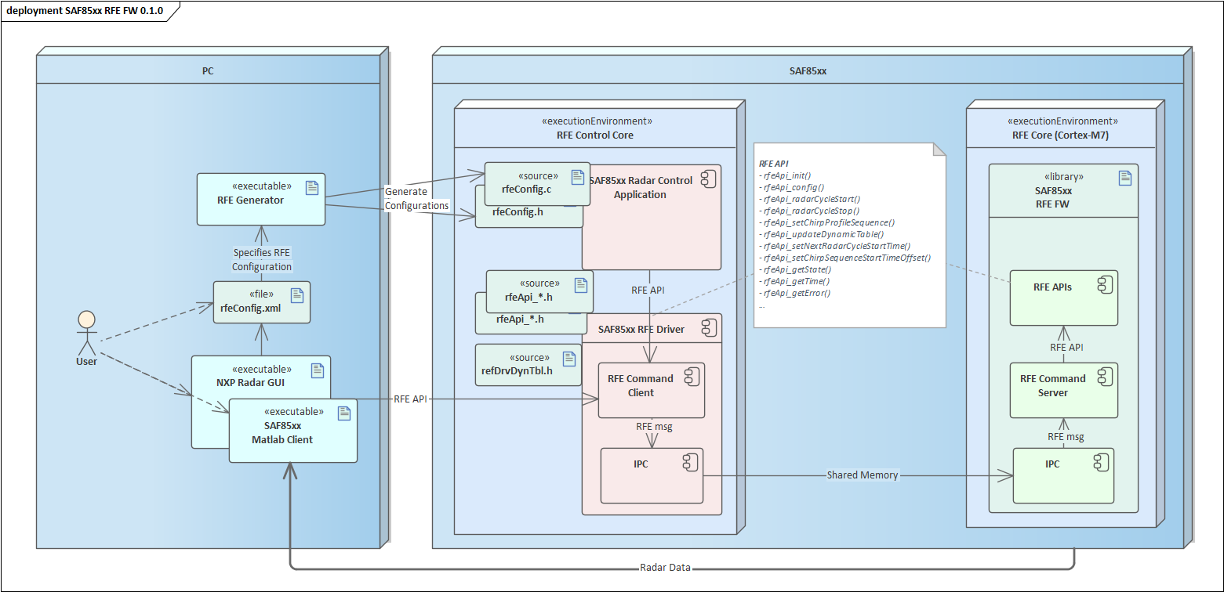
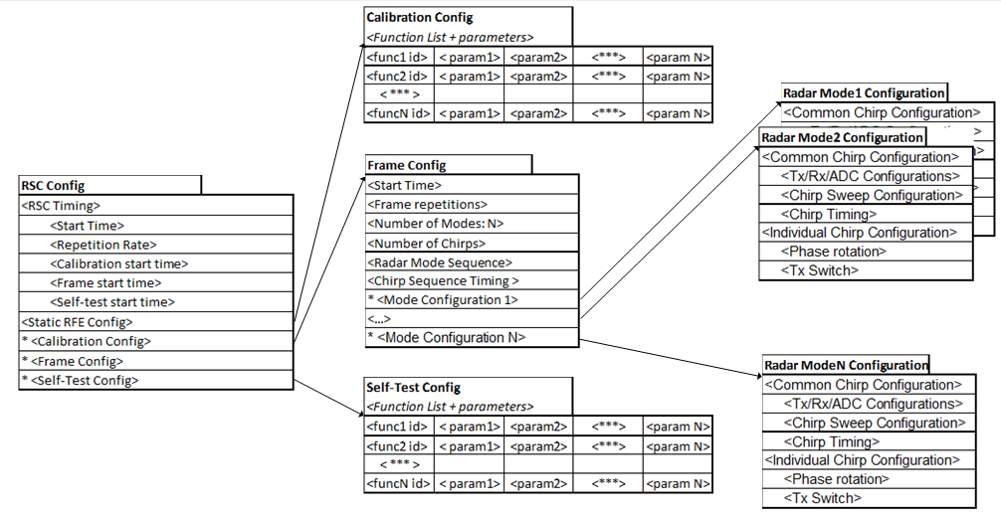
RFE Release Context
Design RFE
Configurations

Slide 4
Purpose of the release
External
Enable Denso to start development towards STRX RFE control, as agreed in RfQ
Release initial SAF85xx RFE API covering Denso use case
Get early feedback from Denso
Internal
Pipe clean the release process
Release initial SAF85xx RFE API for
GUI development
Validation Development
For other teams to familiarize with top level SAF85xx RFE API

Slide 5
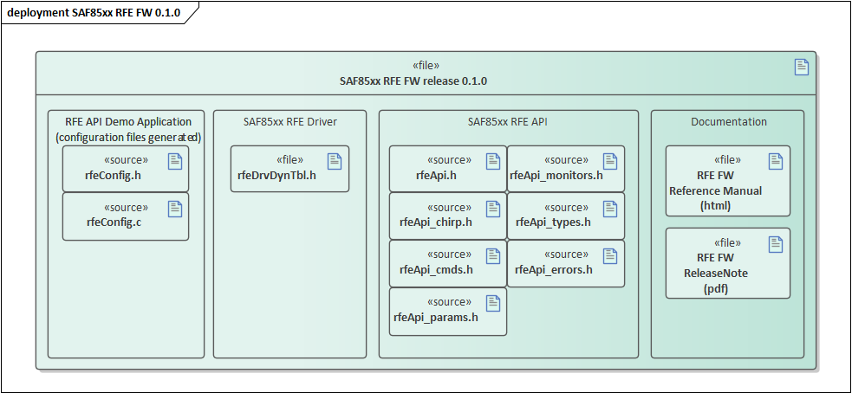
Release Content
Initial Top Level SAF85xx RFE API
Radar Cycle, Radar Frame, Parameters Updates, Commands (e.g. CW)
Dynamic (MIMO) Table
Example (Denso) RFE Configuration
Documentation

Slide 6
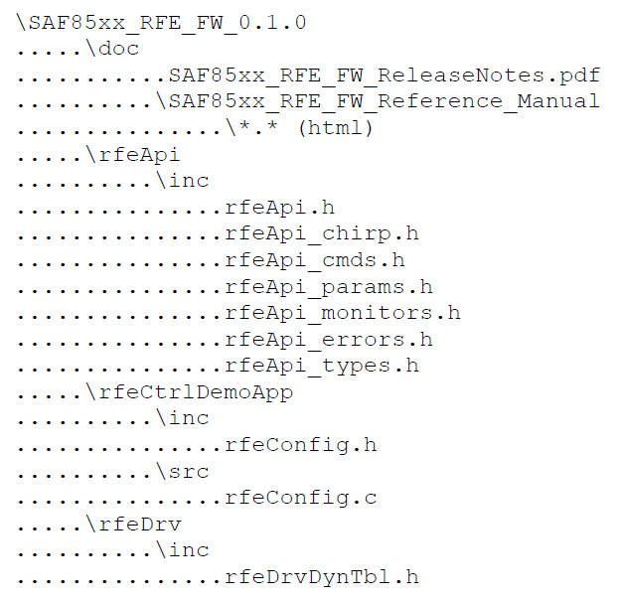
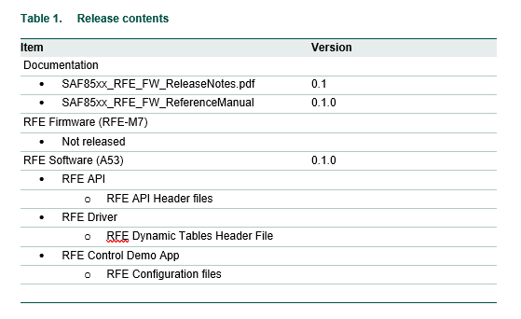
Release Content

Slide 7
reviews
Release Ticket
https://jira.sw.nxp.com/browse/STRX-1840
Code and Reference Manual review
https://crucible1.sw.nxp.com/cru/R-STRX-351
Release Notes review
https://crucible1.sw.nxp.com/cru/R-STRX-350
(this) Release Slides review
https://crucible1.sw.nxp.com/cru/R-STRX-352

