Slide 1
SAF85xx RFE DFT SW Release 0.1.0 internal Slides
RFE SW Team
Javier Cuadros Linde
23-April-2021

Slide 2
SAF85xx RFE DFT Release
Internal Release via Bitbucket:
dftPackage_v0p1.zip + SAF85xxRelease_v0.1.0_DfT.pptx
https://bitbucket.sw.nxp.com/projects/STRX/repos/rfe/commits/a60a312e50bf569ddfa808e64666b22fdbf9f77f
dftPackage_v0p1.zip
SW DROP dftPackage_v0p1 (Web view)
Bitbucket Tags
dftPackage_v0p1

Slide 3
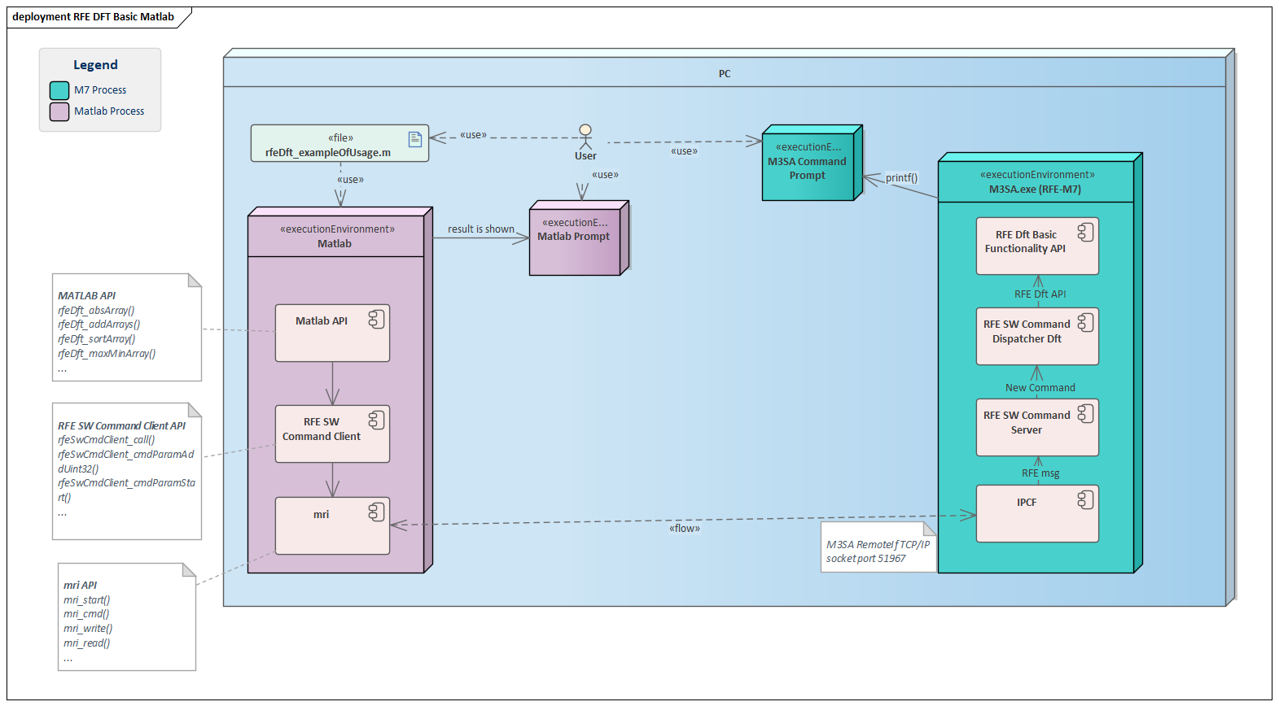
SAF85xx RFE DFT Release Context

Slide 4
Purpose of the release internal DFT
Internal DFT
Provide DfT team first version of the framework limited to basic arithmetic array functionality so that they get used to the workflow.
Enable DfT team to interact with basic arithmetic array functionality via Matlab interfacing with MESA
Internal RFE SW
Implementation of full basic arithmetic array functionality and related functionality for DfT application
Implementation of Matlab interface to MESA for DfT application
Implementation of unit-testing via Matlab and MESA for DfT application

Slide 5
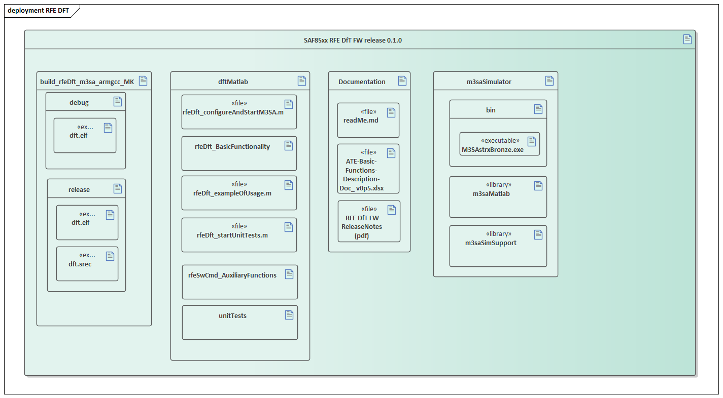
SAF85xx RFE DFT Release Content
Initial Top Level SAF85xx RFE DfT Release
Binaries
dftMatlab API and example of usage
M3SA simulator
Documentation

Slide 6
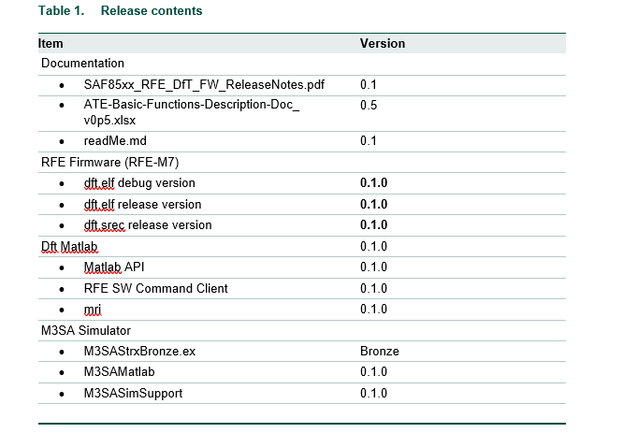
Release Content

Slide 7
reviews
Release Notes and this slide review
https://crucible1.sw.nxp.com/cru/R-STRX-359

