Slide 1
Rfe-Driver Using RFE-FW Interrupt
Pedro Ferrão
May 2023

Slide 2
RFE-Driver Interrupt related APIs
The following RFE API is provided to allow the RFE-Driver to be used with RFE firmware interrupt support:
rfe_configureInterrupt()
This API allows the application to setup the RFE firmware interrupt and in which conditions will trigger this interrupt:
Firmware API responses (allows the application to do other work while waiting for a firmware response).
RFE state changes, Radar Cycle changes and Chirp Sequence changes
(allows events notifications without having to poll the shared memory).
Additionally, this API allows the registration of an API wait for interrupt callback, this callback is called by the RFE Driver instead of polling the shared memory for the response command count.
This API wait for interrupt callback IS NOT an interrupt handler, the application code is responsible for setting up and handle incoming RFE interrupts.

Slide 3
RFE-Driver Code Setup
Register an interrupt handler for IPC_IRQ_1 (number 34 on MSCM):
On CA53 is GIC interrupt 34.
On CM7-0 is NVIC interrupt 2.
Call rfe_configureInterrupt() to configure RFE firmware interrupt:
Provide the Core Id which will receive the interrupt.
Provide RFE APIs which will trigger an interrupt when a firmware response is available.
Provide Events which will trigger an interrupt (state changes, radar/chirp sequence changes).
Optionally: Provide an API wait for interrupt callback.
On the interrupt handler for IPC_IRQ_1:
Clear pending interrupt on MSCM.
Application specific code (…).
If an API wait for interrupt callback was provided, it will be called for all RFE APIs set on rfe_configureInterrupt() and it shall return to driver when a RFE interrupt is received.

Slide 4
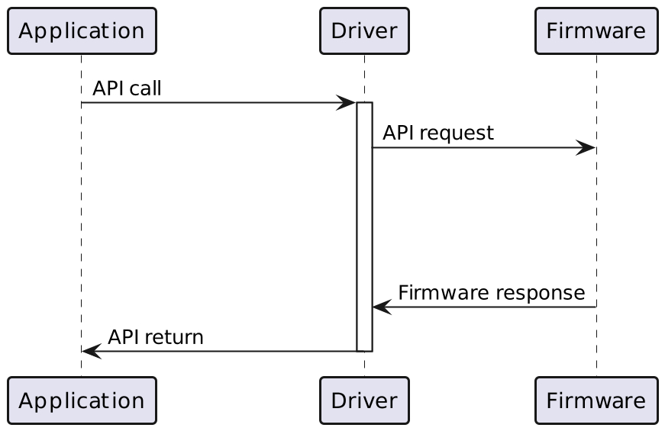
RFE-Driver API call without interrupts
When using the RFE Driver APIs without interrupt support, the control is taken away from the application and the driver blocks while waiting for a firmware response.
During this time, the processor is polling the response shared location, and the application cannot access the processor resources nor trigger any power saving.
Additionally, this polling for the responses may increases memory contention, degrading performance.

Slide 5
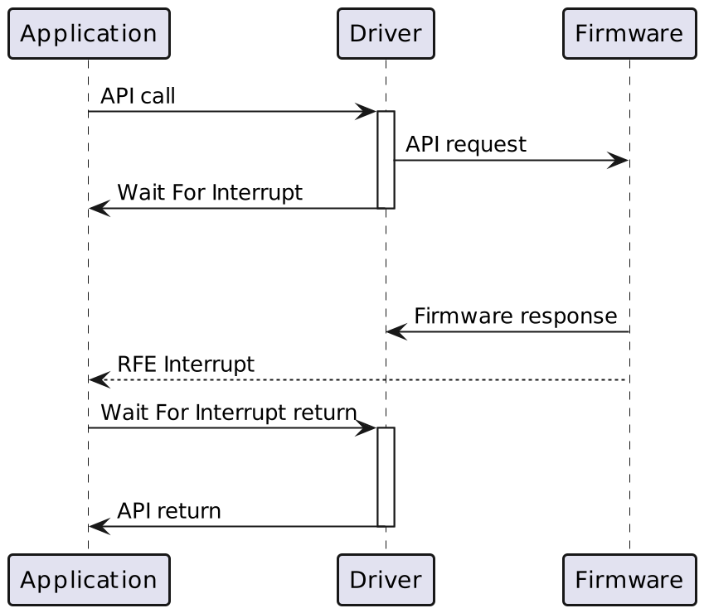
RFE-Driver API call with interrupts
When using the RFE Driver APIs with interrupt support, the control is taken away from the application to send the API request to the firmware and then returned back to the application via the wait for interrupt callback.
On the Wait for interrupt callback, the application can:
Use the processor to perform other tasks.
Trigger a power saving state (via wfi).
When a RFE interrupt is received, the wait for interrupt callback returns to driver, allowing it to finish the API call.

Slide 6
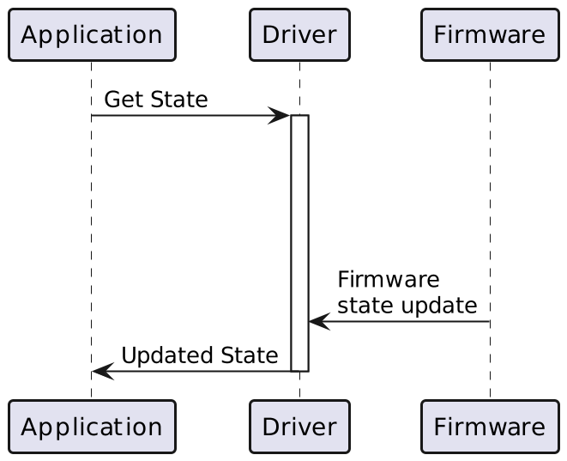
RFE-Driver Events without interrupts
When an application needs to wait for a state change/radar cycle count or chirp sequence change (event), currently it needs to poll the RFE Driver until it gets the desired event.
Example: Wait for the configuration to finish.

Slide 7
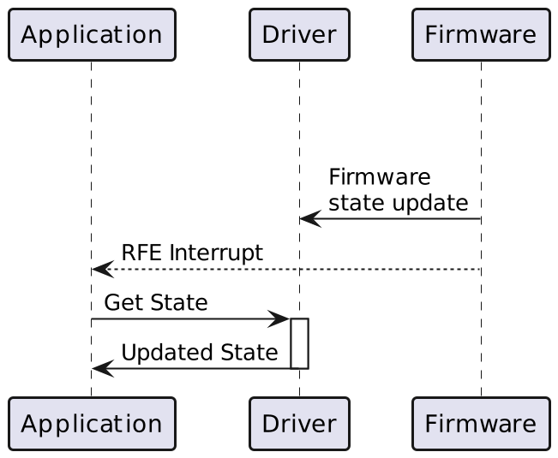
RFE-Driver Events with interrupts
In a manner similar to the API calls, the RFE interrupt can also be used to wait for RFE events.
With interrupt support, the application can do other tasks/work or go into power saving mode, instead of polling for the desired event.

Slide 8
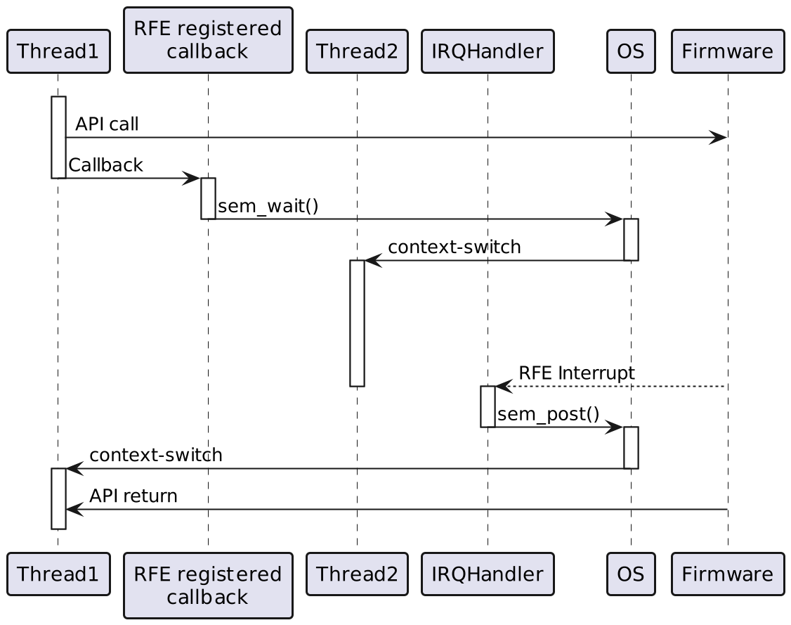
RFE-Driver Multi-thread context example
An RFE-Driver API can be made thread aware (swap to different thread while waiting for a firmware response) with the use of a semaphore like primitive:
In the API wait for interrupt callback:
We wait for the semaphore (ex.: sem_wait(…)), waiting for a semaphore will cause this current thread to block until the semaphore is posted.
In the IRQ interrupt handler:
We post on the semaphore (ex.: sem_post(…)), posting on a semaphore will preempt the executing thread back to any thread blocked on the semaphore (according to the thread priority configuration).

Slide 9
RFE-Driver Other
Does this new API have impact on existing code?
No, without performing any IRQ configuration, the RFE driver will behave exactly as before.
What happens, if the application returns wait for interrupt callback before the response was received (before the interrupt)?
On return the driver will check if the response was actually received and if not the wait for interrupt callback will be called again.
What API calls can be used during the wait for interrupt callback?
All APIs that do not interact with the firmware.

Slide 10
RFE-Driver API signature
/**
* \brief This function configure the RFE firmware interrupt.
*
* \details rfe_configureInterrupt() configures which conditions will raise an IRQ to coreId, these conditions are:
* - RFE state changes
* - Radar Cycle count changes
* - Chirp Sequence count changes
* - Specific RFE API responses from the firmware
*
* The apiWaitForInterrupt function will be called while the driver is waiting for an RFE API response, this function
* shall return whenever a RFE firmware interrupt is received. This function may be called multiple times on a single RFE
* API call. During this call only APIs that do not interact with the firmware are allowed.
*
* \note apiWaitForInterrupt IS NOT an interrupt handler, the application code is responsible for setting up and handle
* incoming RFE interrupts.
*
* \param [in] coreId - Which core should the RFE interrupt be sent.
* \param [in] events - Bitmask of events that will trigger an interrupt.
* \param [in] rfeAPIs - Bitmask of RFE-APIs responses that will trigger an interrupt.
* \param [in] apiWaitForInterrupt - API wait for interrupt function pointer.
* \param [in,out] RFE_ERROR_FUNCTION_PARAMETER - Error handling parameter.
*/
void rfe_configureInterrupt(
rfe_coreId_t coreId, rfe_eventsIRQ_t events, rfe_apiIRQ_t rfeAPIs,
rfe_apiWaitForInterrupt_f apiWaitForInterrupt, RFE_ERROR_FUNCTION_PARAMETER );

