Slide 1
FIT1
Dilip Mannil
Sep 2022

Slide 2
Motivation
FIT 1 (e.g. HW FIT tests) based on HW FIT mechanisms in HW IPs and controlled by FCCU
Once RFE M7, initialized and configured the RFE modules, the modules are ready for FIT1 (Fault Injection Test).
FIT1 can be triggered by setting bit in corresponding register of FCCU. FCCU HW activates the force_error signal towards all modules in parallel and collects the status of the error state into the local registers.
After certain delay, RFE M7 MCU can remove the fault injection and writes the reset_error bit in the register.
FCCU HW collects the current error status information and process with the previous status to declare the Fault Injection Test has passed or failed.

Slide 3
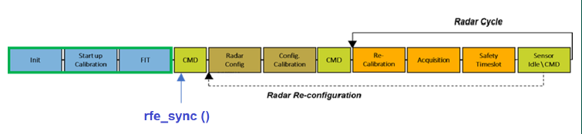
FIT1 in Radar cycle
Performed during the startup phase of RFE

Slide 4
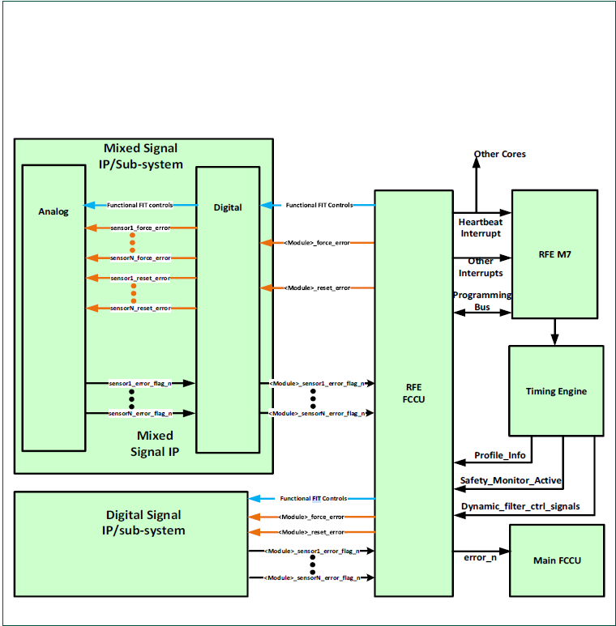
FIT Hardware

Slide 5
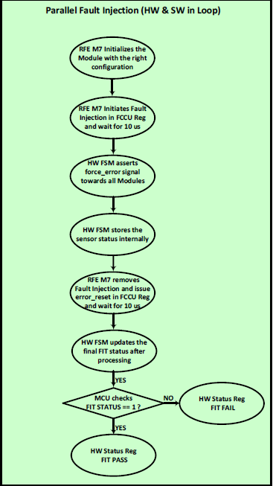
FIT1 HW-SW Flow
Following diagram illustrates HW and SW involvement in FIT1

Slide 6
List of IP’s Covered by FIT1
TX
RX
Chirp
MCGEN
ADPLL
LO
SPIM
ISM
BB BIST
GLDO
ATB
TE
RCOSC
LDO
ADC
PDC
TEMP SENSOR

Slide 7
Key hardware Registers
S.No | Register Name | Description
1. | ISM_FIT_TEST_REG | This register is used for controlling the fault injection testing .FIT time should be min of 10 us (5 us force and 5 us reset)
2. | ISM_FIT_TEST_REG_STATUS
3. | IP*_FIT_STATUS | IP specific register that capture the result of fault injection tests
4. | ISM_ERR_MCU_RESET | Reset ISM errors. Latched error gets cleared only if underlying error is not present anymore
5. | ISM_ERR_STATUS | This register provide the status of the ISM module. Once an error is reported, it is latched and the error get cleared only through a reset and if the underlying error is not present any more

Slide 8
SW Modules
FIT
FCCU
ISM

Slide 9
Top Level Design

Slide 10
Steps(rfefit_fit1.c)
Reset all ISM errors
Force error using FIT register
Reset error using FIT register
Check FIT status

Slide 11
Functions to be coded (Top level)
/*!
* \brief Initiate HW based Fault Injection Tests (FIT1).
*
* \details FIT 1 is based on HW FIT mechanisms in HW IPs and controlled by FCCU. FIT1 can be triggered
* by setting bit in corresponding register of FCCU. FCCU HW activates the force_error signal towards
* all modules in parallel and collects the status of the error state into the local registers. After
* certain delay, fault injection can be removed reset_error bit can be set in register.
*
* \pre IP's on which FIT is performed has to be powered on
*
* \param [in] pFit1ErrStatus Pointer to FIT error enum that contains error details in case
* of FIT failure.
* \param [in, out] RFE_ERROR_FUNCTION_PARAMETER Error handling parameter.
*
* \return FIT1 completion state at the end of tests.
*
* \post NIL
*
* \ingroup NIL
*/
rfeFit_fit_state_t rfeFit_performFit1(
rfeFit_fit1Err_t* pFit1ErrStatus,
RFE_ERROR_FUNCTION_PARAMETER
);

Slide 12
Structures and ENUM types to be added (rfeFIT_internal.h)
typedef enum
{
rfeFit_fit_err_errorn_low_e = 0ul, //!< Error N pin asserted
rfeHwFccu_fit_err_reset_state_change_e = 1ul, //!< Reset state change failed
rfeFit_fit_err_reset_e = 2ul, //!< Error reset failed
rfeFit_fit_err_force_state_change_e = 3ul, //!< Force error state change failed
rfeFit_fit_err_force_e = 4ul, //!< Force error failed
rfeFit_fit_err_e = 5ul, //!< Fault injection test failed
rfeFit_fit_err_tx_status_e = 6ul, //!< FIT failed for TX
rfeFit_fit_err_rx_status_e = 7ul, //!< FIT failed for RX
rfeFit_fit_err_adc_status_e = 8ul, //!< FIT failed for ADC
rfeFit_fit_err_chirp_status_e = 9ul, //!< FIT failed for chirp
rfeFit_fit_err_mcgen_adpll_status_e = 10ul, //!< FIT failed for mcgen
rfeFit_fit_err_lo_spim_ism_status_e = 11ul, //!< FIT failed for lo
rfeFit_fit_err_rxbist_status_e = 12ul, //!< FIT failed for RXBIST
rfeFit_fit_err_gb_gldo_status_e = 13ul, //!< FIT failed for gldo
rfeFit_fit_err_atb_te_rcosc_status_e = 14ul, //!< FIT failed for ATB
rfeFit_fit_err_ldo_dig_pdc_status_e = 15ul, //!< FIT failed for LDO
rfeFit_fit_err_tempsensor_status_e = 16ul, //!< FIT failed for TEMPSENSOR
} rfeFit_fitErr_t;

Slide 13
Reset ISM

Slide 14
Function TO BE USED
/**
* \brief API performs Reset all ISM error in hardware.
*
* \details API performs Reset all ISM error in hardware, A reset will clear error only if the underlying error is not present anymore.
*
* \pre NIL
*
* \param [in, out] RFE_ERROR_FUNCTION_PARAMETER Error handling parameter.
*
* \return NIL
*
* \post NIL
*
* \ingroup NIL
*/
void rfeHwFccu_resetAllErrors(
RFE_ERROR_FUNCTION_PARAMETER
);

Slide 15
Force Error

Slide 16
Functions to be coded (rfehwfcc.c)
This function set force error, wait for 5us and check the status of FIT
/**
* \brief This function sets FORCE_ERROR bit to force FIT error
*
*
* \details This function start hardware fault injection test by setting
* FORCE_ERROR bit of FIT_TEST_REG. Hardaware takes 5us to complete the
* procedure. Function returns the status of FIT.
*
* \pre NIL
*
* \param [in,out] RFE_ERROR_FUNCTION_PARAMETER - Error handling parameter:
* On success rfeError_error_none_e is returned
*
* \return Status of forcing error. In case of success, rfeHwFccu_fit_state_force_err_state_e will be returned
*
* \post NIL
*
* \ingroup NIL
*/
rfeHwFccu_fit_state_t rfeHwFccu_setIsmForceErr(
RFE_ERROR_FUNCTION_PARAMETER
);

Slide 17
Reset Error

Slide 18
Functions to be coded (rfehwfccu.c)
This function removes force error and reset, wait for 5us and check the status of FIT
/**
* \brief This function sets RESET_ERROR bit to start FIT error reset
*
*
* \details This function sets RESET_ERROR bit of FIT_TEST_REG. Hardaware takes 5us to complete the
* procedure. Function returns the status of FIT.
*
* \pre NIL
*
* \param [in,out] RFE_ERROR_FUNCTION_PARAMETER - Error handling parameter:
* On success rfeError_error_none_e is returned
*
* \return Status of reset error. In case of success, rfeHwFccu_fit_state_reset_err_state_e will be returned
*
* \post NIL
*
* \ingroup NIL
*/
rfeHwFccu_fit_state_t rfeHwFccu_setIsmResetErr(
RFE_ERROR_FUNCTION_PARAMETER
);

Slide 19
Check FIT Status

Slide 20
Functions to be coded (rfehwfccu.c)
This function removes reset error and check whether FIT status is complete and the are no errors in RTM
/**
* \brief This function check the final FIT status
*
* \details This function clears RESET_ERROR bit of FIT_TEST_REG and check the status of FIT
*
* \pre NIL
*
* \param [in,out] RFE_ERROR_FUNCTION_PARAMETER - Error handling parameter:
* On success rfeError_error_none_e is returned
*
* \return Status of FIT. In case of success, rfeHwFccu_fit_state_test_completed_state_e will be returned
*
* \post NIL
*
* \ingroup NIL
*/
rfeHwFccu_fit_state_t rfeHwFccu_checkIsmFitStatus(
RFE_ERROR_FUNCTION_PARAMETER
);

Slide 21
Check FIT Status of individual IP‘s

Slide 22
Functions to be coded (rfehwfccu.c)
This function checks the list of IP’s enabled(?) and get the FIT status of different IP’s.
FIT status will be checked IP wise and
/**
* \brief This function check the FIT status of individual IP's
*
* \details
*
* \pre NIL
*
* \param [in,out] RFE_ERROR_FUNCTION_PARAMETER - Error handling parameter:
* On success rfeError_error_none_e is returned
*
* \return Status of FIT. In case of success, rfeHwFccu_fit_state_test_completed_state_e will be returned
*
* \post NIL
*
* \ingroup NIL
*/
rfeFit_fitErr_t rfeHwFccu_checkIsmIpFitStatus(
RFE_ERROR_FUNCTION_PARAMETER
);

Slide 23
Overall FIT Flow

Slide 25
Open Items
None

