Slide 1
LLDO ov/Uv monitoring
MAy 2022

Slide 2
Motivation
Fail
Input voltages can undergo sudden excursions that can have catastrophic consequences if they are outside acceptable values.
An undervoltage condition can force the LDO output to go below its regulation window, causing the load to fail functionally.
An overvoltage is cause for reliability or Safe Operating Area (SOA) concerns.
Detecting the occurrence of these abnormal conditions is useful for designing failsafe limits in the overall system. One of the common responses to such faulty conditions is flagging the system.
Overvoltage threshold
Safe operating Area (SOA)
undervoltage threshold
Fail

Slide 3
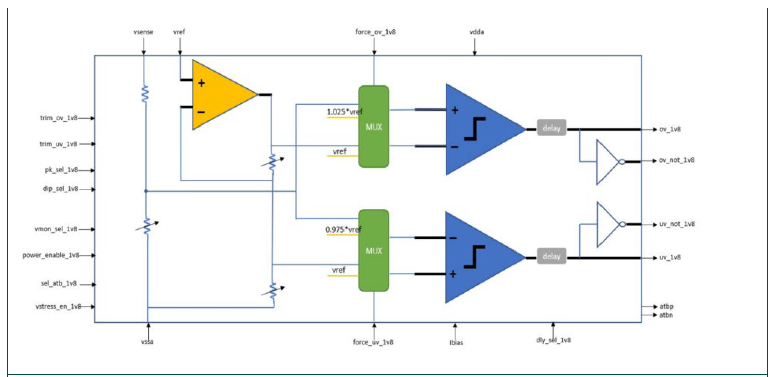
Ovuv monitoring by hardware
4 GLDOs in RFE monitored by a hardware OVUV protection circuit

Slide 4
Ovuv monitoring by software
111 LLDOs is RFE
Functional safety of LLDOs can be verified by implementing a software voltmeter at the output of each LLDO as follows
As we have other Fusa mechanisms like Bist( Rxbist, Txbist…), the number of tested LLDOs is reduced assuming that the Fusa mechanisms will fail if LLDO is not operating in the safe area as it supplies the corresponding components.
Assumption to be verified with validation team
Low drop-out
Vout
Voltage sense
(Voltmeter)
Flag system if abnormal events occur
Can be done by software accessing to ADC captures

Slide 5
LLDOs list
List of LLDOs by IP | # of IP instances in RFE | LDO name | Priority to monitor by SW
APLL IP - Salvo | 1 | chirppll_ldo_vco_1v8 | YES
 |  | chirppll_ldo_vco_0v9 | YES
 |  | chirppll_ldo_pfdcp_1v8 | YES
 |  | chirppll_ldo_pfdcp_0v9 | YES
 |  | chirppll_ldo_pdiv_0v9 | YES
LO interface - Maarten | 1 | ldo_loif_pa | YES
 |  | ldo_loif_lna | YES
 |  | ldo_loif_lox4 | YES
 |  | ldo_loif_driver | YES
MCGEN_XO_WRAPPER - Gerhard O. | 1 | ldo_xo_core | YES
 |  | ldo_xo_out | YES
 |  | ldo_mcgen | YES
 |  | ldo_dco_capbank | YES
 |  | ldo_dco_buffer | YES
 |  | ldo_div3 | YES
 |  | ldo_sampler | YES
 |  | ldo_digital | YES
RXBIST - Dominique | 1 | ldo_rf_1v1 | YES
 |  | ldo_lo_0v9 | YES
 |  | ldo_dig_0v9 | YES
RFE PDC - Francoise | 1 | ldo_rfe_pdc | YES

Slide 6
List for power supplies (LLDO,VDDA)
Chirppll (6)
VDDA_chirppll_1V45
chirppll_ldo_vco_1v8
chirppll_ldo_vco_0v9
chirppll_ldo_pfdcp_1v8
chirppll_ldo_pfdcp_0v9
chirppll_ldo_pdiv_0v9
Mcgen (9)
VDDA_MCCGEN_1V45
ldo_xo_core
ldo_xo_out
ldo_mcgen
ldo_dco_capbank
ldo_dco_buffer
ldo_div3
ldo_sampler
ldo_digital

Slide 7
Thresholds choice
Functional (SOA) of LDO is defined by +-7% around the LDO nominal voltage
ATB ADC accuracy is defined by +-2% (to be confirmed with validation team)
Fail
+2%
+7%
-2%
False negative will occur
Safe operating Area (SOA)
False positive will occur
-7%
+2%
-2%
Fail
As our goal is to detect hard fails, the higher thresholds choice is preferable

Slide 8
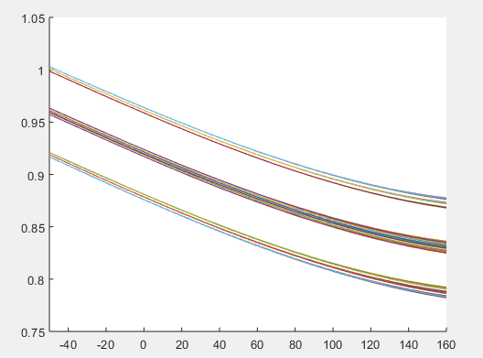
PVT tracking LLDO
Contrary to fixed level LLDO, the nominal voltage varies in function of process (typical, slow, fast) and temperature
Voltage=f(Process,temperature)
The function f needs to be fitted based on trimming samples
The OV/UV thresholds will be defined by a margin (+-x%) around the function f
In order to monitor PVT tracking LLDO, we need to know the process and to sense the temperature, based on that we can define the thresholds as a function of process, temperature and margin
Then we need to sense the LLDO output, compare it to the corresponding OV/UV thresholds and flag system if needed.
Typical
Voltage
Slow
Fast
Temperature

Slide 9
Top design level

Slide 10
STEPS (SWBist.c)
Select LLDO
Configure LLDO measurement
IP
ATB
ADC
Node
OV/UV thresholds
Measure the output voltage
Flag the system

Slide 11
Functions to be coded (Top level)
/**
* \brief This function performs the OVUV test
* \param [in,out] LLDOId -LLDO to be tested
* \param [in,out] RFE_ERROR_FUNCTION_PARAMETER Output error code.
* On success #RFE_ERROR_IS_NO_ERROR is true,
* On failure #RFE_ERROR_IS_ERROR is true
void rfeSwBist_LLDO_ovuv_test(
rfeSwBist_LLDOID_t LLDOId,
RFE_ERROR_FUNCTION_PARAMETER
);

Slide 12
Select LLDO

Slide 13
Structures and ENUM types to be added (SWBist.h)
/**
* This enumerated type defines the IDs of all LLDOs .
*/
typedef enum
{
rfeSwBist_Id_chirppll_ldo_vco_1v8_e = 0u,
rfeSwBist_Id_chirppll_ldo_vco_0v9_e = 1u,
rfeSwBist_Id_chirppll_ldo_pfdcp_1v8_e = 2u,
rfeSwBist_Id_chirppll_ldo_pfdcp_0v9_e = 3u,
rfeSwBist_Id_chirppll_ldo_pdiv_0v9_e = 4u,
rfeSwBist_Id_ldo_loif_pa_e = 5u,
rfeSwBist_Id_ldo_loif_lna_e = 6u,
rfeSwBist_Id_ldo_loif_lox4_e = 7u,
rfeSwBist_Id_ldo_loif_driver_e = 8u,
rfeSwBist_Id_ldo_xo_core_e = 9u,
rfeSwBist_Id_ldo_xo_out_e = 10u,
rfeSwBist_Id_ldo_mcgen_e = 11u,
rfeSwBist_Id_ldo_dco_capbank_e = 12u,
rfeSwBist_Id_ldo_dco_buffer_e = 13u,
rfeSwBist_Id_ldo_div3_e = 14u,
rfeSwBist_Id_ldo_sampler_e = 15u,
rfeSwBist_Id_ldo_digital_e = 16u,
} rfeSwBist_LLDOID_t;

Slide 14
Configure LLDO measurement

Slide 15
STEPS (SWBist.c)
Set LLDO parameters
Connect LLDO to ATB
Configure ATB ADC

Slide 16
Functions to be coded
/**
* \brief This function configures the parameters (IP, ovuv, atbCtlSelValue, selectedAtbX) of the LLDO to be tested
* \param [in,out] LLDO -LLDO to be tested
* \param [in,out] ipToConnect - Pointer to the corresponding IP of the LLDO
* \param [in,out] ovuv -Pointer to the corresponding OVUV structure variables
* \param [in,out] atbCtlSelValue - Pointer to the ATBCTL to be selected
* \param [in,out] selectedAtbX - Pointer to the associated selected ATB
* \param [in,out] RFE_ERROR_FUNCTION_PARAMETER Output error code.
* On success #RFE_ERROR_IS_NO_ERROR is true,
* On failure #RFE_ERROR_IS_ERROR is true
*
void rfeSwBist_LLDO_Configure(
rfeSwBist_LLDOID_t LLDOId,
rfeHwAtb_connectedIp_t* ipToConnect,
rfeSwBist_ovuvCfg_t* ovuv,
rfeHwSpi_register32_t* atbCtlSelValue,
rfeHwAtb_atbMaster_t* selectedAtbX,
RFE_ERROR_FUNCTION_PARAMETER
);

Slide 17
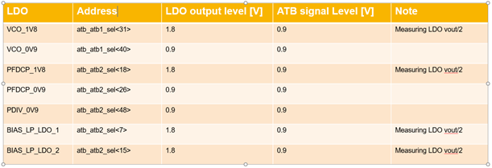
Structures and ENUM types to be added (SWBist_internal.h)
//ATBCTLSEL for different LLDOs
#define RFE_SW_BIST_ATBCTLSEL_LDO_VCO_1V8 (31ul)
#define RFE_SW_BIST_ATBCTLSELLDO_VCO_0V9 (40ul)
#define RFE_SW_BIST_ATBCTLSEL_LDO_PFDCP_1V8 (18ul)
#define RFE_SW_BIST_ATBCTLSEL_LDO_PFDCP_0V9 (26ul)
#define RFE_SW_BIST_ATBCTLSEL_PDIV_0V9 (48ul)
#define RFE_SW_BIST_ATBCTLSEL_LOIF_PA (39ul)
#define RFE_SW_BIST_ATBCTLSEL_LOIF_LNA (31ul)
#define RFE_SW_BIST_ATBCTLSEL_LOIF_LOX4 (31ul)
#define RFE_SW_BIST_ATBCTLSELLOIF_DRIVER (39ul)
Set LLDO parameters
Connect LLDO to ATB
Configure ATB ADC

Slide 18
Structures and ENUM types to be added (SWBist.h)
/**
* \struct
* \brief Structure to hold LLDO voltage, undervoltage threshold and overvoltage threshold
typedef struct {
/** OVUV nominal monitoring monitored voltage value. */
float vMon;
/** Over-voltage level threshold setting . */
float ovThre;
/** Under-voltage level threshold setting . */
float uvThre;
} rfeSwBist_ovuvCfg_t;
Set LLDO parameters
Connect LLDO to ATB
Configure ATB ADC
// Nominal voltage, Overvoltage and undervoltage thresholds (fixed by +-10% around nominal voltage), Actual discussion with safety team concerning this percentage
#define RFE_SW_BIST_CHIRPPLL_LDO_VCO_1V8_VOLTAGE ( ( float ) 0.9f )
#define RFE_SW_BIST_CHIRPPLL_LDO_VCO_1V8_OVERVOLTAGE ( ( float ) 0.99f )
#define RFE_SW_BIST_CHIRPPLL_LDO_VCO_1V8_UNDERVOLTAGE ( ( float ) 0.81f )
#define RFE_SW_BIST_CHIRPPLL_LDO_VCO_0V9_VOLTAGE ( ( float ) 0.9f )
#define RFE_SW_BIST_CHIRPPLL_LDO_VCO_0V9_OVERVOLTAGE ( ( float ) 0.99f )
#define RFE_SW_BIST_CHIRPPLL_LDO_VCO_0V9_UNDERVOLTAGE ( ( float ) 0.81f )
#define RFE_SW_BIST_CHIRPPLL_LDO_PFDCP_1V8_VOLTAGE ( ( float ) 0.9f )
#define RFE_SW_BIST_CHIRPPLL_LDO_PFDCP_1V8_OVERVOLTAGE ( ( float ) 0.99f )
#define RFE_SW_BIST_CHIRPPLL_LDO_PFDCP_1V8_UNDERVOLTAGE ( ( float ) 0.81f )
#define RFE_SW_BIST_CHIRPPLL_LDO_PFDCP_0V9_VOLTAGE ( ( float ) 0.9f )
#define RFE_SW_BIST_CHIRPPLL_LDO_PFDCP_0V9_OVERVOLTAGE ( ( float ) 0.99f )
#define RFE_SW_BIST_CHIRPPLL_LDO_PFDCP_0V9_UNDERVOLTAGE ( ( float ) 0.81f )
.
.
.

Slide 19
Set LLDO parameters(SWBist.c)
CHIRP_PLL
*selectedAtbX = rfeHwAtb_atbMaster_1_e;
ipToConnect->id = RFE_HW_SPI_CHIRP_AFC_MODULE;
ipToConnect->atbCtlOffset = rfeHwAtb_ctlOffset_default_e;
ipToConnect->atbCtlEnShf = RFE_HW_CHIRPPLL_ATB_ATB1_EN_BIT;
ipToConnect->atbCtlMaskToApply = RFE_HW_CHIRPPLL_ATB_ATB1_SEL_MSK;
ipToConnect->atbCtlSelShf = RFE_HW_CHIRPPLL_ATB_ATB1_SEL_SHF;
*atbCtlSelValue = RFE_SW_BIST_ATBCTLSEL_LDO_VCO_1V8;
ovuv->vNom=RFE_SW_BIST_CHIRPPLL_LDO_VCO_1V8_VOLTAGE ;
ovuv->ovThre=RFE_SW_BIST_CHIRPPLL_LDO_VCO_1V8_OVERVOLTAGE;
ovuv->uvThre=RFE_SW_BIST_CHIRPPLL_LDO_VCO_1V8_UNDERVOLTAGE;
Set LLDO parameters
Connect LLDO to ATB
Configure ATB ADC

Slide 20
Functions to be coded
rfeSwBist_ConfigureAtbAdc(); (follow the example in rfeSwCalibration_rxbistCalibration.c)
rfeHwAtb_ctrlAtbConnectToIpModule();
rfeHwAtb_ctrlAtbDcInputSourceSetter();
rfeHwAtb_ctrlAtbPullDownLinesSetter();
rfeHwAtb_ctrlAtbAdcBasicSettingsSetter();
rfeHwAtb_ctrlAtbAdcModeSetter();
Set LLDO parameters
Connect LLDO to ATB
Configure ATB ADC
/**
* \brief This function configures the ATB ADC * \param [in,out] atbCtlSelValue -variable to hold the LLDO output measured voltage
* \param [in,out] iptoUse - the TP to be connected to ATB
* \param [in,out] atbCtlSelValue -variable to hold the LLDO output measured voltage
* \param [in,out] adcSettings - Pointer to the used ADC settings
* \param [in,out] RFE_ERROR_FUNCTION_PARAMETER Output error code.
* On success #RFE_ERROR_IS_NO_ERROR is true,
* On failure #RFE_ERROR_IS_ERROR is true
void rfeSwBist_ConfigureAtbAdc(
rfeHwSpi_register32_t atbCtlSelValue,
rfeHwAtb_connectedIp_t iptoUse,
rfeHwAtb_atbMaster_t selectedAtbX,
rfeHwAtb_adcSettings_t* adcSettings,
RFE_ERROR_FUNCTION_PARAMETER );

Slide 21
Measure output voltage

Slide 22
STEPS (SWBist.c)
Start sampling
Read ATB ADC
Convert to voltage

Slide 23
Predefined functions to be used
Start sampling
rfeHwAtb_funcAtbAdcTriggerContSampling();
Read ATB ADC
Convert to voltage
bool startStopSampling = true;
rfeHwAtb_funcAtbAdcTriggerContSampling( selectedAtbX,
startStopSampling,
RFE_ERROR_FUNCTION_ARGUMENT );

Slide 24
Functions to be coded
Start sampling
rfeSwBist_ReadAdcValue(); (follow the example in rfeSwCalibration_rxbistCalibration.c)
rfeHwAtb_funcAtbCollectSamples()
RFE_WAIT_USEC ( WAIT_TIME )
Read ATB ADC
Convert to voltage
rfeSwBist_ReadAtbAdcValue(selectedAtbX, RFE_SWBist_LLDO_WAIT_TIME,
RFE_ERROR_FUNCTION_ARGUMENT );

Slide 25
Functions to be coded
Start sampling
rfeHwAtb_funcAtbAdcSamplesToVoltageConvert()
Read ATB ADC
Convert to voltage
measured_Voltage = rfeHwAtb_funcAtbAdcSamplesToVoltageConvert( Code_out,
selectedAtbX,
adcSettings.adcEndingMode,
adcSettings.adcInputGain,
RFE_ERROR_FUNCTION_ARGUMENT );

Slide 26
Set monitor

Slide 27
STEPS (SWBist.c)
Measured voltage
Voltage > OV threshold ?
yes
No
OV flag
Voltage < UV threshold ?
yes
No
UV flag
Do nothing
(Safe)

Slide 28
Functions to be coded
Please mention that contrary to GLDO monitoring which is hard coded, the flags in our case will be setted by software
rfeSwBist_ovuv_setMonitor();
API (FCCU) to be implemented, it will be similar to the function below
void rfeHwFccu_setErrorId(
rfeHwFccu_faultId_t faultId,
RFE_ERROR_FUNCTION_PARAMETER
)

Slide 29
Functions to be coded
/**
* \brief This function sets an error flag when overvoltage or undervoltage event occurs
* \details This function
* \param [in,out] measured_voltage -variable to hold the LLDO output measured voltage
* \param [in,out] ovuv - varible to hold the LLDO voltage, undervoltage threshold and overvoltage threshold
* \param [in,out] RFE_ERROR_FUNCTION_PARAMETER Output error code.
* On success #RFE_ERROR_IS_NO_ERROR is true,
* On failure #RFE_ERROR_IS_ERROR is true
void rfeSwBist_ovuv_setMonitor(
float measured_voltage,
rfeSwBist_ovuvCfg_t ovuv,
RFE_ERROR_FUNCTION_PARAMETER
);

Slide 30
Monitoring choices
The same ATB ADC settings will be used for different LLDO
The ATB configuration is different from an LLDO to another based on which ATB that can be connected
For simplicity, the LLDO OV/UV monitoring will be coded serially (may be concurrently if needed)
Settling time is not considered as we assume that the different LLDOs are already enabled
Fault injection tests
Radar Frame Loop
Power Up
Start up calib.
FIT
Radar Config
(Re-) Calib.
Acquisitions
Safety timeslot
Idle time
BIST Test
LLDOs OV/UV (via ATB ADC)
Ball break detectors
Startup
Assumption: LLDOs are all enabled

Slide 31
MISSED Tasks
Add MCGEN IP LLDOs when information are available
Implement rfeSwBist_ovuv_setMonitor() when FCCU API to set error flag is available
Add more tests for rfeSwBist_ovuv_setMonitor() function when implemented
Please mention that the list of LLDOs is not finalized yet. More discussion to converge to a finalized one.

