Slide 1
Tx BIST design
2022

Slide 2
Txs+Txbist structure
7-bit Phase-rotator
x2
From LOI
IQ
DAC
PPD
Dig-Controller
Measured TX
ATB ADC Capture
VGA
To ATB ADC
ATB ADC Capture
Reference TX
Dig-Controller
From LOI
PPD
IQ
DAC
x2
7-bit Phase-rotator

Slide 3
Block diagrams

Slide 4
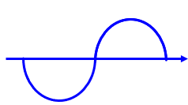
Block Diagram: Txbist main operation
TXbist main operation : measure the TX phase shift
TX1 phase φ1 : to be measured.
PA
Coupler
Measured TX
TXBIST
fft(Vout_txbist), N pts
Vout = A1.cos(Δφ)
VGA
Vout_txbist = A2.cos(Δφ)
Phase TX1
Reference TX
PA
Coupler
TX2 phase φ2 : 0º → 360º

Slide 5
TX BIST Phase difference

Slide 6
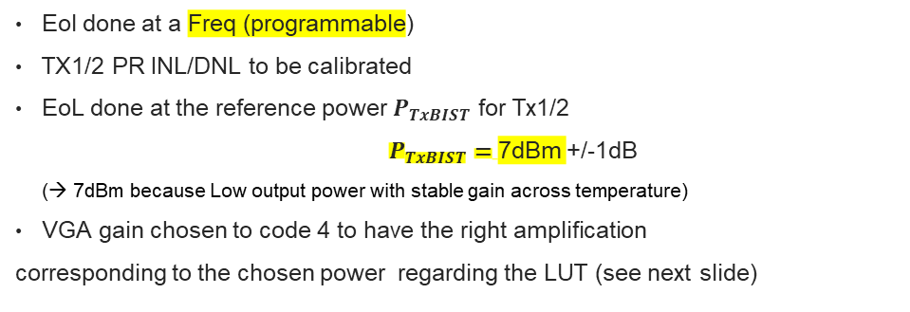


TXbist main operation : measure tx to TX phase difference
NB: TXBIST is only working with 2 consecutive Tx channels enabled
End of line measurement to be done and stored
Fusa TxBIST measurement
Load TX1 and Tx2 profiles for TxBIST measurement
Load BIST profile
VGA gain to code 4
Eol done at a Freq (programmable)
TX1/2 PR INL/DNL to be calibrated
EoL done at the reference power $P_{TxBIST}$ for Tx1/2
$P_{TxBIST}=$7dBm +/-1dB
(→ 7dBm because Low output power with stable gain across temperature)
VGA gain chosen to code 4 to have the right amplification
corresponding to the chosen power regarding the LUT (see next slide)
TX1 : Fixed phase
φ1 : 0º
Threshold programmable
(Based on validation)
φ1 : 0º
TX1 : Fixed phase
fft
+10°
To ATB ADC
ATB ADC Capture
+FFT
$$φ_{1−2}−φ_{EoL}$$
VGA
ATB ADC Capture
fft
VGA
To ATB ADC
$$φ_{EoL}$$
-10°
Reference TX
φ2 : 0º → 360º (45° steps/8steps)
Reference TX
Config 1 : 45° x 8 steps
φ2 : 0º → 360º
(Config 1 : 45° x 8 steps)

Slide 7
TX BIST Phase STEPS

Slide 8







TXbist main operation : measure tx to TX phase STEP
NB: This new method is chosen to be the plan of record to reduce the emission time
TX profile for BIST is loaded, same configuration as for phase difference
$$φ_{1}$$
Reference Tx
Reference Tx : Fixed phase
φ1 : 0º
Measured Tx
$$θ_{1}$$
$$θ_{2}$$
$$θ_{3}$$
$$θ_{4}$$
+10°
VGA
To ATB ADC
ATB ADC Capture
Real signal
Hilbert transform
(FFT+IFFT)
Analytic signal (complex)
Atan
8 real samples
8 complex samples
8 phases: $θ_{1}$… $θ_{8}$ - 45°
-10°
Measured TX
$θ_{i}$: 0º → 360º (45° /8steps)
Threshold programmable
(Based on validation)
Decisions taken during safety meetings:
Programmable threshold
Threshold to be determined regarding validation data
Fault injection models need to be done to validate this new method

Slide 9
Design FLOW

Slide 10
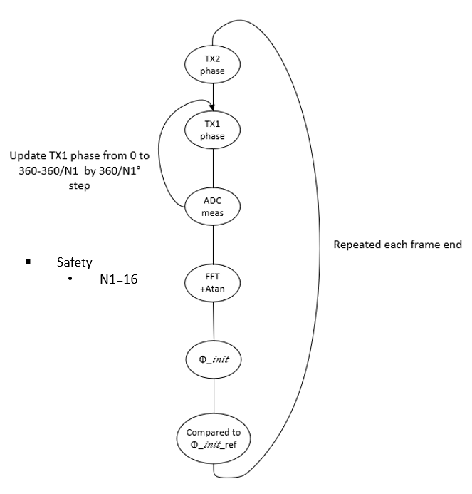
Design flow diagram (rfeSwBist_calculateTxBistParameters)
Txs On, TxBist On
Get Power
TxBIST Calibration
rfeSwBist_calibrateTxBist
Set VGA gain
IF signal samples measurement
rfeSwBist_measureTxBistIfSignalSamples
Set Measured Tx phase
Set reference Tx phase
Measure IF signal sample
IF signal FFT calculation
FFT processing
rfeSwBist_calculateFftOfIfSignal(
IF signal phase calculation
rfeSwBist_calculateIfSignalPhase
Arctan
Phase step deviation calculation
rfeSwBist_calculateMaximumPhaseStepDeviation
Hilbert transform

Slide 11
TX BIST
/**
* rfeSwBist_txBistParam_t type defines the parameters and results in TxBist.
*/
typedef struct {
/** Measured calibrated power at Txs */
float targetPower;
/** Used frequency for Bist */
uint32_t txFrequencyForBist;
/** Enabled Txs */
uint8_t selectedTxs;
/** Input phasesdiff thresholds at txbists */
float phaseDiffThreshold;
/** Input phasesStep thresholds at txs */
float phaseStepThreshold;
/** Measured phases at txbists */
float phaseMeas[RFE_TXBIST_COUNT];
/** Measured zero Hour phases at txbists */
float zeroHourPhaseMeas[RFE_TXBIST_COUNT];
/** Phase difference deviation from zero hour measurement at txbists */
float phaseDiffDeviation[RFE_TXBIST_COUNT];
/** Maximum measured phase step deviation from setted phase step at txbists */
float maximumPhaseStepDeviation[RFE_TX_COUNT];
} rfeSwBist_txBistParam_t;

Slide 12
TX BIST
Enum structure that enumerates the 3 txbists
typedef enum
{
rfeSwBist_ txbistIndex _1_e,
rfeSwBist_ txbistIndex _2_e,
rfeSwBist_ txbistIndex _2_e
} rfeSwBist_txbistIndex_t;
Function that will be used to enable TxBist
rfeHwTx_subcomponentEnabling( txToUse,
currentSubcomponent,
enableSubcomponent,
RFE_ERROR_FUNCTION_ARGUMENT );

Slide 13
Txbist Calibration

Slide 14
TxBIST Calibration function
void rfeSwBist_calibrateTxBist(
const rfeSwBist_txBistParam_t *pTxBistParam,
rfeSwBist_txBistIndex_t txBistInd,
RFE_ERROR_FUNCTION_PARAMETER)

Slide 15
Txbist calibration : specification
The aim of the calibration is to provide a signal whose amplitude Vout is in the dynamic range of the ADC. Additionally, system studies has shown that too low level would lead to a degradation of the phase accuracy. Consequently, the output differential level should be between 0.2Vpp and 1.2Vpp.
The calibration is made with VGA_gain using a simple LUT.
TX1 phase φ1
PA
Coupler
TX1
TXBIST
VGA_gain
Vout = A1.cos(Δφ)
VGA
Vout_final = Vout.cos(Δφ)
ADC
TX2
PA
TX2 phase φ2 : 0º → 360º

Slide 16
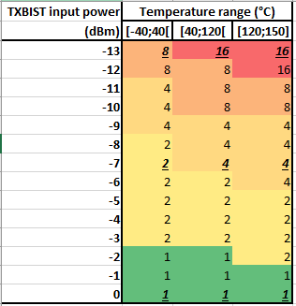
Txbist calibration (set vga gain)
Structure that enumerates the txbist VGA gains
typedef enum
{
rfeHwTx_txBistVGACtrl_0dB_e = 0x01u, /**< rfeHwTx_txBistVGACtrl_0dB_e, default value for TX BIST VGA Calibration */
rfeHwTx_txBistVGACtrl_5dB_e = 0x02u, /**< rfeHwTx_txBistVGACtrl_5dB_e */
rfeHwTx_txBistVGACtrl_10dB_e = 0x04u,/**< rfeHwTx_txBistVGACtrl_10dB_e */
rfeHwTx_txBistVGACtrl_15dB_e = 0x08u,/**< rfeHwTx_txBistVGACtrl_15dB_e */
rfeHwTx_txBistVGACtrl_20dB_e = 0x10u,/**< rfeHwTx_txBistVGACtrl_20dB_e */
rfeHwTx_txBistVGACtrl_25dB_e = 0x20u /**< rfeHwTx_txBistVGACtrl_25dB_e */
} rfeHwTx_txBistVGACtrl_t;
Function to set the VGA gain of txbist
void rfeHwTx_bistCtrlVGASetter(
rfe_txIndex_t txSelected,
rfeHwTx_txBistVGACtrl_t vgaCtrlGain,
RFE_ERROR_FUNCTION_PARAMETER
);

Slide 17
IF SIGNAL measurement

Slide 18
IF signal measurement function
Function that will measure the IF signal sample
void rfeSwBist_measureTxBistIfSignalSamples(
rfeHwAtb_atbMaster_t selectedAtbX,
float IfSignalMeas[RFE_SAMPLES_COUNT],
rfeSwBist_txBistIndex_t txBistInd,
rfe_txIndex_t txToMeasure,
rfe_txIndex_t txRef,
rfe_phaseRotation_t txToMeasurePhase,
RFE_ERROR_FUNCTION_PARAMETER)

Slide 19
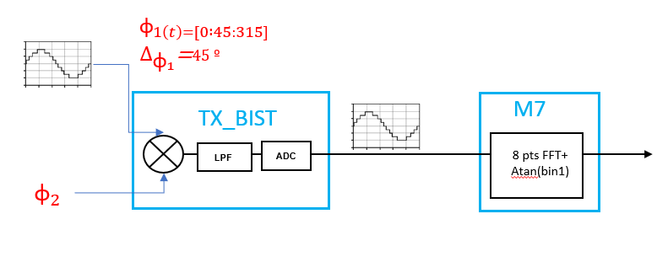
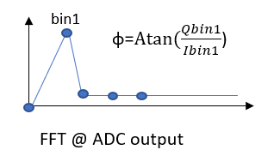
IF signal samples measurements
Example of 8 IF samples measurement for one period

Slide 20
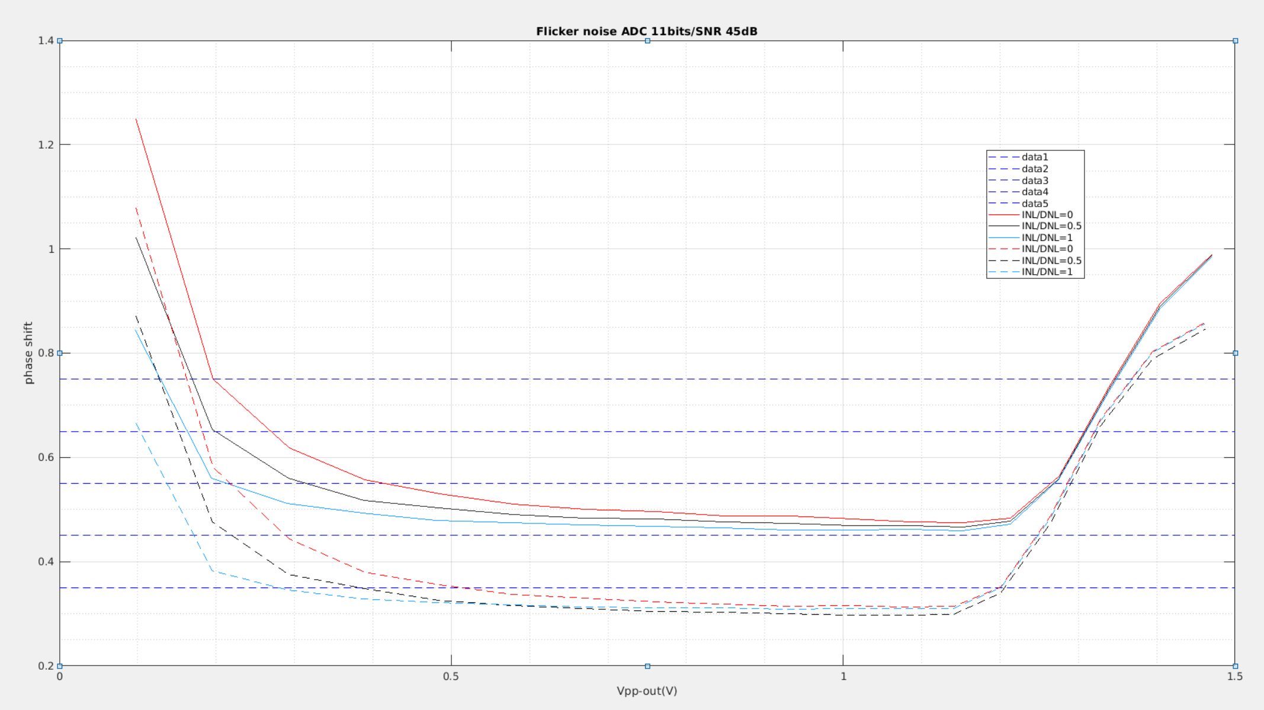
IF signal samples measurement
Number of phases in one period: 8
Number of periods:1/ 2
Function to set the PR phase
void rfeHwTx_overridePrPhaseSetter(
rfe_txIndex_t txSelected,
bool overRidePrPhase,
rfe_phaseRotation_t prPhase,
RFE_ERROR_FUNCTION_PARAMETER );
Set Measured Tx phase
Set reference Tx phase
Function that will measure the actual IF signal sample
void rfeSwBist_measureTxBistIfSignalSamples(
rfeHwAtb_atbMaster_t selectedAtbX,
float IfSignalMeas[RFE_SAMPLES_COUNT],
rfeSwBist_txBistIndex_t txBistInd,
rfe_txIndex_t txToMeasure,
rfe_txIndex_t txRef,
rfe_phaseRotation_t txToMeasurePhase,
RFE_ERROR_FUNCTION_PARAMETER)
Measure IF signal sample

Slide 21
IF signal FFT calculation

Slide 22
FFT calculation function
Function that will calculate the FFT of the measured IF signal
void rfeSwBist_calculateFftOfIfSignal(
float IfSignalMeas[RFE_SAMPLES_COUNT],
cfloat32_t fftResult[RFE_SAMPLES_COUNT / 2],
RFE_ERROR_FUNCTION_PARAMETER)

Slide 23
PHASE calculation

Slide 24
Phase calculation function
Function that will calculate the phase of the IF signal from calculated FFT of the measured IF signal
float rfeSwBist_calculateIfSignalPhase(
cfloat32_t fftResult[RFE_SAMPLES_COUNT / 2],
RFE_ERROR_FUNCTION_PARAMETER)

Slide 25
Phase Calculation

Slide 26
PHASE STEP calculation

Slide 27
Phase calculation function
Function that will calculate the phase step from calculated FFT of the measured IF signal
float rfeSwBist_calculateMaximumPhaseStepDeviation(
cfloat32_t fftResult[RFE_SAMPLES_COUNT / 2],
RFE_ERROR_FUNCTION_PARAMETER)

Slide 28
TXBIST REquirements

