Slide 1
STRX CALIBRATION Timing HOT FIX 0.8.2
RFE SW Team
March 14 2022

Slide 2
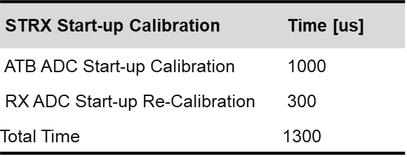
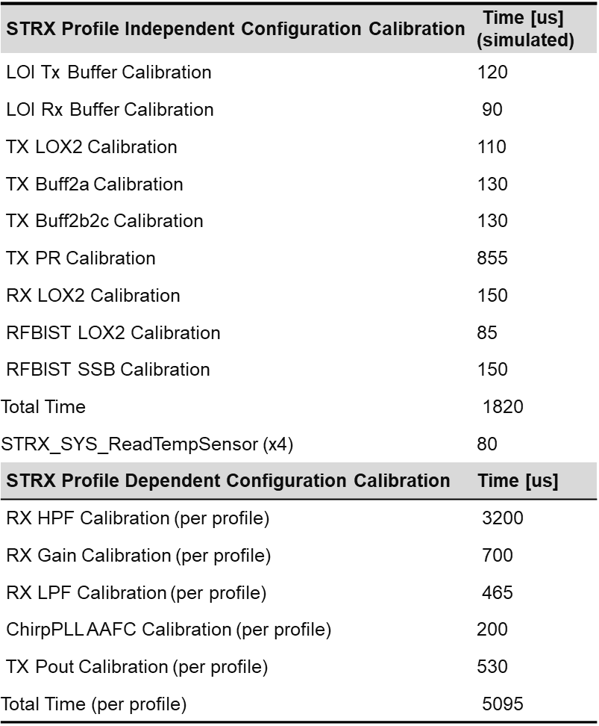
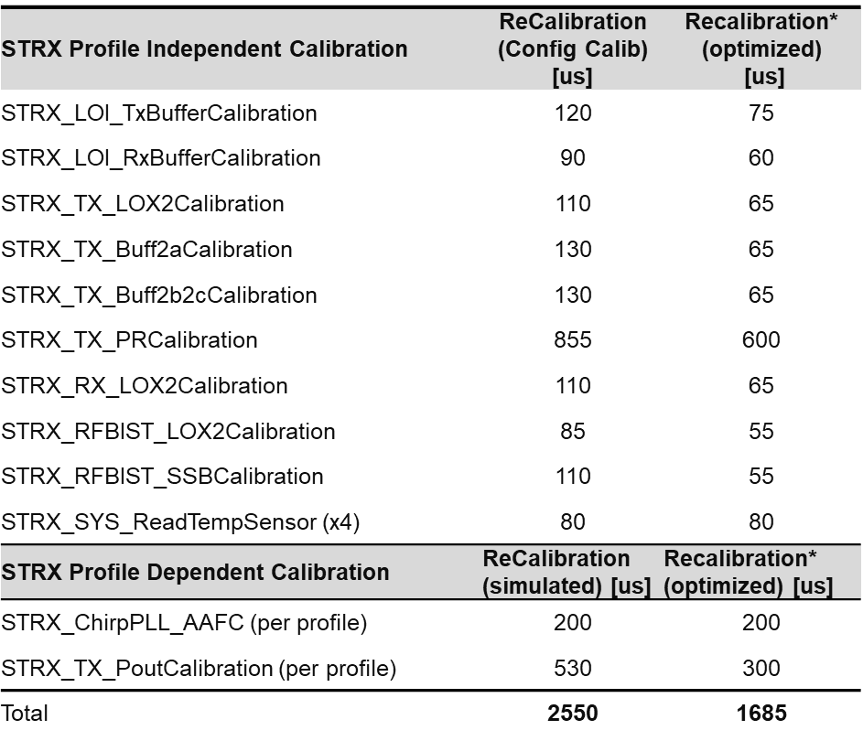
Radar Cycle
Init
Start up Calib.
FIT
Idle
Radar Config
Config. Calib.
Idle
(Re-) Calib.
Acquisition
Safety Timeslot
Sensor
Idle
[1ms]
Startup
Customer initiates radar re-configuration

Slide 3
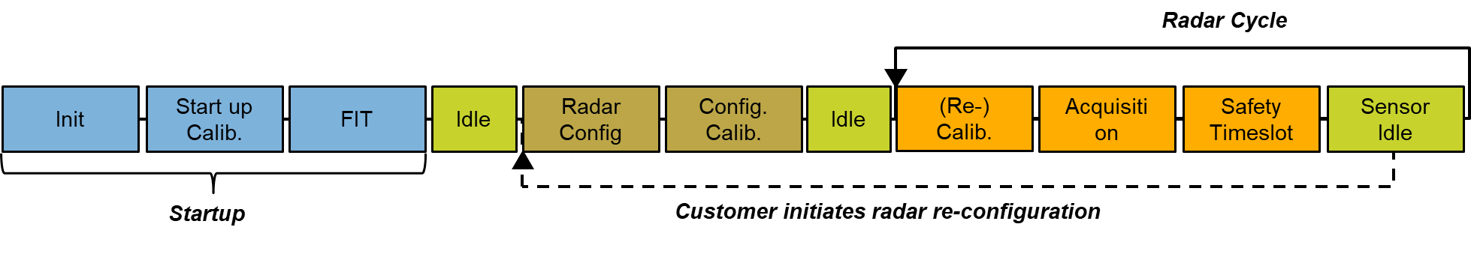
SAF85xx Start-Up calibration items
STRX Start-up Calibration | Time [us]
ATB ADC Start-up Calibration | 1000
RX ADC Start-up Re-Calibration | 300
Total Time | 1300

Slide 4
SAF85xx Configuration calibration items
STRX Profile Independent Configuration Calibration | Time [us] (simulated)
LOI Tx Buffer Calibration | 120
LOI Rx Buffer Calibration | 90
TX LOX2 Calibration | 110
TX Buff2a Calibration | 130
TX Buff2b2c Calibration | 130
TX PR Calibration | 855
RX LOX2 Calibration | 150
RFBIST LOX2 Calibration | 85
RFBIST SSB Calibration | 150
Total Time | 1820
STRX_SYS_ReadTempSensor (x4) | 80
STRX Profile Dependent Configuration Calibration | Time [us]
RX HPF Calibration (per profile) | 3200
RX Gain Calibration (per profile) | 700
RX LPF Calibration (per profile) | 465
ChirpPLL AAFC Calibration (per profile) | 200
TX Pout Calibration (per profile) | 530
Total Time (per profile) | 5095
To calculate the duration of configuration calibration, phase the following shall be used:
total time = [profile independent calibrations] +
[profile dependent calibrations] * [number of profiles used]

Slide 5
SAF85xx Recalibration items
STRX Profile Independent Calibration | ReCalibration (Config Calib) [us] | Recalibration* (optimized) [us]
STRX_LOI_TxBufferCalibration | 120 | 75
STRX_LOI_RxBufferCalibration | 90 | 60
STRX_TX_LOX2Calibration | 110 | 65
STRX_TX_Buff2aCalibration | 130 | 65
STRX_TX_Buff2b2cCalibration | 130 | 65
STRX_TX_PRCalibration | 855 | 600
STRX_RX_LOX2Calibration | 110 | 65
STRX_RFBIST_LOX2Calibration | 85 | 55
STRX_RFBIST_SSBCalibration | 110 | 55
STRX_SYS_ReadTempSensor (x4) | 80 | 80
STRX Profile Dependent Calibration | ReCalibration (simulated) [us] | Recalibration* (optimized) [us]
STRX_ChirpPLL_AAFC (per profile) | 200 | 200
STRX_TX_PoutCalibration (per profile) | 530 | 300
Total | 2550 | 1685
To calculate the duration of re-calibration phase per chirp sequence[x] the following shall be used:
total time[x] = [profile independent re-calibrations] * [recalibrateProfileIndependent] +
[profile dependent re-calibrations] * [recalibrateProfileDependent[x]]
so taking into account RFE calibrations settings per given chirp sequence:
recalibrateProfileDependent[x]
recalibrateProfileIndependent
* Note: Optimized Calibration will be available June 2022 EAR 1.4, for the rest of the document we use simulated data

Slide 6
CALIBRATION CONFIGURATION / API
Single radar frame / system cycle could consist of multiple chirp sequences
Calibration slot can be configured before any chirp sequence:
Calibration slot can be configured to perform profile independent calibrations
Calibration slot can be configured to perform profile dependent calibrations (AAFC, Pout)
Calibration slot is not limited to profiles used in subsequent chirp sequence only, i.e. calibration slot 1 can include profiles from chirp sequence 2.
idle
Cal 1
Chirp Sequence 1
Cal 2
Chirp Sequence 2
BIST
idle
Profile Independent calibrations: yes / no
Profile Dependent Calibrations
Profile 0: yes / no
Profile 1: yes / no
Profile 2: yes / no
Profile 3: yes / no
…
Profile 7: yes / no
Profile Independent calibrations: yes / no
Profile Dependent Calibrations
Profile 0: yes / no
Profile 1: yes / no
Profile 2: yes / no
Profile 3: yes / no
…
Profile 7: yes / no

Slide 7
CALIBRATION CONFIGURATION / API EXAMPLES
[ms]
a)
Cal 1
Chirp Sequence 1
Idle
Cal 2
Chirp Sequence 2
BIST
idle
Profile Independent calibrations: Yes
Profile Dependent calibrations:
- all used profiles for Chirp Sequence 1: Yes
- all used profiles for Chirp Sequence 2: No
Profile Independent calibrations: Yes
Profile Dependent calibrations:
- all used profiles for Chirp Sequence 1: No
- all used profiles for Chirp Sequence 2: Yes
[ms]
b)
Cal 1
Chirp Sequence 1
Idle
Cal 2
Chirp Sequence 2
BIST
idle
Profile Independent calibrations: Yes
Profile Dependent calibrations:
- all used profiles for Chirp Sequence 1: Yes
- all used profiles for Chirp Sequence 2: No
Profile Independent calibrations: No
Profile Dependent calibrations:
- all used profiles for Chirp Sequence 1: No
- all used profiles for Chirp Sequence 2: Yes
[ms]
c)
Cal 1\2
Chirp Sequence 1
idle
Chirp Sequence 2
BIST
idle
Profile Independent calibrations: Yes
Profile Dependent calibrations:
- all used profiles for Chirp Sequence 1: Yes
- all used profiles for Chirp Sequence 2: Yes
Profile Independent calibrations: No
Profile Dependent calibrations:
- all used profiles for Chirp Sequence 1: No
- all used profiles for Chirp Sequence 2: No

Slide 8
CALIBRATION CONFIGURATION / API (EXAMPLE)
Single radar frame / system cycle could consist of multiple chirp sequences (LR / MR)
Calibration slot can be configured before any chirp sequence:
Calibration slot can be configured to perform profile independent calibrations
Calibration slot can be configured to perform profile dependent calibrations (AAFC, Pout)
Calibration slot is not limited to profiles used in subsequent chirp sequence only, i.e. calibration slot 1 can include profiles from chirp sequence 2.
TX4 is not ReCalibrated in Slot1 !
idle
Cal 1
Chirp Sequence 1
Cal 2
Chirp Sequence 2
BIST
idle
Profile Independent calibrations: yes
Profile Dependent Calibrations
Profile 0: yes (FCM1: TX1-2-3)
Profile 1: yes (FCM1: TX1-2-3)
Profile 2: yes (FCM2: TX2-3-4)
Profile 3: yes (FCM2: TX2-3-4)
Profile 4: no
…
Profile 7: no
Profile Independent calibrations: no
Profile Dependent Calibrations
Profile 0: no
Profile 1: no
Profile 2: no
Profile 3: no
Profile 4: no
…
Profile 8: no

Slide 9
CALIBRATION CONFIGURATION / API (EXAMPLE)
Single radar frame / system cycle could consist of multiple chirp sequences (LR / MR)
Calibration slot can be configured before any chirp sequence:
Calibration slot can be configured to perform profile independent calibrations
Calibration slot can be configured to perform profile dependent calibrations (AAFC, Pout)
Calibration slot is not limited to profiles used in subsequent chirp sequence only, i.e. calibration slot 1 can include profiles from chirp sequence 2.
Chirp Sequence 2 does not work
idle
Cal 1
Chirp Sequence 1
Cal 2
Chirp Sequence 2
BIST
idle
Profile Independent calibrations: yes
Profile Dependent Calibrations
Profile 0: yes (FCM1: All TX disabled)
Profile 1: yes (FCM1: All TX disabled)
Profile 2: yes (FCM2: TX2-3-4)
Profile 3: yes (FCM2: TX2-3-4)
Profile 4: no
…
Profile 7: no
Profile Independent calibrations: no
Profile Dependent Calibrations
Profile 0: no
Profile 1: no
Profile 2: no
Profile 3: no
Profile 4: no
…
Profile 8: no

Slide 10
CALIBRATION CONFIGURATION / API (EXAMPLE)
Single radar frame / system cycle could consist of multiple chirp sequences (LR / MR)
Calibration slot can be configured before any chirp sequence:
Calibration slot can be configured to perform profile independent calibrations
Calibration slot can be configured to perform profile dependent calibrations (AAFC, Pout)
Calibration slot is not limited to profiles used in subsequent chirp sequence only, i.e. calibration slot 1 can include profiles from chirp sequence 2.
Profile Dependent Calibrations are not working what called without Profile Independent
idle
Cal 1
Chirp Sequence 1
Cal 2
Chirp Sequence 2
BIST
idle
Profile Independent calibrations: Yes\No
Profile Dependent Calibrations
Profile 0: yes (FCM1: TX1-2-3)
Profile 1: yes (FCM1: TX1-2-3)
Profile 2: yes (FCM2: TX2-3-4)
Profile 3: yes (FCM2: TX2-3-4)
Profile 4: no
…
Profile 7: no
Profile Independent calibrations: no
Profile Dependent Calibrations
Profile 0: no
Profile 1: no
Profile 2: no
Profile 3: no
Profile 4: no
…
Profile 8: no

Slide 11
CALIBRATION CONFIGURATION / API (EXAMPLE)
Single radar frame / system cycle could consist of multiple chirp sequences (LR / MR)
Calibration slot can be configured before any chirp sequence:
Calibration slot can be configured to perform profile independent calibrations
Calibration slot can be configured to perform profile dependent calibrations (AAFC, Pout)
Calibration slot is not limited to profiles used in subsequent chirp sequence only, i.e. calibration slot 1 can include profiles from chirp sequence 2.
TX1-4 Calibration takes 200[us] more then TX2-3
idle
Cal 1
Chirp Sequence 1
Cal 2
Chirp Sequence 2
BIST
idle
Profile Independent calibrations: No
Profile Dependent Calibrations
Profile 0: yes (FCM1: TX2-3)
Profile 1: yes (FCM1: TX2-3)
Profile 2: no
Profile 3: no
Profile 4: no
…
Profile 7: no
Profile Independent calibrations: no
Profile Dependent Calibrations
Profile 0: no
Profile 1: no
Profile 2: yes (FCM2: TX1-4)
Profile 3: yes (FCM2: TX1-4)
Profile 4: no
…
Profile 8: no

Slide 12
TX selection issue in rel0.8.9
Issue: failed to calibrate profiles selected only in calibration but not in chirping
Wrong assumption: ‘TxEnable’ from chirp sequence configuration includes all TXs used in a chirp sequence for chirping and calibration. Failed if cali includes profiles not used in chirping of a sequence
Need to clarify how to use the two settings on TX selection in radar configuration rfeConfig
‘TxEnable’ in each chirp sequence configuration: used to power-on TX channels used in a chirp sequence
Should ‘TxEnable’ include all TX channels required in calibration (but not in chirping) only, when customer programs rfeConfig?
Does NXP-J disable all TXs using ‘TxEnable’ in their failed tests? Why do they do this test?
‘TxTransmissionEnable’ in each profile configuration: required by TE to start chirping a profile on right TX channel
Can this setting be changed between radar cycles?
Can this be not fully enabled in a chirping using this profile, e.g. profile selects TX1, 2 and 3, but TxEnable of a sequence enables only TX1?
Current rel0.8.9 recalibration only uses ‘TxEnable’ to select TX channels
Should use ‘TxTransmissionEnable’ when calibrating a given profile

Slide 13
Proposal to solve TX selection issue in rel0.8.9
Use ‘TxTransmissionEnable’ when calibrating a given profile
Get proper calibrated results for each profile
Should profile-independent recalibration be done for all (power-enabled in all sequences of the radar cycle ) TXs , no matter the configuration of the selected profile for profile-independent calibration? ➔ Yes
Especially for Phase Rotator Calibration ➔ Yes
Use TxTransmissionEnable to do profile-dependent calibration
Power-on and power-down all TXs ( at least required TXs in TxEnable and TxTransmissionEnable of each selected profiles for calibration ) by power manager before and after calibration/recalibration is called
Need power down TX channels only used in calibration after calibration completed? ➔ Not now
Need to optimize power-on duration ( Srinivasa )
Specify that customer should define TxEnable includes all TXs required in TxTransmissionEnable of profiles used in chirping and calibration of a chirp sequence
Need to update of rfeConfig Doc on relation between TxEnable and TxTransmissionEnable
Take the same way to deal with RxEnable

Slide 14
0.8.2 Release

Slide 15
Solution B1: supported
Sequence 0
Sequence 1
STRX Profile Independent Calibration | ReCalibration (Config Calib) [us]
STRX_LOI_TxBufferCalibration | 120
STRX_LOI_RxBufferCalibration | 90
STRX_TX_LOX2Calibration | 110
STRX_TX_Buff2aCalibration | 130
STRX_TX_Buff2b2cCalibration | 130
STRX_TX_PRCalibration | 855
STRX_RX_LOX2Calibration | 110
STRX_RFBIST_LOX2Calibration | 85
STRX_RFBIST_SSBCalibration | 110
STRX_SYS_ReadTempSensor (x4) | 80
STRX Profile Dependent Calibration | ReCalibration (simulated) [us]
STRX_ChirpPLL_AAFC (profile 0) | 200
STRX_TX_PoutCalibration (profile 0) | 530
STRX_ChirpPLL_AAFC (profile 1) | 200
STRX_TX_PoutCalibration (profile 1) | 530
Total | 2550+730=3280
STRX Profile Independent Calibration | ReCalibration (Config Calib) [us]
STRX Profile Dependent Calibration | ReCalibration (simulated) [us]
Total
Chirp Sequence Start offset:
833,216 ticks, 20.8304 [ms]

Slide 16
Solution B2: supported
Sequence 0
Sequence 1
STRX Profile Independent Calibration | ReCalibration (Config Calib) [us]
STRX Profile Dependent Calibration | ReCalibration (simulated) [us]
STRX_ChirpPLL_AAFC (profile 0) | 200
STRX_TX_PoutCalibration (profile 0) | 530
Total | 730
STRX Profile Independent Calibration | ReCalibration (Config Calib) [us]
STRX_LOI_TxBufferCalibration | 120
STRX_LOI_RxBufferCalibration | 90
STRX_TX_LOX2Calibration | 110
STRX_TX_Buff2aCalibration | 130
STRX_TX_Buff2b2cCalibration | 130
STRX_TX_PRCalibration | 855
STRX_RX_LOX2Calibration | 110
STRX_RFBIST_LOX2Calibration | 85
STRX_RFBIST_SSBCalibration | 110
STRX_SYS_ReadTempSensor (x4) | 80
STRX Profile Dependent Calibration | ReCalibration (simulated) [us]
STRX_ChirpPLL_AAFC (profile 1) | 200
STRX_TX_PoutCalibration (profile 1) | 530
Total | 2550
Chirp Sequence Start offset:
833,216 ticks, 20.8304 [ms]

Slide 17
A1: NOT SUPPORTED NOW (SUPPORTED once Calibrations are implemented: STRX-5187
Sequence 0 (profile 0)
Sequence 1 (profile 1)
STRX Profile Independent Calibration | ReCalibration (Config Calib) [us]
STRX_LOI_TxBufferCalibration | 120
STRX_LOI_RxBufferCalibration | 90
STRX_TX_LOX2Calibration | 110
STRX_TX_Buff2aCalibration | 130
STRX_TX_Buff2b2cCalibration | 130
STRX_TX_PRCalibration | 855
STRX_RX_LOX2Calibration | 110
STRX_RFBIST_LOX2Calibration | 85
STRX_RFBIST_SSBCalibration | 110
STRX_SYS_ReadTempSensor (x4) | 80
STRX Profile Dependent Calibration | ReCalibration (simulated) [us]
STRX_ChirpPLL_AAFC (profile 0) | 200
STRX_TX_PoutCalibration (profile 0) | 530
Total | 2550
STRX Profile Independent Calibration | ReCalibration (Config Calib) [us]
STRX Profile Dependent Calibration | ReCalibration (simulated) [us]
STRX_ChirpPLL_AAFC (profile 1) | 200
STRX_TX_PoutCalibration (profile 1) | 530
Total | 730
Chirp Sequence Start offset:
833,216 ticks, 20.8304 [ms]

Slide 18
A2 (END GOAL): NOT SUPPORTED NOW (will be SUPPORTED by optimized Calibrations)
Sequence 0 (profile 0)
Sequence 1 (profile 1)
STRX Profile Independent Calibration | ReCalibration (Config Calib) [us]
STRX_LOI_TxBufferCalibration | 120
STRX_LOI_RxBufferCalibration | 90
STRX_TX_LOX2Calibration | 110
STRX_TX_Buff2aCalibration | 130
STRX_TX_Buff2b2cCalibration | 130
STRX_TX_PRCalibration | 855
STRX_RX_LOX2Calibration | 110
STRX_RFBIST_LOX2Calibration | 85
STRX_RFBIST_SSBCalibration | 110
STRX_SYS_ReadTempSensor (x4) | 80
STRX Profile Dependent Calibration | ReCalibration (simulated) [us]
STRX_ChirpPLL_AAFC (profile 0) | 200
STRX_TX_PoutCalibration (profile 0) | 530
Total | 2550
STRX Profile Independent Calibration | ReCalibration (Config Calib) [us]
STRX Profile Dependent Calibration | ReCalibration (simulated) [us]
STRX_ChirpPLL_AAFC (profile 1) | 200
STRX_TX_PoutCalibration (profile 1) | 530
Total | 730
Chirp Sequence Start offset:
804.000 ticks, 20.1 [ms]

