Slide 1

Team Details
Team name: Expediters
Team leader name: Chandan Kumar
Problem Statement: Scaling trust-AI powered detection of online harms

Slide 2

INTRODUCTION:
Our solution is a Streamlit-based UPI fraud detection app that uses a local machine learning model to analyze transaction text and determine if it's fraudulent.
Key Features:
ML-Based Fraud Detection
Text Processing
Confidence-Based Alerting
CSV Export
Workflow:
User inputs transaction details. The ML model analyzes the text and predicts whether it’s FRAUD or NO_FRAUD. Confidence is displayed, and a warning appears for high-risk transactions. Results are stored in transaction history and can be exported as a CSV.

Slide 3
Opportunities:
1. How different is it from any of the other existing ideas?
Unlike traditional rule-based fraud detection (e.g., bank alerts for large transactions), your solution analyzes transaction text using ML, making it smarter and more adaptable.
2. How will it be able to solve the problem?
Detects Fraudulent Patterns in UPI Transactions.By giving users an instant fraud probability score, they can stop transactions before it’s too late. Users learn fraud patterns over time, making them more vigilant against scams.
3. USP of the our solution
AI-Powered, Not Rule-Based – Learns and improves over time, unlike static fraud filters. User-Customizable Sensitivity – Allows users to adjust confidence thresholds. Easy to Deploy & Use – Runs as a simple app with no need for complex banking integrations. Analyzes Transaction Descriptions – Unlike most fraud detection tools, it focuses on text-based fraud indicators.

Slide 4
List of the features:
Core Features:
ML-Based Fraud Detection – Uses a pre-trained machine learning model to classify transactions as FRAUD or NO_FRAUD.
Text-Based Analysis – Scans transaction descriptions for fraudulent patterns, unlike traditional amount-based detection.
Confidence Score Calculation – Provides a fraud probability percentage to indicate the model's certainty.
User-Defined Confidence Threshold – Allows users to adjust fraud detection sensitivity (50-95%) for better accuracy.
Instant Transaction Analysis – Users get real-time fraud detection results with a single click.

Slide 5
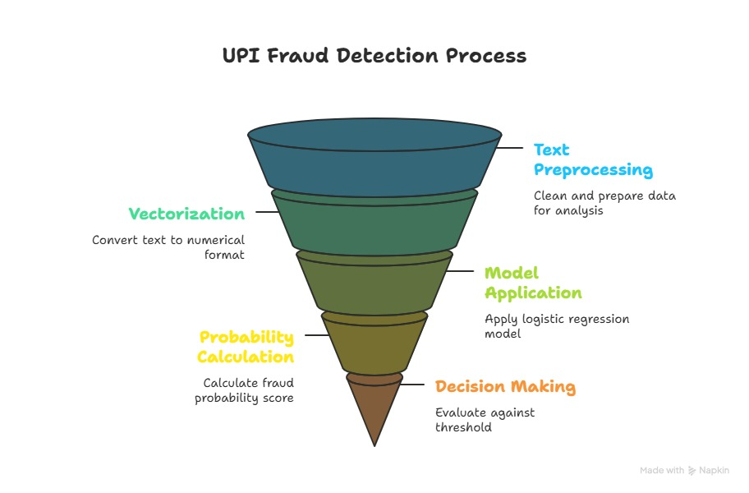
Process flow diagram:
1️⃣ User Inputs Transaction Details
2️⃣ Text Preprocessing & Vectorization
3️⃣ Fraud Detection Model (Logistic Regression)
4️⃣ Fraud Probability Score Calculation
5️⃣ Decision Based on Confidence Threshold
6️⃣ User Alert & History Logging

Slide 6
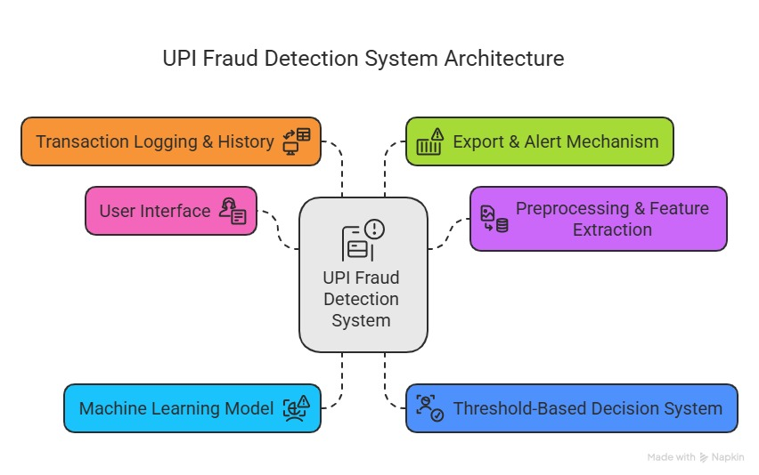
Architecture diagram:

Slide 7
Technologies to be used in the solution:
Category | Technology Used
ML Model & Processing | Scikit-learn , joblib
Text Vectorization | Tfidvectorizer or Countvectorizer
Web App Framework | streamlit
File Handling & Storage | Json, csv, os, datetime
Working Model Enhancement | Pandas

Slide 8
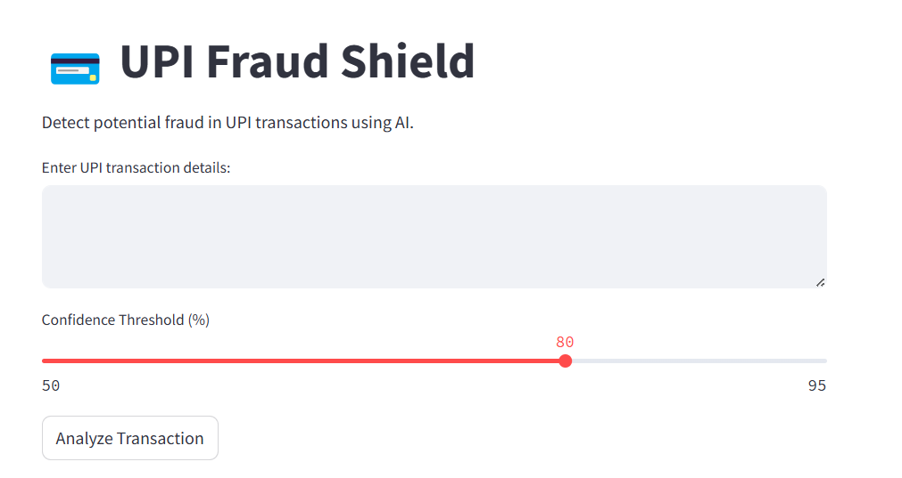
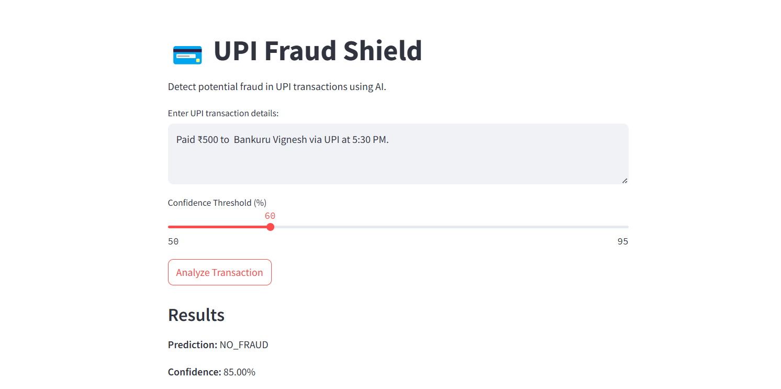
Snapshots of the MVP:

Slide 9
Potential Future Development:
Live API Integration – Connect with UPI payment gateways for real-time fraud checks.
Multi-Language Support – Detect fraud in regional languages for wider accessibility.
Advanced ML Models – Upgrade to deep learning for even better fraud detection accuracy.
Real-Time Alerts via Email/SMS – Notify users immediately about risky transactions.

Slide 10
Provide links to your:
GitHub Public Repository : https://github.com/kumarchandan13/Expediters.git
Demo Video Link (3 Minutes) : https://vioo.cc/v/3eyw
MVP Link : http://172.29.38.149:8502

Slide 11


