Slide 1

SUMMER COURSE
Airline Booking Management
System
NATIONAL INSTITUTE OF SCIENCE AND TECHNOLOGY
presented by
Firoj Kumar Patnaik-201760013
PAGE-01

Slide 2
SUMMER COURSE
Contents:-
Activities Involved
Activity Diagram
Classes Involved
Class Diagram
ER Diagram
NATIONAL INSTITUTE OF SCIENCE AND TECHNOLOGY
PAGE-02

Slide 3
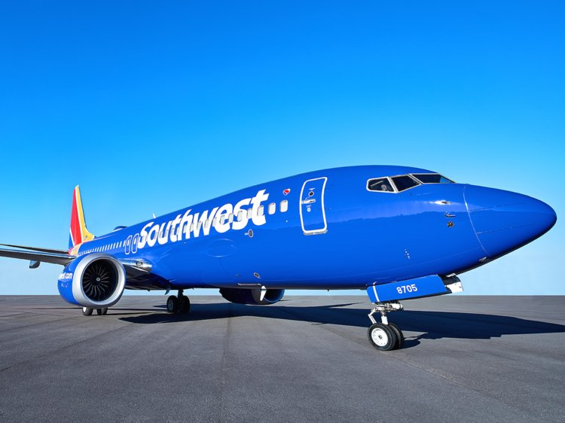
SUMMER COURSE
ACTIVITIES:-
Airline Enquiry Activity
Ticket Booking Activity
Passengar Activity
Other activities involves registration of a new customer and log in of existing users
NATIONAL INSTITUTE OF SCIENCE AND TECHNOLOGY
PAGE-03

Slide 4
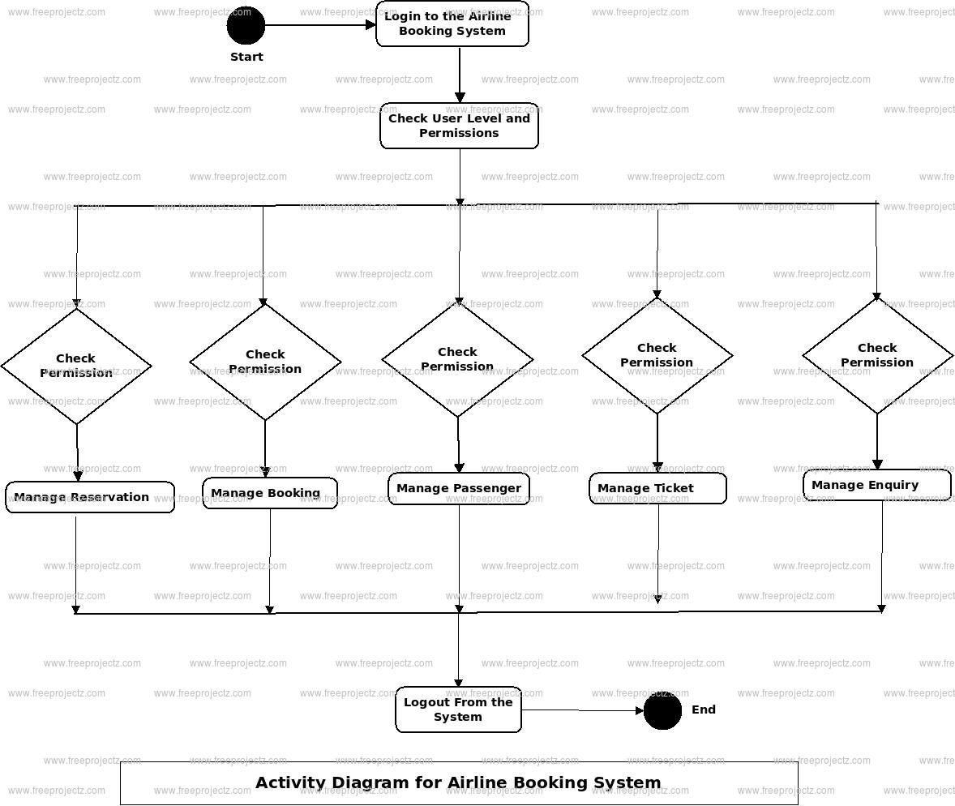
SOFT SKILLS 2019
ACTIVITY DIAGRAM : -
NATIONAL INSTITUTE OF SCIENCE AND TECHNOLOGY
PAGE-04

Slide 5
SUMMER COURSE
CLASSES : -
Ticket Class : Manage all the operations of Ticket
Passenger Class : Manage all the operations of Passenger
Booking Enquiry Class : Manage all the operations of Booking Enquiry,
Airline Enquiry Class : Manage all the operations of Airline Enquiry
NATIONAL INSTITUTE OF SCIENCE AND TECHNOLOGY
PAGE-05

Slide 6
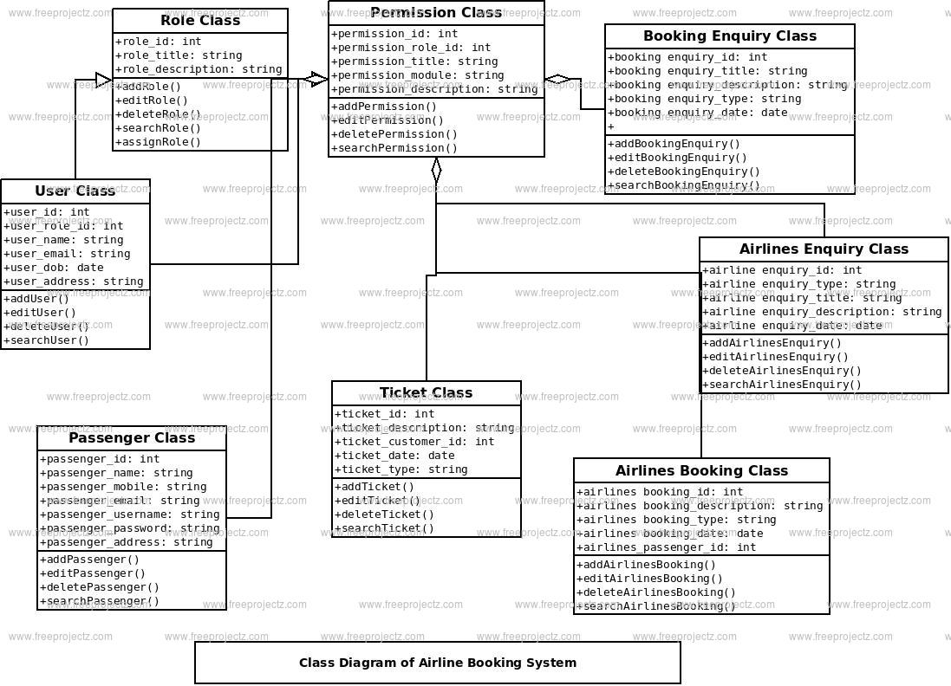
SUMMER COURSE
CLASS DIAGRAM: -
NATIONAL INSTITUTE OF SCIENCE AND TECHNOLOGY
PAGE-06

Slide 7
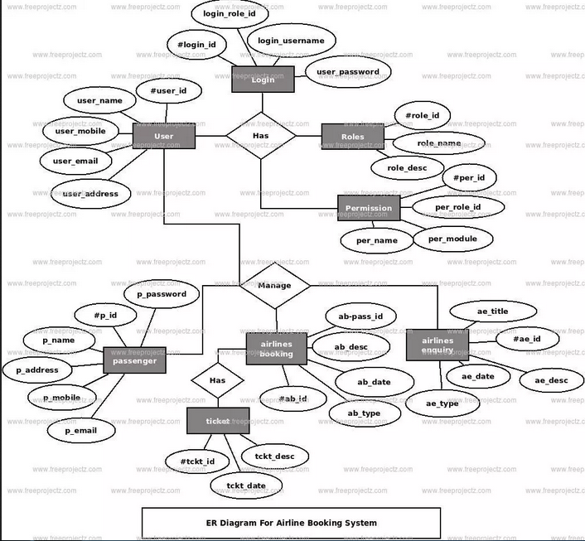
SUMMER COURSE
ER Diagram :-
NATIONAL INSTITUTE OF SCIENCE AND TECHNOLOGY
PAGE-07

Slide 8
SUMMER COURSE
Thank you
NATIONAL INSTITUTE OF SCIENCE AND TECHNOLOGY
PAGE-08

