Slide 1

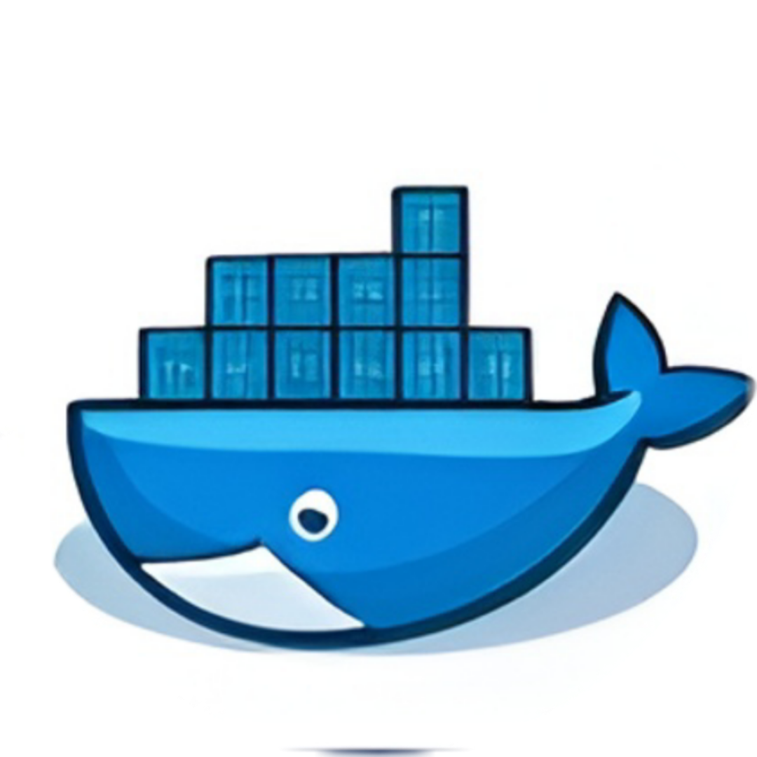





Grocery Mart Full-Stack E-Commerce Platform
End-to-End DevOps CI/CD Pipeline
Git | GitHub | Jenkins | Docker | Kubernetes | Prometheus | Grafana

Slide 2
Why This Project?
Build real-world e-commerce website
Implement CI/CD automation
Faster & reliable deployments
Hands-on DevOps experience

Slide 3
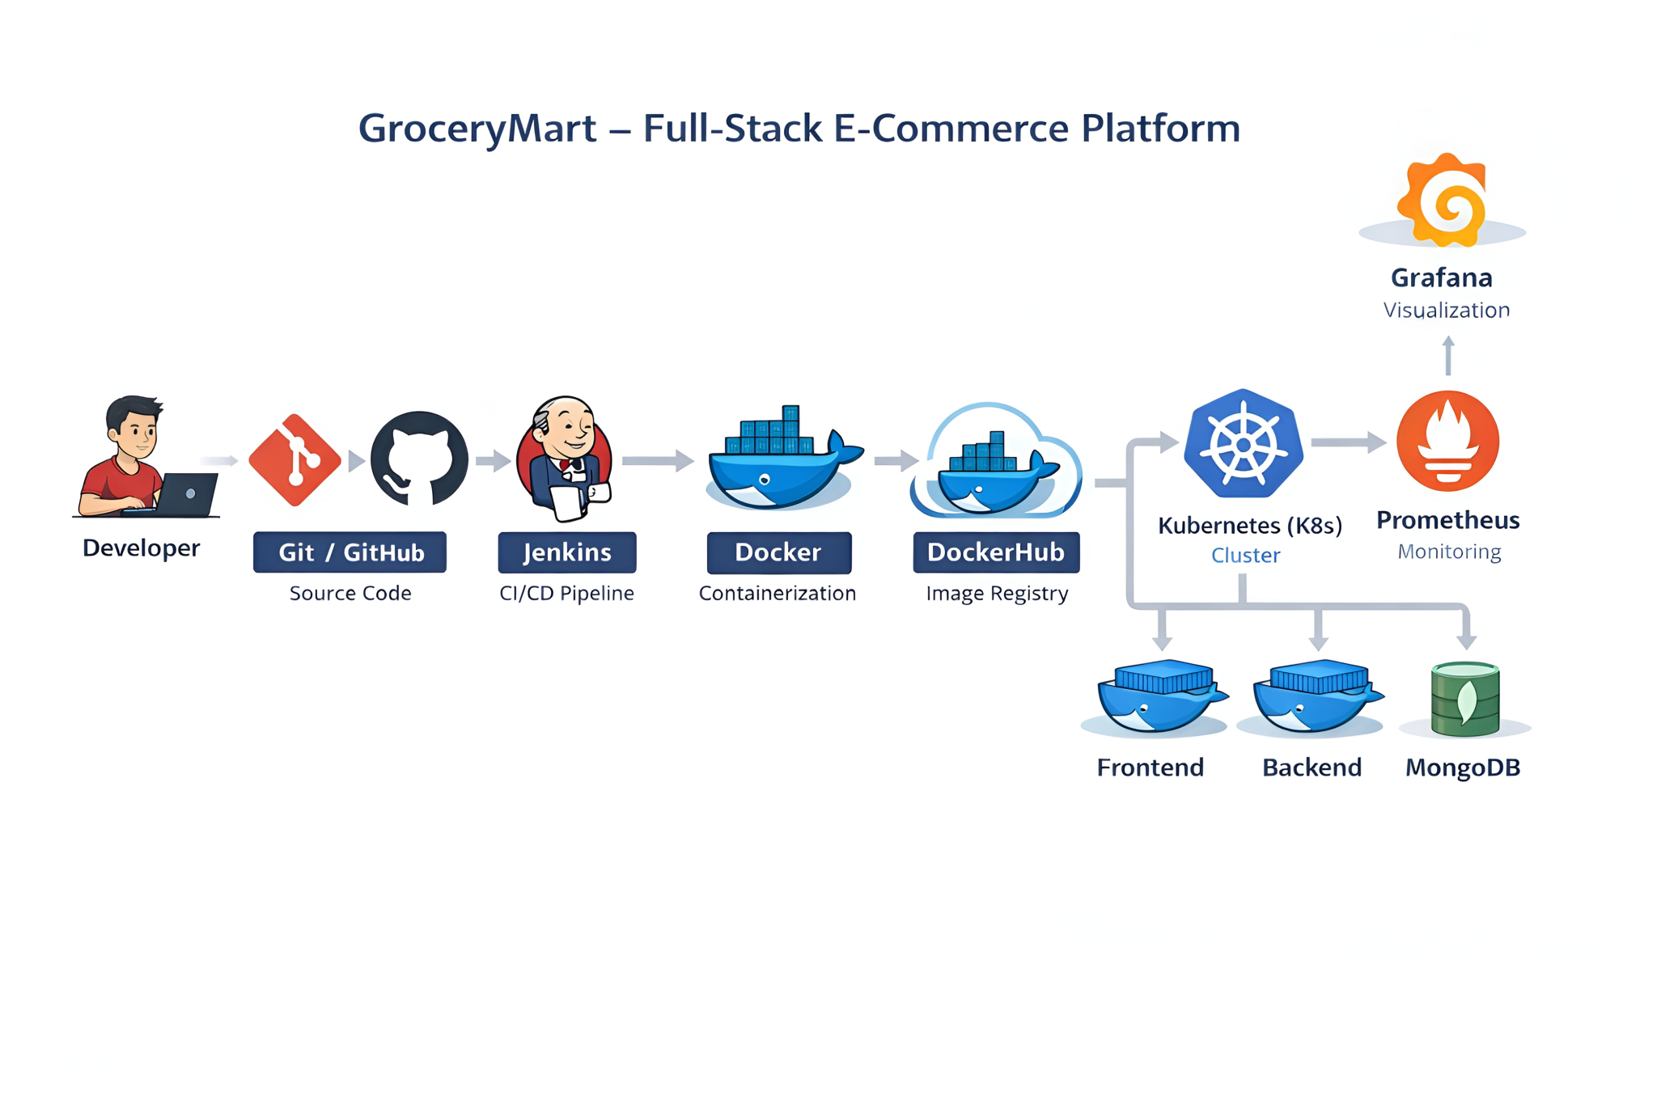
CI/CD Architecture Overview

Slide 4
Purpose of the Project
Build real-world e-commerce website
Implement CI/CD automation
Faster & reliable deployments
Hands-on DevOps experience

Slide 5
Technology Stack
Frontend: HTML, CSS, JS
Backend: Node.js, Express
Database: MongoDB
CI/CD: Jenkins
Containers: Docker
Orchestration: Kubernetes
Monitoring: Prometheus & Grafana

Slide 6
CI/CD Workflow
Developer pushes code to GitHub
GitHub webhook triggers Jenkins
Build & test phase executed
Docker image created & pushed
Kubernetes deploys containers
Prometheus & Grafana monitor

Slide 7
Jenkins – CI/CD Automation
Automated pipeline execution
Jenkinsfile-based stage management
Seamless GitHub integration
Docker & Kubernetes integration
Real-time build logs & feedback

Slide 8
Kubernetes (K8s)
Automated container deployment & scaling
Self-healing & auto-recovery
Load balancing & traffic management
Rolling updates with zero downtime
High availability across clusters

Slide 9
Prometheus & Grafana
Real-time metrics collection
Custom dashboard creation
Alert management system
Performance visualization
Proactive issue detection

Slide 10
Advantages
Fully automated
Faster releases
Reduced errors
Scalable & observable

Slide 11
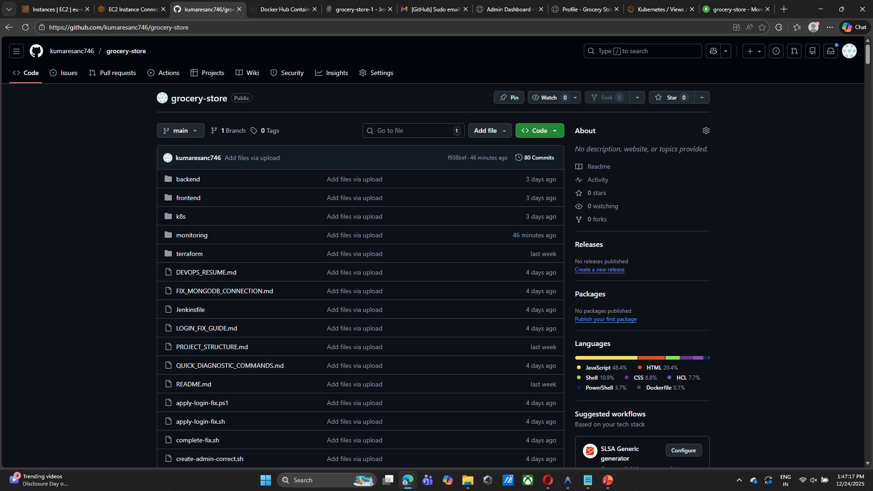
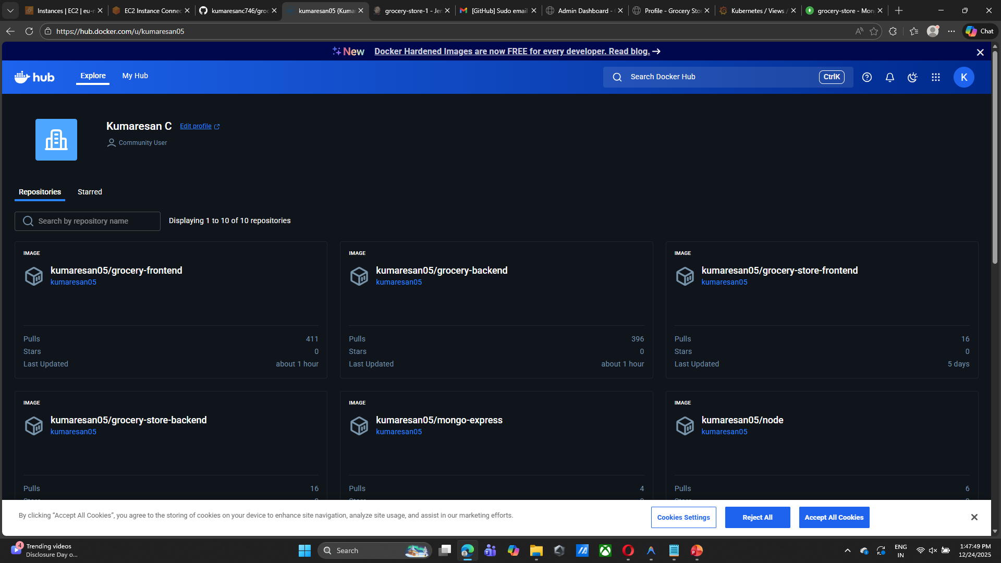
Output screen short

Slide 12
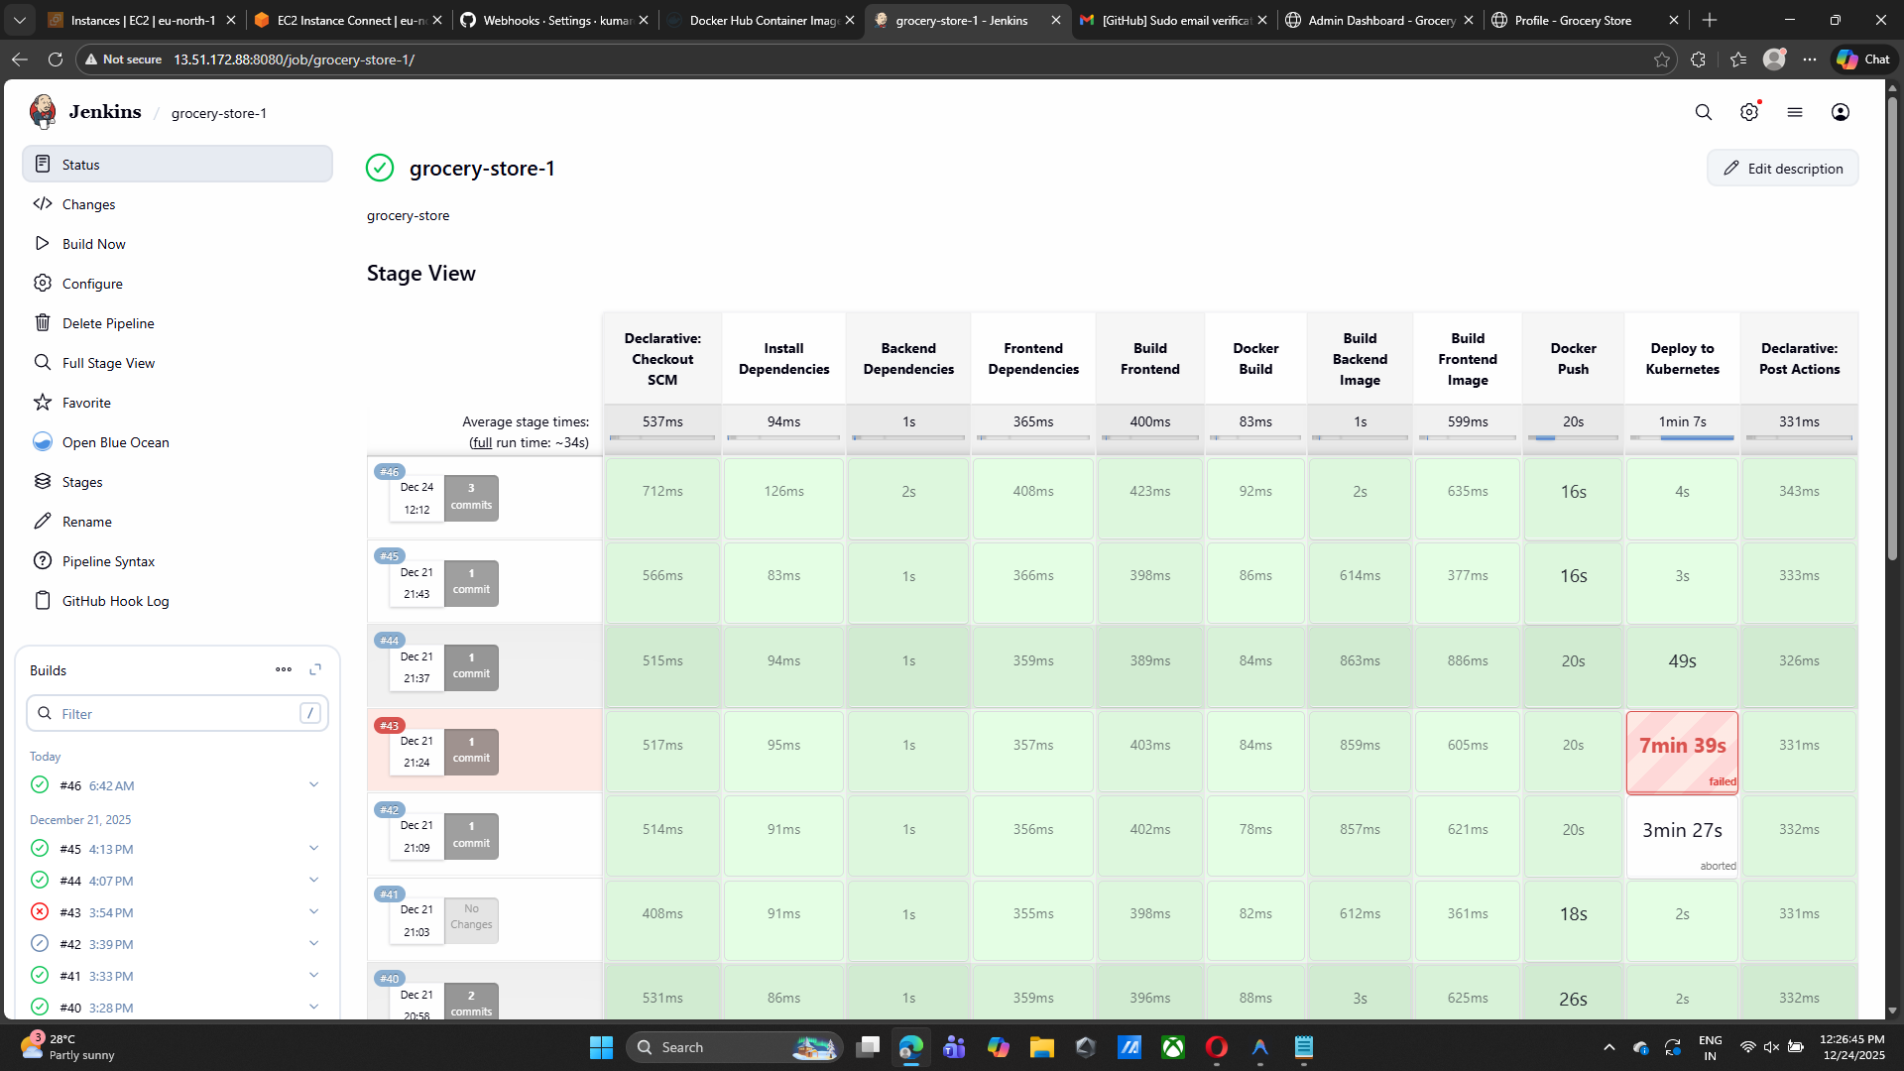
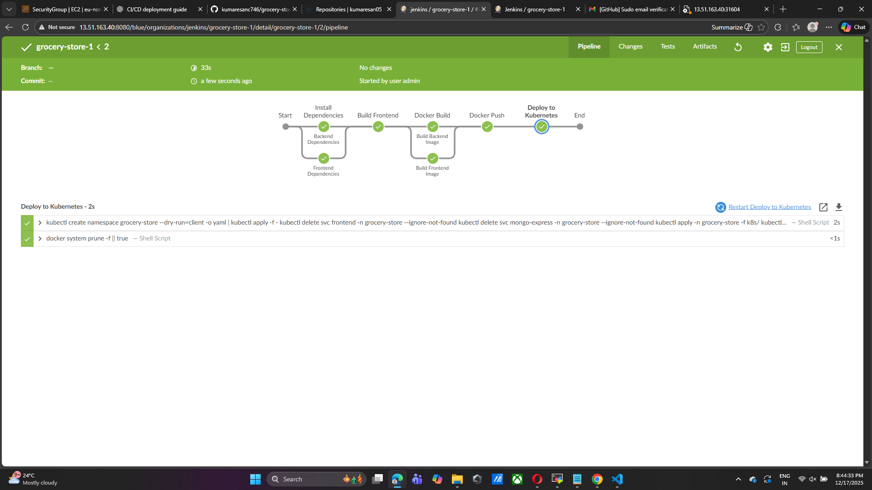
Output screen short

Slide 13
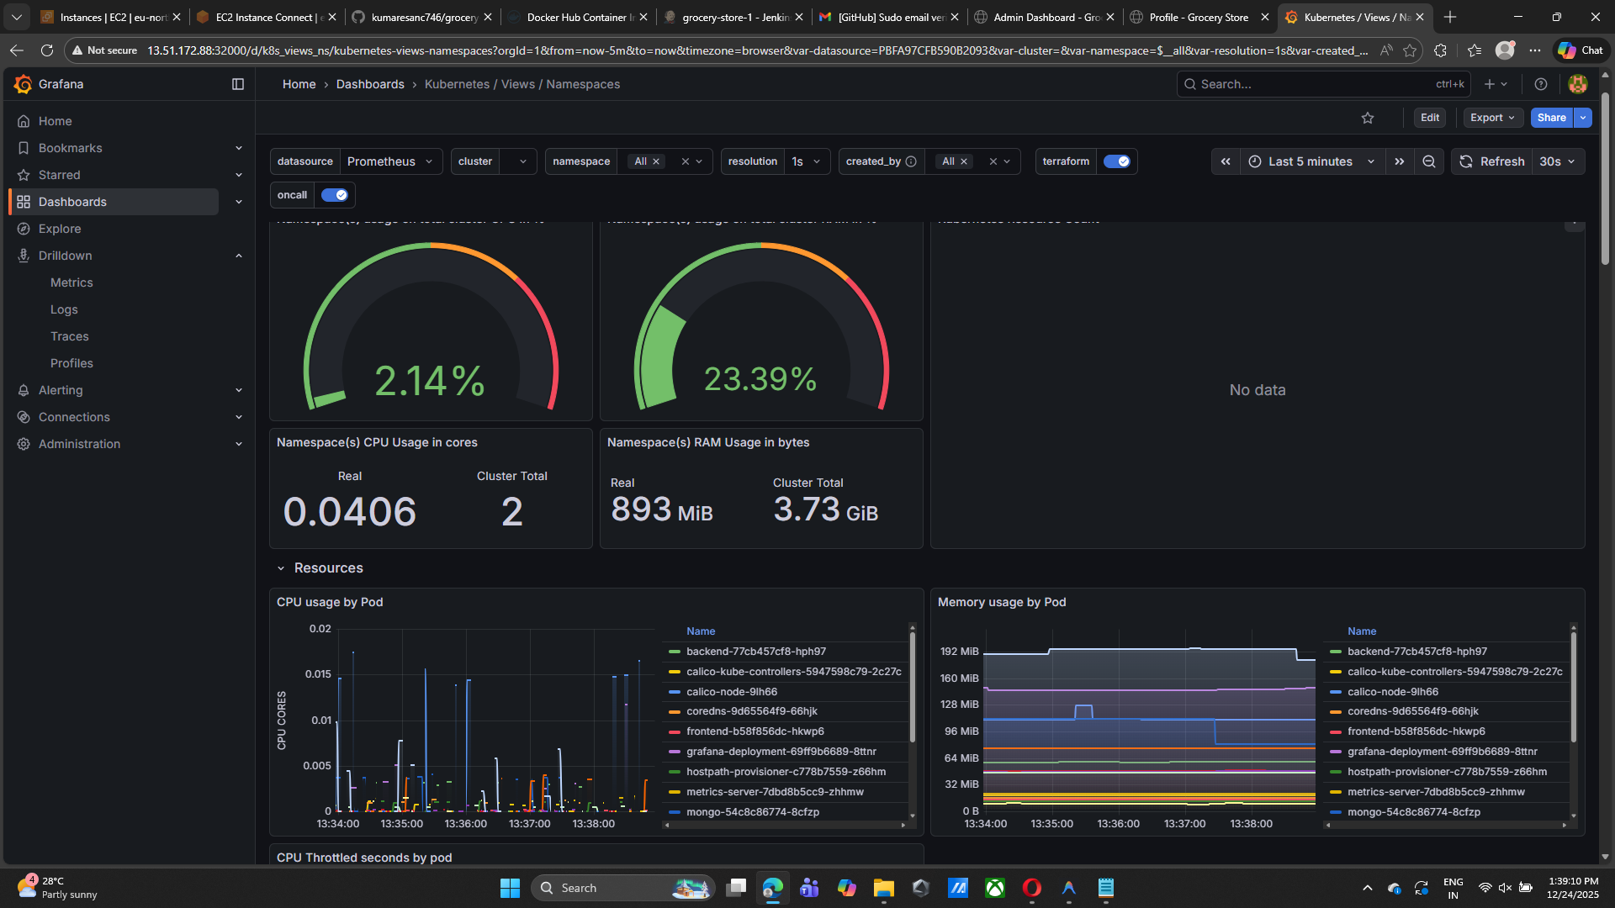
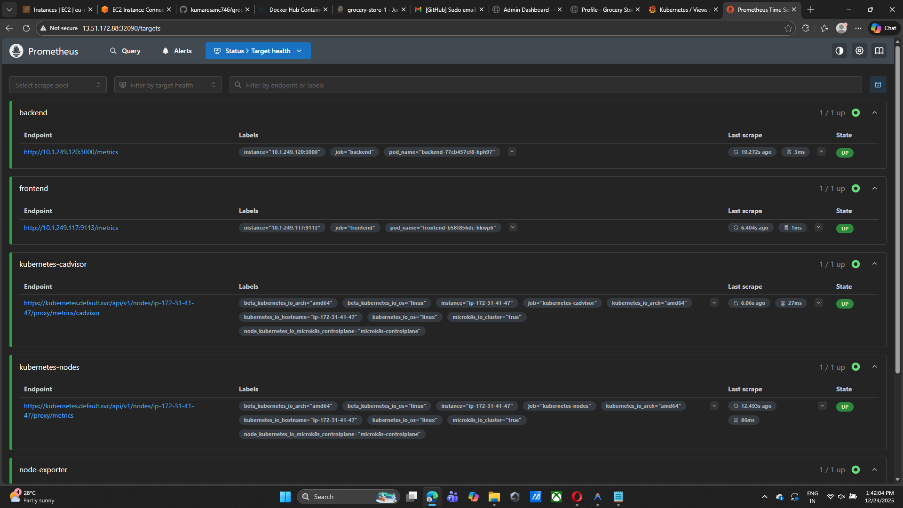
Output screen short

Slide 14
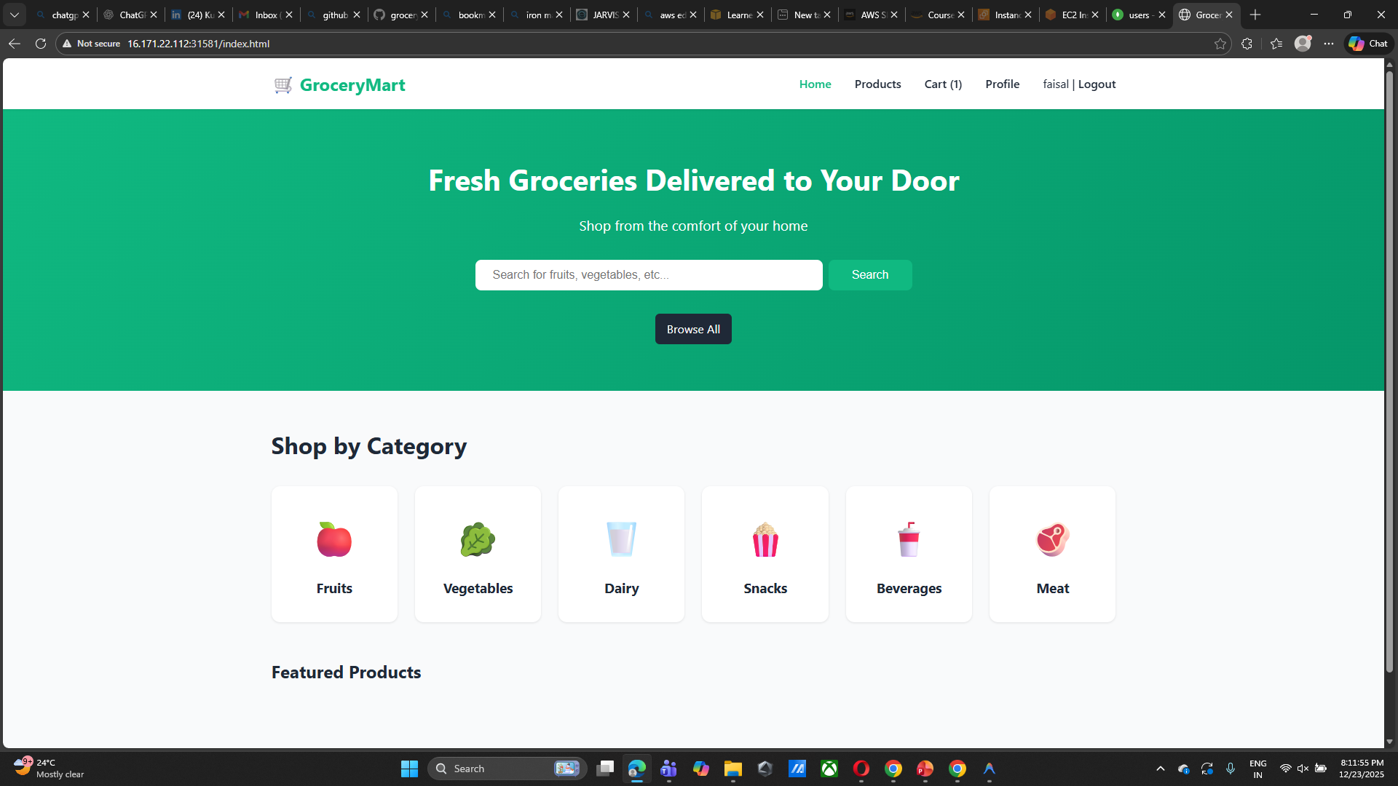
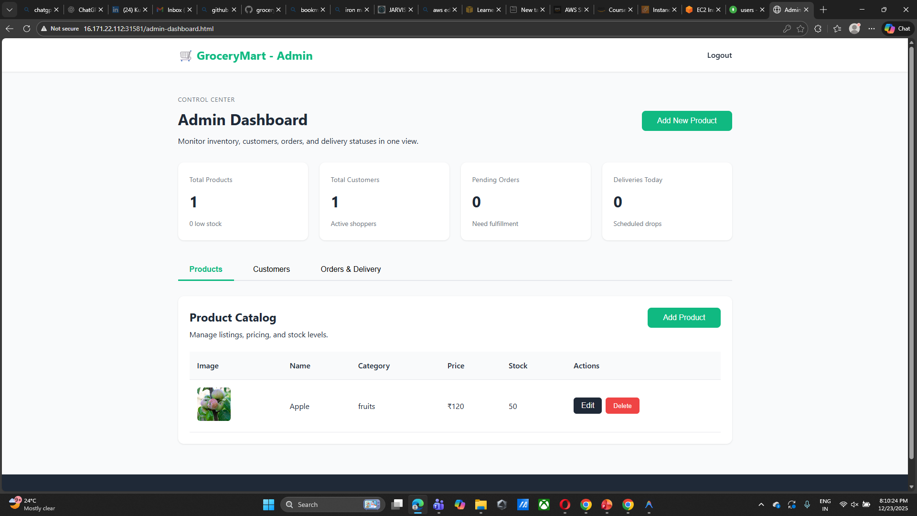
Output screen short

Slide 15
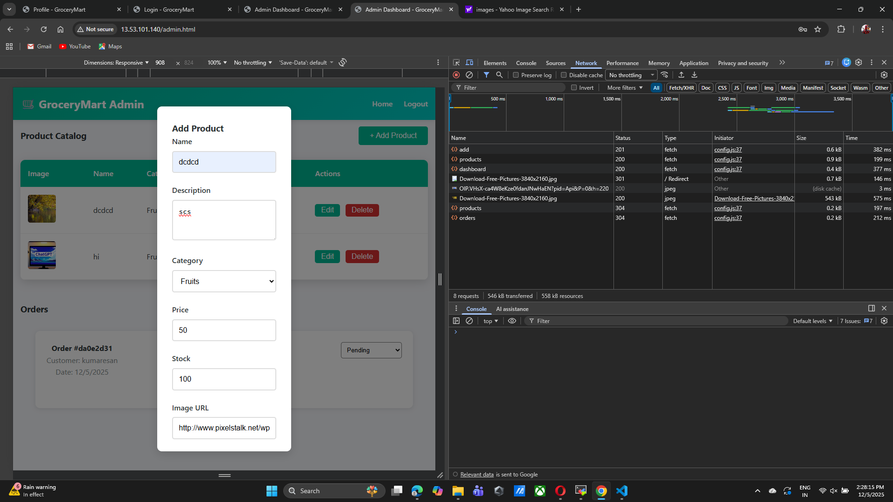
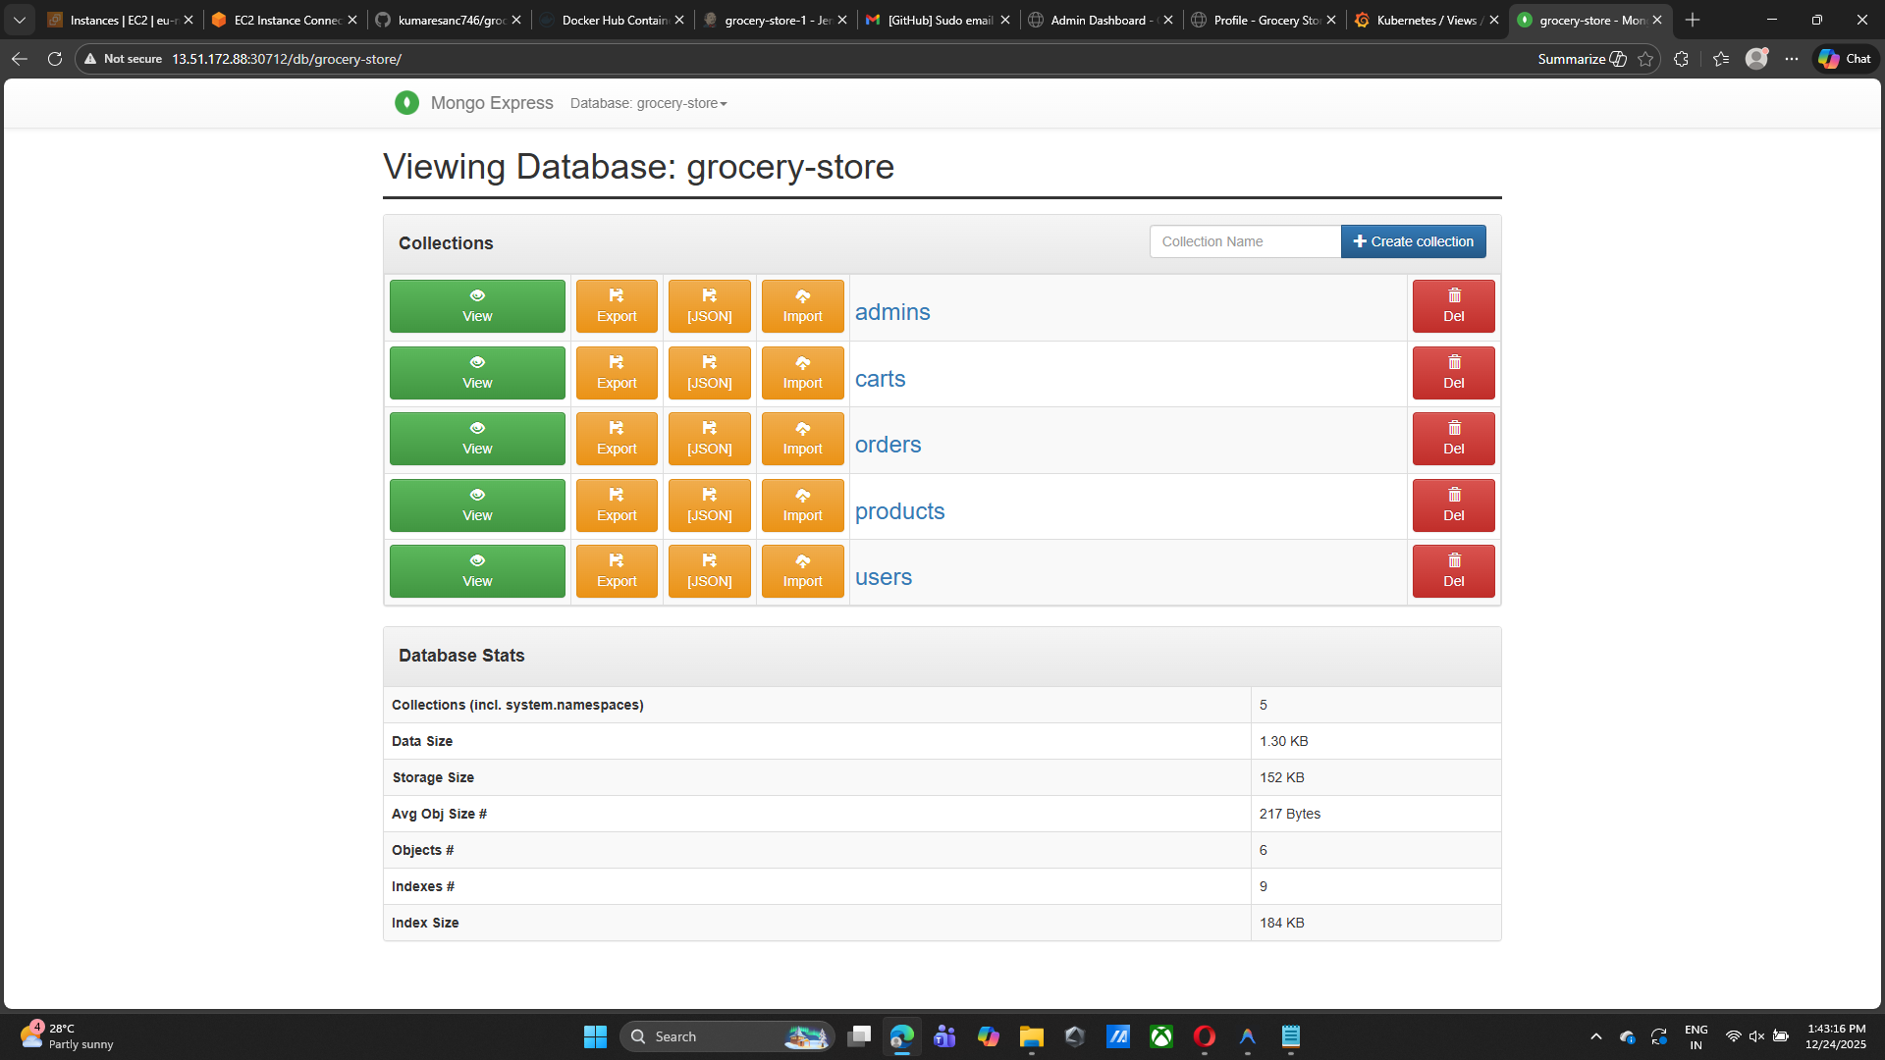
Output screen short

